Slide 1
Ordinance 2024-11
Referendum for Financing of
Subaqueous Wastewater Force Main Through
Clean Water State Revolving Fund (CWSRF) Loan Program
November 12, 2024

Slide 2
Project Overview
2

Slide 3
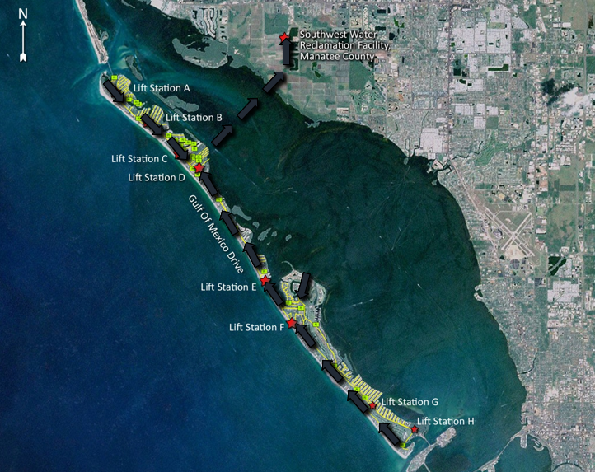
Town Wastewater System Overview
47 Lift Stations island-wide to move effluent to Primary Lift Station “D” on Gulf Bay Road
Town effluent pumped from Lift Station D through a four (4) mile route to Manatee County Southwest Water Reclamation Facility on 65th Avenue East
  Approx. 2-miles under Sarasota Bay
  Approx. 2-miles under land
  Town owns up to master meter on 53rd Ave.
Town’s 20-inch ductile iron force main was installed in 1973 and placed into service in 1975
3

Slide 4
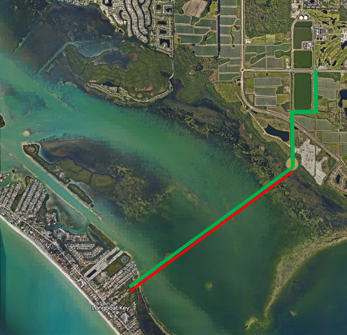
Update on Current Force Main Efforts
Town has been planning the addition of a redundant force main (replacement) for some time.
Jan. 2020: Began preliminary design and permitting for a Sarasota Bay “open-cut” project.
  Carollo Engineers, Inc. and ESA
June 2020: Manatee County and Town staff discovered a force main leak on the mainland side in Long Bar Pointe. Repaired and placed back into service in about 30-hours.
February 2021: Entered into consent order with Florida Department of Environmental Protection (“FDEP”).
May 2023: Town completed slip-line rehabilitation of major mainland portion of the force main pipe line (~6,400 linear feet).
4

Slide 5
Subaqueous Force Main Project:
Current Status
Current Status
Town has signed a preconstruction agreement with Garney Construction to perform Construction Manager at Risk Duties for the Subaqueous Project.
New Force Main under Sarasota Bay preliminary design is complete.
Town has received FDEP and U.S. Army Corps permits to open cut and install a redundant Subaqueous Force Main under Sarasota Bay
In accordance with our permits, Town will have to perform sea grass and mangrove mitigation for the open cut (8-acres and 1-acre, respectively).
Town staff proposed $33 Million in FY 2025 for final design, easement acquisition, and construction
Intent is to complete final design, obtain necessary easements, construct the new pipeline project, and construct the mitigation areas.
$3 million grant pending through Congressman Vern Buchanan
5

Slide 6
Financing
6

Slide 7
Financing Options Considered
Town MUST Complete Project
Total Project Cost = $31.4 Million
  Assumed $27 Million Financed and $4.4 Million Cash Funded
  Additional Amounts in Referendum Language for Contingencies
Financing Option 1: Clean Water State Revolving Fund (CWSRF) Loan Program
  Assumed Interest Rate of 2.89%, 20-Year Term, Annual Payment of $1.9 Million
  Total Cost to Town = $37.6 Million (20 Years of Payments)
  REQUIRES REFERENDUM PER TOWN CHARTER LANGUAGE AND LANGUAGE IN STANDARD SRF LOAN AGREEMENT
7

Slide 8
Financing Options Considered (cont.)
Financing Option 2: 30-Year Revenue Bonds
  Line of Credit or Bond Anticipation Note for Fiscal Year 2026 and 2027 Spending
  Assumed Interest Rate of 5.51%, 30-Year Term, Annual Payment of $1.9 Million
  Total Cost to Town = $58.5 Million (30 Years of Payments Plus Line of Credit Payments)
  Additional $20.9 Million Cost to Town Compared With SRF Loan Option
  NO REFERENDUM REQUIRED
Financing Option 3: 20-Year Revenue Bonds
  Line of Credit or Bond Anticipation Note for Fiscal Year 2026 and 2027 Spending
  Assumed Interest Rate of 5.00%, 20-Year Term, Annual Payment of $2.2 Million
  Total Cost to Town = $45.9 Million (20 Years of Payments Plus Line of Credit Payments)
  Additional $8.3 Million Cost to Town Compared With SRF Loan Option
  NO REFERENDUM REQUIRED
  Estimated Additional 3% Rate Increase Needed Compared With SRF Loan or 30-Year Revenue Bonds
8

Slide 9
Town Commission Has Communicated Support for SRF Loan
Substantial Savings to Town
  Estimated $20.9 Million Less in Payments Compared With 30-Year Bonds
  Lower Interest Rate
  Paid Off in 20 Years
  Savings Could Be Used to Address Other Critical System Needs
Lower Monthly User Rates Over the Long Term
  Much Lower Interest and Issuance Costs
9

Slide 10
CWSRF Loan Program Overview
Town Has Previously Taken Advantage of This Program
Administered By Florida Department of Environmental Protection (FDEP)
  Amount of Funding Available Can Vary By Year
Standard Terms
  20-Year Amortization Schedule
  Interest Rate Determined Based on Affordability Index
  Payments Start Six Months After Project Completion
  Interest on Withdrawals During Construction Is Added to Principal Amount at Closeout (Capitalized Interest)
10

Slide 11
Town Charter Language and
SRF Loan Standard Language
Town Charter Language
  The town or any public entity controlled by the town may issue revenue bonds in excess of the Bonding Limitation at any one time only when approved by vote of the qualified electors. For purposes of this limitation, "at any one time" means within 90 days and "Bonding Limitation" means $5,000,000.00 initially. As of each October 1 thereafter, the amount of the "Bonding Limitation" in effect shall be adjusted to reflect the percentage change in the Consumer Price Index (U.S. City Average All Workers) by using the most recent available information for the prior 12 month period. The town commission may waive the requirement…for a vote of the electors for said revenue bonds if it determines, in its sole discretion, that there exists an emergency such that it is in the best interest of the town to issue the bonds without a vote of the electors.
  Notwithstanding the above, a vote of the electors shall not be required to refund outstanding bonds and interest and redemption premium thereon at a lower net average interest cost rate, to issue any revenue bonds payable exclusively from non-ad valorem revenues in the proprietary funds, or to incur any obligation which is subject to annual appropriation.
11

Slide 12
Town Charter Language and
SRF Loan Standard Language (cont.)
  SRF Loan Standard Language
  In the event the anticipated Pledged Revenues are shown by the Local Government's annual budget to be insufficient to make the Semiannual Loan Payments for such Fiscal Year when due, the Local Government shall include in such budget other legally available non-ad valorem funds which will be sufficient, together with the Pledged Revenues, to make the Semiannual Loan Payments. Such other legally available non-ad valorem funds shall be budgeted in the regular annual government budget and designated for the purpose provided by this Subsection, and the Local Government shall collect such funds for application as provided herein
  Because of Need to "Budget and Appropriate" Other Legally Available Non-Ad Valorem Funds, Town's Legal Counsel Considers That Referendum Is Required for SRF Loan
12

Slide 13
REFERENDUM QUESTION
Shall Town of Longboat Key be authorized to borrow money through a State Revolving Fund loan, not exceeding $33,000,000, bearing interest not exceeding maximum legal rates, maturing over a term not longer than 25 years, payable from revenues of the Town's water and sewer utility system and a backup covenant to budget and appropriate legally available non-ad valorem revenues, to finance the design and construction of a subaqueous wastewater line across Sarasota Bay?
13

Slide 14
Subaqueous Force Main Project:
Next Steps
Next Steps
Referendum March 11, 2025
Proceed with and complete final design and permit updating (approx. 1-yr.).
Obtain necessary easement (temporary and permanent) from Long Bar Pointe and Florida Office of State Lands.
Target start of Construction Fall 2025.
In addition:
Resolve final settlement with Long Bar Pointe regarding leak impacts.
Resolve restoration area mangrove mitigation alternative.
14

Slide 15
Referendum Dates and Next Steps
November 12, 2024: First Reading of Ordinance 2024-11 and to Move Forward With Referendum and Referendum Language
December 2, 2024: Second Reading and Adoption of Ordinance 2024-11
March 11, 2025: Referendum
15

Slide 16
Requested Commission Action
Recommendation to forward Ordinance 2024-14 to December 2, 2024 Regular Meeting for Second Reading and Public Hearing:
16

