Slide 1
Utility Rate Study Workshop
June 28, 2024

Slide 2
Utility System Overview
Provides Essential Service on Continuous Basis to Approximately 2,950 Water Customers (10,500 Water Equivalent Living Units) and 2,500 Wastewater Customers (10,000 Wastewater Equivalent Living Units)
  Public Health and Safety – Primary Objective
  Highly-Regulated (FDEP / SWFWMD / Department of Health)
  Permits Require Satisfactory Operating Performance
Operations Funded Primarily Through Monthly User Rates
About $60 Million Installed Cost of Depreciable Utility Assets Under Town Management
  Amount Would Be Much Higher If Right-Sized to Today's Dollars
2

Slide 3
Last Formal Rate Study Completed in 2021
Town Adopted Annual Increases Through Fiscal Year 2026:
5% Plus Pass-Through of Future Wholesale Rate Adjustments
  Wastewater Billing Cap for Single Family Residences Changed from 7,000 to 10,000 Gallons
  Town Implemented Pass-Through of Manatee County Wholesale Water and Wastewater Rate Increases Effective June 1, 2023 and June 1, 2024
Recommendation to Perform Another Financial Checkup or Rate Review at Least Once Every Three Years
  Proactive Financial Planning Helps to Avoid Large Future "Catch Up" Increases
Current Rate Study Provides Update to Financial and Rate Plan
  Focuses on Changes in Town's Costs to Provide Service Other Than Manatee County Charges
3

Slide 4
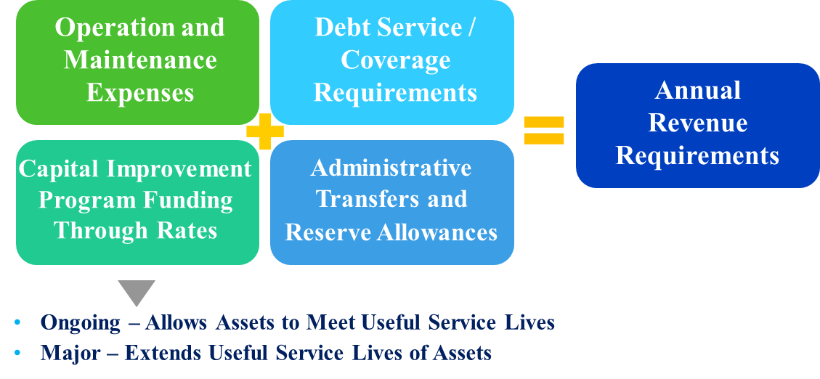
Financial Forecast
Have Prepared Financial Forecast Through Fiscal Year 2034
4

Slide 5
Changes in Capital Costs Since Last Rate Study
Need for Rate Adjustments Primarily Driven By Need to Fund Two Major Capital Projects
  With Grant Funding and Use of Cash Reserves, Assumed Financing Need of About $27 Million (Same Assumption as 2021 Rate Study)
  Current Study Assumes $26.9 Million Financing of Subaqueous Wastewater Main
5

Slide 6
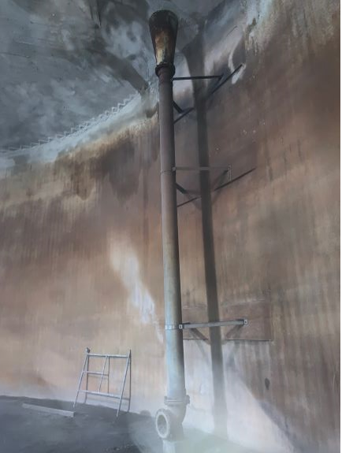
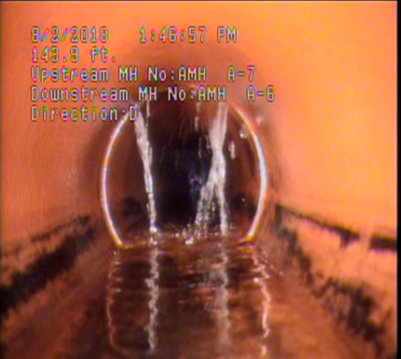
Changes in Capital Costs Since Last Rate Study (cont.)
  Utility Infrastructure Is Often "Out of Sight, Out of Mind"
Multi-Year Capital Improvement Program Recognized
Revenue/Cash-Funded Capital Needs of $42.1M
6

Slide 7
Financing Options for Wastewater
Collection Subaqueous
Town MUST Complete Project
Clean Water State Revolving Fund (SRF) Loan Program
  Assumed Interest Rate of 2.89%
  20-Year Term
  Annual Payment of $1.9 Million
  Total Cost to Town = $37.6 Million (20 Years of Payments)
  REQUIRES REFERENDUM PER TOWN CHARTER LANGUAGE AND LANGUAGE IN STANDARD SRF LOAN AGREEMENT (Most Likely March 2025 Election Cycle)
30-Year Revenue Bonds
  Line of Credit or Bond Anticipation Note for Fiscal Year 2026 and 2027 Spending
  Assumed Interest Rate of 5.51%
  30-Year Term
  Annual Payment of $1.9 Million
  Total Cost to Town = $58.5 Million (30 Years of Payments Plus Line of Credit Payments)
  Additional $20.9 Million Cost to Town Compared With SRF Loan Option
  NO REFERENDUM REQUIRED
7

Slide 8
Financing Options for Wastewater
Collection Subaqueous (cont.)
Town MUST Complete Project
20-Year Revenue Bonds
  Line of Credit or Bond Anticipation Note for Fiscal Year 2026 and 2027 Spending
  Assumed Interest Rate of 5.00%
  20-Year Term
  Annual Payment of $2.2 Million
  Total Cost to Town = $45.9 Million (20 Years of Payments Plus Line of Credit Payments)
  Additional $8.3 Million Cost to Town Compared With SRF Loan Option
  NO REFERENDUM REQUIRED
  Estimated Additional 4% Rate Increase Needed Compared With SRF Loan or 30-Year Revenue Bonds
  Asset Life Is Greater Than 20 Years – Interperiod Equity Considerations
8

Slide 9
Town Charter Language and
SRF Loan Standard Language
Town Charter Language
  The town or any public entity controlled by the town may issue revenue bonds in excess of the Bonding Limitation at any one time only when approved by vote of the qualified electors. For purposes of this limitation, "at any one time" means within 90 days and "Bonding Limitation" means $5,000,000.00 initially. As of each October 1 thereafter, the amount of the "Bonding Limitation" in effect shall be adjusted to reflect the percentage change in the Consumer Price Index (U.S. City Average All Workers) by using the most recent available information for the prior 12 month period. The town commission may waive the requirement…for a vote of the electors for said revenue bonds if it determines, in its sole discretion, that there exists an emergency such that it is in the best interest of the town to issue the bonds without a vote of the electors.
  Notwithstanding the above, a vote of the electors shall not be required to refund outstanding bonds and interest and redemption premium thereon at a lower net average interest cost rate, to issue any revenue bonds payable exclusively from non-ad valorem revenues in the proprietary funds, or to incur any obligation which is subject to annual appropriation.
9

Slide 10
Town Charter Language and
SRF Loan Standard Language (cont.)
  SRF Loan Standard Language
  In the event the anticipated Pledged Revenues are shown by the Local Government's annual budget to be insufficient to make the Semiannual Loan Payments for such Fiscal Year when due, the Local Government shall include in such budget other legally available non-ad valorem funds which will be sufficient, together with the Pledged Revenues, to make the Semiannual Loan Payments. Such other legally available non-ad valorem funds shall be budgeted in the regular annual government budget and designated for the purpose provided by this Subsection, and the Local Government shall collect such funds for application as provided herein
10

Slide 11
Changes in Operating Costs Since
Last Rate Study
Fiscal Year 2025 Operating Costs Other Than Manatee County Charges Are 14.4% Higher Than Projected in 2021 Rate Study and Are Anticipated to Continue Increasing
  Florida's Inflation Currently Outpacing National Trends
  Utility Has Limited Control Over Many Operating Costs (e.g., Electricity, Chemicals)
  Nationwide Issues With Filling Positions and Keeping Employees
    A Well-Trained, Experienced, and Sufficient Utility Staff Is Critical for Effectively Running Utility 24 Hours Per Day and 365 Days Per Year, for Maintaining Level of Service, and for Emergency Preparedness (e.g., Hurricanes)
  Due to Regulatory Environment, Utility Costs Normally Increase at a Higher Rate Than CPI
  Permanent Increases in Costs Must Ultimately Be Passed Through to Customers Through Rates
11

Slide 12
Need to Preserve
Access to Capital Markets
Given Current Volatile Market Conditions, Recommend 200% All-In Debt Service Coverage Target
  Supported By Credit Rating Agencies and Town's Financial Advisor
    Fitch Median for AA-Rated Utilities = 250%
  Provides More Assurance That Utility Will Meet Coverage Requirements
  Revenues After Payment of Operating Expenses and Debt Service Should Ideally Be at Least Equal to Annual Depreciation Expense (Annual "Wear and Tear" on System)
12

Slide 13
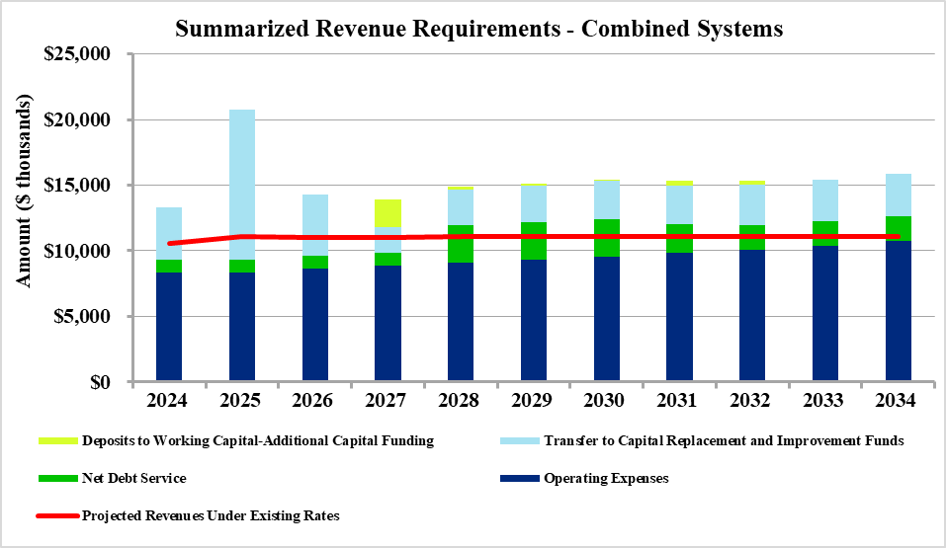
Revenue Requirements Analysis
Projected Need to Adjust Rates to Keep Utility Sustainable
13

Slide 14
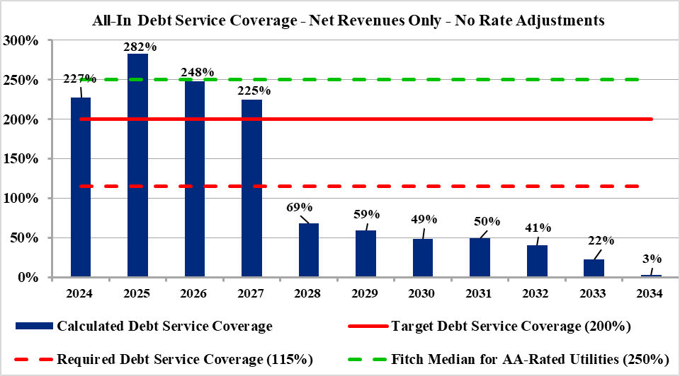
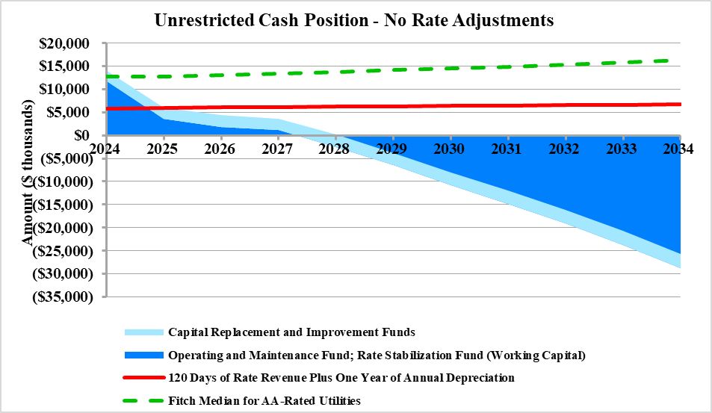
Financial Risks of Not Adjusting Rates
Inability to Issue New Debt for Critical Capital Needs
Inability to Fund All Revenue Requirements, Fund Capital Program, and Meet Financial Targets
  User Rates Will Be Even Higher in the Future
  Capital Needs for Utility Will Not Go Away, But Will Be More Expensive to Address in the Future; Risk of Future Fines and Consent Orders If Infrastructure Failures Cause Pollution or Utility Does Not Comply With Regulatory Requirements
  Inflation in Operating and Construction Costs Continues to Affect System Costs to Provide Service
14

Slide 15
Rate Plan Options
Best Financial Management Practices: Smaller, Incremental Increases Over Time Help to Avoid Future "Rate Shock" and Higher "Catch Up" Rate Increases
  Recommend Adoption of Five (5) Years of Rate Adjustments
  Lenders and / or Credit Rating Agencies Want to See That Plan to Support Debt Has Been Adopted
Recommend Performing Another Financial Checkup or Rate Review at Least Once Every Three Years, or If Circumstances Change Significantly
15

Slide 16
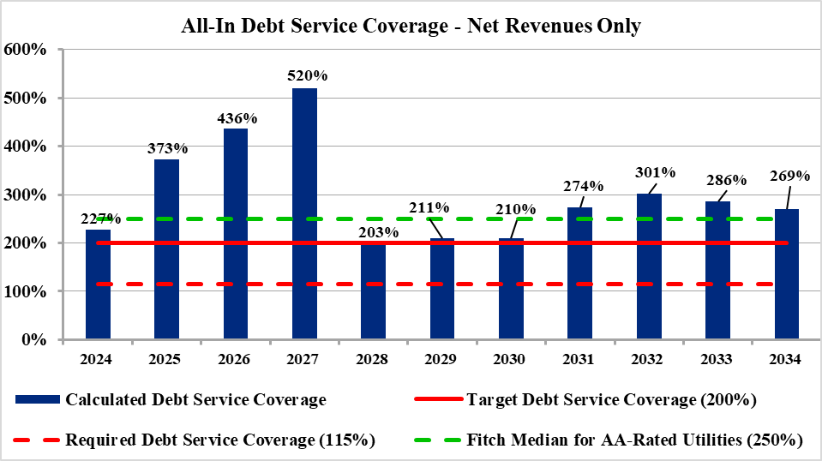
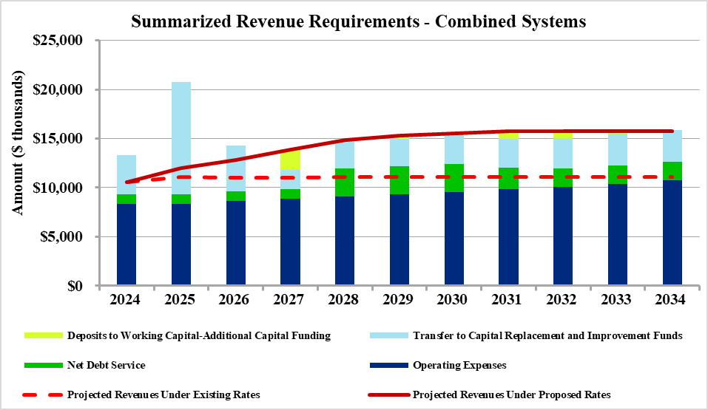
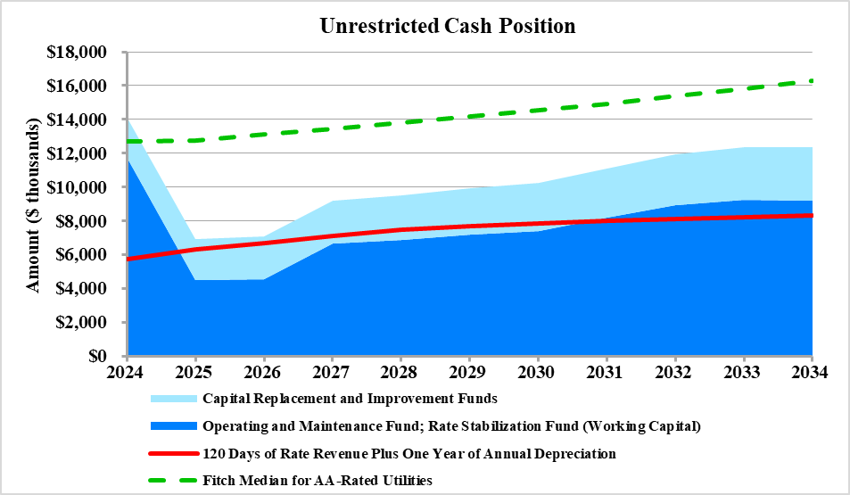
Projected Financial Position

Slide 17
Projected Financial Position (cont.)
17

Slide 18
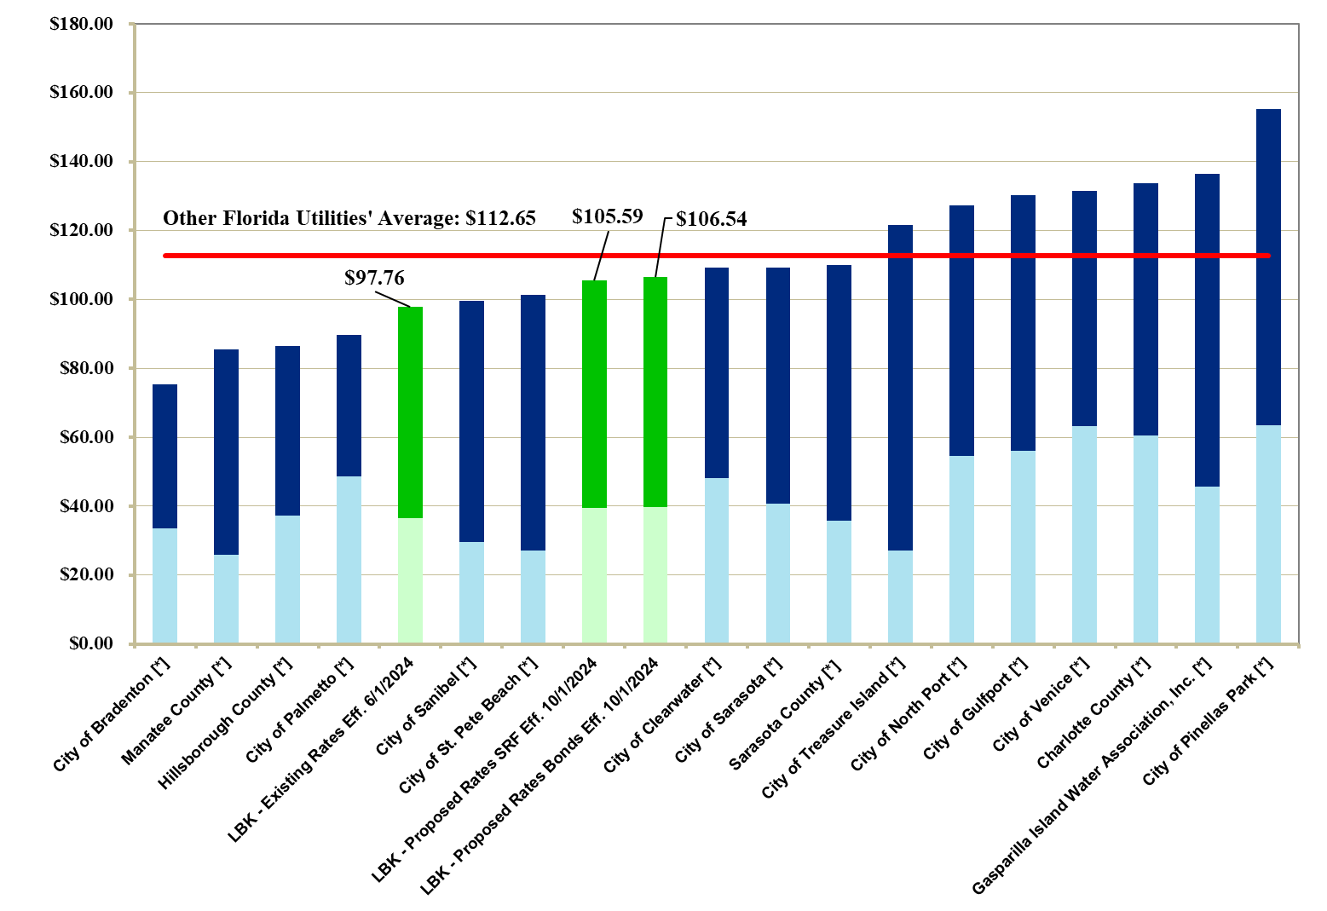
User Rate Comparison –
5,000 Gallons of Monthly Usage
Bills Under Rates Effective in June 2024
[*] Utility is currently involved in a rate study, is planning to conduct a rate study, or plans to implement a rate revision or price index / pass-through adjustment within the next twelve months following the comparison preparation date
18

Slide 19
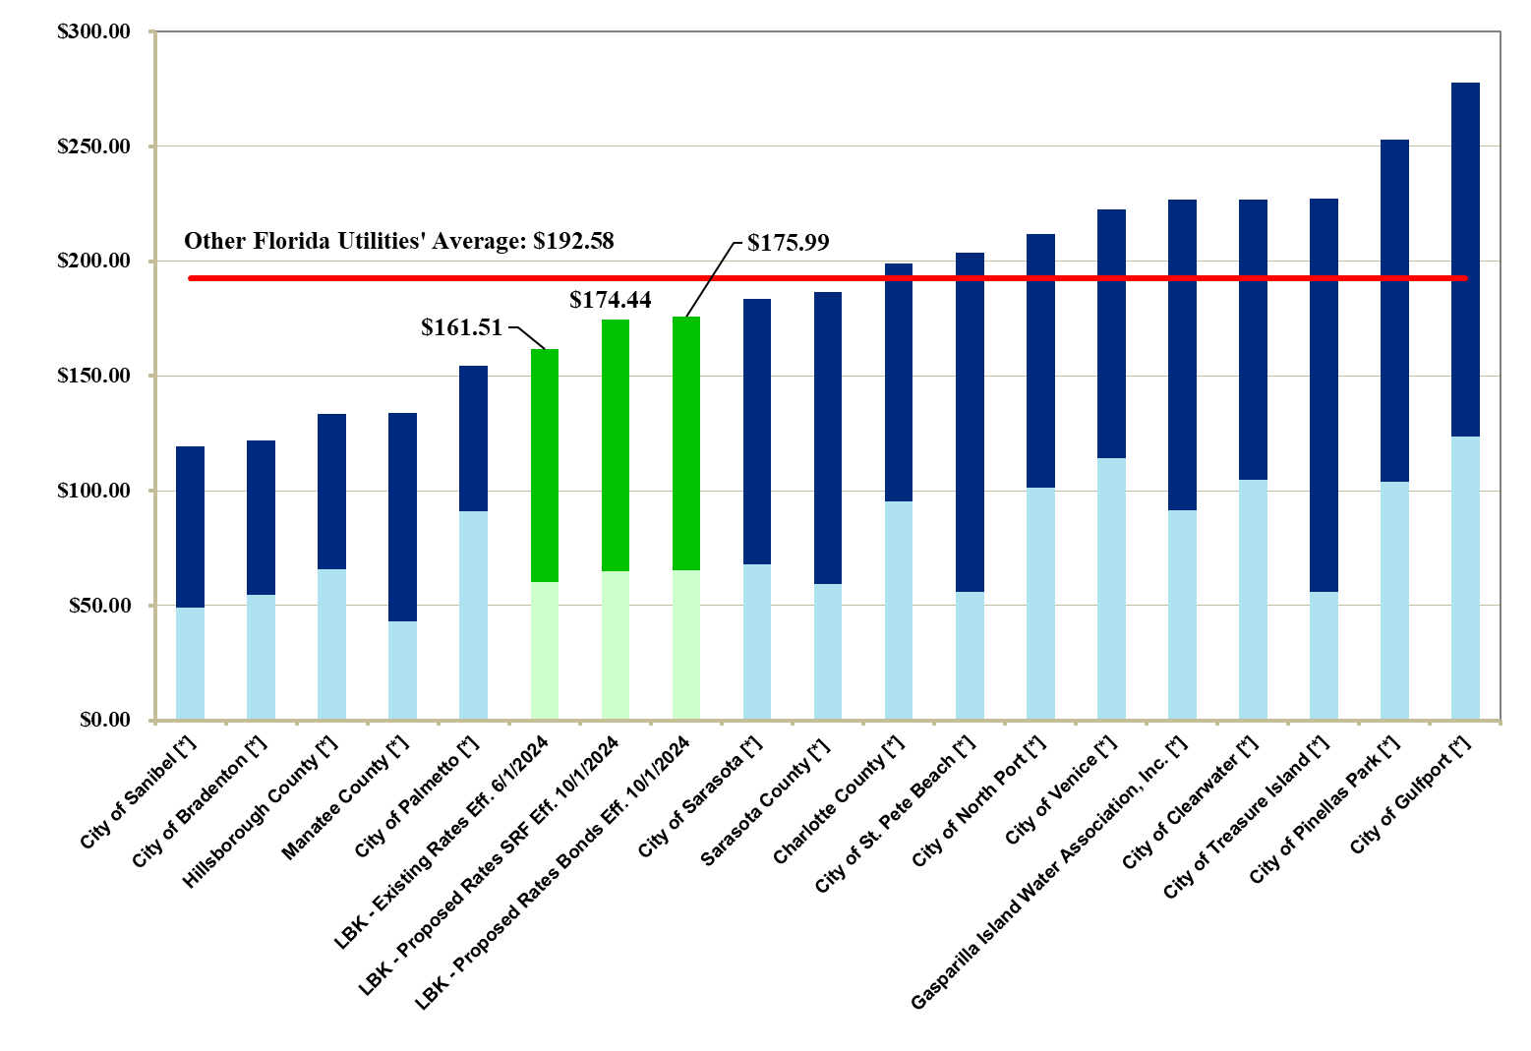
User Rate Comparison –
10,000 Gallons of Monthly Usage
Bills Under Rates Effective in June 2024
[*] Utility is currently involved in a rate study, is planning to conduct a rate study, or plans to implement a rate revision or price index / pass-through adjustment within the next twelve months following the comparison preparation date
19

Slide 20
Rate Comparison Not a "Report Card" on How Well Utility Is Performing
Some Reasons Why User Rates Differ Among Utilities
  Size of Existing Customer Base / Available System Growth
  Demographics (e.g., Customers Spread Out vs. Close Together, Types of Customers Served)
  Level of Capital Improvements to Meet Service Area Growth
  Amount of Needed Renewals and Replacements / Remaining Service Life of Assets
  Differences in Bond Covenants
  Source of Water Supply and Treatment Process Costs
  Plant Capacity Utilization and Assistance in Funding of Such Capacity (e.g., Grants, Impact Fees)
  Time of Last Rate Review
  Amount of General Fund and Administrative Fee Transfers
20

Slide 21
Requested Commission Action
Provide Direction on Financing Alternative
  Lowest Cost Financing Option (SRF Loan) Requires Referendum
Recommendation to Adopt Proposed Schedule of Water and Wastewater User Rate Increases for Fiscal Years 2025 to 2029
  Smaller, Incremental Rate Increases Over Time Help to Avoid Future Large "Catch Up" Increases
  Preserves Access to Capital Markets
    When Evaluating Utility's Ability to Repay Debt, Credit Rating Agencies and Lenders Will Only Consider Rate Increases That Have Been Adopted
    100% Pay-As-You-Go Funding of Capital Program Would Require Much Higher Rate Increases
  Staff Needs to Know Revenue Stream to Implement Multi-Year Capital Program Since Projects Usually Take More Than One Year to Complete
    Funding Must Be in Place to Enable Bidding for Projects
  Rates Considered Competitive and Affordable
21

Slide 22
Requested Commission Action (cont.)
  Monitor Actual Vs. Projected Financial Results
  Changes in Economic Conditions, Customer Usage Trends, Regulatory Environment, Capital Needs, Etc.
  Update Financial and Rate Plan as Needed
  Financial Checkup or Review at Least Once Every Three Years
22

