Slide 1
Sarasota County
Infrastructure Surtax
Phase IV
Regular Workshop
February 7, 2022

Slide 2
Background
October 18, 2021 Commission Retreat – Reviewed Infrastructure Surtax (IST) IV and provided proposed Functional Categories and preliminary estimates
November 15, 2021 Commission Workshop – Overview of IST III and IST IV Program and approved Categories
County Website / Ability for public comments and suggestions
Developed Final List
Proposed Resolution 2202-01 in Support of Surtax Extension for 15 years and Approve Project List
Referendum November 2022

Slide 3

Purpose of Surtax Referendum
1989
1990
1991
1992
1993
1994
To continue a one-cent sales tax that has been in place for more than 30 years
1995
1996
1997
1998
1999
2000
2001
2002
2003
2004
2005
2006
2007
2008
2009
2010
2011
2012
2013
2014
2015
2016
2017
2018
2019
2020
2021
2022
2023
2024
3
Notes:
Reinforce that this is not a new tax as this is a critical piece of our continuing education.

Slide 4

Infrastructure Surtax
Cash Inflows
Phase IV Revised Estimate $15.1 million
for Longboat Key
Revised Estimate is $2M higher
County provided estimate
4

Slide 5
Infrastructure Surtax
Eligible Uses
Local community improvements, such as parks, roads, sidewalks, libraries and schools
Must be capital in nature with at least a 5 year useful life, such as construction, reconstruction or improvement of public facilities
To acquire land for public recreation, conservation or protection of natural resources
Public safety vehicles and equipment
To finance the closure of government owned landfills
5

Slide 6
Infrastructure Surtax (Phase IV 2025-2039)
Functional categories
1. Streets and Drainage
2. Parks, Recreation and Beach Improvements
  Tennis Building and Grounds Improvements, Community/Recreation Center, Town Center Improvements, Park Improvements
3. Canal dredging
  Dredging of Public benefit /common areas
4. Public Safety Vehicles and Equipment
  Ambulances, Fire Trucks, Battalion & Administrative Vehicles, Technology/Communication Upgrades, Police and Fire/EMS Equipment, Water Vessels and Boat Motors
5. Improvements to Public Facilities
  Roofs, HVAC, Generators, Parking Lots, Technology Upgrades, Other Building Improvements
6

Slide 7
Streets and Drainage
Design, planning, permitting and/or construction of various streets, sidewalks, bike paths, pedestrian crossings, storm water and drainage systems or other street element improvements located in Sarasota County.
Sea Level Rise/Storm Water and Flood Control $1,000,000
Contingencies and Future Project Needs $ 750,000
Total $1,750,000
7

Slide 8
Park, Recreation and Beach Improvements
Recreation Center - $1.500 M
Further infrastructure improvements and/or other amenities related to the Recreation Center location within Bayfront Park
Tennis Center - $1.088 M
Scheduled replacement and upgrades to underground watering systems, fencing, canopies, and deck/picnic area upgrades
Other Parks Improvements within Sarasota County (Town Center Green, court resurfacing, pickleball, tennis, basketball, shuffleboard) $0.020 M
Beach Nourishment - $0.500 M
Preservation of beaches and improvements to beach access areas
Contingency and Future Projects - $0.500 M
Total $3,608,000
8

Slide 9
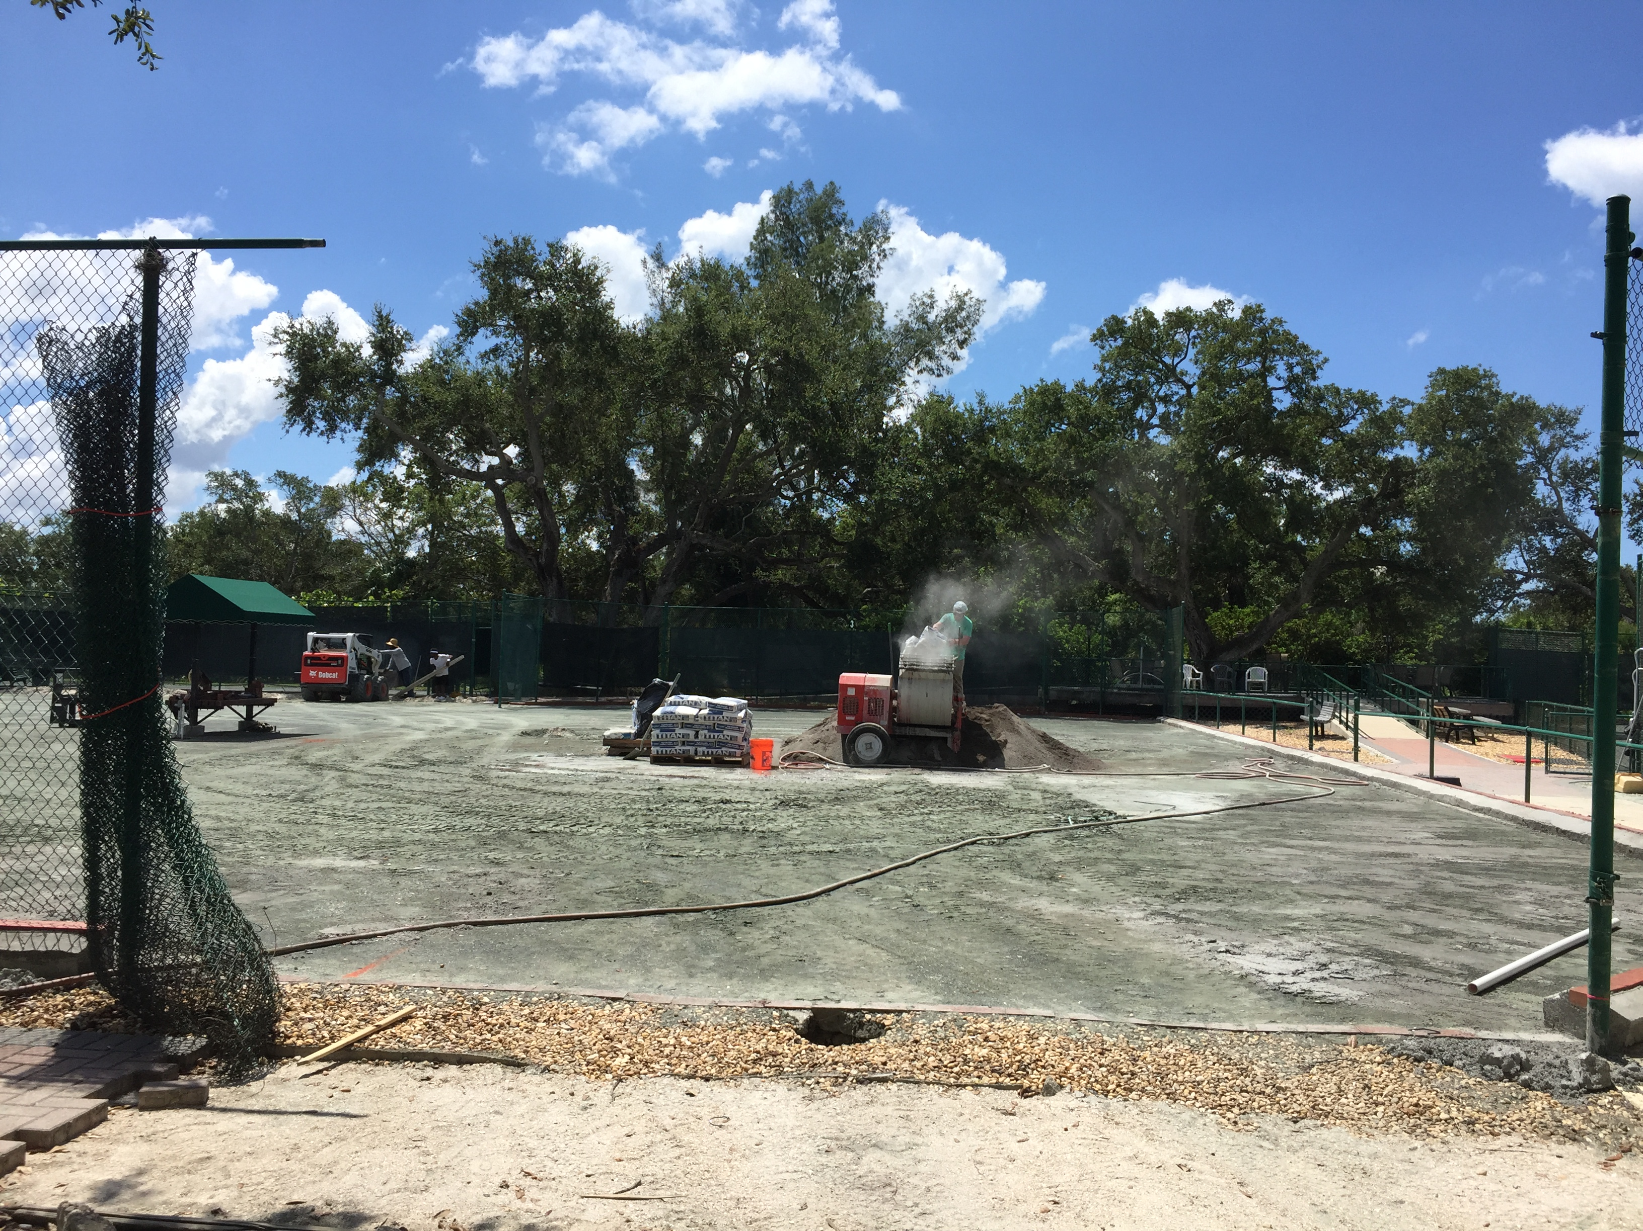
Parks, Recreation and Beach Improvements – Tennis Center
Tennis Center Projects | Replacement Year | Est Cost $1.088 M
Underground Watering System | 2030, 2034, 2036 | $700,000
A/C and Plumbing | 2025-2039 | $100,000
Fencing | 2027, 2032, 2037 | $145,000
Canopies | 2025-2036 | $48,000
Deck/Picnic Area | 2027 | $50,000
Signage | 2029, 2039 | $45,000
9

Slide 10
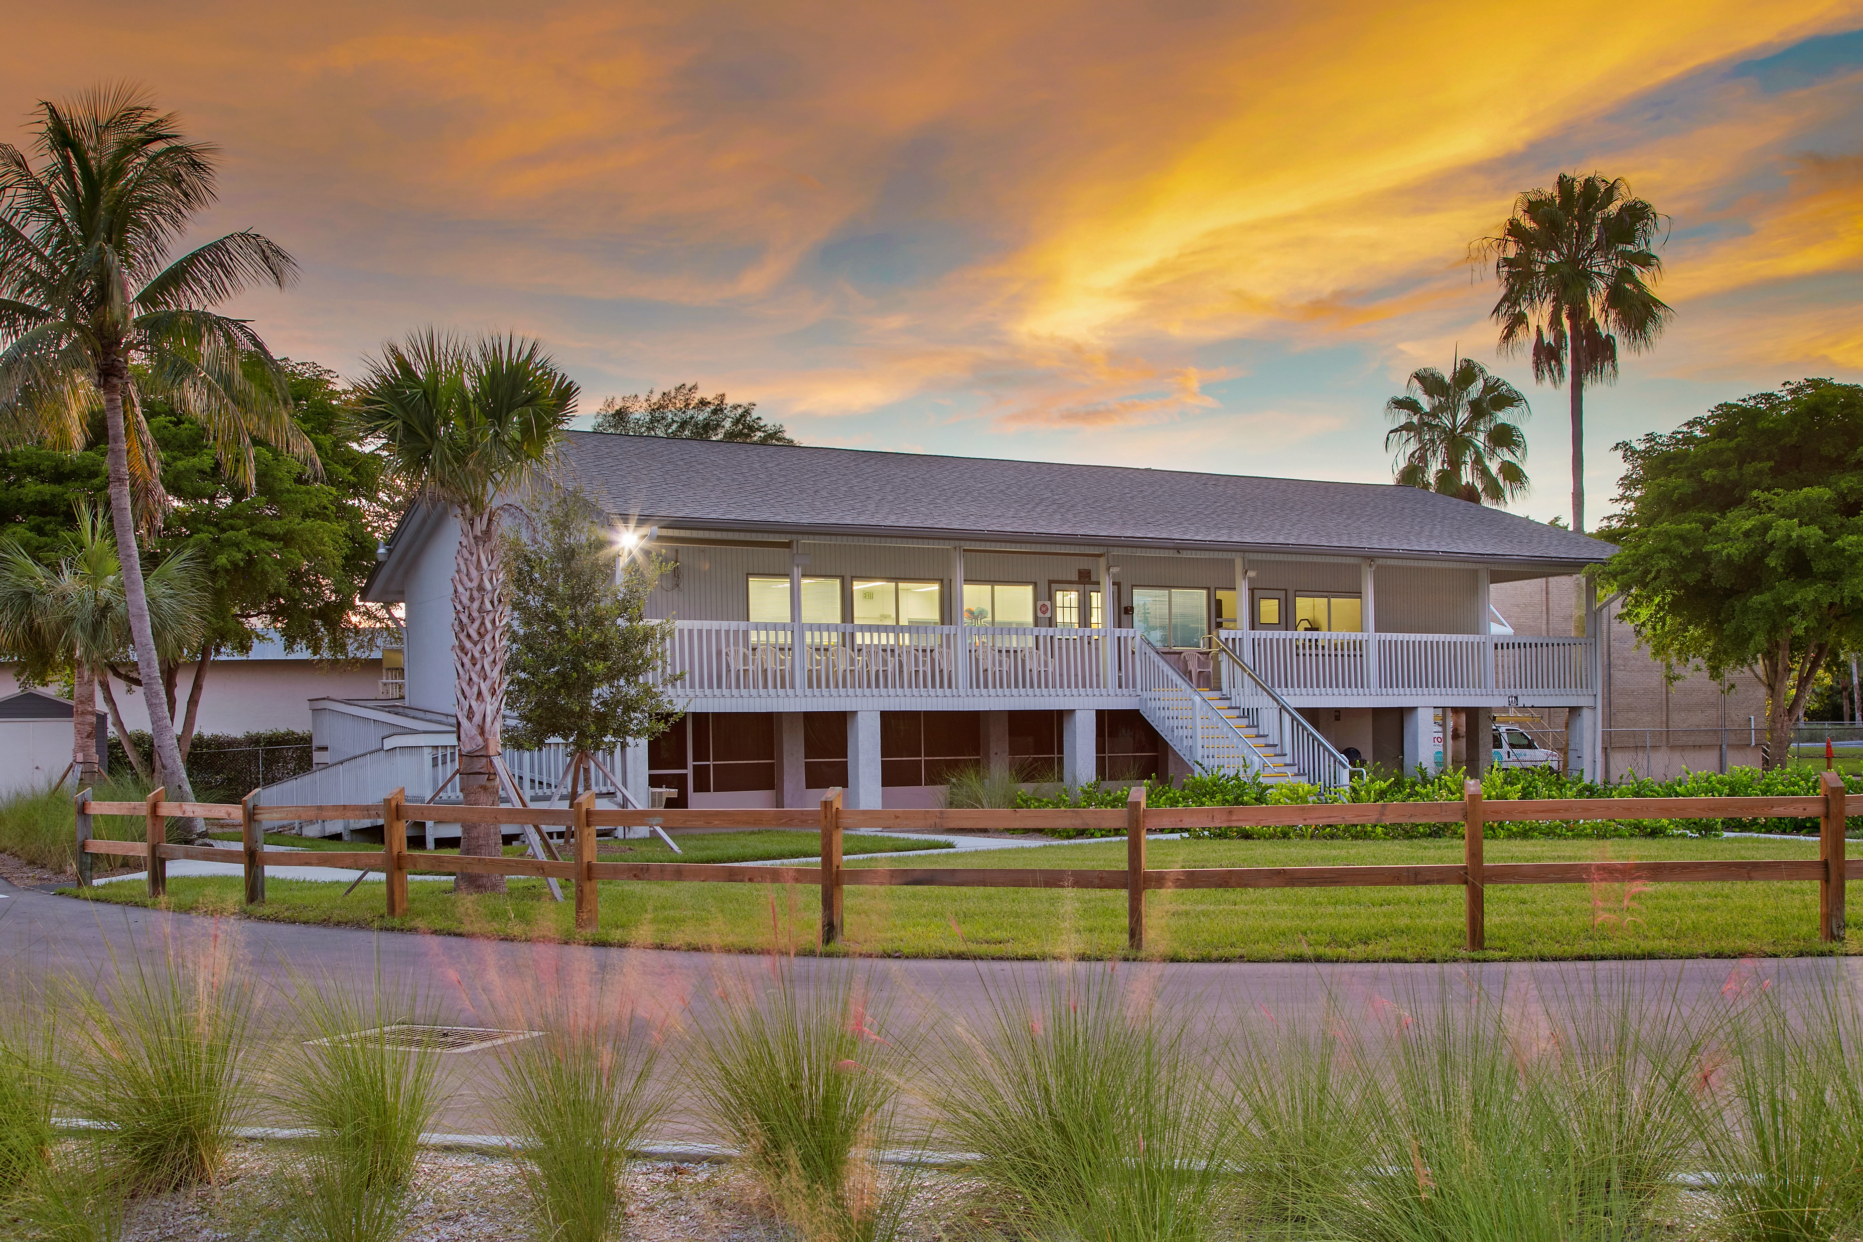
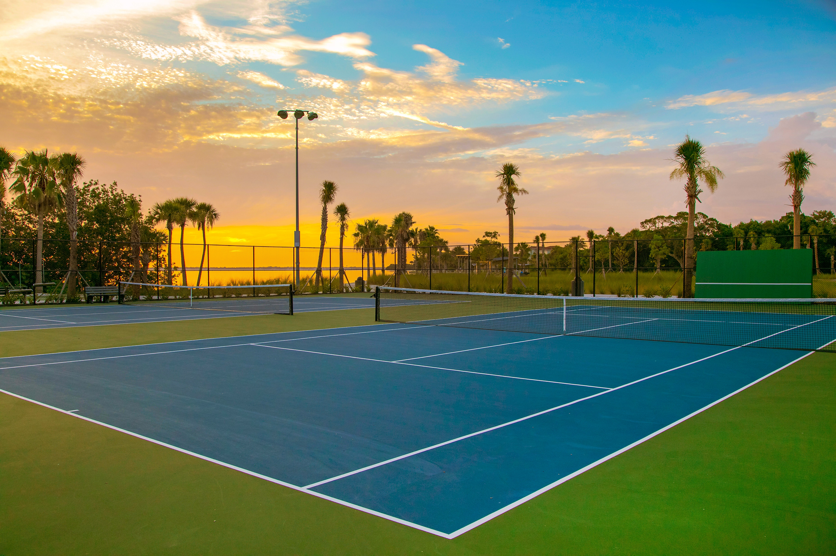
Parks, Recreation and Beach Improvements – Recreation Center and Parks
Projects | Replacement Year | Est Cost $2.02 M
Recreation Center | $100K/yr | $1,500,000
Court Maintenance | 2030 | $20,000
Contingency/Future Projects | 2025-2039 | $500,000
10

Slide 11
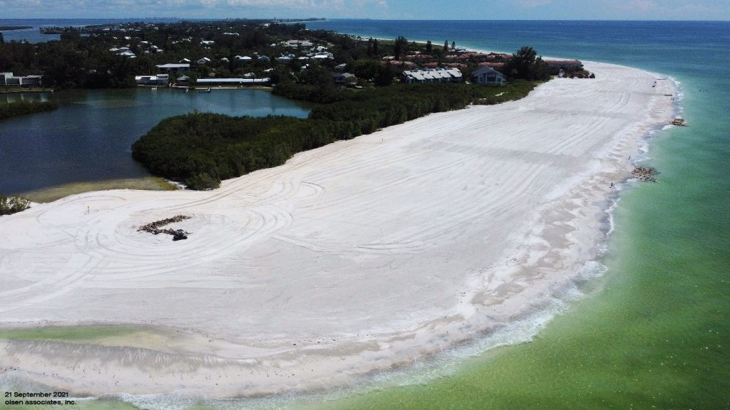
Beach Nourishment
Preservation of the Town’s 10-miles of beaches in 8-year intervals and beach access points. Planning design and permitting, and engineering of construction program, borrow site locations and construction Post construction requirements include beach physical monitoring, sea turtle monitoring, artificial reef biological monitoring, shorebird monitoring and beach tilling. Provides protection of residential and commercial properties.
Total $500,000
11

Slide 12
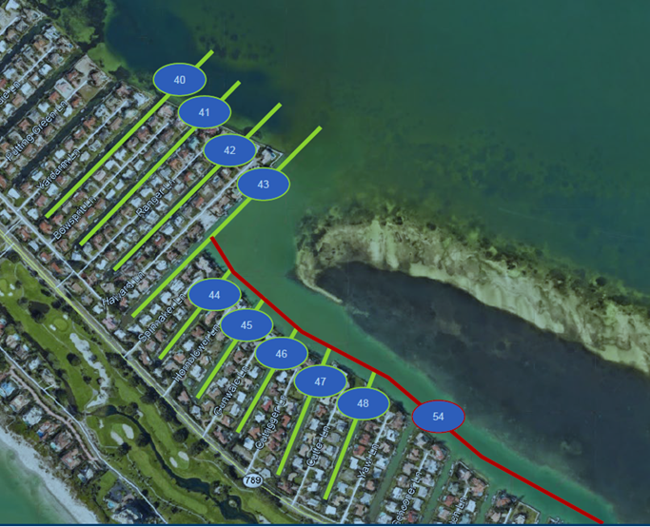
Canal Dredging
Preservation of navigable waterways through a canal navigation maintenance dredging program including engineering, surveying, monitoring and dredging, subsidizing the assessment program for common public benefit portions of the system.
$100K/yr
Total $1,500,000
12

Slide 13
Public Safety Vehicles and Equipment
Fire Trucks - $1.950 M
Ambulances - $1.395 M
Fire Battalion & Administrative Vehicles- $0.574 M
Fire Water vessels & Motors- $0.162 M
Fire/EMS/Police Equipment - $1.278 M
Bunker gear, radios, hose, stretchers, helmets, defibrillators, extrication, gear extractors, message boards
Technology/Communication Upgrades - $1.702 M
Mobile data terminals, mobile tablets, radio equipment, license plate recognition systems
Contingency and Future Projects - $.408 M
Total $7,469,000
13

Slide 14
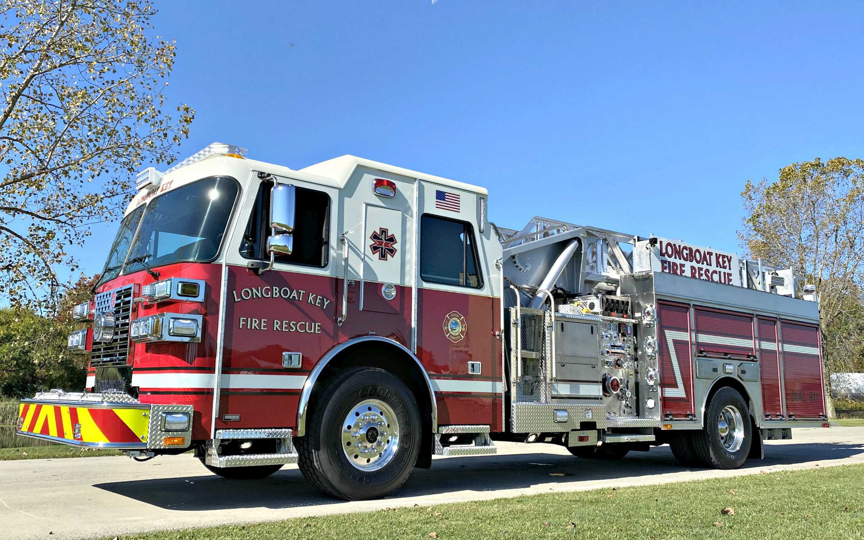
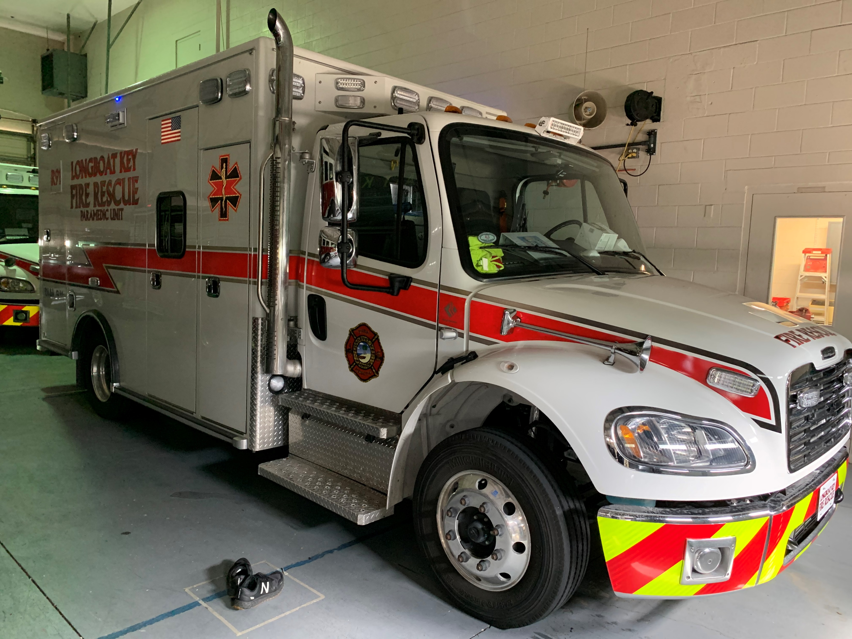
Public Safety Vehicles – Fire Trucks and Ambulances
Fire Trucks | Replacement Year | Est Cost $1.95 M
Ladder 1 | 2028 | $ 950,000
Ladder 2 | 2035 | $1,000,000
Schedule based on 15 Yr Useful Life
Ambulances | Replacement Year | Est Cost $1.395 M
Ambulance 1 | 2031 | $350,000
Ambulance 2 | 2033 | $350,000
Ambulance 3 | 2028 | $320,000
Ambulance 3 | 2038 | $375,000
Schedule based on 10 Yr Useful Life
14

Slide 15
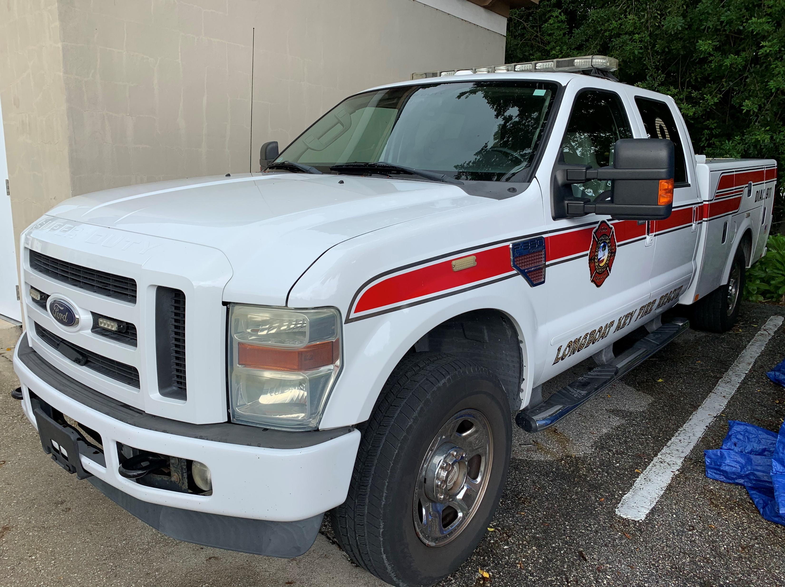
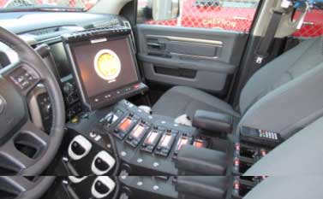
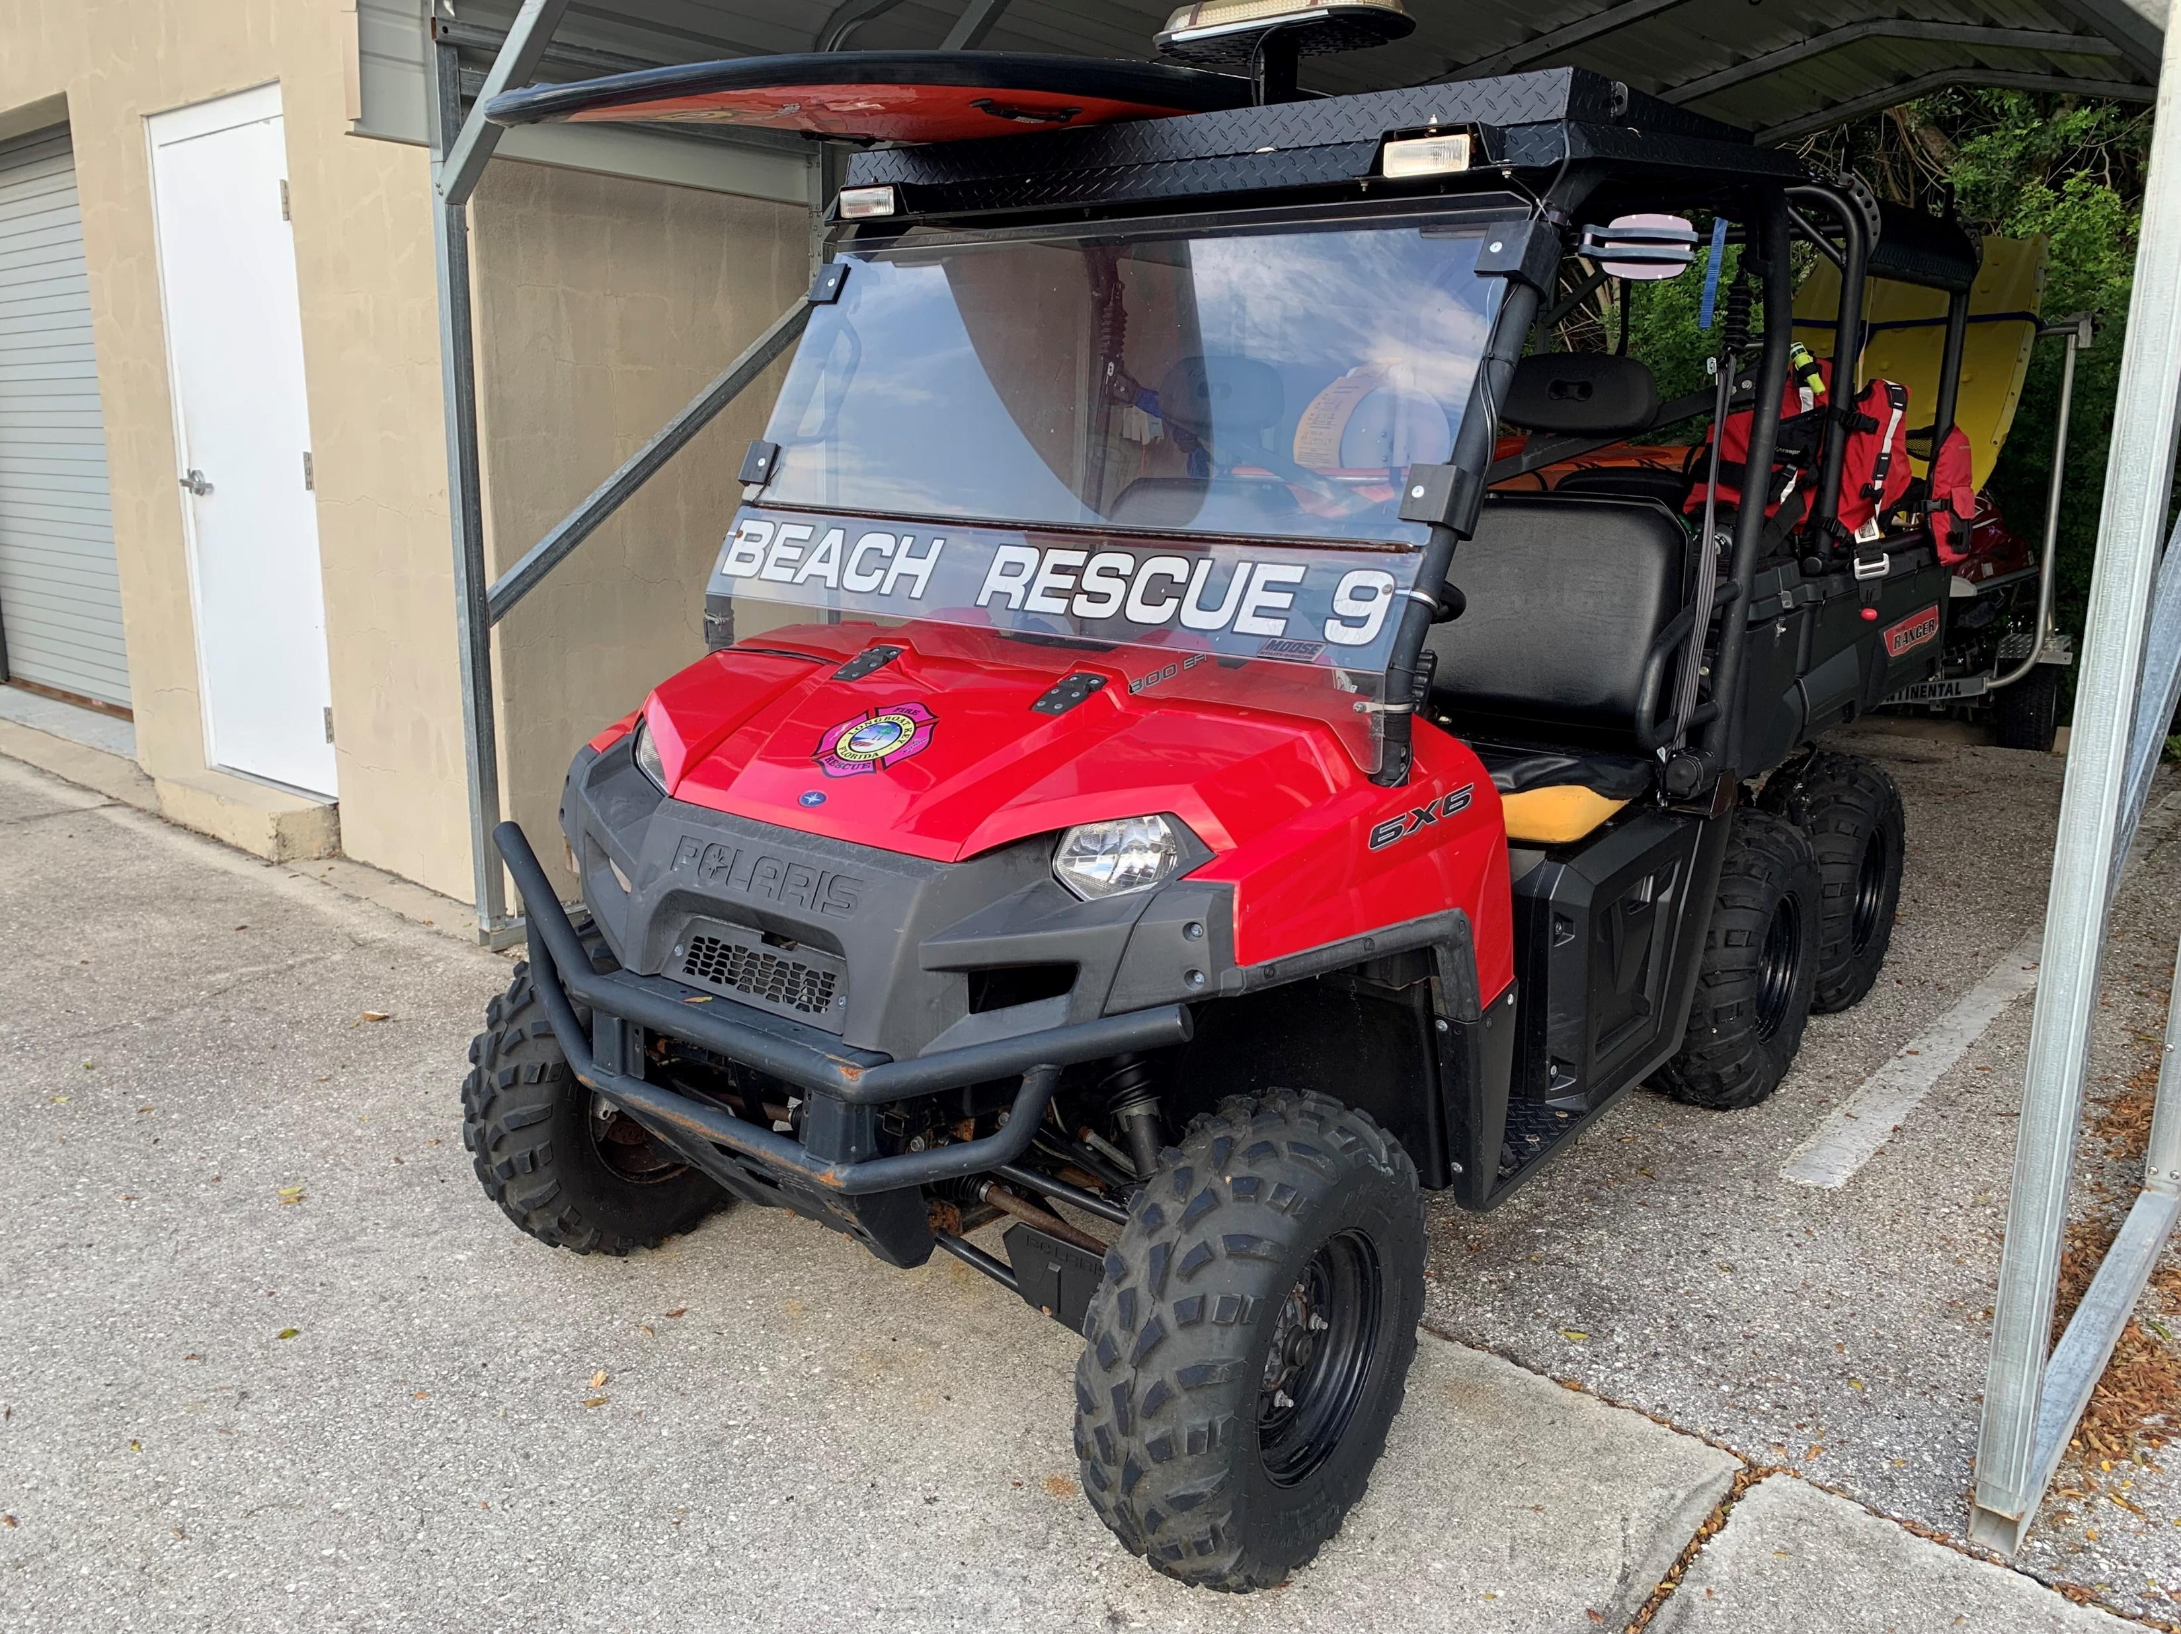
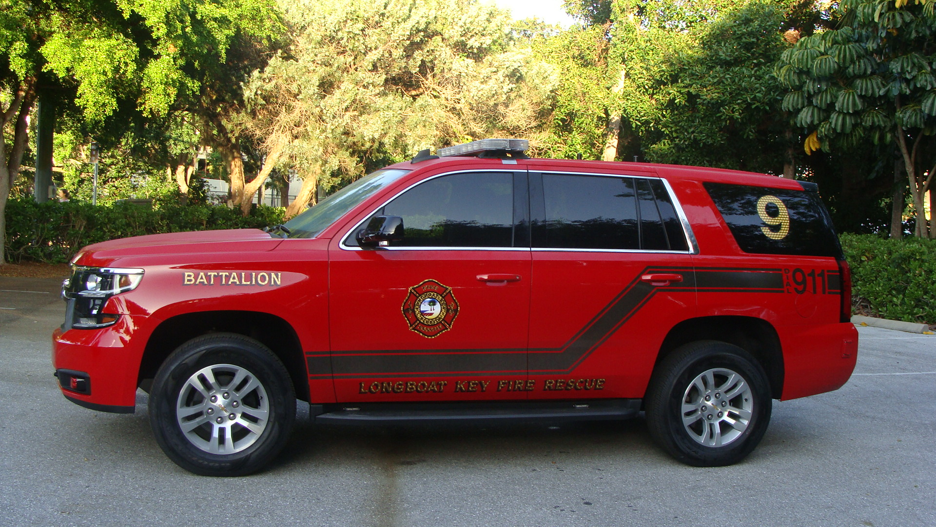
Public Safety Vehicles – Battalion and Administration
BAT & Admin | Replacement Year | Est Cost $.574 M
ATV w/Trailer | 2028, 2034 | $53,000
BAT 1 | 2029, 2037 | $126,000
BAT 2 | 2030, 2038 | $126,000
Chief Vehicle | 2027, 2032, 2037 | $184,000
Fire Marshall | 2029 | $30,000
Pool SUV | 2027 | $55,000
Schedule based on 5-10 Yr Useful Life
15

Slide 16
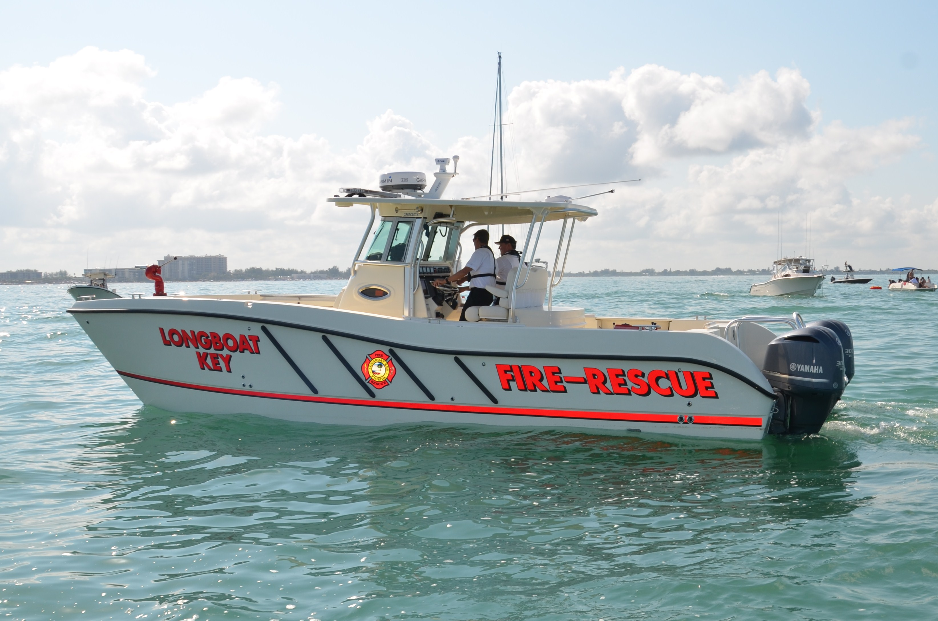
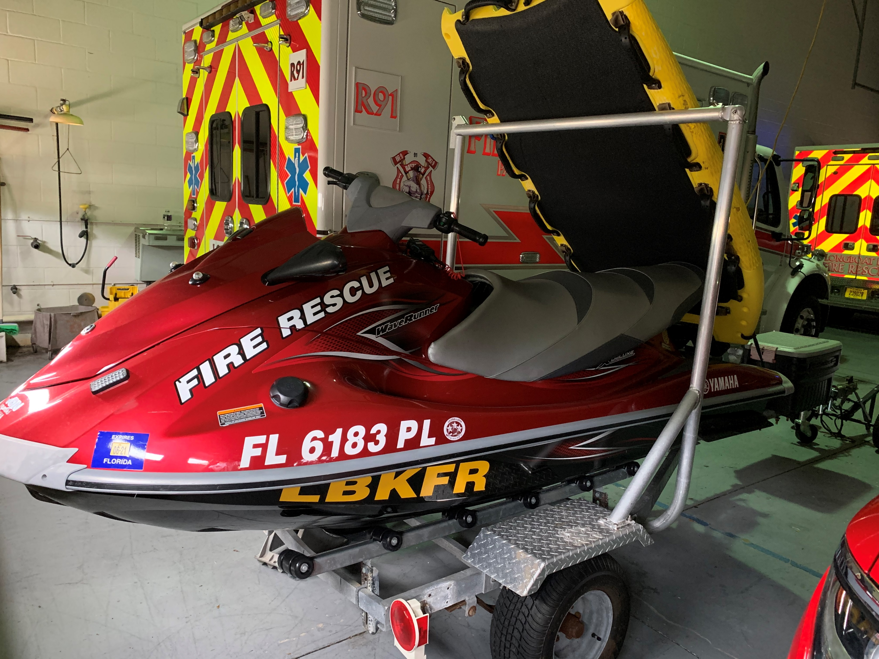
Public Safety Vehicles – Fire Water Vessels
Water Vessels | Replacement Year | Est Cost $.162 M
Outboard Motors | 2027, 2034 | $72,000
Vessel trailer | 2038 | $25,000
Jet Ski Rescue with Trailer | 2028, 2033, 2038 | $65,000
Amounts represent 50% grant match for WCIND
16

Slide 17
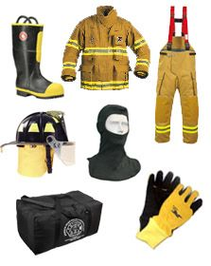
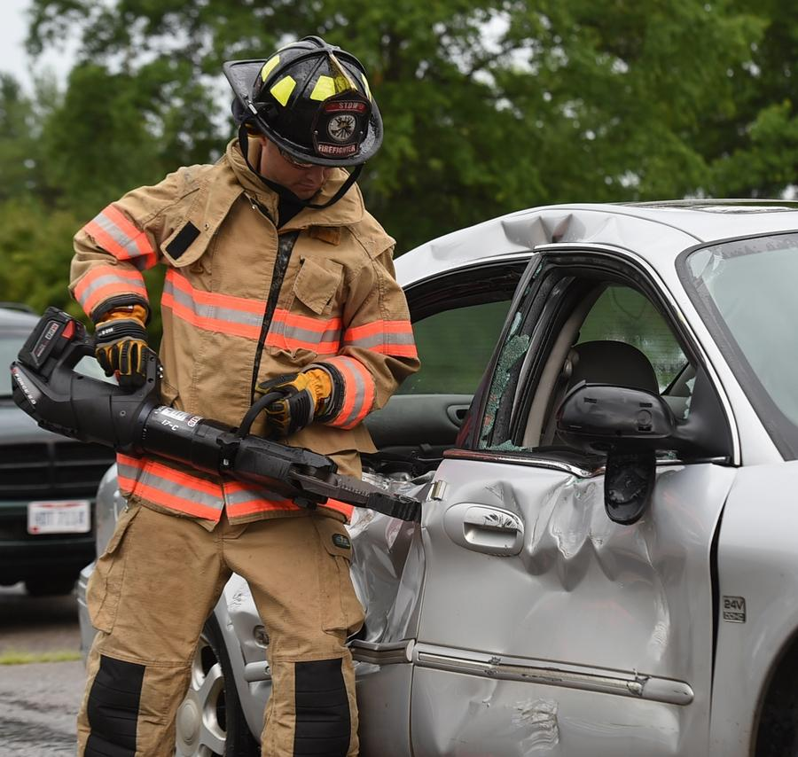
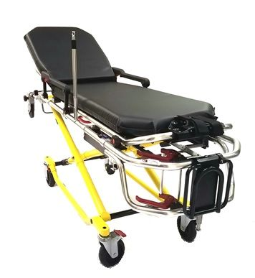
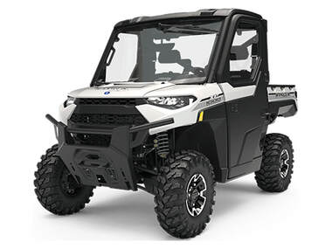
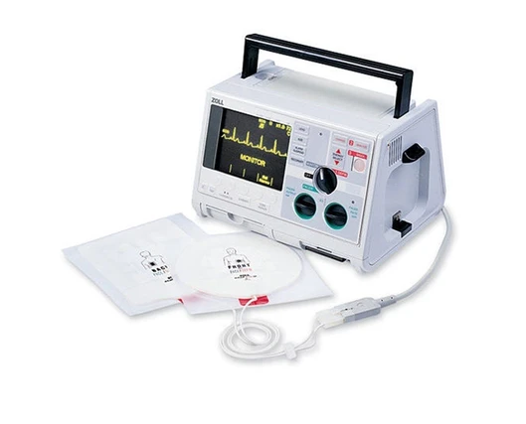
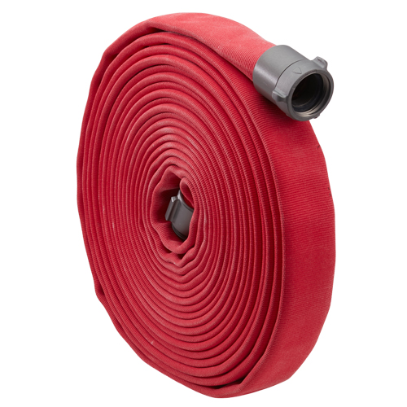
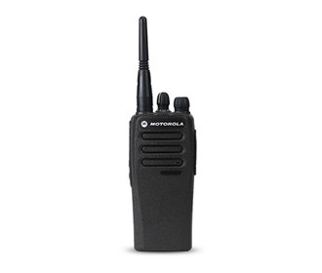
Public Safety Equipment
Equipment | Replacement Year | Est Cost $1.278 M
Bunker Gear | 2029, 2037 | $220,000
SCBA Cylinders | 2029 | $188,000
Radios | 2029-2038 | $110,000
Fire hose | 2029-2038 | $48,000
Stretchers | 2028, 2038 | $340,000
Fire helmets | 2028, 2037 | $30,000
Video Airway | 2029-2038 | $36,000
Defibrillators | 2030-2033 | $105,000
Extrication | 2030-2031 | $40,000
Gear extractor | 2028, 2037 | $136,000
ATV | 2027 | $25,000
17

Slide 18
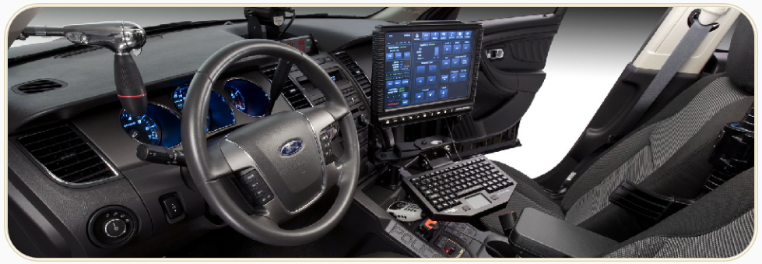
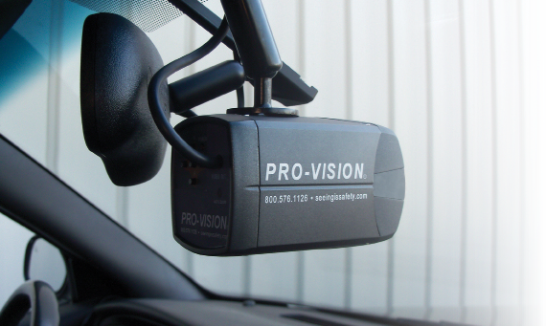
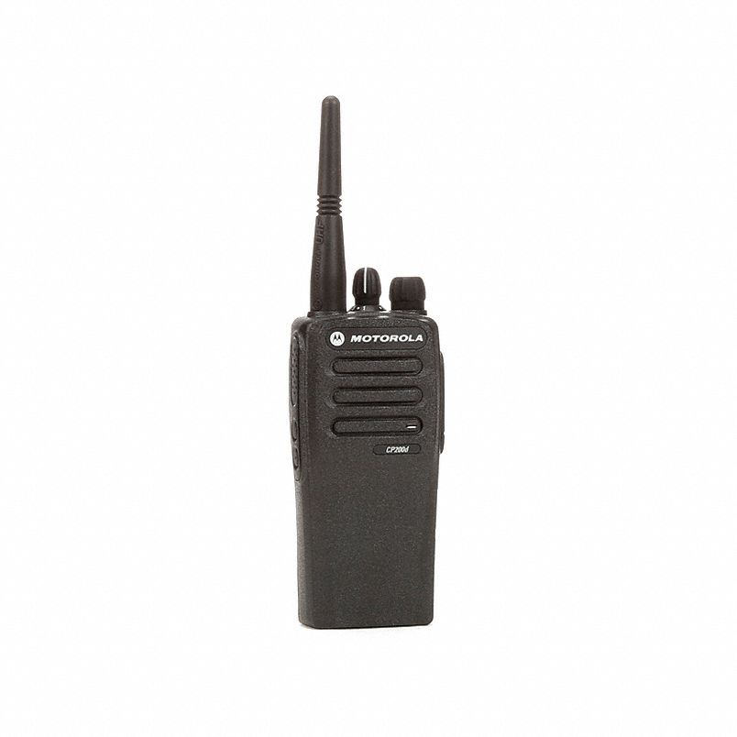
Public Safety Technology & Communication Equipment
Technology and Communications | Replacement Year | Est Cost $1.702 M
Fire MDTs | 2031, 2036 | $85,000
Police MDTs | 2029, 2034, 2039 | $240,000
Fire Mobile Tablets | 2031, 2036 | $40,000
Police Radios | 2026, 2033 | $630,000
In car Cameras and server | 2027 – 2037 | $235,000
License Plate Recognition System | 2028, 2033, 2038 | $472,000
18

Slide 19
Public Facilities Improvements
Roofs - $0.140 M
Tennis Center and Town Hall
HVAC - $0.225 M
Generators
Parking Lot Resurfacing
Technology Upgrades - $0.235 M
Servers, network upgrades, Badge and camera security systems, A/V Equipment
Other Building Improvements and maintenance
Contingency and Future Projects - $0.500 M
Total $800,000
19

Slide 20
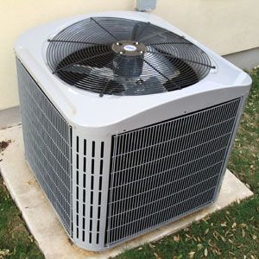
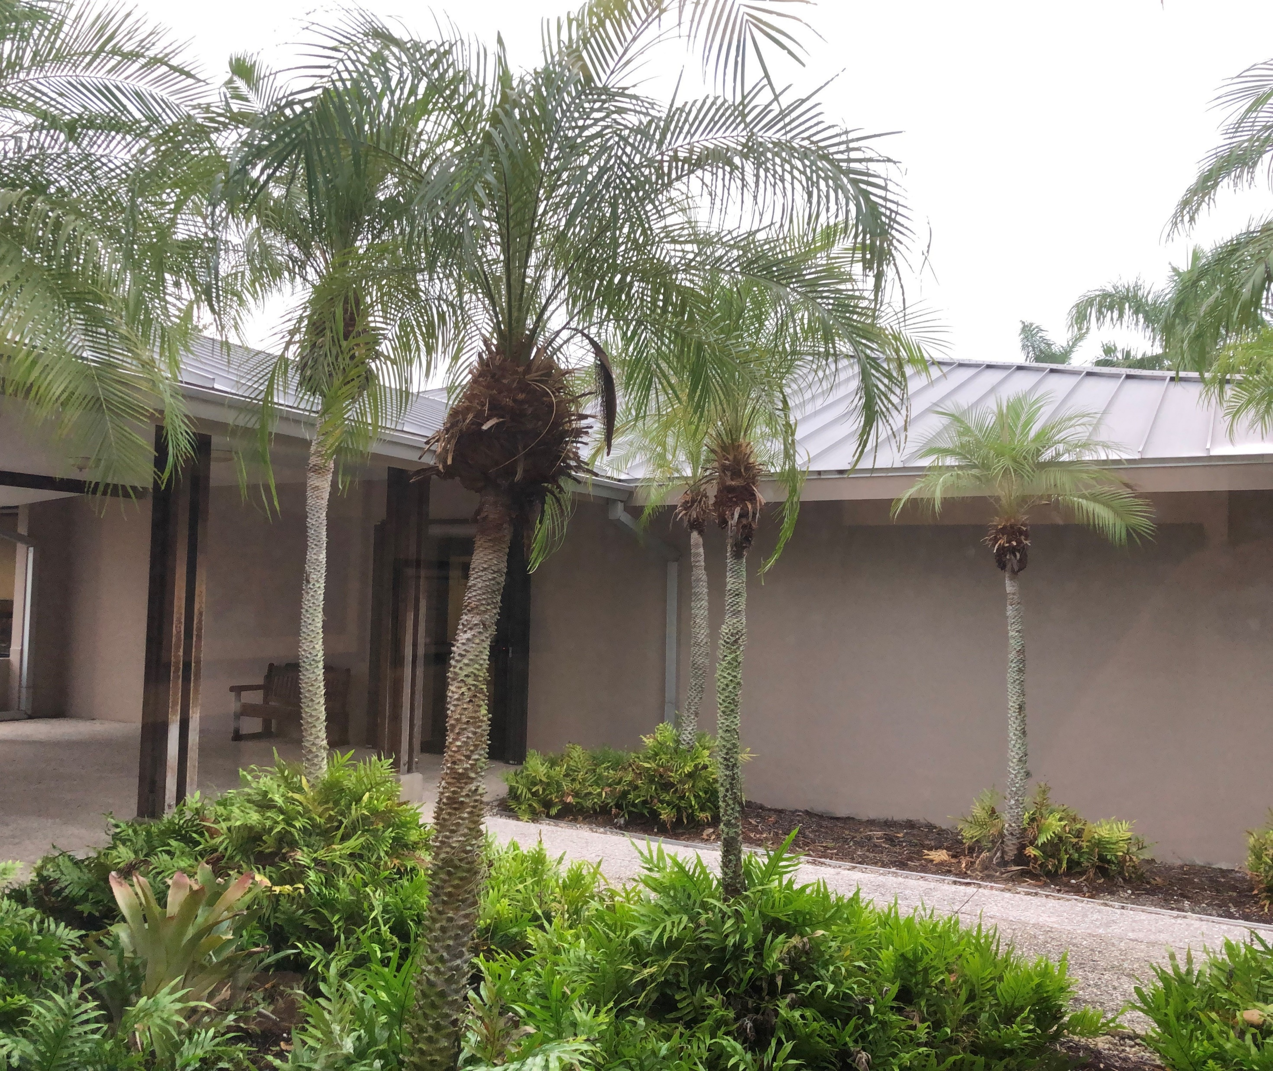

Public Facility Improvements
Public Facility Improvements | Replacement Year | Est Cost $.800 M
HVAC | 2027-2037 | $225,000
Town Hall Roof (PZB) | 2029 | $100,000
Tennis Center Roof | 2031 | $40,000
Town Hall Network | 2028-2038 | $130,000
Server | 2032 | $85,000
Projector Equipment | 2036 | $20,000
Contingency/Future Projects | 2025-2039 | $200,000
20

Slide 21
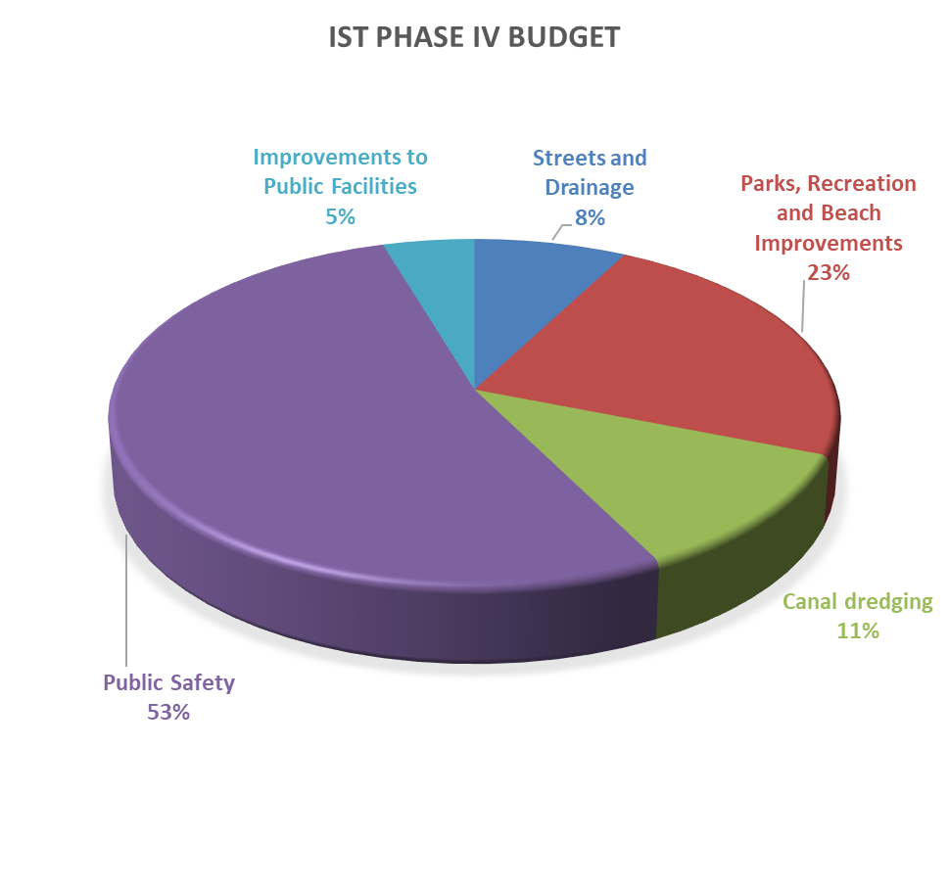
Infrastructure Surtax (Phase IV 2025-2039)
Functional categories and estimated values November Workshop
Preliminary
Proposed 15 Year Budget for functional areas-Phase IV:
1. Streets and Drainage $1,000,000
2. Parks, Recreation and Beach Improvements $3,000,000
3. Canal dredging $1,500,000
4. Public Safety Vehicles and Equipment $6,900,000
5. Improvements to Public Facilities $ 600,000
Total $13,000,000
21

Slide 22
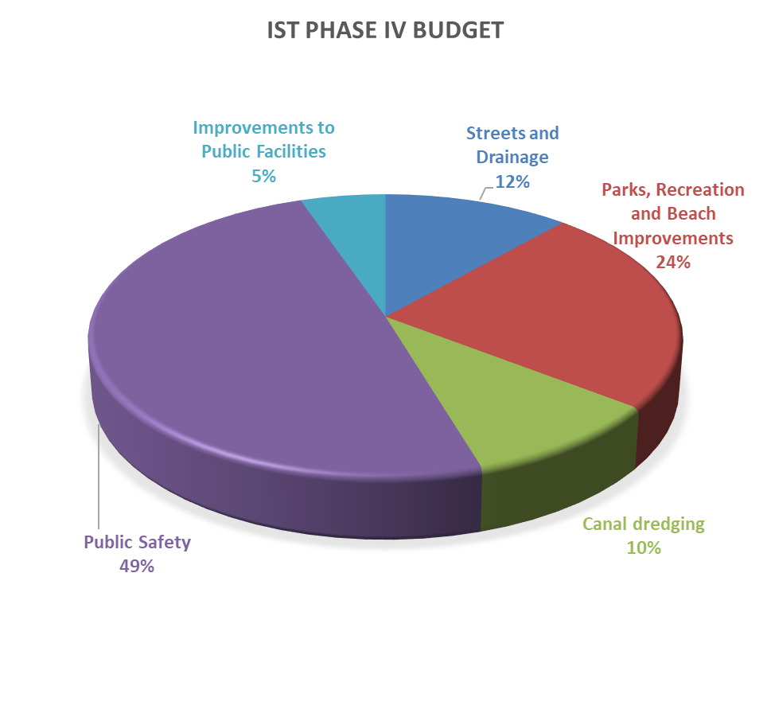
Infrastructure Surtax (Phase IV 2025-2039)
Functional categories
Proposed
Proposed 15 Year Budget for functional areas-Phase IV:
1. Streets and Drainage $1,750,000
2. Parks, Recreation and Beach Improvements $3,608,000
3. Canal dredging $1,500,000
4. Public Safety Vehicles and Equipment $7,469,000
5. Improvements to Public Facilities $ 800,000
Total $15,127,000
22

Slide 23
23

Slide 24
Next Steps
Pass Resolution in support of extending the surtax
Submit Final list of Surtax Projects to County by March 8, 2022
County develops Final Ordinance and Exhibits for Public Hearing March 29, 2022
Proceed with planning for November 2022 referendum
24

