Slide 1
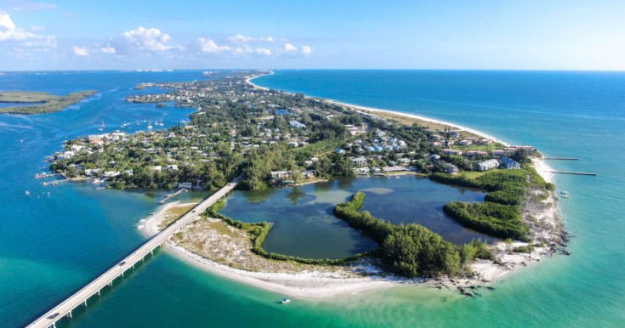
Environmental Action Plan Matrix
Town of Longboat Key
Town Commission Meeting November 13, 2023
Jennifer Shafer, PhD
David Shafer, PhD

Slide 2
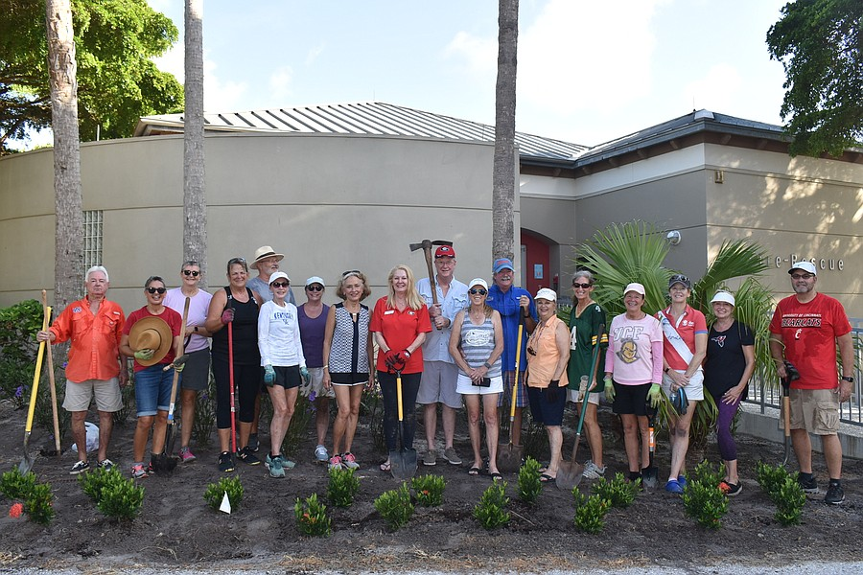
Purpose
Focus, prioritize, and coordinate Town of Longboat Key environmental support activities
Engage community leaders and staff to co-create an environmental action plan
Ensure consistency with existing approved plans and codes

Slide 3
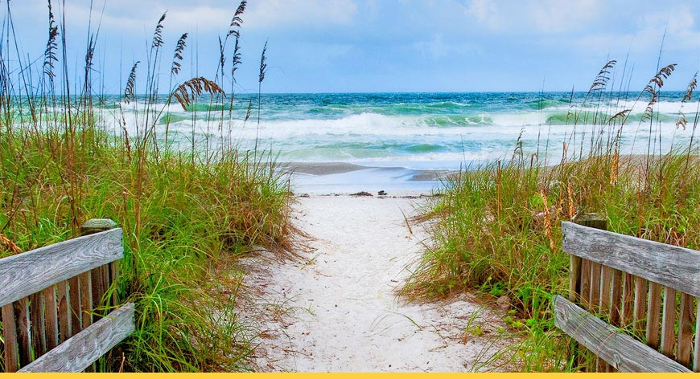
Contract Tasks
Task 1. Facilitate meetings with Town staff and community stakeholders to explore concerns and opportunities
Task 2. Develop an Environmental Action Plan Matrix with recommended goals, objectives, activities, performance measures, partners, and potential funding.
Task 3. Present Draft Strategic Plan Matrix to Town Commission

Slide 4
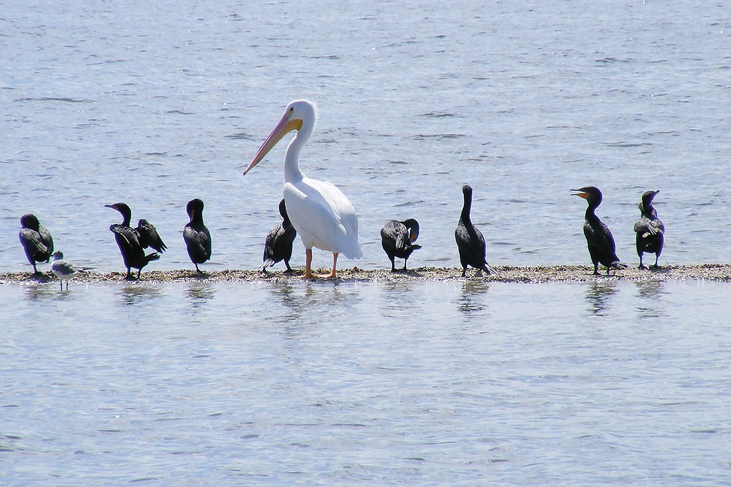
Process
September 13, 2023
Workshop with Town staff to identify Goals and Objectives; prioritize Activities
September 14
Workshop with Green Community Committee and Town staff to survey and discuss concerns, priorities, and partners
September 18
Meeting with Town staff to finalize Matrix

Slide 5
Strategic Plan
Goals and Objectives
Goal 1: Conserve and restore LBK's ecological biodiversity, function, services, and resilience.
1.1 Conserve and restore native coastal habitats of LBK (CCM 1.2-1.4)
1.2 Conserve and restore fish and wildlife of LBK (CCM 1.6)
Goal 2: Reduce human impacts on LBK's natural environment
2.1 Reduce stormwater pollution
2.2 Reduce wastewater pollution
2.3 Improve energy use efficiencies and increase use of clean energy alternatives
2.4 Reduce litter and landfill waste
Goal 3: Build capacity of LBK and partners to conserve and restore LBK ecosystems and to
collaborate on environmental initiatives.
3.1 Collaborate with local governments, SBEP, and NGOs on shared environmental goals
and objectives.

Slide 6
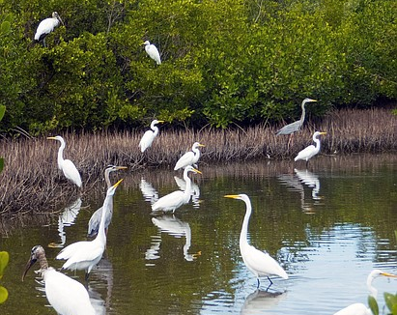
Considerations for Activities
5-year Timeframe
Well defined Town role
Support | Coordinate | Collaborate | Conduct
Explicit criteria for prioritizing activities
(in order of priority)
multiple co-benefits, especially fiscal
relevant to environmental goals
aligned with policymaker directives
high priority for stakeholders & partners
progress likely within 5 years
likely to be effective & measurable
technically feasible

Slide 7
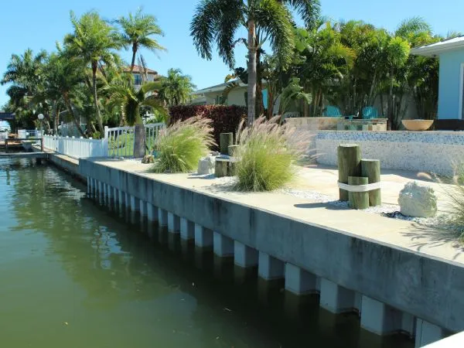
Sample Activity
Goal 1. Objective 1. Activity A.
Replace or modify seawalls and other hard shoreline structures on Town properties where feasible with natural shorelines or living seawalls that create habitat (CCM 1.4.2.4).
Example: Sarasota Bay Estuary Program pilot study of vinyl seawall modifications to enhance oyster habitat

Slide 8
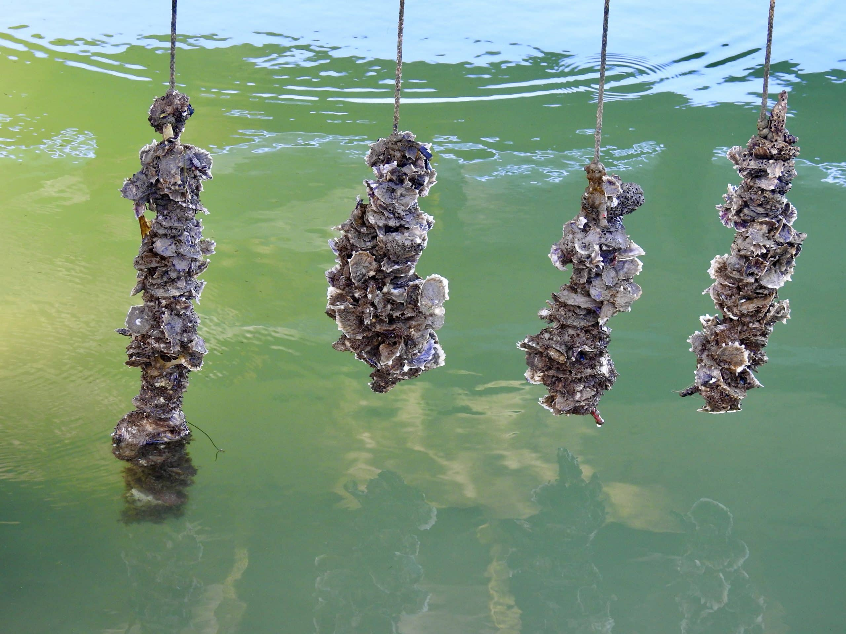
Sample Activity
Goal 1. Objective 2. Activity A.
Educate, encourage, and install oyster restoration on Town and private properties.
Example: Multi-partner campaign to install Vertical Oyster Gardens on docks

Slide 9
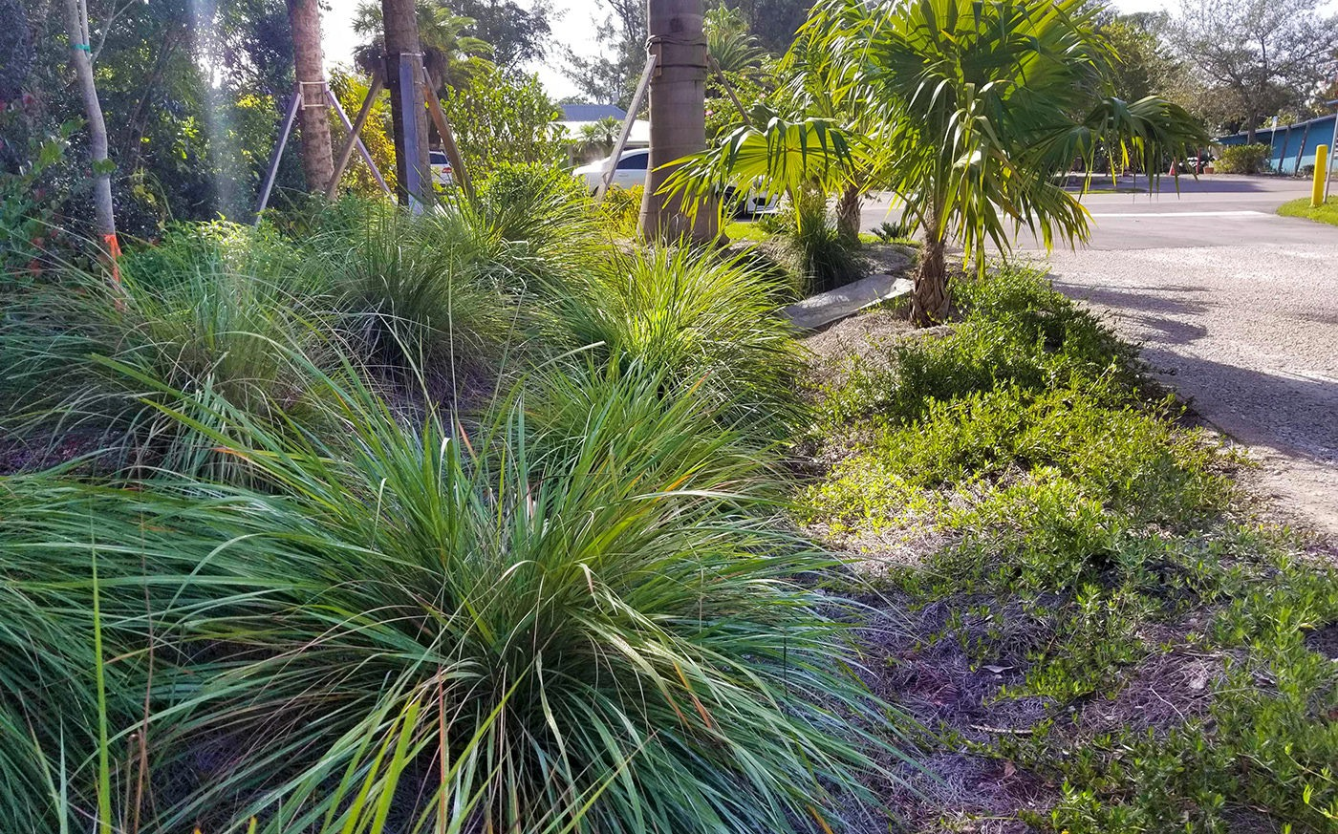
Sample Activity
Goal 2. Objective 3. Activity G.
Install green infrastructure (LID) on Town properties and right of ways (CCM 1.1.2.2).
Example: rain gardens, bioswales, pervious trails, walkways and drives.

Slide 10
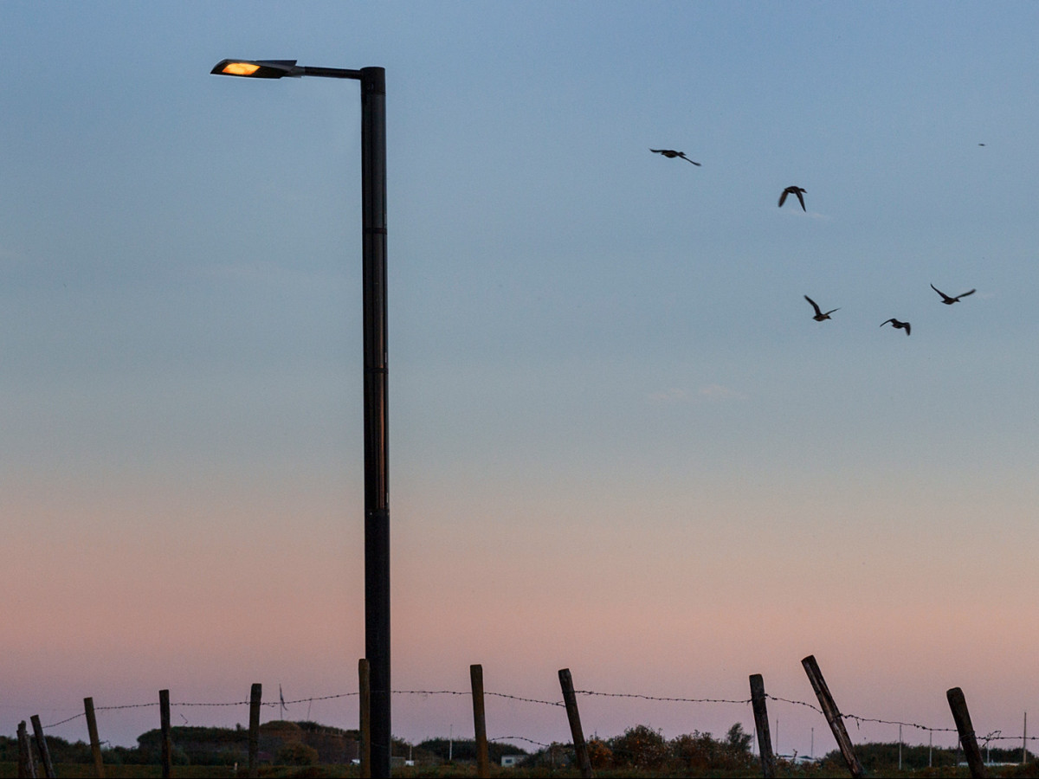
Sample Activity
Goal 2. Objective 3. Activity G.
Continue to replace legacy lighting for Town rights-of-way with energy-efficient wildlife-friendly LED fixtures. Explore solar-powered lighting.
Example: Replace lighting along electrical undergrounding corridors.

Slide 11
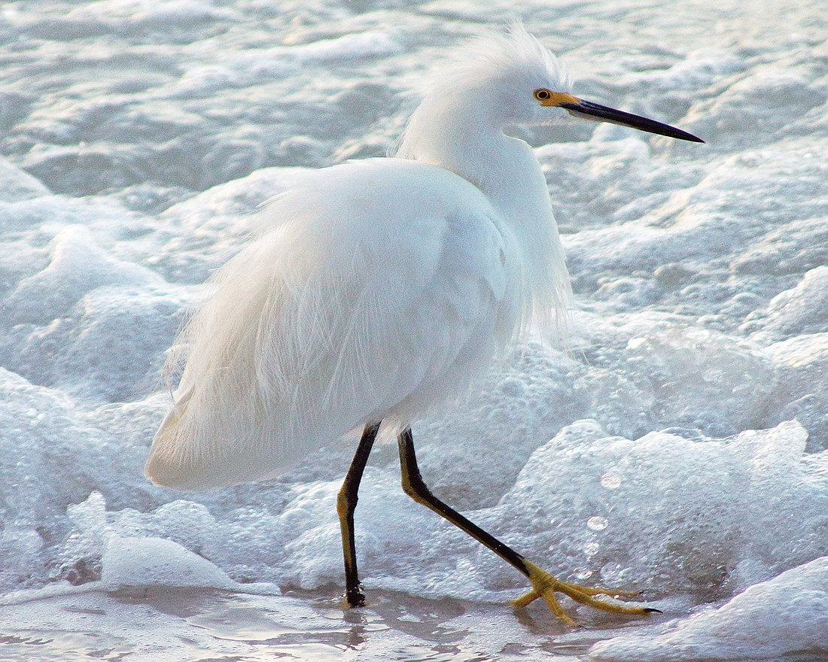
Next Steps
Consider implementing a public-facing dashboard for communicating environmental Goals and Objectives and tracking performance
Consider Town staff, stakeholder, and partner capacity to implement ongoing and new initiatives
Consider future budgetary needs, especially leveraging State and Federal appropriations and grants with County and Agency partners

