Slide 1
Canal Navigation Maintenance Program Update
Town Commission Workshop
November 12, 2024

Slide 2
Path to Canal District Discussion
Town Vision & Mission
“Longboat Key is a beautiful place to live, work, and visit, where the natural assets of a barrier island combine with cultural and recreational amenities, visionary planning, and proactive leadership to enhance your way of life.”
“To vigorously maintain and preserve Longboat Key’s status as a premier residential and visitor destination that supports the historic balance between residential, recreational, tourism, and commercial attributes, through a commitment to long-term and short-term planning excellence and measurable results.”
Town Core Expectations
6. The town will maintain Longboat Key as a premier vacation destination and enhance year round tourism through continued revitalization, development, and maintenance of tourism-oriented businesses and amenities such as; lodging, cultural attractions, restaurants, golf courses, tennis facilities and beaches.
7. The town will maintain and improve the quality and variety of island-based recreational and educational opportunities, including a high-quality community center, and will support and promote off-island recreational, cultural and urban attractions.
11. The town recognizes the need to provide suitable amenities for visitors and residents of all ages.

Slide 3
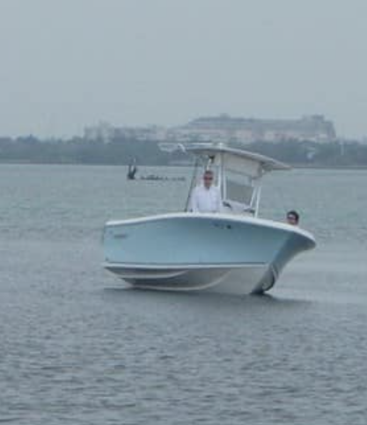
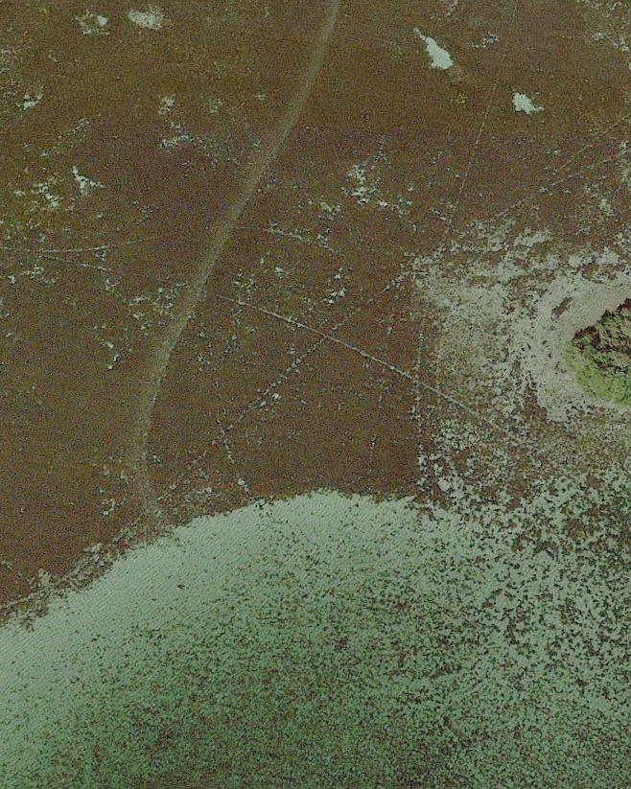
Path to Canal District Discussion Cont.
Conservation and Coastal Management (CCM) Element of the 2022 Comprehensive Plan (adopted June 6, 2022, Ordinance 2022-03) contains objectives and policies relating to Canal Navigability.
Specifically, it:
Objective 1.5: Preserve the navigability of canals.
Policy 1.5.1: Create and implement a Town Canal Navigation Maintenance Program
Also Supports Vision, Mission, Community Expectation 9: Boat Usage Within Canal System Protects Environmental/Benthic Resources (Seagrasses & Oyster Beds) and Boater Safety.
Buttonwood Harbor

Slide 4
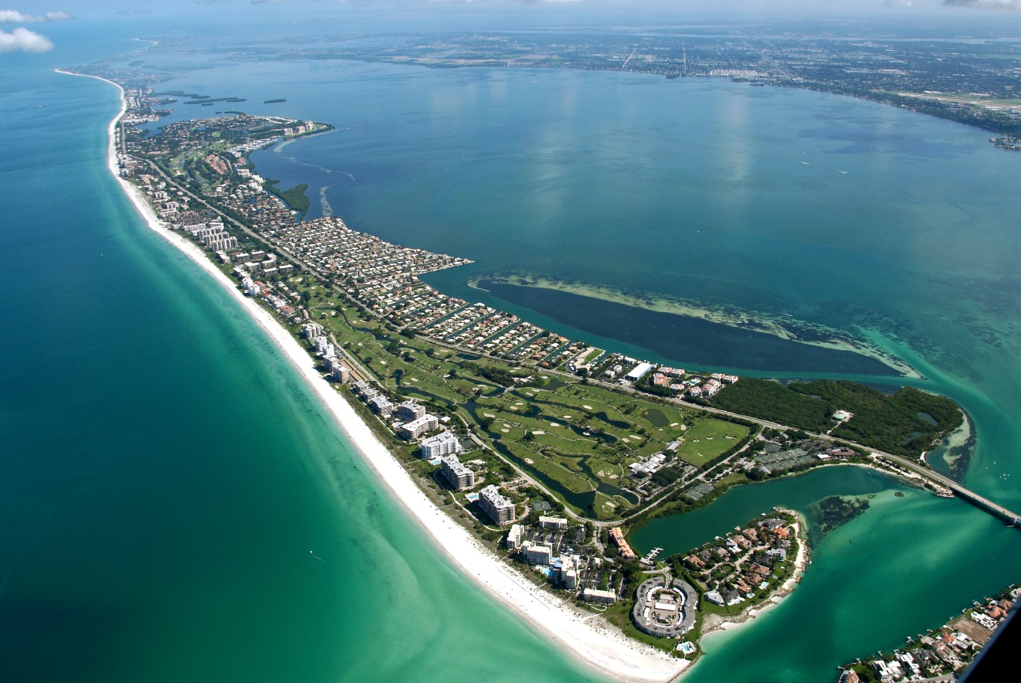
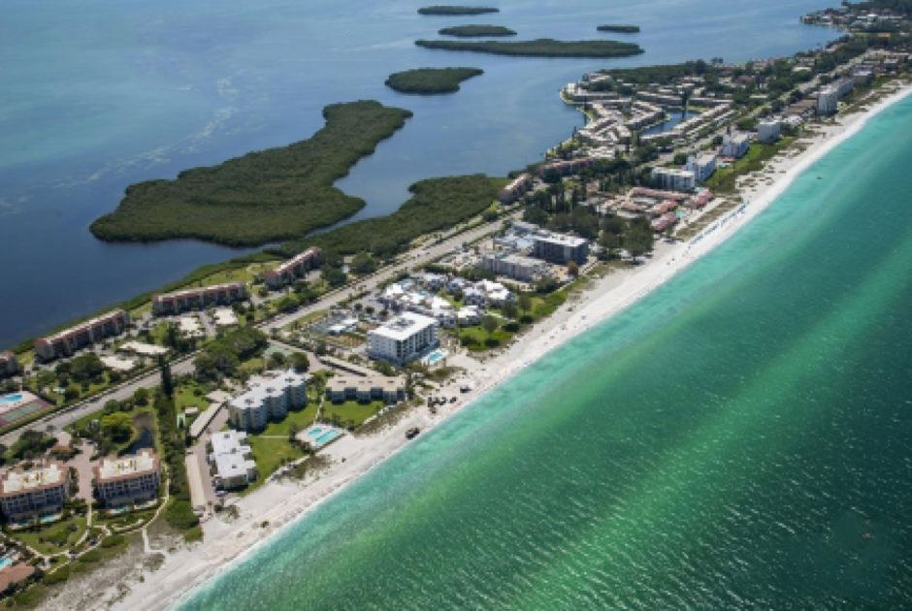
Background
Island Amenity and Ambiance
As an island, (def. “…land surrounded by water…”), waterway and bay access for navigation and recreation is an important element to the overall quality of island life as an amenity enhancing the ambiance on Longboat Key.
Wholistic Benefit
Portions of the Channel / Canal system can be considered as providing an overall benefit to the residents of the Town, as a recreational amenity to the island.
Some canals may have an overall Town-wide benefit and some have a more private benefit (canal fronting properties)

Slide 5
Established Premise
Every property is unique, and benefits vary based on accessible canals
Three Utilization Types
Local Canal | Communal Access | Mixed Use
direct access to residents via their property or community | accessible and commonly used by all boaters | both direct access to residents via their property or community and are commonly used by all boaters
Direct Benefit | General Benefit | Shared Benefit

Slide 6
Advancements Toward Implementation
Have included:
Data collection and initial conditions assessment (presented June 2024)
Initial Opinion of Probable Construction Cost (presented June 2024)
Development and presentation of funding strategies (Oct 2024 & Today)
Seeking guidance today:
Resolution of Intent and Tax District Ordinance preparation for December 2nd meeting
Begin public outreach
Continue with BUDM design concurrent with the subaqueous force main effort

Slide 7
District Creation
Critical Milestones
Option 1
Maintain ability to collect funds in Nov. 2025
Create Special Districts by March 2025
Option 2
Delay assessments 1 yr until Nov. 2026
Create Special Districts in 2026
Creation of a District provides the ability to progress but does not require funding.
Event | Date
Workshop of assessment with Commission | 10/21/2024
Workshop of assessment with Commission | 11/12/2024
Ordinance Establishing Ad Valorem District (First Reading) | 11/12/2024 (SPC MTG)
Ad: Public Notice of Intent to Use Uniform Method of Collection (Assessments) in Newspaper | Ad to be Run 4 Fridays prior/up to Public hearing: Nov 8, 15, 22, 29
Resolution: Electing To Use Uniform Method of Collection | 12/02/2024
Ordinance Establishing Ad Valorem District (Second Reading/Public Hearing) | 12/02/2024
Public Meetings | January 2025 – March 2025

Slide 8
Community Outreach & Engagement Opportunities
Objectives
  Present and inform on the program need, benefits, and costs
  Garner public feedback
  Opportunity for public engagement in the process
  Specific address searches to inform on direct costs for properties
Forums & Venues
  General Benefit & Canal Group focus sessions
  Virtual, Town Hall, Condo Federation, North End Coalition, etc.
  Per District Specific Meetings focus on specifics within district
  Program website, handouts, mailers
Robust Public Outreach Campaign: VancoreJones

Slide 9
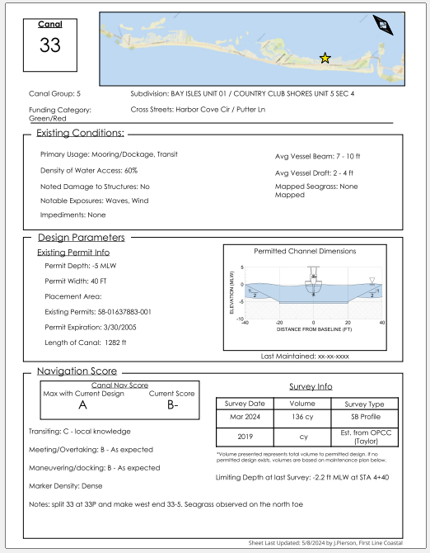
Feedback from October 21st Meeting
Storm recovery is the top priority for the Town currently and should remain so.
Canal program feedback:
  Requested more detail:
    Waterway specifics & categorization
    Assessment methodology
    Cost allocation
  Additional detail for shared benefit canals
  Appropriate cost-share models & examples

Slide 10
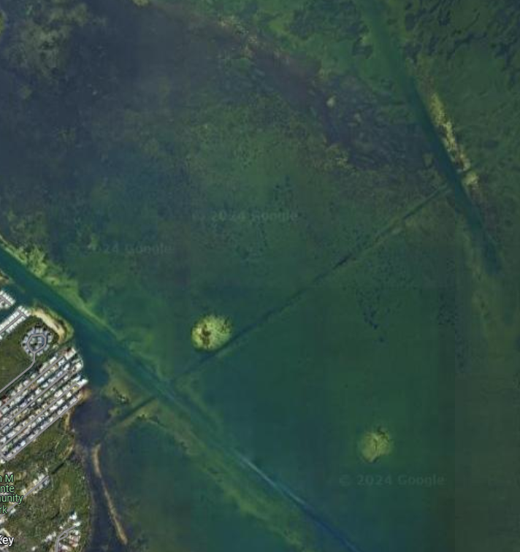
Order of Brief
Waterway Maintenance Program
  Work allocation review
  Subaqueous pipeline install
Pause for discussion
Assessment Program Methodology
  Assessment program framework
  Example Scenarios

Slide 11
Waterway Maintenance Program

Slide 12

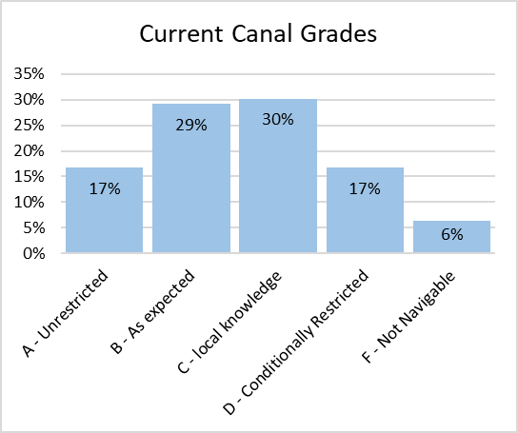

Program Statistics
Existing island wide conditions
Max available volume (before cost saving measures) | 62,000 CY
Target Volume (current maintenance plan) | 40,000 CY
Category | Advanced Update
Dredging Cost | $ 3,680,000
Permit, Design, Management | $ 900,000
2025 Dredging Cost | $ 4,580,000
Mitigation Cost | $ 3,600,000
Adjustment for 2028 | $ 1,070,000
Initial Construction Estimated Cost (2028) | $ 9,250,000
Annual Operations and Maintenance | $ 450,000

Slide 13
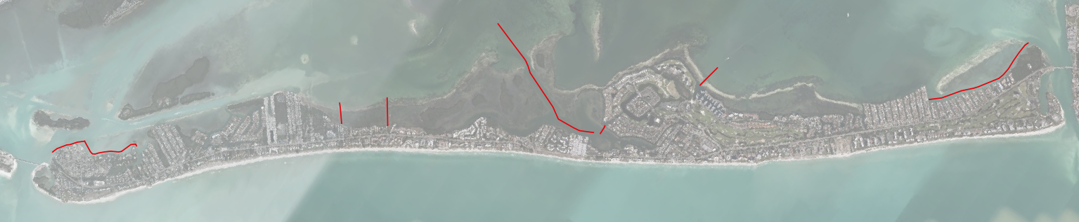
Canal and Funding Types – General Benefit
Communal Access Waterways - General Benefit
Number of Waterways | 8
Volume to Dredge | 5,600 CY
Funding Strategy | Ad Valorem
Funding Group | All Residents
Similar to WCIND millage found on all tax bills

Slide 14
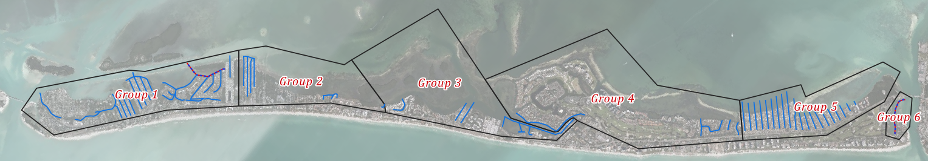
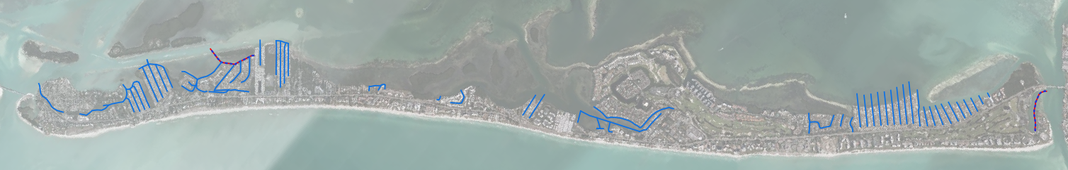
Canal and Funding Types – Direct Benefit
Local Canal – Direct Benefit
Number of Waterways | 70
Volume to Dredge | 17,000 CY
Funding Strategy | Non Ad Valorem
Funding Group | Water Abutting properties inside given group (1-6)

Slide 15
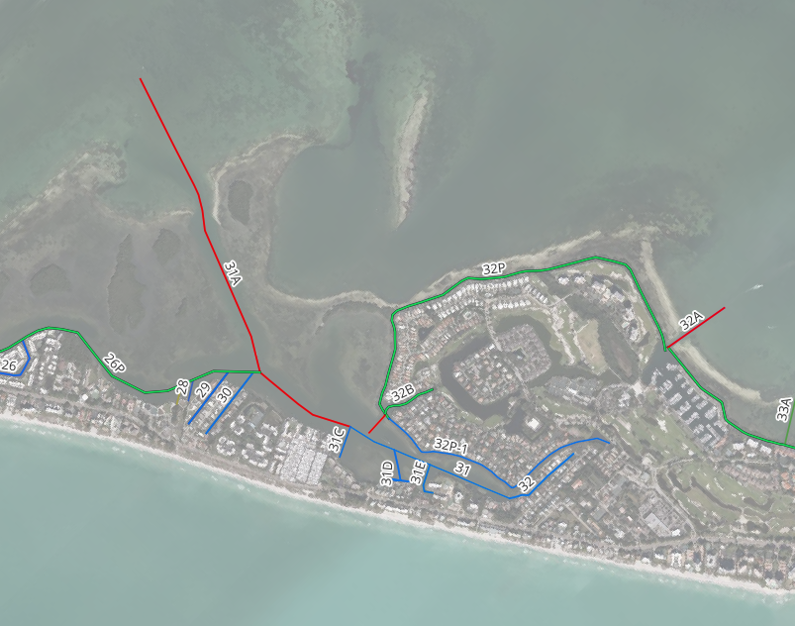
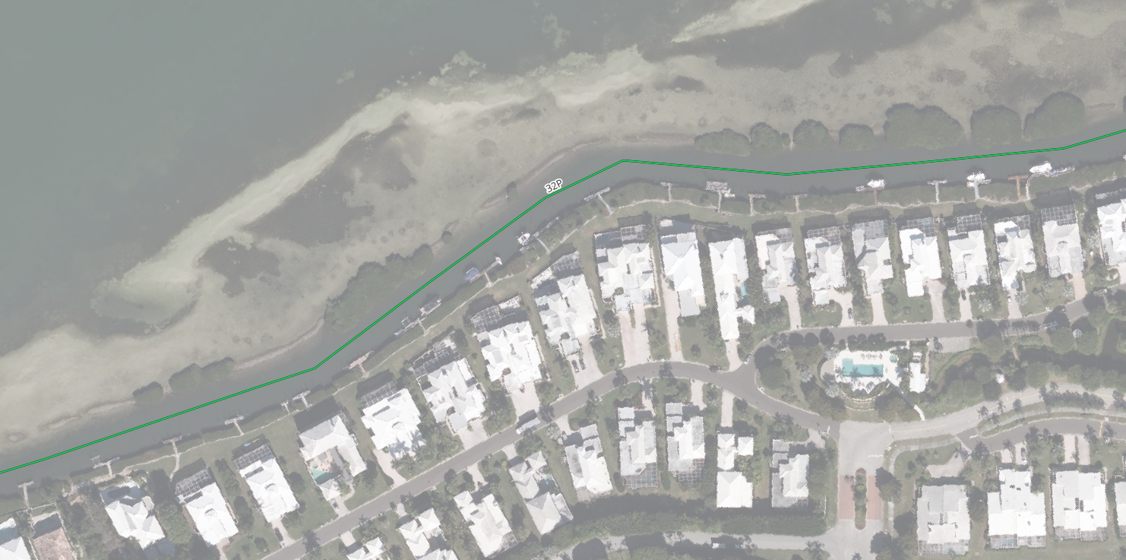
Canal and Funding Types – Shared Benefit
Canal 32P – Bay Isles perimeter canal

Slide 16
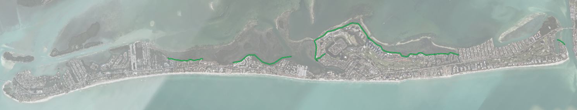
Canal and Funding Types – Shared Benefit
Mixed Use – Shared Benefit
Number of Waterways | 7
Volume to Dredge | 15,000 CY
Funding Strategy | Shared Assessment: Ad Valorem & Non
Funding Group | Ad Valorem – All Residents / Non Ad Valorem – Groups 1-6

Slide 17
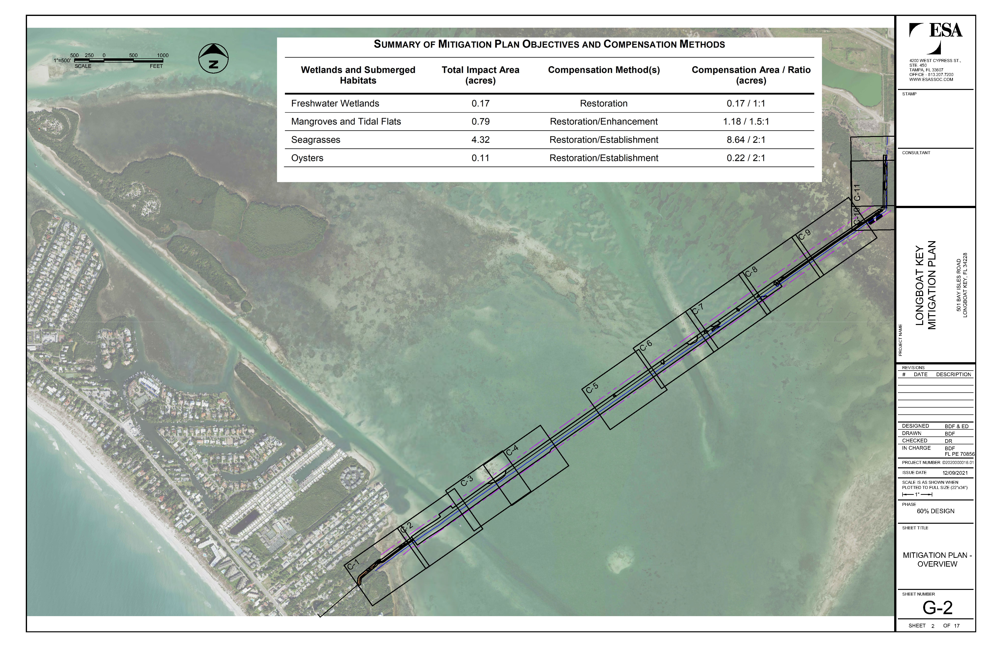
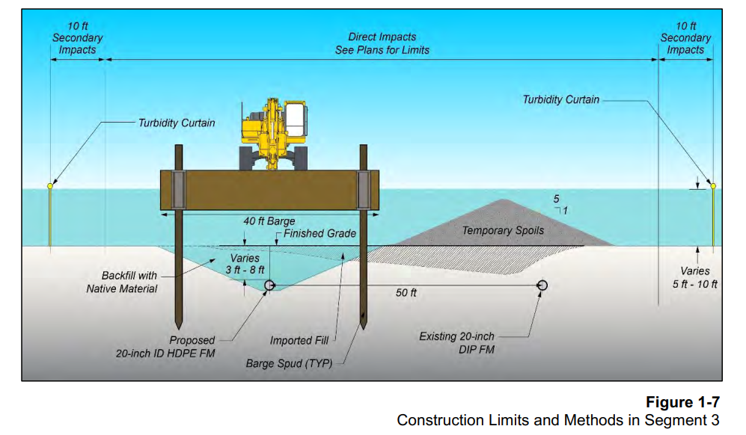
Subaqueous Pipeline Install
Theoretical Cost to Obtain Fill
Material Cost | $ 20 / CY
Trucking | $ 40 / CY
Barge & Place | $ 35 / CY
Total Unit Cost | $ 95 / CY
Ready for Fill: May – Aug 2025
Completion Target: Jan – Aug 2026
Imported fill

Slide 18
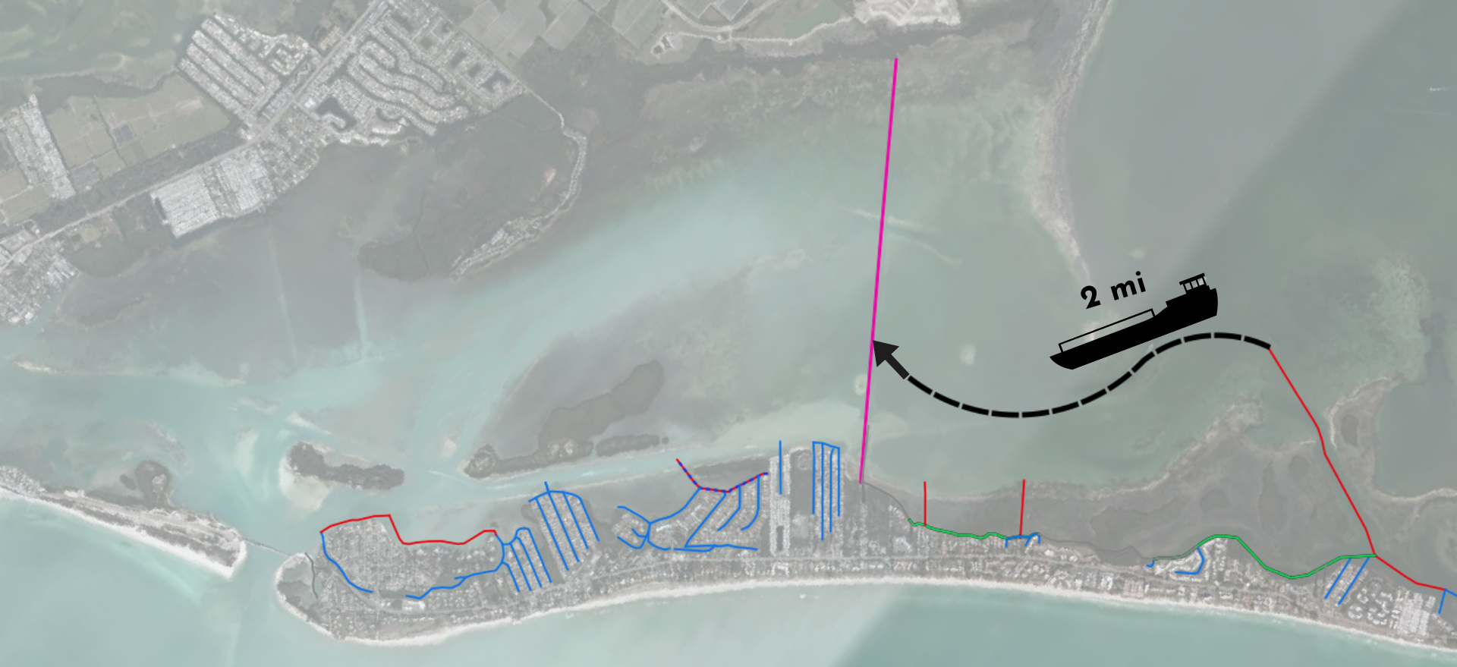
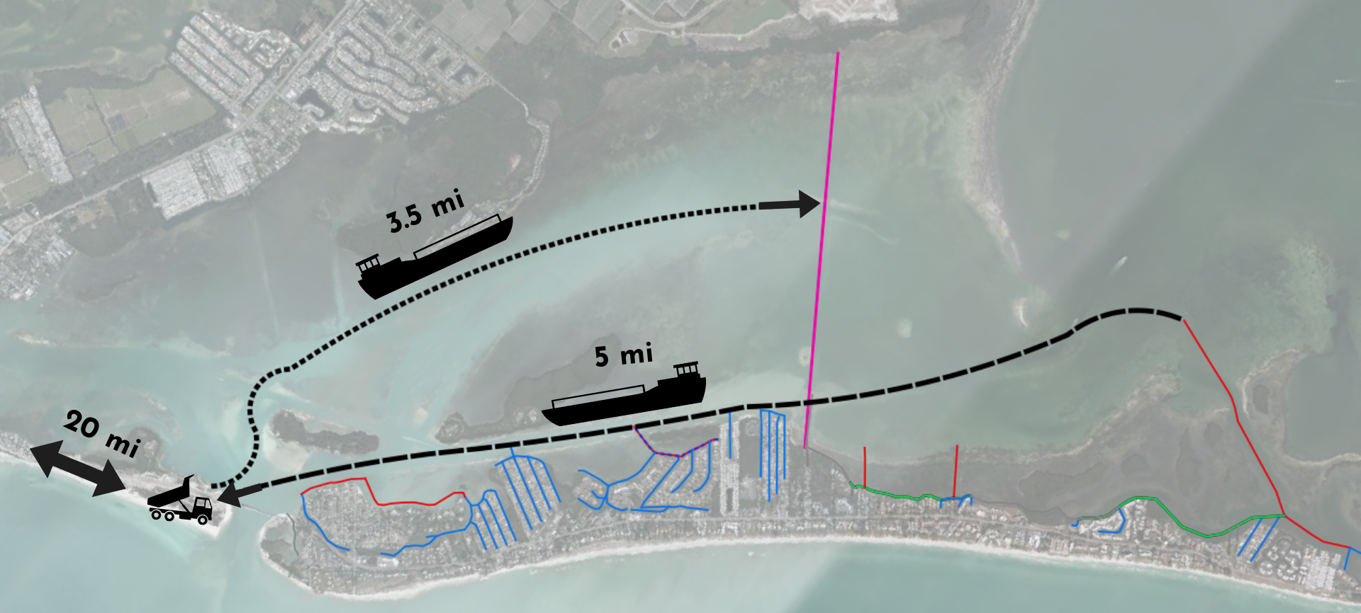
Canal BUDM
Estimated Available ~ TBD
  Potential for seagrass transplants
Subaqueous force
main mitigation site

Slide 19
Canal BUDM
Estimated volume available from canal program = TBD
Theoretical Cost to Obtain Fill
Material Cost | $ 20 / CY
Trucking | $ 40 / CY
BUDM Dredge & Place | $ 50 / CY
Total Unit Cost | $ 50 / CY
Example Dredging Costs
Dredge & Transport | $ 40 / CY
Trucking | $ 35 / CY
Misc. & Add. | $ 5 / CY
Total Unit Cost | $ 80 / CY
ROM Potential Savings
$ 450,000
per
10,000 cy
Waterway maintenance program
$ 800,000
per
10,000 cy
Force main project
+
=
=

Slide 20
Discussion break

Slide 21
Assessment Program Methodology

Slide 22
Apportionment Methodology
General Benefit
General Benefit Canals (Red) – Town wide Ad Valorem Millage
Costs Include:
  Dredging – mobilization, dredging and transport, truck hauling, etc.
  Mitigation Costs
  Annual Assessment Program Costs (legal, study and implementation)
Approximately 81.32% of Ad Valorem Funds for General Benefit and Mitigation Costs

Slide 23
Apportionment Methodology
Direct Benefit
Direct Benefit Canals (Blue) – Non-Ad Valorem Assessment for Water Abutting Properties
Parcels are equated using Equivalent Benefit Units (EBUs)
Water Access Unit (WAU) – Dock, slip, boat lift, or similar that offers mooring and water access for vessels
1 WAU = 1 EBU
Cost for Direct Benefit Canals Inside Group
Cost per EBU
# of EBUs Per Group

Slide 24
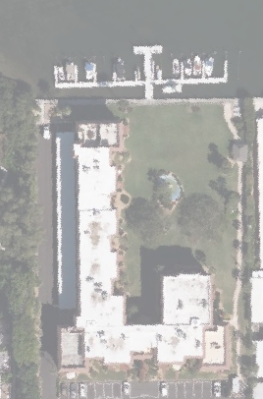
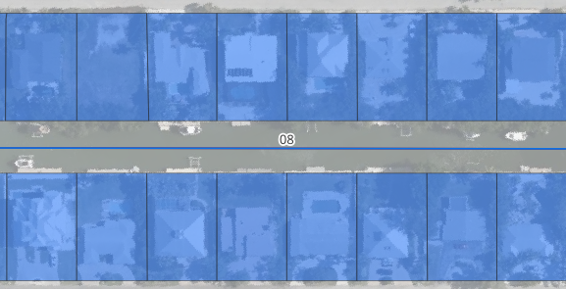
Apportionment Methodology
Direct Benefit
Condominium, COA and HOA facilities: Total # of WAUs divided by total # of condo’s/units with access to the facilities
Single Family Homes = 1 EBU
Property has 133 Units and 15 WAUs
Each resident would pay for 0.11 EBUs

Slide 25
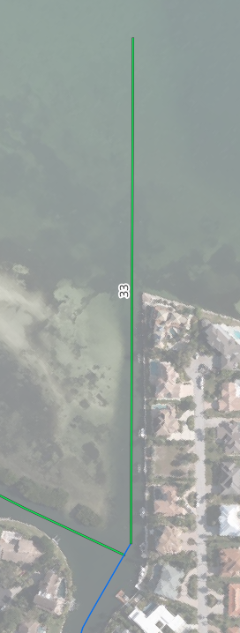
Apportionment Methodology
Shared Benefit
Shared Benefit Canal – (Green) Cost Breakdown Example
Cost to Dredge Canal 33 (approx) = $16,000
Cost paid through island wide
Ad Valorem Millage = $8,000
Cost paid by direct benefit parcels inside Group 4 direct Non-Ad Valorem Assessment = $8,000

Slide 26
Cost Breakdown by Funding Source
Note: Preliminary Costs subject to change. Costs reflect Pre-BUDM Potential Savings

Slide 27
Ad Valorem Millage Calculation
Note: Preliminary Costs subject to change. Costs reflect Pre-BUDM Potential Savings

Slide 28
Example – General & 50% Shared Benefits
Note: Preliminary Costs subject to change. Costs reflect Pre-BUDM Potential Savings

Slide 29
Example – Direct Benefit
Group 1
Note: Preliminary Costs subject to change. Costs reflect Pre-BUDM Potential Savings

Slide 30
Example – Benefit Groups
Note: Preliminary Costs subject to change. Costs reflect Pre-BUDM Potential Savings

Slide 31
Example – Annual Assessments
Note: Preliminary Costs subject to change. Costs reflect Pre-BUDM Potential Savings

Slide 32
Questions?

Slide 33
Extra Slides

Slide 34
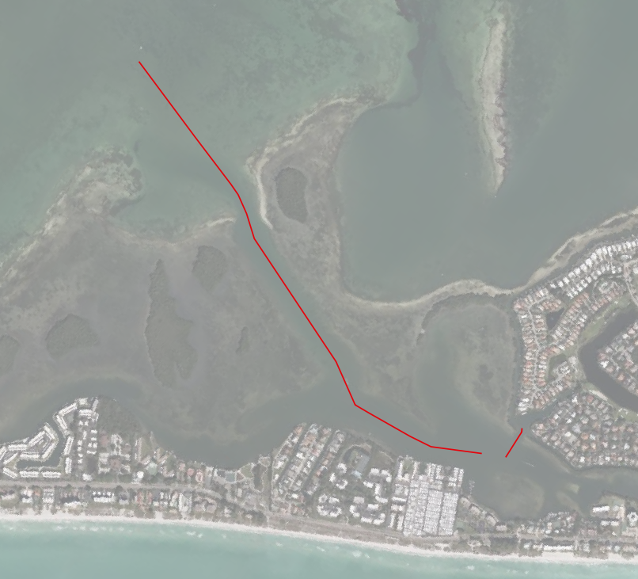
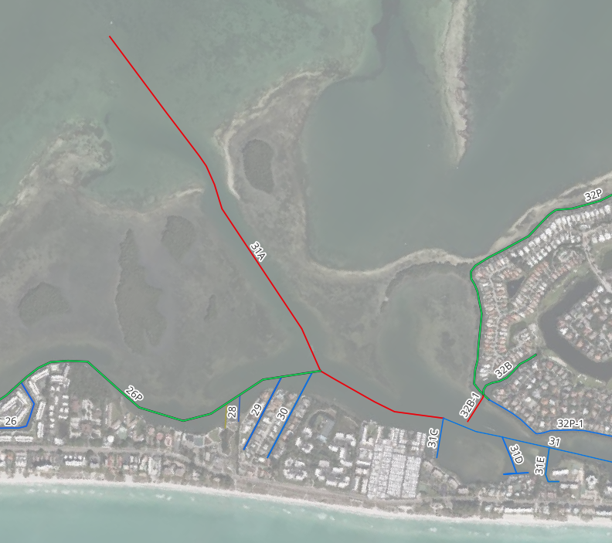
Canal and Funding Types – General Benefit
Canal 31A – Access to Buttonwood Harbor and other back waters

Slide 35
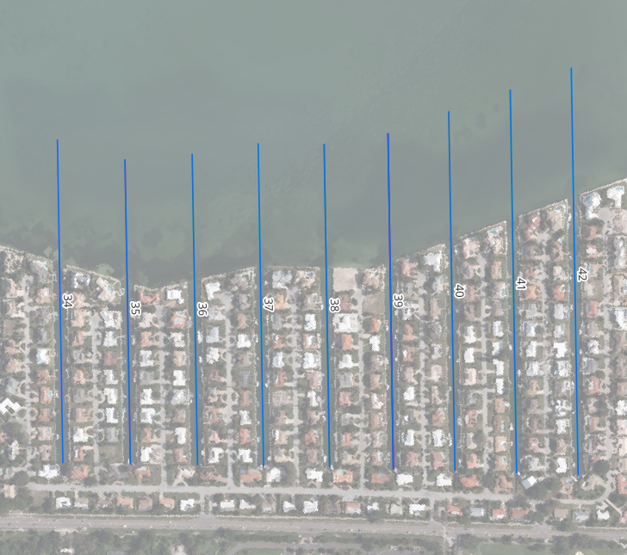
Canal and Funding Types – Direct Benefit
Country Clubs Shores Canals

Slide 36
Cost Breakdown by Location and Funding Source
Note: Preliminary Costs subject to change.

