Slide 1
Elected Official Training
May 1, 2026

Slide 2

Government in the Sunshine
Scott E. Rudacille, Esq.

Slide 3
Government in the Sunshine
Generally, the Government in the Sunshine Law (Section 286.011, Fla. Stat.) requires (1) that meetings of public boards be open to the public, (2) that the public is given reasonable notice of these meetings, and (3) that minutes are taken.
These requirements generally apply regardless of whether the board members are elected or appointed by the governing board.

Slide 4
Government in the Sunshine
When do communications between board members become Sunshine meetings?
The answer is that the Sunshine Law applies to “any gathering, whether formal or informal, involving two or more members of the same board, where a matter which will foreseeably come before the board for action is being discussed”.

Slide 5
Example:
You are a City Commissioner, and you run into a County Commissioner in the grocery store. The two of you start having a discussion about your families, golf, weather, etc.

Slide 6


Slide 7
Example:
You mention to the County Commissioner that the City Commission may vote to allow urban chickens, and you are in favor of it.

Slide 8
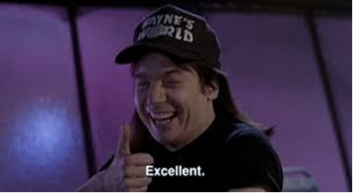

Slide 9
Example:
Then, another City Commissioner joins your conversation and starts talking about the County’s Comprehensive Plan revisions they are working on.

Slide 10


Slide 11
Example:
Then, you mention to the group that you think the City should also rewrite its Comprehensive Plan and propose to bring it up at the next City Commission meeting. The other City Commissioner says that she agrees and will support it.

Slide 12
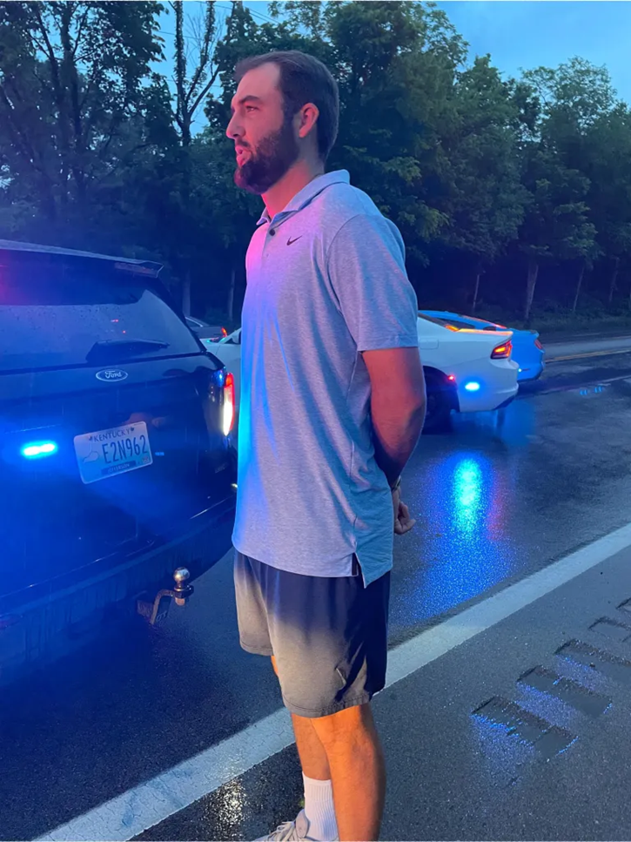

Slide 13
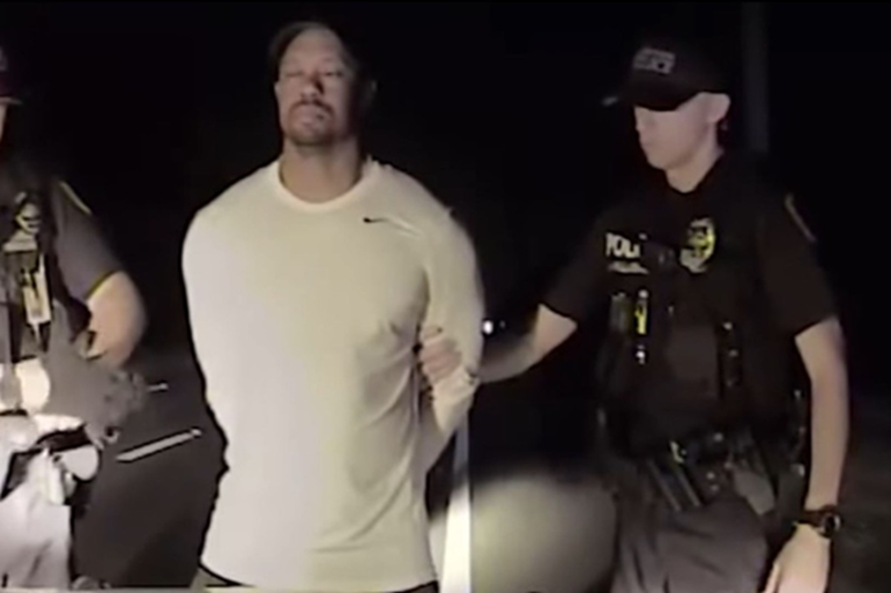

Slide 14
Government in the Sunshine
Committees and Advisory Boards
The Sunshine Law requirements apply not only to the public board, but also to most committees and advisory boards formed by the public board.
This means that committee and advisory board meetings must be noticed, and minutes must be taken.

Slide 15
Staff Meetings
The Sunshine requirements do not generally apply to staff meetings, unless there has been some delegation of decision-making authority to staff members, or the staff member is acting as a liaison between board members.
Development Review Committees
Purchasing Committees
Selection Committes

Slide 16
Email & Internet Activity
The Sunshine Law will also apply even though two board members (or committee members) are not physically present together, such as when they are communicating by telephone, e-mail, web chat, Facebook, text message, Twitter, etc.

Slide 17
Example:
You are a City Commissioner and you post on your Facebook page that the City’s budget is a mess, you are not going to vote for it, and you encourage the public to come out and voice their concerns.

Slide 18


Slide 19
Example:
One of your fellow Commissioners replies to your post and says “That’s because you’re a RINO and you want to defund the police!”

Slide 20
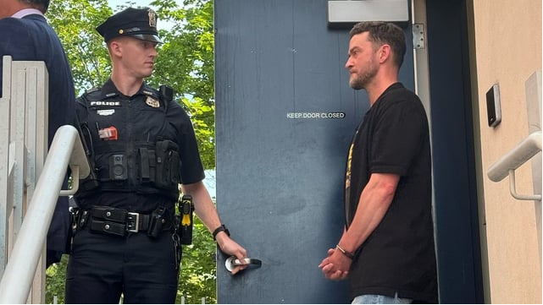

Slide 21
Conduits and Delegation of Authority
A Sunshine violation can occur even when two board members have no interaction whatsoever. This can generally happen under two circumstances.
The first situation is where an individual acts as a conduit to convey information between board members that they could not directly convey themselves.
The second situation is when an individual is delegated the decision-making authority of a public board.

Slide 22
Example:
The City Planner meets individually with all of the City Commissioners to discuss the background details of an upcoming land use project and answer questions.

Slide 23


Slide 24
Example:
The City Planner tells Commissioner A that she met with Commissioner B and C, and they are in support of the application, so if she supports it, it will be approved.

Slide 25
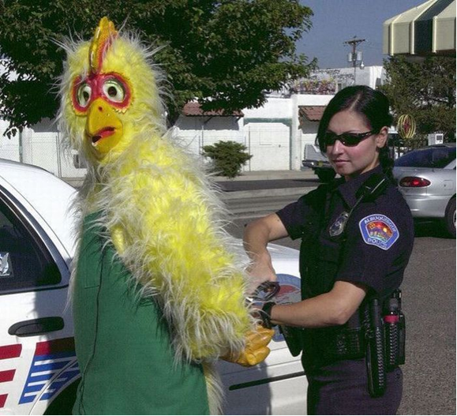

Slide 26
Open Meetings
What is required for an open meeting?
Public Place
Accessibility
Distance
Ability to hear discussions

Slide 27
Telephone & Virtual Meeting Participation
• Physical quorum present (not a Sunshine requirement)
• Statutory authorization or suspended during state of emergency (AGO 20-03)
• Extraordinary circumstances? (AGO 03-41)
• Maybe workshops? (AGO 01-66)

Slide 28
Notice
What kind of notice is required for the meeting?
The type of notice required varies depending on the circumstances, such as the gravity of the matter considered and the type of board involved.
The only requirement under the Sunshine Law is that the notice is “reasonable.”
Certain public bodies or agenda items may have additional notice requirements under the local code or Florida Statutes.

Slide 29
Minutes
What is required for the minutes?
Written minutes of a meeting must be made (this goes for committees and advisory boards too). But, that does not mean a verbatim transcript.
All that is required are brief notes or memoranda reflecting the events of the meeting.
Any person desiring to have a verbatim record of the meeting is responsible for hiring a court reporter, tape recording the meeting, etc.

Slide 30
Public Comment
Section 286.0114, Fla. Stat. requires that the public be given an opportunity to address the Board prior to official action on any “proposition”.
  During the decision-making process
  Reasonable proximity to the official action
  Exceptions
    Proclamations
    Minutes
    Emergency items
Notes:
City Policy and Procedure for Voluntary Advisory Boards and Committees indicates that all agendas must include a designated opportunity for public comment

Slide 31
Exceptions to the Sunshine Law:
Collective Bargaining (Section 447.605, Florida Statutes)
Competitive Solicitation (Section 286.0113, Florida Statutes)
Pending Litigation (Section 286.011(8), Florida Statutes)

Slide 32
Exception to the Sunshine Law: Attorney-Client Session
Pending litigation
Strict procedural requirements
Limited subject matter
Only Board, Chief Administrator and Attorney
Court reporter → transcript becomes public

Slide 33
Consequences of Sunshine Violations

Slide 34
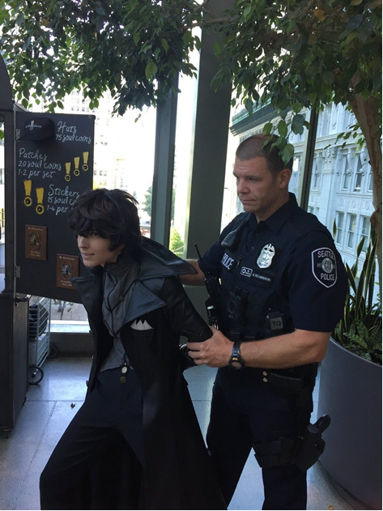

Slide 35


Slide 36
Consequences of Sunshine Violations
Criminal penalties
A knowing violation of the Sunshine Laws is a second degree misdemeanor, punishable by up to 60 days in jail and/or a $500 fine.

Slide 37
Consequences of Sunshine Violations
Removal from committee or advisory board

Slide 38
Consequences of Sunshine Violations
Attorneys’ fees
Reasonable attorneys’ fees will be assessed against a board which has been found to have violated the Sunshine Laws. Such fees may also be assessed against the individual board members, unless they were acting under the advice of the board’s legal counsel.

Slide 39
Consequences of Sunshine Violations
Validity of action taken
Any action taken in violation of the Sunshine Laws is generally void ab initio. Thus, any board action taken during meetings which violate the Sunshine Law may be of no effect and may have to be re-examined, re-discussed, and re-approved at an open meeting.

Slide 40
Cure
In some instances, Sunshine Law violations can be “cured” by subsequent examination of the issue by the governing body in a public meeting.

Slide 41
Questions?

