Slide 1
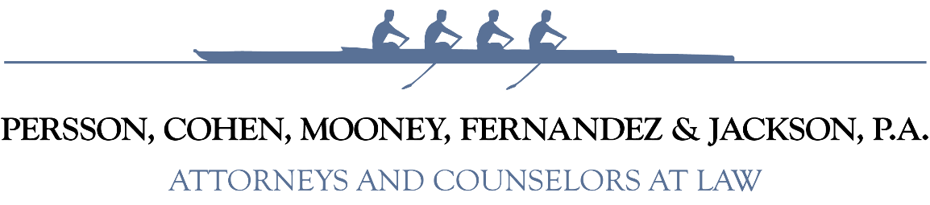

Florida’s Public Records Laws
Presentation for
Elected Officials Training
May 1, 2026
Maggie D. Mooney
Longboat Key Town Attorney

Slide 2
A Public Record is…
Any documents, papers, letters, maps, books, tapes, photographs, films, sound recordings, data processing software, or other material, regardless of the physical form, characteristics, or means of transmission, made or received pursuant to law or ordinance or in connection with the transaction of official business by an agency.
Art. I, s. 24, Fla. Const.; Ch. 119, Fla. Stat.

Slide 3
A Public Record is…
Any material
Prepared in connection with official agency business
Intended to perpetuate, communicate, or formalize knowledge.

Slide 4
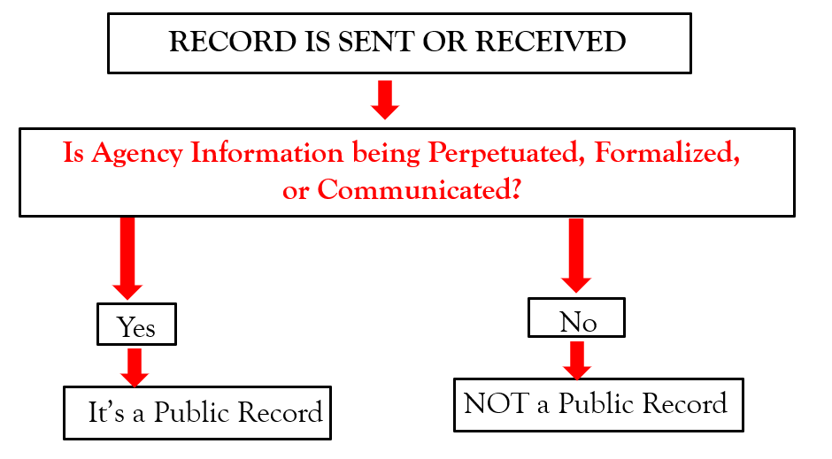

Slide 5


Potential Public Records
  Letters
  Handwritten Notes (sometimes)
  Drafts (sometimes)
  Emails (on any email account)
  Memorandums
  Text messages
  Other digital messaging apps
  (i.e., Snapchat, etc.)
  Cell phone statements
  Social media messages

Slide 6

Public Records are Determined By Content
The means of record transmittal is immaterial.
There is not an unfinished business exception.
Non-final records that are shared are a public record.
    Draft Meeting Minutes (even if not approved)
    Interoffice Memos
    Preliminary Studies/Analysis
    Draft Reports
    Legal Documents

Slide 7
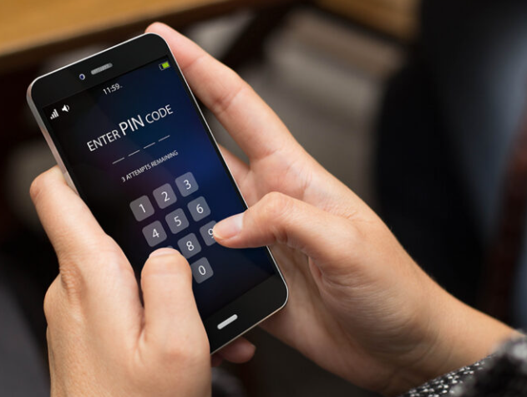
Device and Account Ownership is Immaterial
Personal ownership of device or payment for services does not alter the analysis.
Communications on private devices/accounts still creates public records when the record relates to public business.
If the device/account is inaccessible to the agency, then the individual is responsible for the records created.

Slide 8
Public Records Laws Apply to Expanding Mediums
A Board member posting comments relating to public business on a private website “would be responsible for ensuring that the information is maintained in accordance with the Public Records Law.” Op. Att’y Gen. Fla. 08-07 (2008)
A public employee’s private cell phone text use can create an electronic public record if the message is prepared, owned, used, or retained in the scope of agency employment. O’Boyle v. Town of Gulf Stream, 257 So.3d 1036, 1040-1041 (Fla. 4th DCA 2018)

Slide 9


Public Records Law Applies to Virtual Content!
National Collegiate Athletic Association v. Associated Press, 18 So. 3d 1201 (Fla. 1st DCA 2009)(NCAA was ordered to release records shared in an FSU academic cheating investigation that were viewed through a private, read-only system managed by the NCAA.)
Virtual transmittals for preliminary review and comment is a public record.
Implicates records shared via “Teams”, Zoom, or other virtual platforms. platforms.

Slide 10
Public Records Laws Apply To Social Media
Bear v. Escambia County Board of County Commissioners, 2022 WL 602266 (N.D. March 01, 2022) (court found that Commissioner’s privately maintained Facebook account that was used as a message board to constituents on county matters created public records obligations and liability on the individual).
Social Media messages on individual private accounts that relate to public business are a public record (Includes: Facebook, X, Instagram, Nextdoor, etc.)

Slide 11

What Is NOT A Public Record?
Personal records that do not relate to public business remain personal (even if on a government issued device).
Personal notes that are not shared.
Draft records that are not shared.
Transitory messages are generally not considered a public record (i.e., “Come have birthday cake in lunchroom…”).

Slide 12
Transitory Messages
“Transitory messages” are those messages that do not communicate information or they have short-term value.
Includes meeting and appointment reminders; most telephone messages (whether in paper, voice mail, or other electronic form); holiday parties or group lunches; event announcements; and news releases received by the agency.
Retention until obsolete, superseded, or administrative value is lost. (See, Division of Library Services Schedule).

Slide 13

Who Can Request Public Records?
“Every person has the right to inspect or copy any public record…” Art. I, Section 24, Florida Constitution

Slide 14

Why Do People Make Public Records Requests?
The Requestor legitimately needs the records (i.e., press for reporting purposes).
Conducting “audit” either personally or on behalf of some open government association/group.
Seeking Information to expose “corruption” or embarrass someone.
To set up the government and recover attorney’s fees.

Slide 15
Factors That Cannot Be Considered:
A requester’s motive for wanting the records.
Whether they are a resident.
How many times they make records requests.
Whether the requestor will fill out a form.
Whether or not the requester will identify him/herself.

Slide 16

Public Records Requests
Request for public records can be verbal!
Any withheld or redacted records must be based upon a statutory exemption that has to be cited in writing.
Can charge copying costs pursuant to Florida Statutes.
Can charge special service charges for “extensive” clerical, supervisory labor or IT services.
Can request advance deposits for allowable charges.

Slide 17
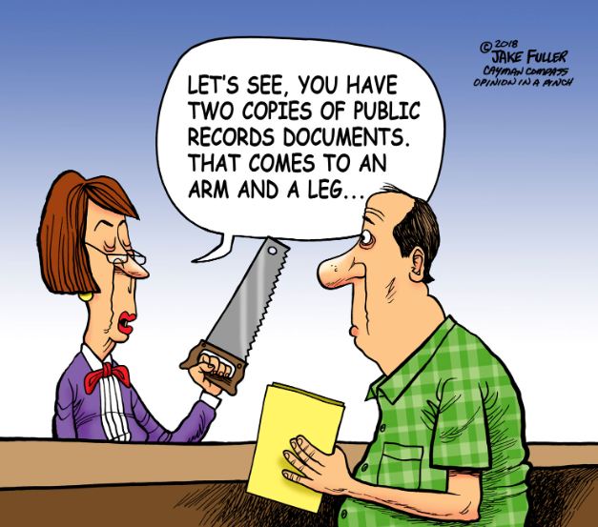

Slide 18
Information Requests ≠Public Records Request
Florida’s public records law requires an agency to provide access to existing public records.
The agency IS NOT required to answer questions about those records.
Agencies ARE NOT required to create new records to respond to public records requests.

Slide 19


Electronic Records
Government must provide a copy of a public record in the format requested (if the record is maintained in that format).
If not maintained in that format, government has the option of converting the record and charging a reasonable special service fee.
An agency is not required to provide public records in an electronic format other than the standard format routinely maintained.

Slide 20


Records That Are Public
Job applications.
Personnel files.
Salary and Travel Records.
Concluded investigation files.
Discipline records.
Telephone records and call logs.
Litigation files (once litigation is concluded).
Background check/criminal history information is generally a public record (unless a juvenile record).

Slide 21
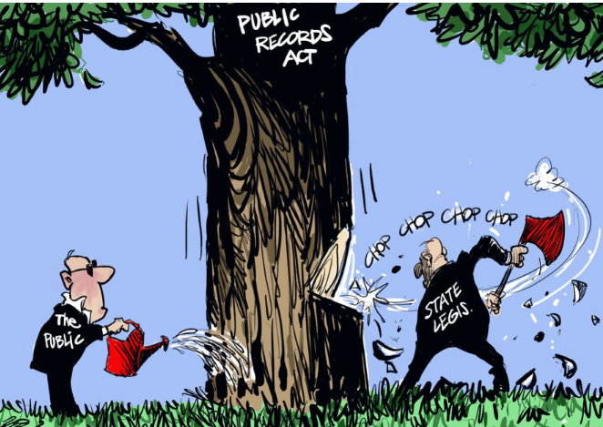
Public Record Exemptions

Slide 22

Public Record Exemptions
Legislature has established list of exemptions from public records throughout Florida Statutes.
To withhold all or a portion of a record (through redaction), an agency must have a statutory reference.
Must assert the statutory reference in writing.
Advisable to have the agency’s Records Custodian perform these functions.

Slide 23
Examples of Common Exemptions
Law enforcement, firefighters, correctional officers, judges, magistrates, code inspectors , city attorneys personal information.
Social Security numbers.
Security or firesafety system plans (including evacuation plans and audio/video security footage).
Emergency notification information.
Bank account numbers, and debit, charge, and credit card numbers.
Direct deposit information.
Drug Testing pursuant to the Drug-Free Workplace Act.
Patient medical records made by health care practitioners.
Active discrimination investigations/complaints.
Active litigation work product of attorney.
Blueprints and structural layouts of buildings

Slide 24

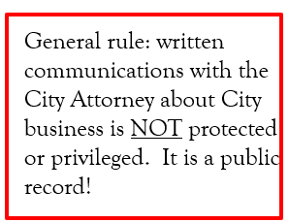
Are Communications with the City Attorney Exempt?

Slide 25

Communicating with the City’s Attorney
Do not expect privilege when communicating in writing with your agency’s Attorney(s)!
This includes emails, handwritten materials, documents, and text messages.
Limited exemptions for communications relating to active or imminent litigation or labor negotiations. Once litigation completed, the record is public!

Slide 26
Penalties for Violations of Public Records Law:
A knowing violation constitutes a: 1st degree misdemeanor (up to 1 year in jail), and/or $1,000 fine, and/or potential suspension, removal or impeachment from office.
Non-criminal infraction (committed without the requisite knowledge) is punishable by a not to exceed $500.00 fine
The above may be pursued by the State Attorney’s Office.
Also, there is a civil action provided by statute that allows for the recovery of attorney’s fees and costs for violations of this law.

Slide 27

Public Officials & Indemnification
Public officials have a right to be defended when acting in the course and scope of their duties.
Right to indemnification based upon:
  Common law.
  Florida Statutes § 111.07.
  Municipal Code?
Right extends to public records lawsuits.

Slide 28
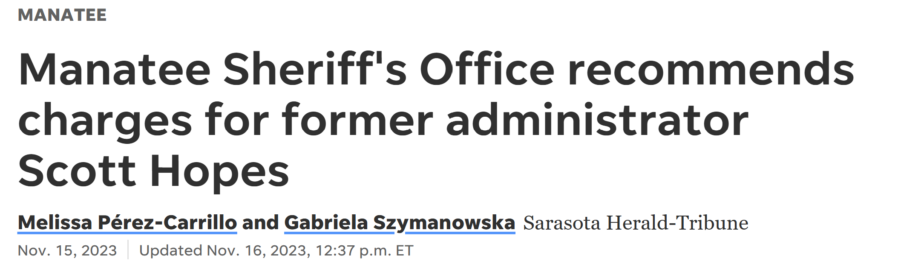
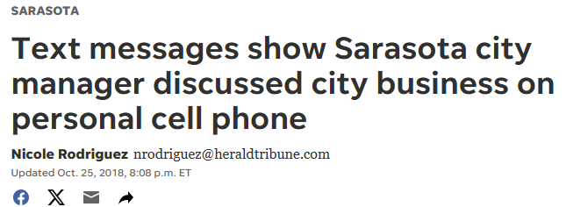
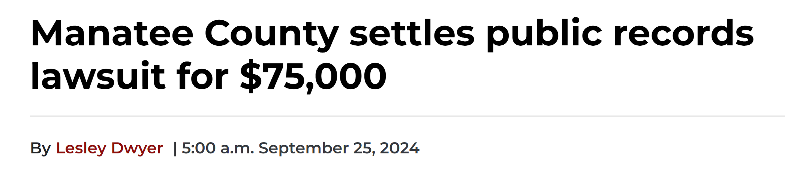
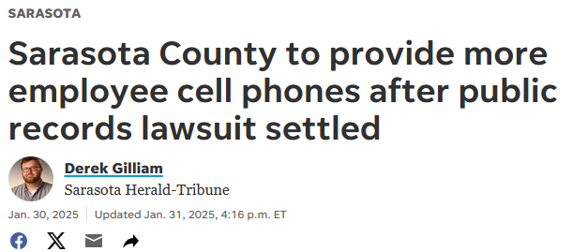
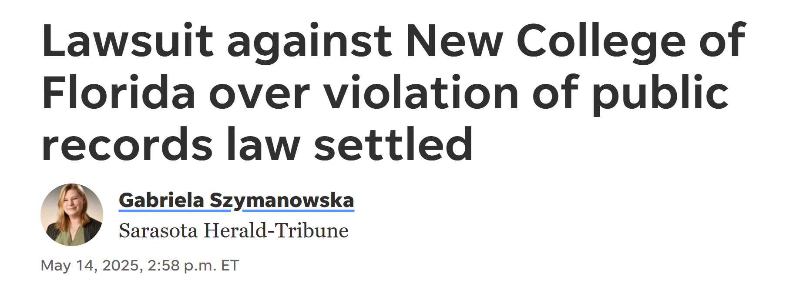
Local Headlines
Source: Observer
Source: 9/25/24; Manatee County settles public records lawsuit for $75,000 | Your Observer

Slide 29

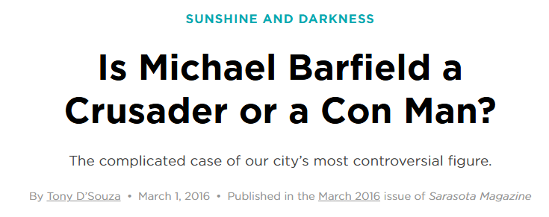
Source: Is Michael Barfield a Crusader or a Con Man? | Sarasota Magazine

Slide 30
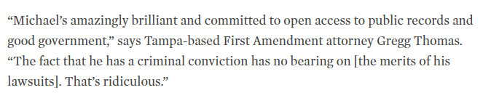


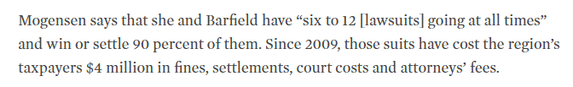

Slide 31
City of Venice (2018)
Denovo Law Services (associated with Michael Barfield) sued the City of Venice alleging the Public Records Act violations due to failure to retain text messages related to City business on public and personal devices.
City believed messaging function was “off” on City-issued devices.
Third-party vendor retrieved all text messages relating to City business on City phones AND private phones.
Case settled for ~$45,000, implementation of retention software for text messaging on City-issued phones, a policy prohibiting the conduct of public business on personal devices..

Slide 32
City of Sarasota (2018)
Michael Barfield City Manager Tom Barwin for failing to produce city-related discussions from his private Gmail account.
Hundreds of emails were later released from his personal email.
Case settled for $30,000 with no admission of guilt.
Barwin also agreed to:
  not respond to emails from his personal Gmail account;
  forward any emails received to the City server for preservation;
  set up an automatic response on his personal account directing senders to send City business to his City email account.

Slide 33
Manatee County (2020-21)
Michael Barfield sued three Manatee County Commissioners in December 2020 over a failure to timely respond to a public records request.
Subsequent FDLE investigation found text message and phone communication between Commissioners, but none of those records confirmed anyone broke the law.
County paid over $100,000 for settlement, private attorney fees, and court costs.

Slide 34
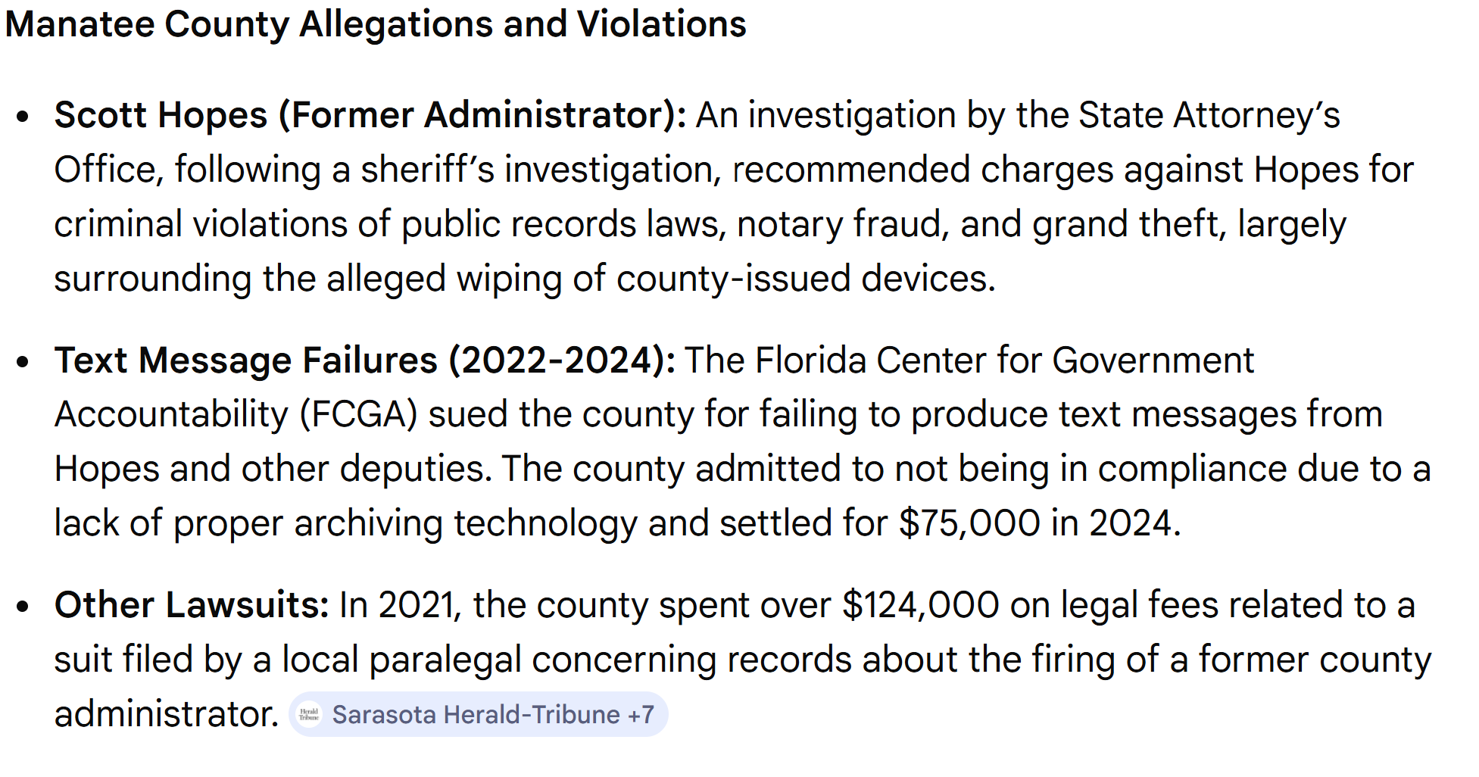

Slide 35
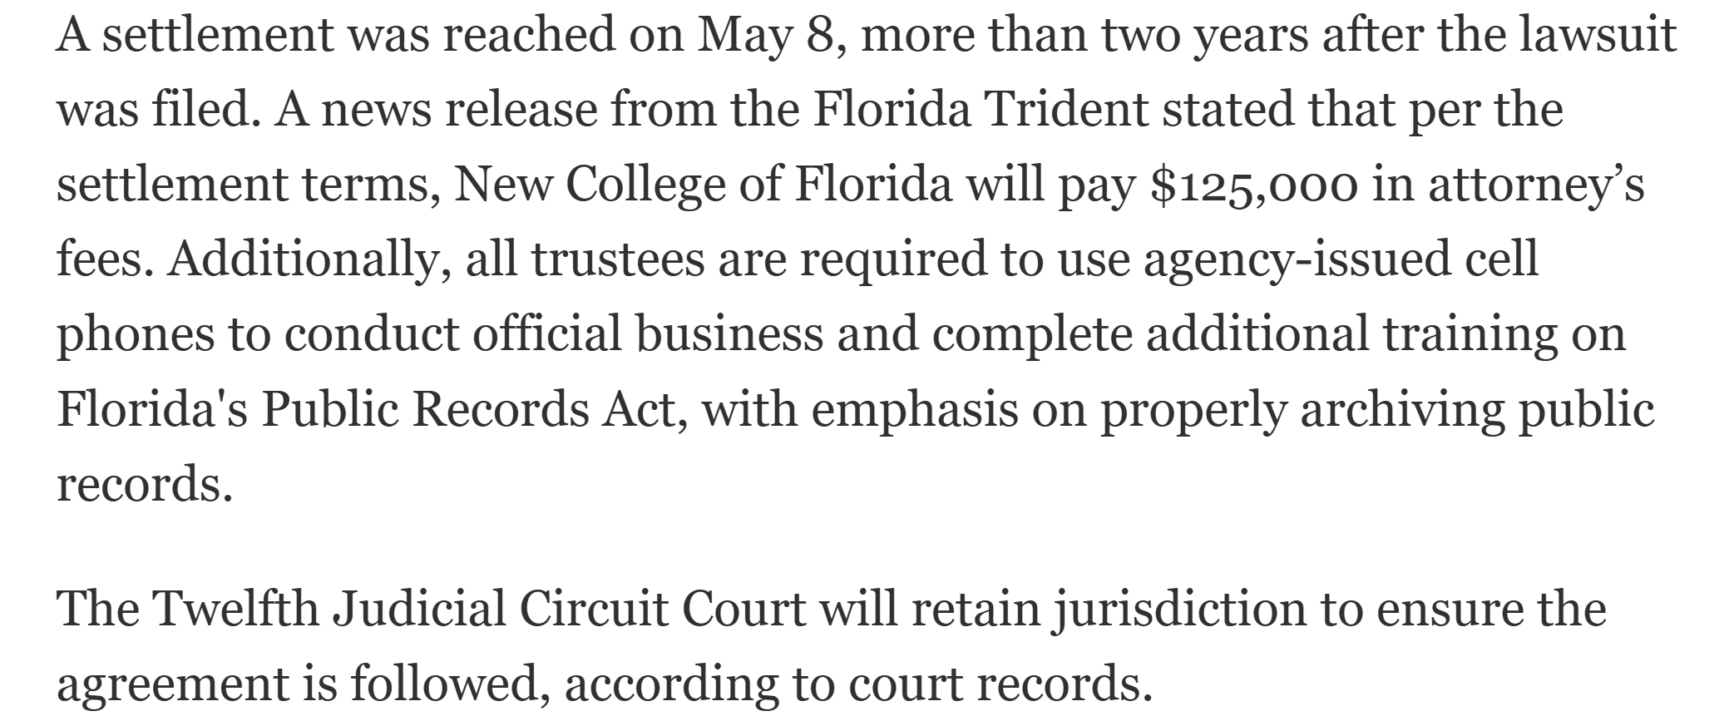

Slide 36

Making Bank!

Slide 37
Public Records Law: Best Practices
If your government has a public records policy, you need to follow it …. All the time!
Avoid become a Records Custodian; let the government’s Clerk perform this function on your behalf.
Minimize your exposure by using government issued devices and accounts to transact all government business. (ie, emails, cell phones, etc.)
Develop a practice to capture all records relating to government business that come to your personal accounts.

Slide 38
Public Records Law: Best Practices
Do not use social media for government business unless you (or your government) have a way to capture all records associated with the social media account!
Keep personal notes and drafts to yourself.
Know your government’s indemnification policy and how to avail yourself of it.
Do not ignore records requests… including verbal ones!
If you have questions, ask your Clerk or attorney .
Follow the advice of your local government attorney .

Slide 39

QUESTIONS?
Maggie D. Mooney townattorney@longboatkey.org mmooney@flgovlaw.com
(941)306-4730
Persson, Cohen, Mooney, Fernandez & Jackson, P.A.
Offices Located in:
Lakewood Ranch & Venice www.flgovlaw.com

