Slide 1
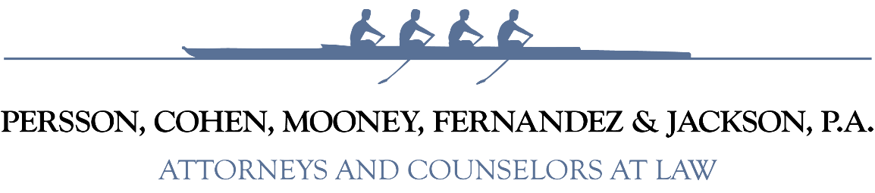
Quasi-Judicial Hearings
Presented by:
Kelly M. Fernandez, Esq.
May 1, 2026
Elected Official Training

Slide 2
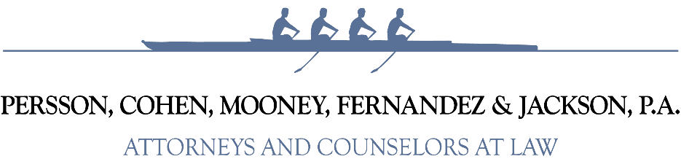
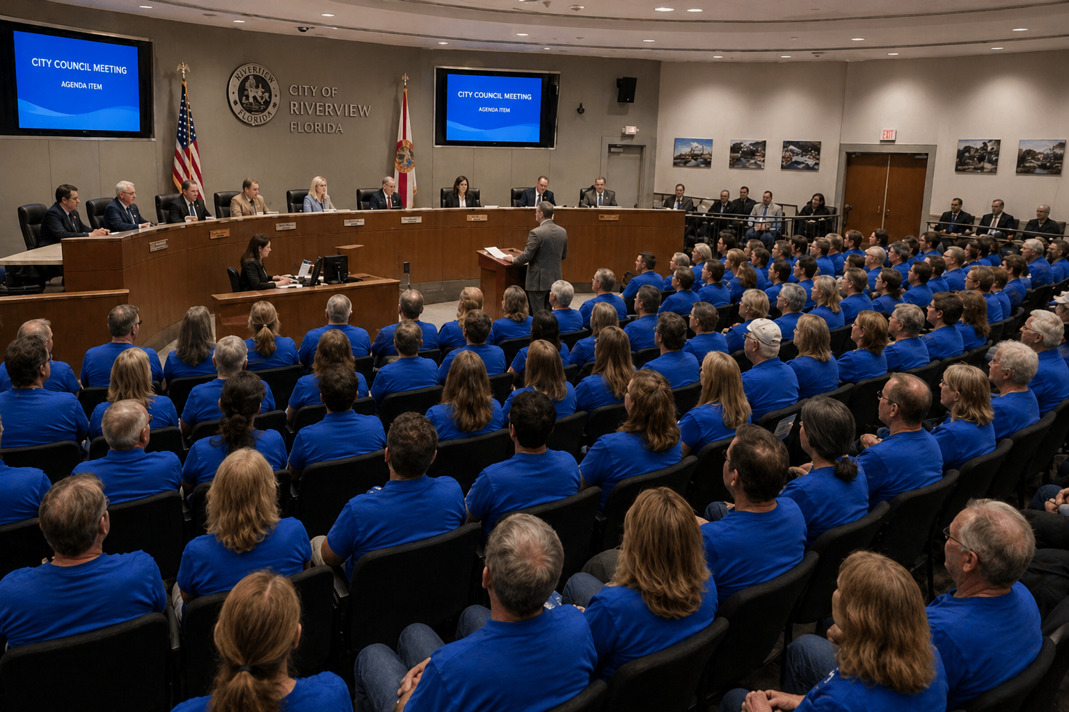
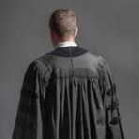
2 Types of Municipal Decision Making
Legislative
VS
Quasi-Judicial

Slide 3

Legislative Decision Making
Involves the adoption of laws or policies that will be applied city-wide.
Examples: Comprehensive Plan amendments and land development regulations.
Burden of proof is on the challenger to show the decision is arbitrary and capricious.
Courts apply a deferential ‘fairly debatable’ standard.
Judicial review is de novo.

Slide 4

Quasi-Judicial Decision Making
Involves the application of existing laws/policies to a particular property or person.
Requires additional procedural due process.
Decisions reviewed by a writ of certiorari evaluating the record before the deciding body.
Hearings are “akin to informal trials” because it imposes obligations on the QJ Board.

Slide 5
Voting Requirements
Section 286.012, F.S. requires members of municipal boards who are present at meetings vote unless there is a conflict of interest or a possible conflict (under Florida’s Ethics Laws).
However, in quasi-judicial proceedings, a member may abstain if the abstention is to assure a fair proceeding free from potential bias or prejudice.

Slide 6


Slide 7

Types of Quasi-Judicial Matters
Site plan approvals
Site-specific rezoning of land
Special exceptions
Variances
Preliminary plat approvals
Appeals from an administrative staff determination

Slide 8
3 Quasi-Judicial Hearing Standards
Has Due Process Been Afforded to the Parties?
Was the Decision Based Upon Competent Substantial Evidence?
Have the Essential Requirements of Law Been Followed?
A violation of any 1 of the 3 elements will result in a reviewing Court remanding the matter back to the Board.

Slide 9
Due Process = Fairness
Notice.
Right to know all factors that contribute to the decision making (i.e., ex parte communications, site visits).
Meaningful right to be heard.
Right to present evidence.
Right to cross-examine witnesses.
Right to consistent treatment.
Right to have established procedures followed.

Slide 10
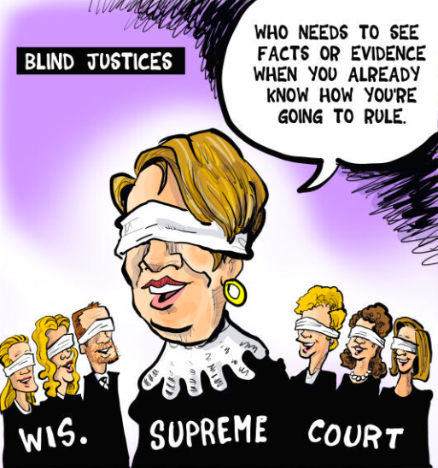

Slide 11
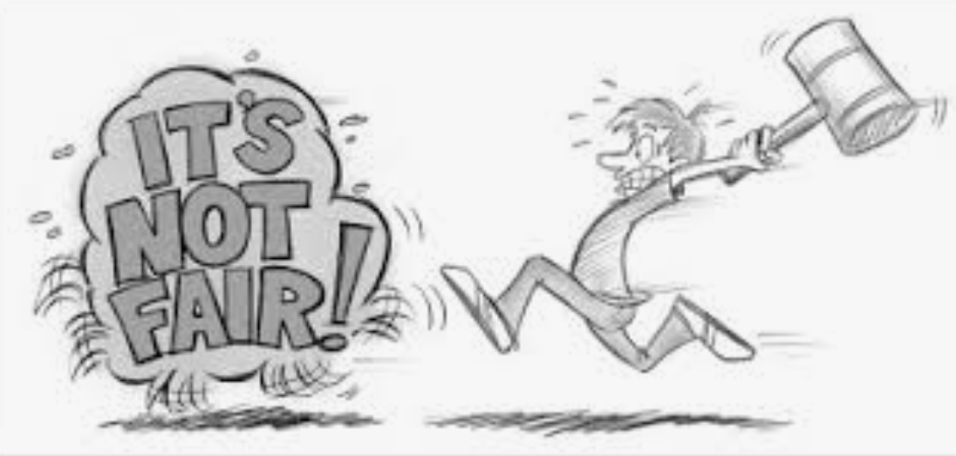
Due Process Means Fairness For ALL
Has the hearing process been fair and reasonable to all parties involved?
Was everyone who wanted to be heard afforded an opportunity to be heard/participate?
If there is an error, is it material and/or can it be corrected?

Slide 12
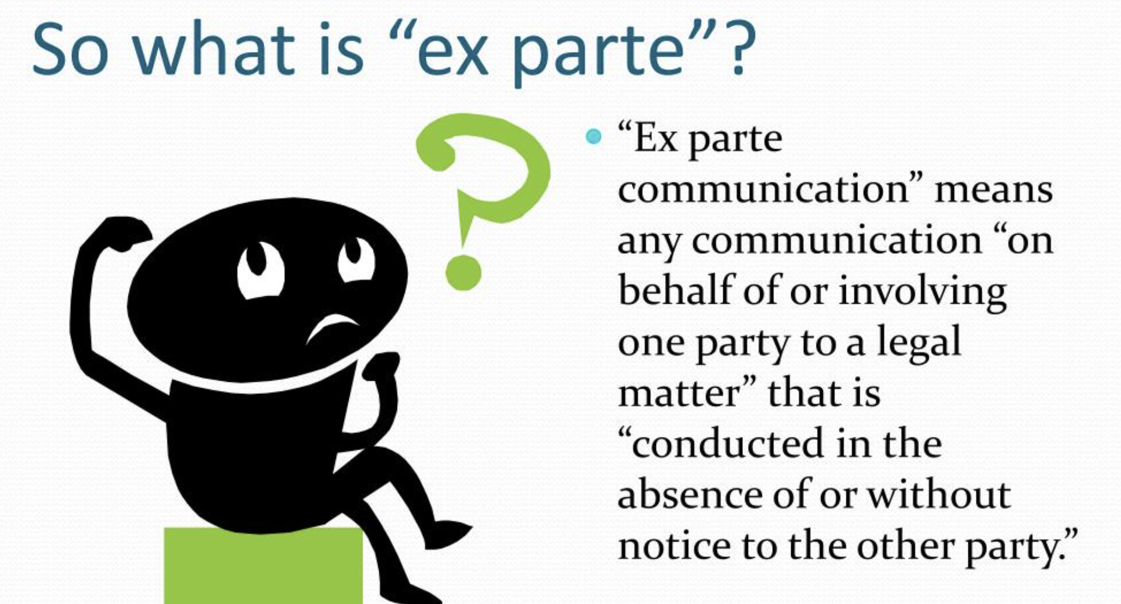

Slide 13
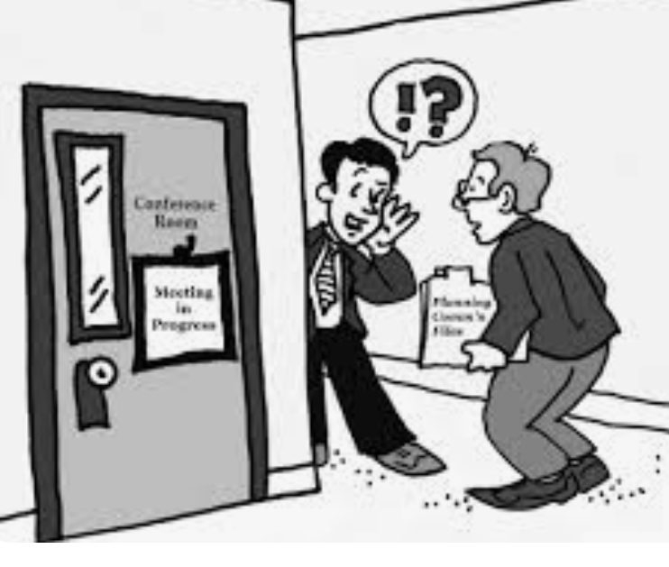
Ex Parte Examples
Site Visits
Conversation with Spouses, Friends, Neighbors, Strangers
Information gathered on Social Media Feeds (Facebook, Nextdoor, etc.)
Research Board Members do “On Their Own”

Slide 14
Ex Parte Communications/Experiences
Caselaw presumes these are prejudicial as those with a contrary position must have the opportunity to respond/refute the communication/experience.
Fla. Stat. § 286.0115 modifies the presumption and allows cities to adopt an ordinance/resolution removing the presumption if communication and/or experience is disclosed and made part of the record.
Disclosure of a verbal communication must include the subject and identity of the person, group, or entity

Slide 15
Best Practices
Don’t communicate about quasi-judicial matters, then there is nothing to disclose!
Halt any incidental communications with an invite for the person to participate in the hearing or to submit written comments.
Disclose any and all ex parte communications at the beginning of each hearing, no matter how minor.
Provide all emails/texts/social media posts/letters received to the Clerk for inclusion in the record.

Slide 16
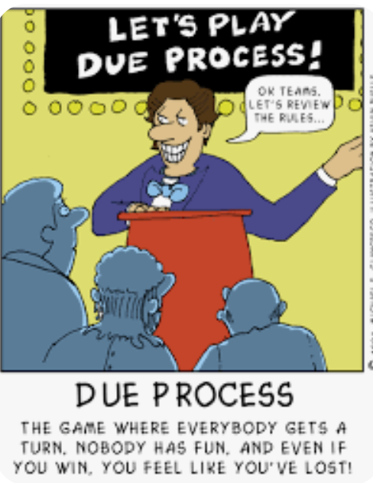
Consequences of Due Process Violations
If a due process violation is found by court, the case will be remanded back o the approving board for another public hearing.

Slide 17

Due Process is the Low Hanging Fruit
Due Process challenges are the easiest to raise on appeal.
How participants are treated, the time they are allocated, and how fair you are to the parties - are all under the Board’s control.
Best Practice: Have CLEARLY defined hearing procedures in your Code

Slide 18
Competent Substantial Evidence
“We have used the term ‘competent substantial evidence’ advisedly. Substantial evidence has been described as such evidence as will establish a substantial basis of fact from which the fact at issue can be reasonably inferred. We have stated it to be such relevant evidence as a reasonable mind would accept as adequate to support a conclusion.”
DeGroot v. Sheffield, 95 So.2d 912, 916 (Fla. 1957)

Slide 19

Initial Burden of Proof
The Applicant carries the initial burden of proof.
Applicant must show through competent substantial that it complies with the land use requirements of the jurisdiction. Bd. Of County Comm’rs of Brevard Co. v. Snyder, 627 So. 2d 469, 476 (Fla. 1993).

Slide 20

Burden of Proof Shift
Once the Applicant’s burden is met, the burden shifts to the Opponent(s).
Opponents must then show through competent substantial evidence that there is a legitimate public purpose to deny the request. Id.; see also, City of Hialeah Gardens v. Miami Dade Charter Foundation Inc., 857 So. 2d 202 (Fla. 3d DCA 2003)

Slide 21
Competency of Evidence
Evidence that is relevant, material, and reasonable.
Witnesses must generally be sworn in.
Formal rules of evidence are relaxed.
Witnesses are subject to cross-examination.
Hearsay testimony is admissible, but insufficient on its own to support a decision.

Slide 22
Competent Substantial Evidence
3 General Categories of Testimony:
Comments and opinions of professional staff
Expert testimony
Fact-based testimony of neighbors and lay people

Slide 23
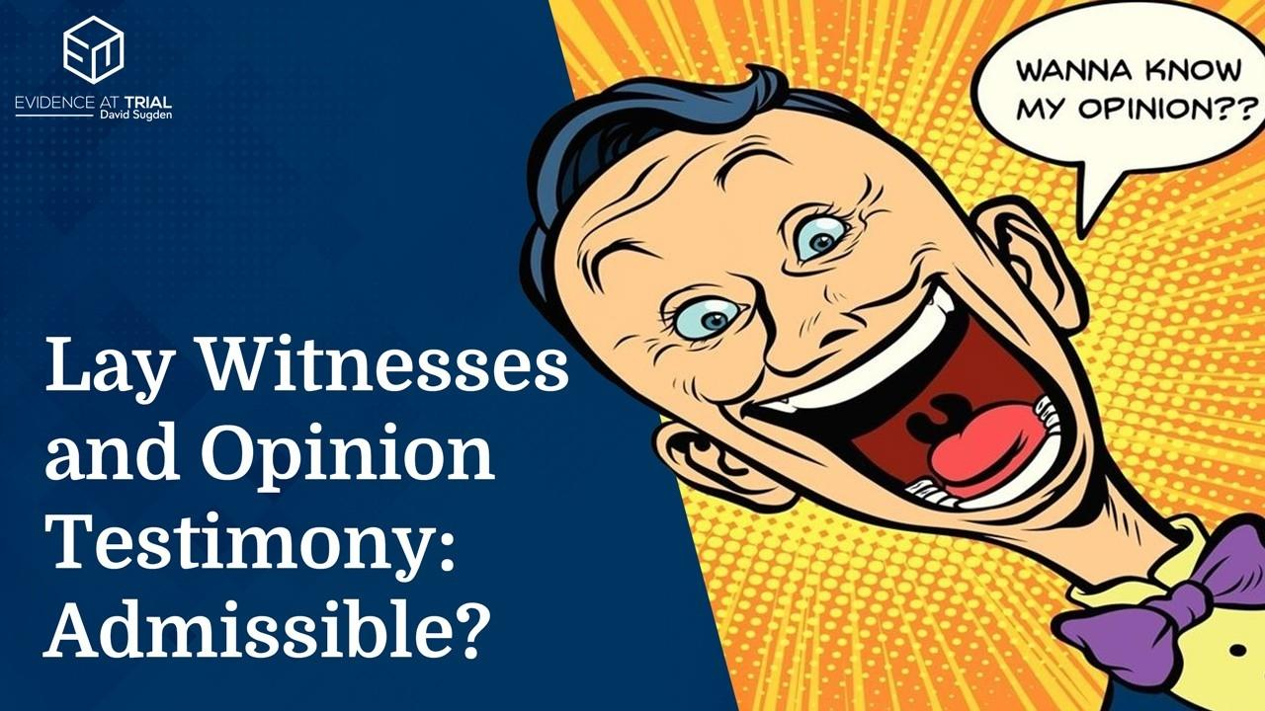
Not Competent Substantial Evidence
Lay person testimony on technical matters.
Statements of public support or opposition without facts (i.e., NIMBY)
Signature petitions
Not a Popularity Contest!

Slide 24
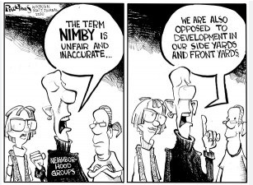
BANANA =
Build Absolutely Nothing Anywhere Near Anything!
LULU =
Locally Unwanted Land Use
CAVE People =
Citizens Against Virtually Everything
NIMTOO = Not In My Term Of Office

Slide 25
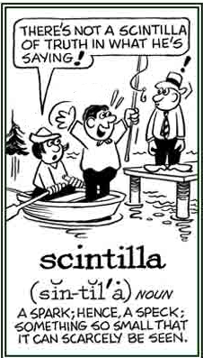
Competent Substantial Evidence
The Quasi-Judicial Board gets to weigh and evaluate relevant evidence.
If there is competing evidence, the Board gets to decide which evidence it believes more probative.
Reviewing Courts are not permitted to second guess the Quasi-Judicial Board’s decision.
Just need a scintilla of evidence!

Slide 26

What About Other “Outside” Evidence ?
Officials should not conduct their own investigations to introduce as evidence …

Slide 27
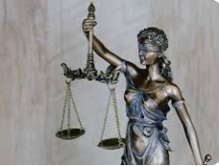
Elected Official Role
If you have particular knowledge on a subject matter at issue, ask questions of witnesses on the subject.
If the witnesses do not have answers, request that the answers be provided at a future (continued) hearing.
Do not testify as to your knowledge, your research, and your findings!

Slide 28

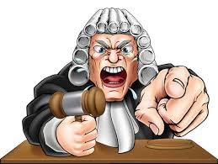
Know Your Role on a Quasi-Judicial Board
You can be a Witness or a Judge, but you CANNOT be BOTH!

Slide 29
Essential Requirements of Law
Apply the correct law and/or Code.
Correctly interpret the law and/or Code.
Meet all applicable constitutional requirements.

Slide 30
Essential Requirements of Law
Must be more than legal error, the departure must result in a miscarriage of justice. Malloy v. Gunster, et. al., 850 So. 2d 578 (Fla. 2d DCA 2003).

Slide 31

Rendition of the Order
Denials must be memorialized in a written Order of denial.
Order must include citations to the applicable portions of an ordinance, rule, statute, or other legal authority that have not been met.
Order serves as the basis for challenges by Writ of Certiorari.
Continue to refrain from ex-parte communications until all challenge periods expire.

Slide 32
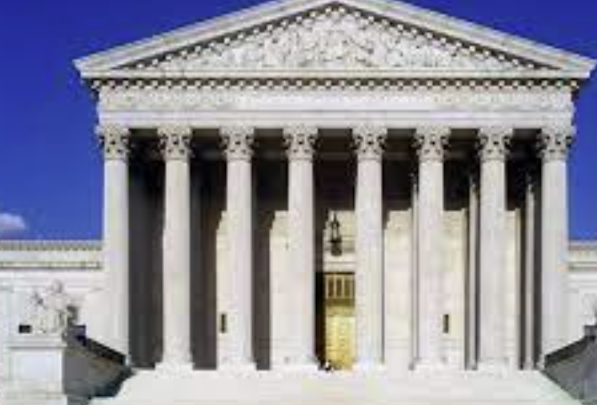
Judicial Review of Quasi-Judicial Decisions
A Writ of Certiorari is a request for a review of a lower court ruling.
Known as First Tier Review.
The Writ must be filed within 30 days of the rendition of the written Order.
The Court’s review is based on the hearing record and briefs by the parties.
There is no discovery; frequently, there is no oral argument.

Slide 33
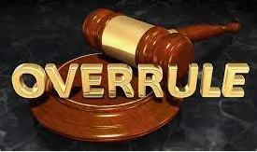
Writ of Certiorari
Issues must be raised in the hearing to be preserved for the reviewing court; therefore, objections during the hearing may occur.
The party seeking to challenge must preserve the record (including exhibits) and generate a verbatim transcript.
No one expects quasi-judicial boards to have law degrees or know the Rules of Civil Procedure.

Slide 34
Best Practices
Set clear procedural and time requirements and observe them.
Ensure that the hearing record is complete.
Ensure the 3 quasi-judicial hearing standards have been observed.
Remember Civility, Order and Decorum are the standard! Don’t let chaos take control.

Slide 35


Slide 36
For more information, please contact: Kelly Fernandez kfernandez@flgovlaw.com (941) 306-4730 Persson, Cohen, Mooney, Fernandez & Jackson P.A. Offices Located in: Lakewood Ranch & Venice www.flgovlaw.com

