Slide 1
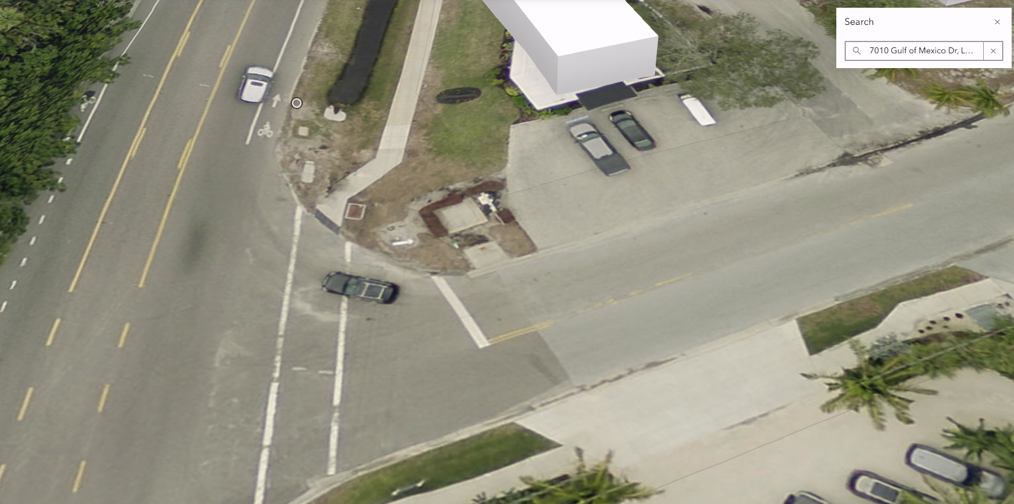
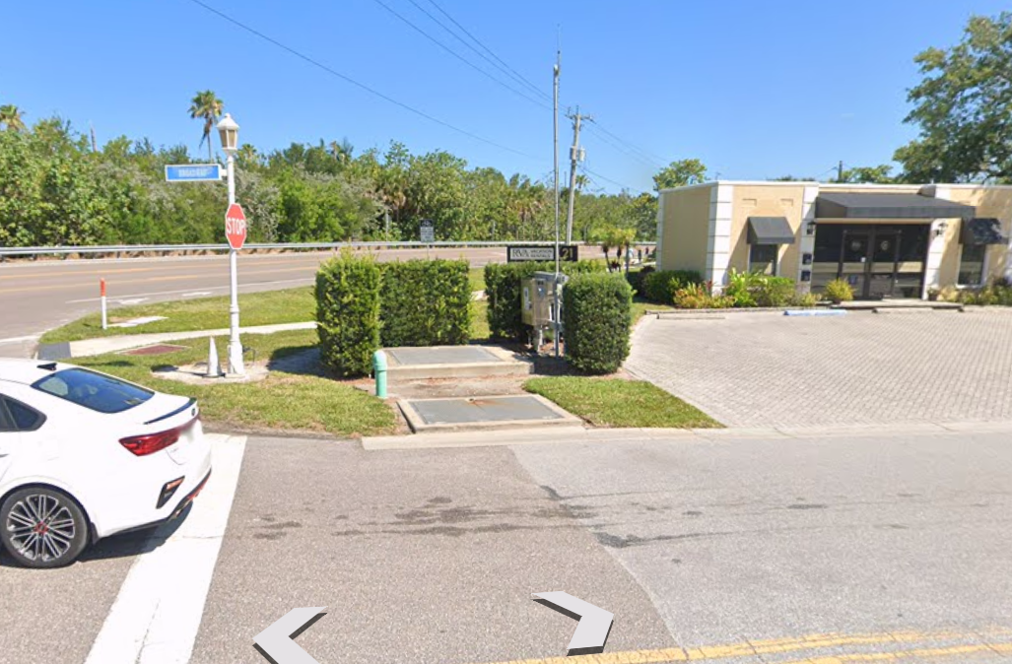
Lift Station A
7010 Gulf of Mexico Drive
27.435524, -82.685498

Slide 2
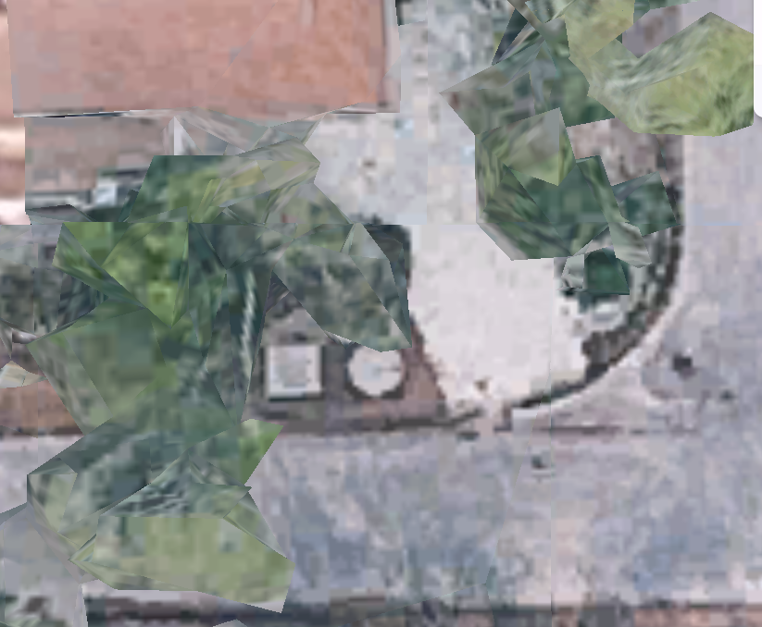
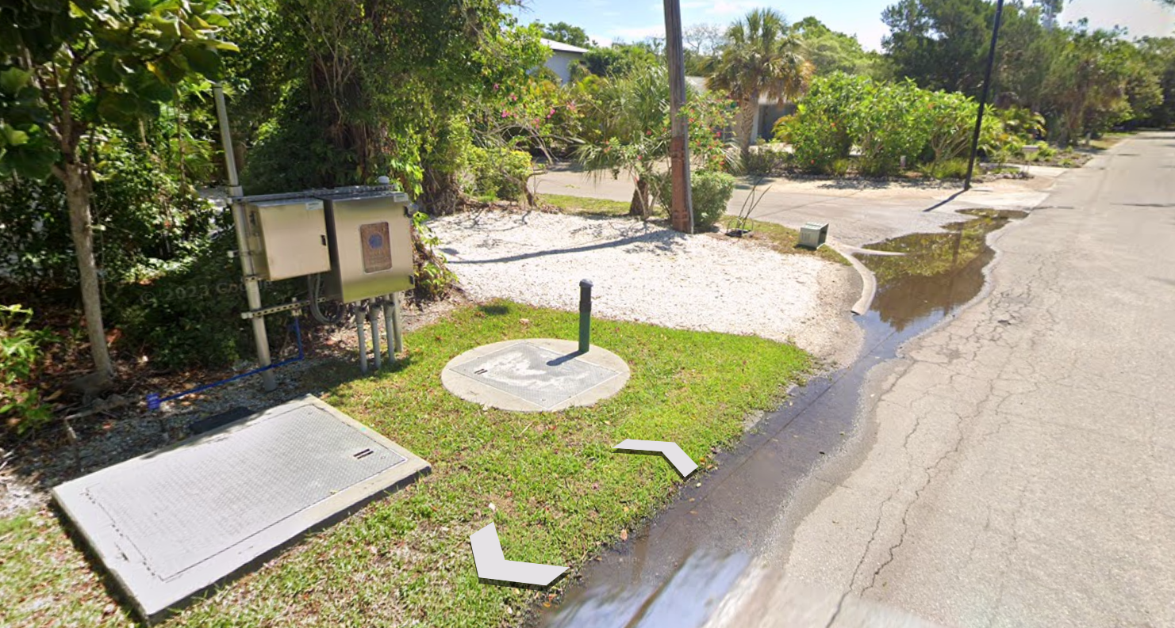
Lift Station 2A
605 Jackson Way
27.433507, -82.681112

Slide 3
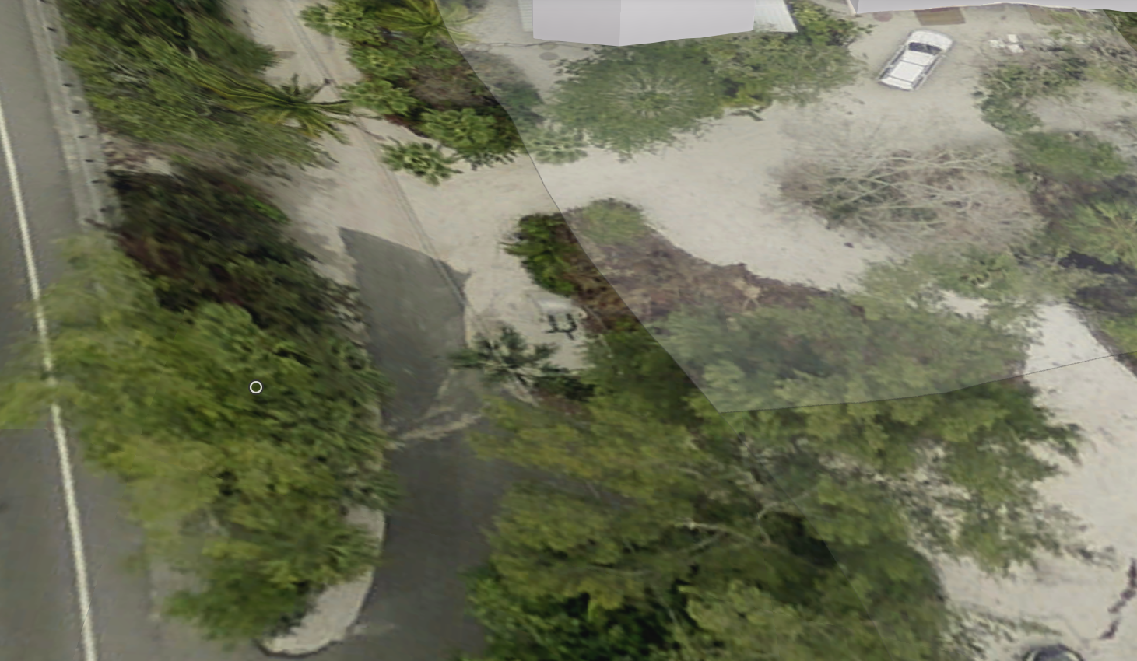
Lift Station 3A
7310 Gulf of Mexico Drive
27.439612, -82.685834
No Street View Available

Slide 4
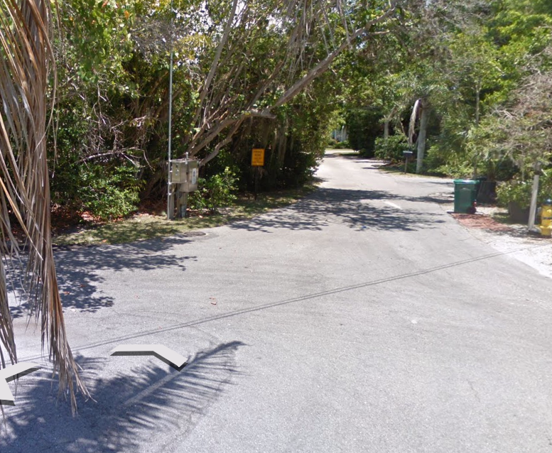
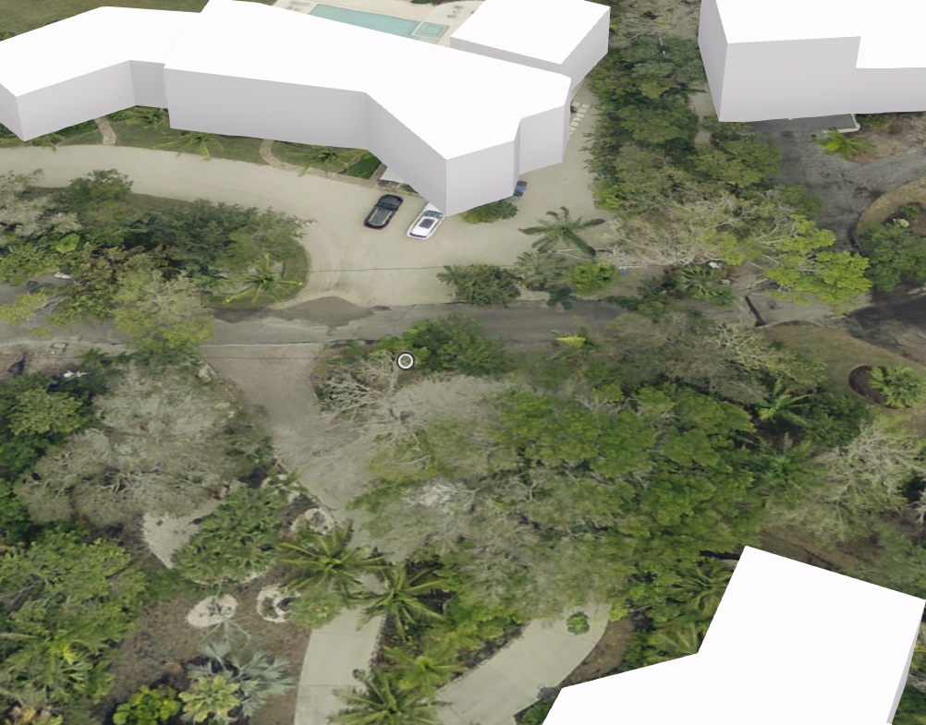
Lift Station 4A
6520 Bayou Hammock Rd
27.432122, -82.677846

Slide 5
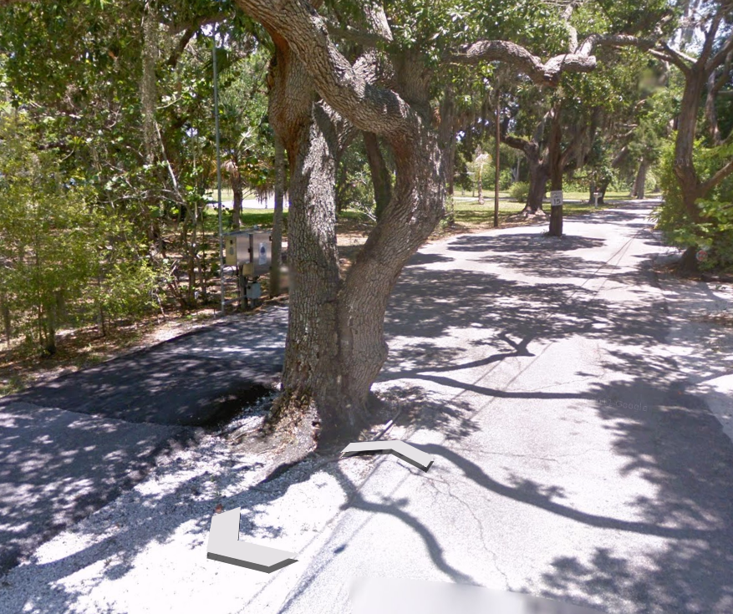
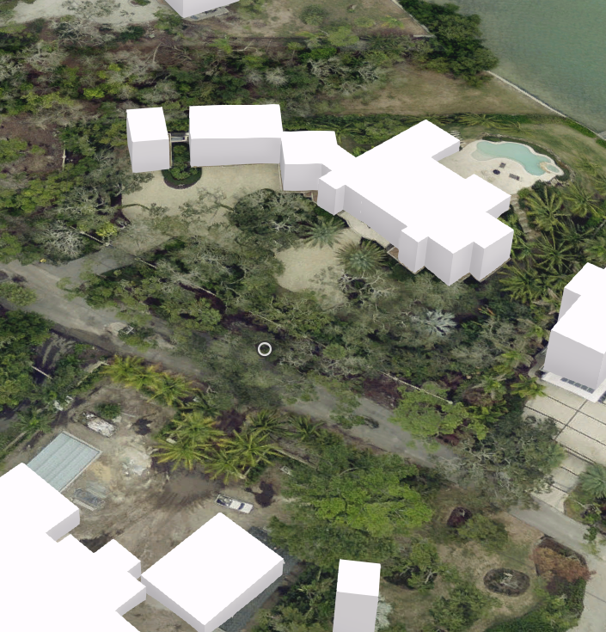
Lift Station 5A
6580 Bayou Hammock Rd
27.432829, -82.678845

Slide 6
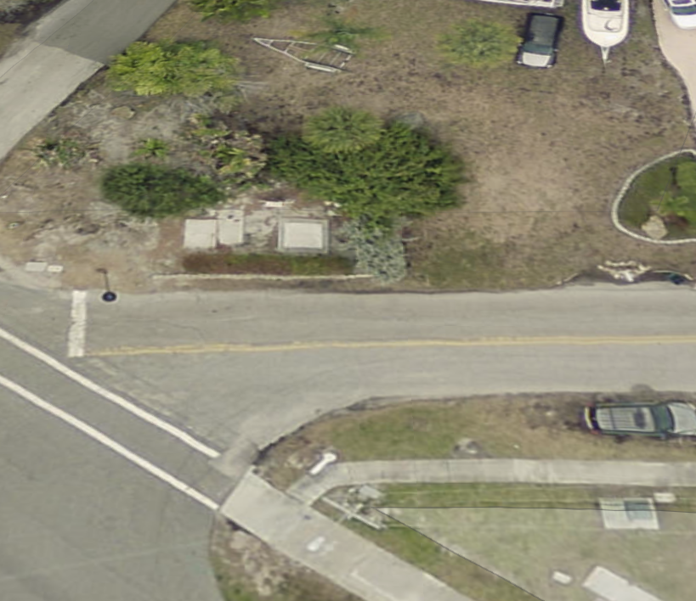
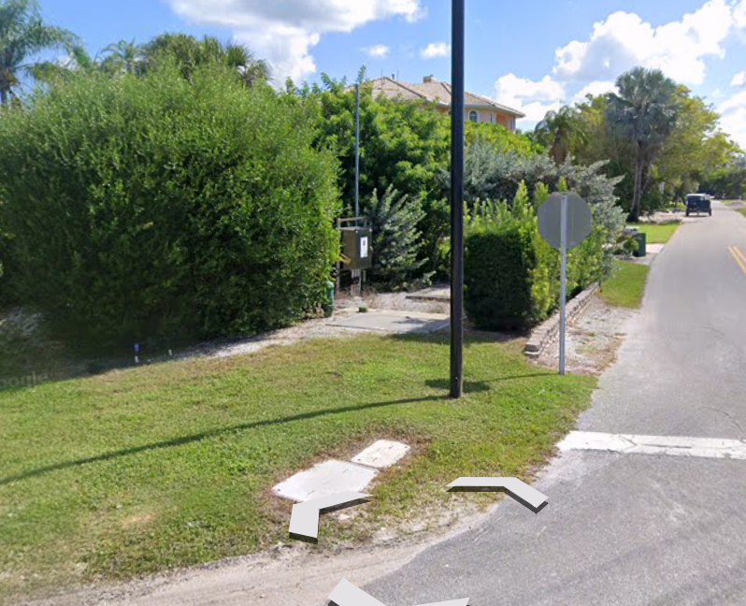
Lift Station B
510 General Harris St
27.426896, -82.675412

Slide 7
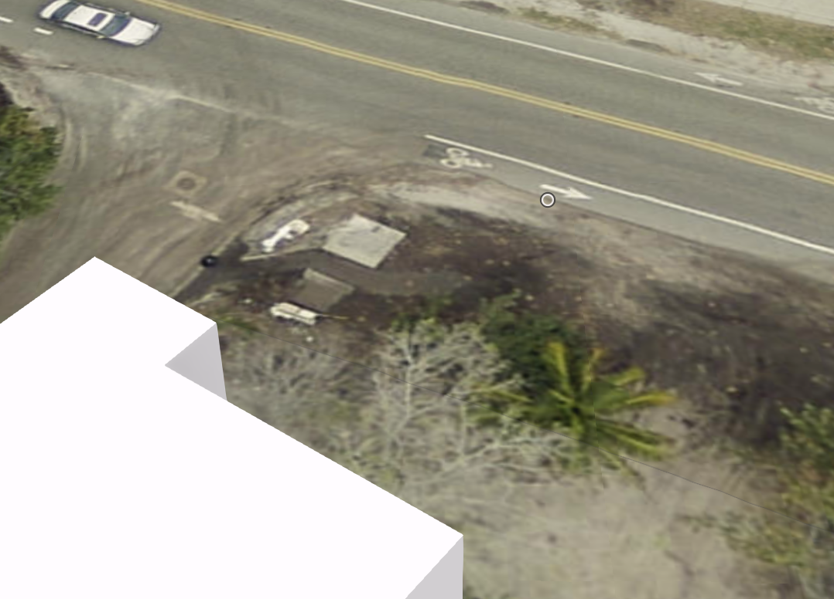
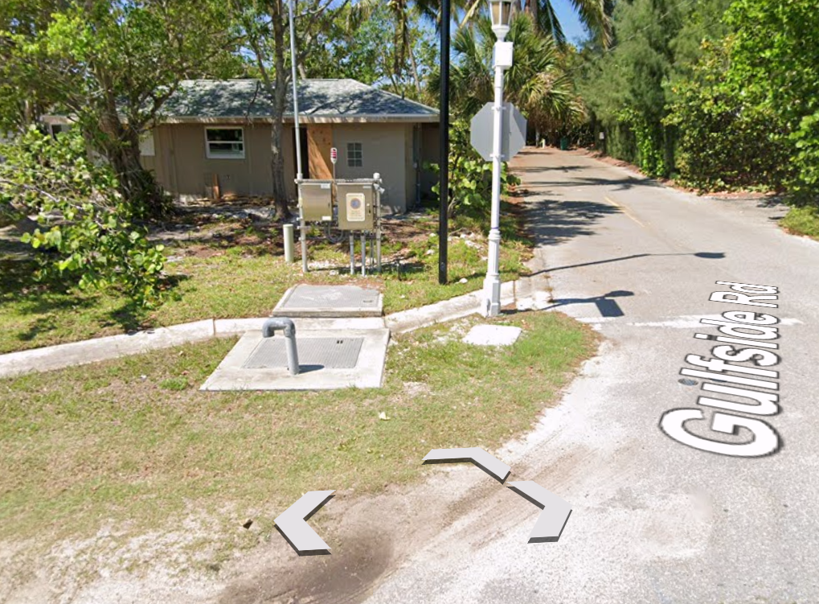
Lift Station 2B
6585 Gulf of Mexico Drive
27.427968, -82.677947

Slide 8
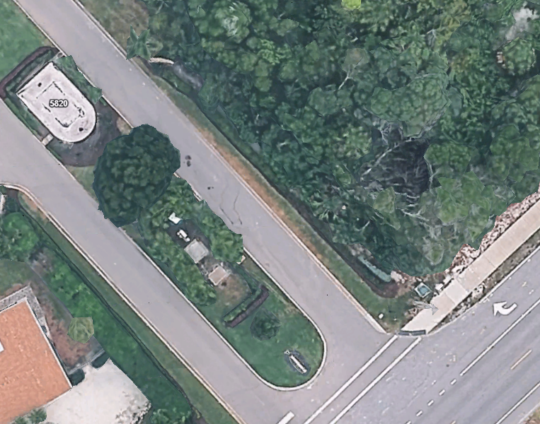
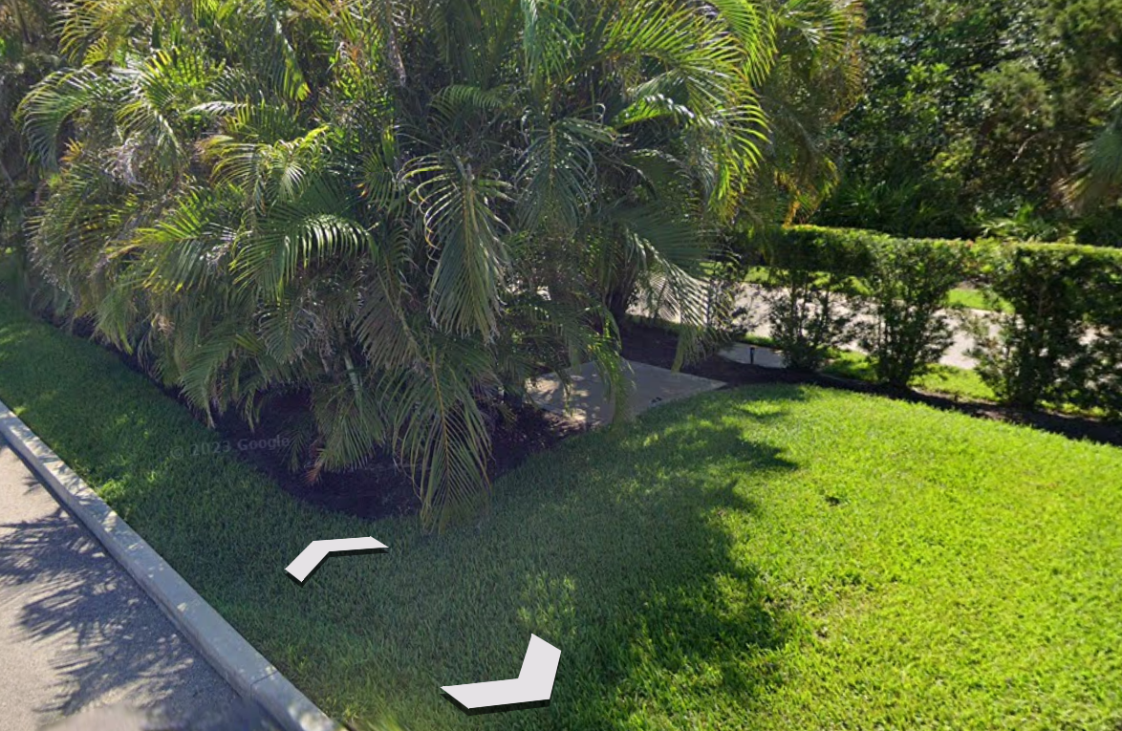
Lift Station C
5820 Emerald Harbor Drive
27.418105, -82.663896

Slide 9
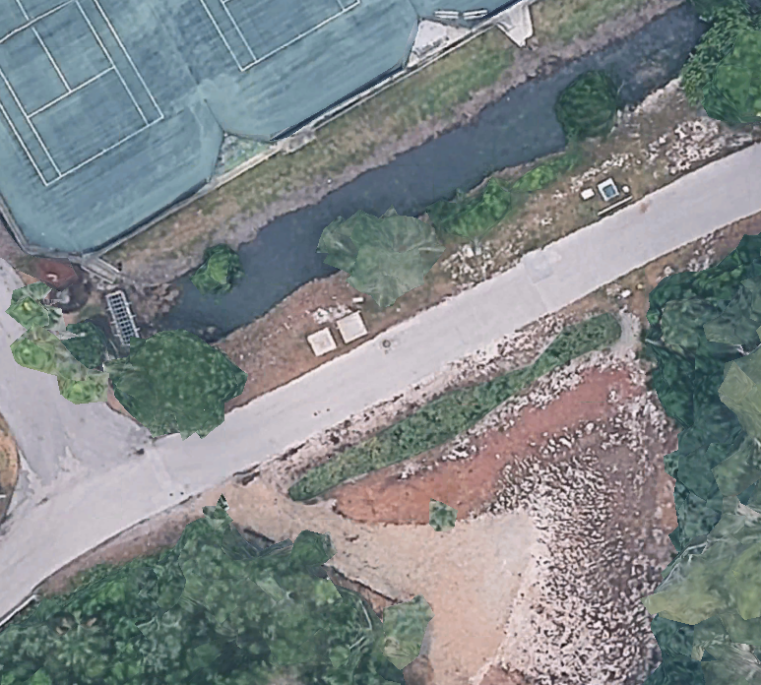
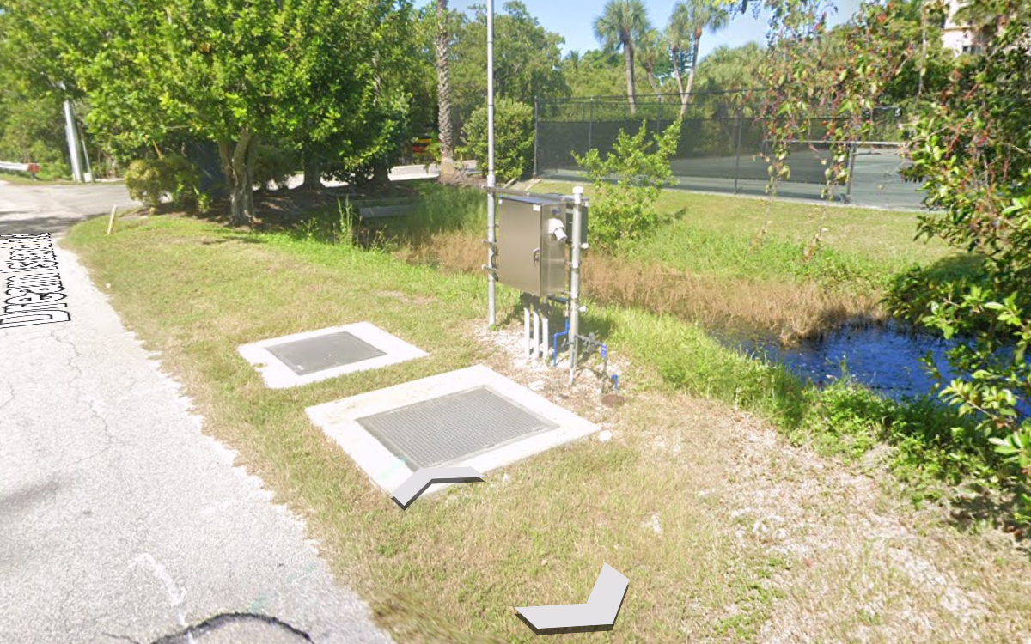
Lift Station 2C
605 Dream Island Rd
27.423041, -82.667567

Slide 10
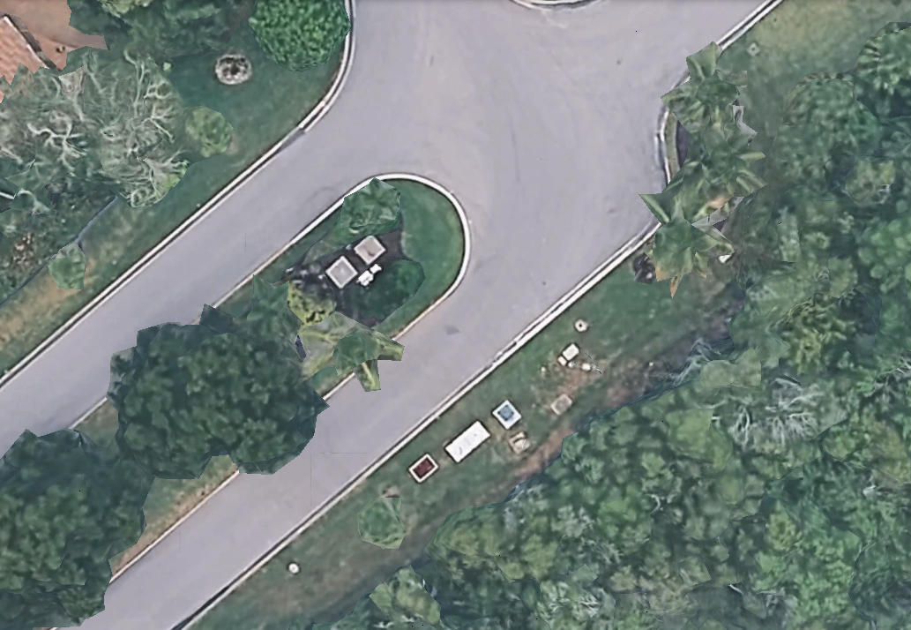
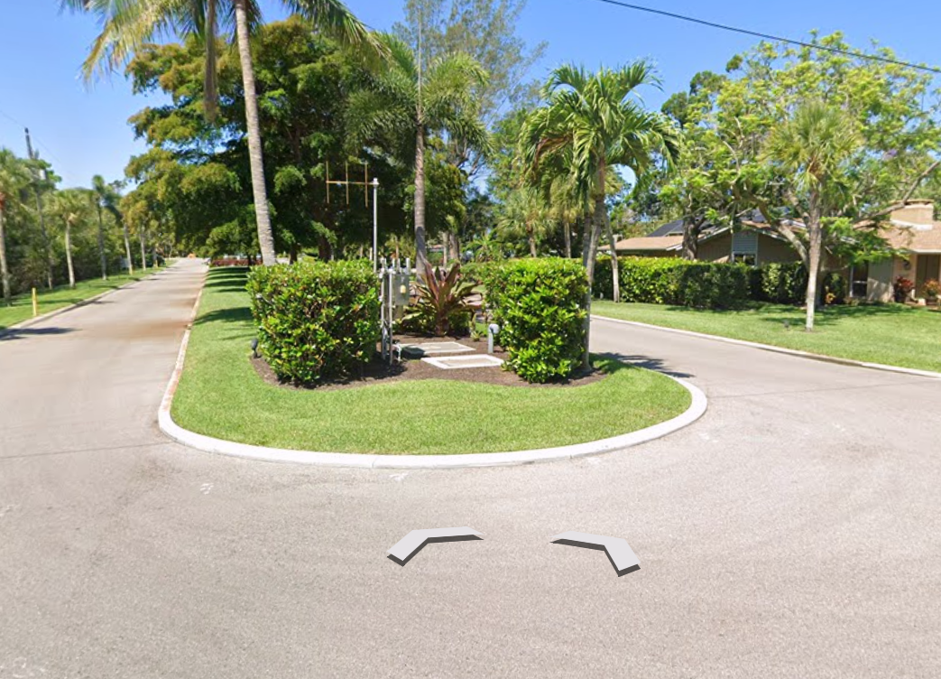
Lift Station 3C
5895 Gulf of Mexico Drive
27.420273, -82.660001

Slide 11
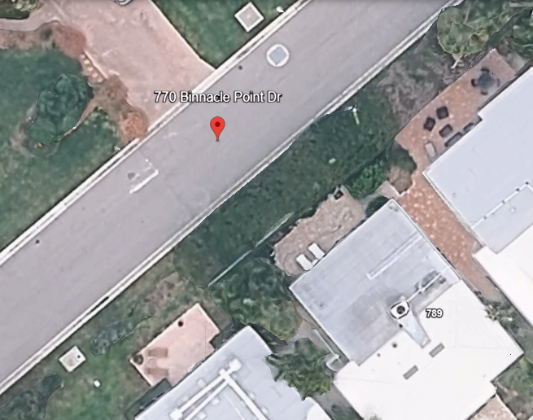
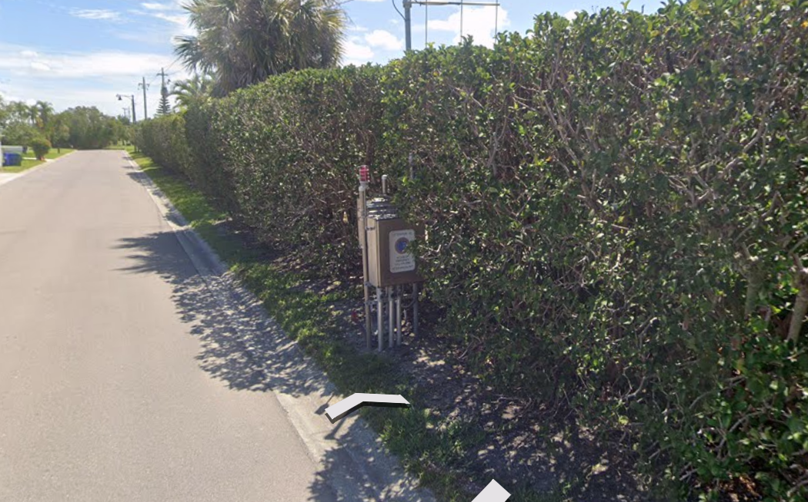
Lift Station 4C
770 Binnacle Point Drive
27.419904, -82.660397

Slide 12
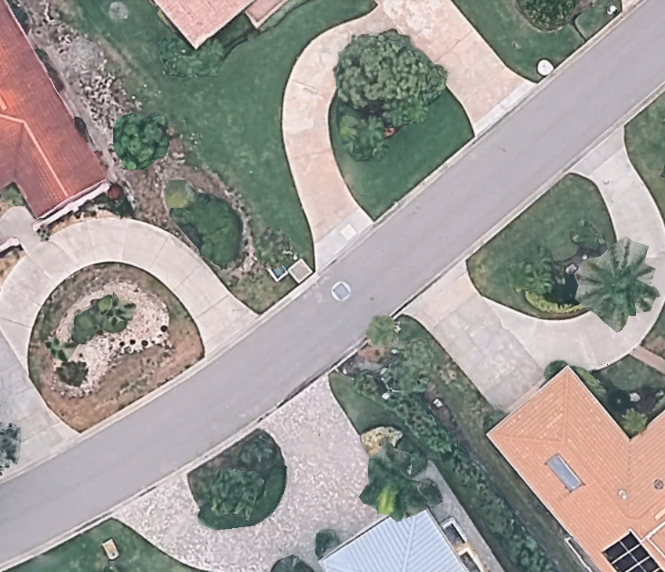
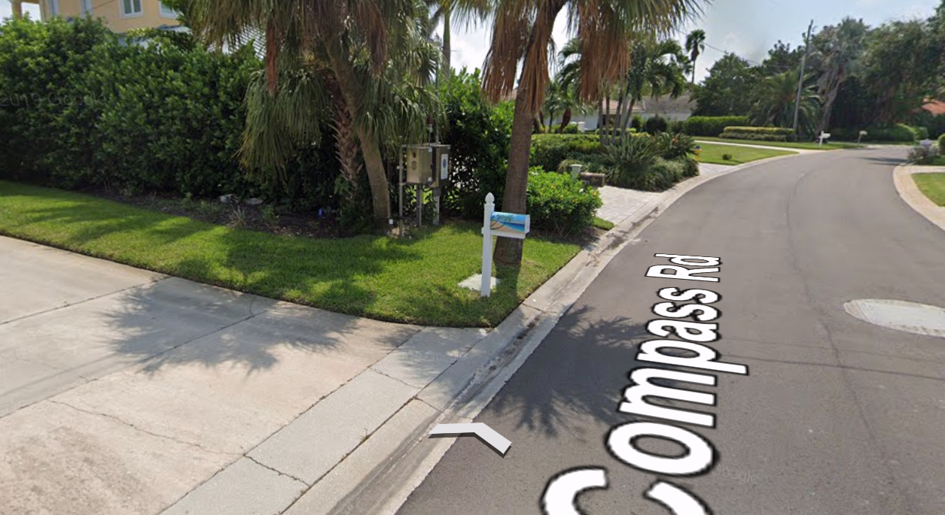
Lift Station 2B
740 Old Compass Road
27.420622, -82.661679

Slide 13
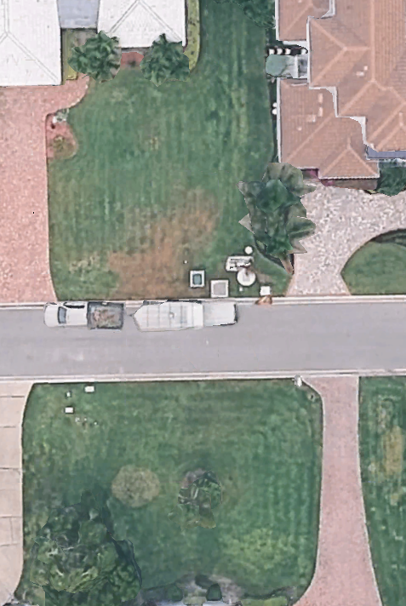
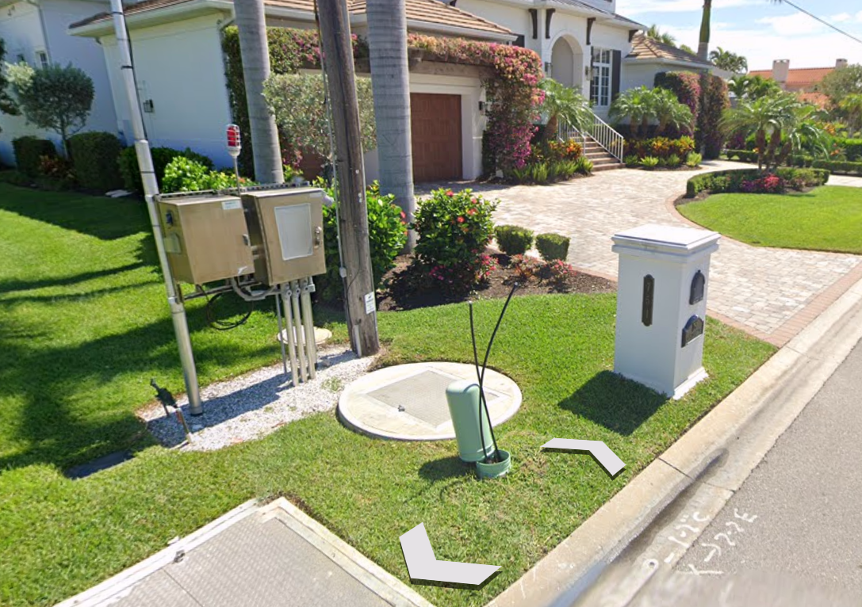
Lift Station 6C
755 Emerald Harbor Drive
27.421811, -82.663258

Slide 14
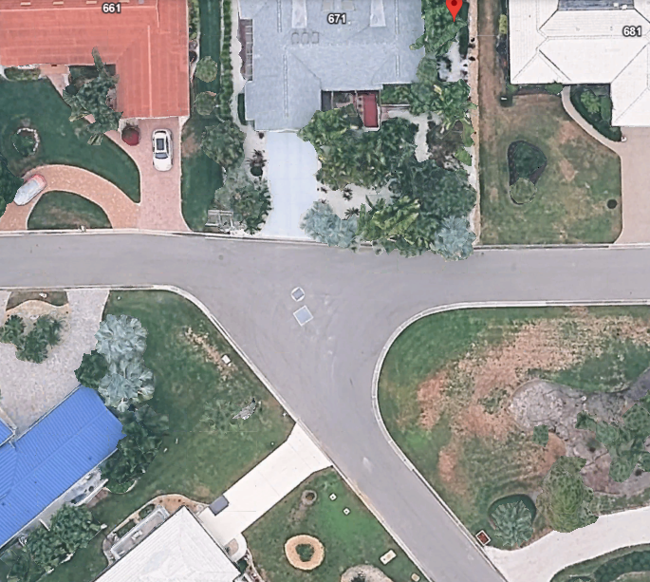
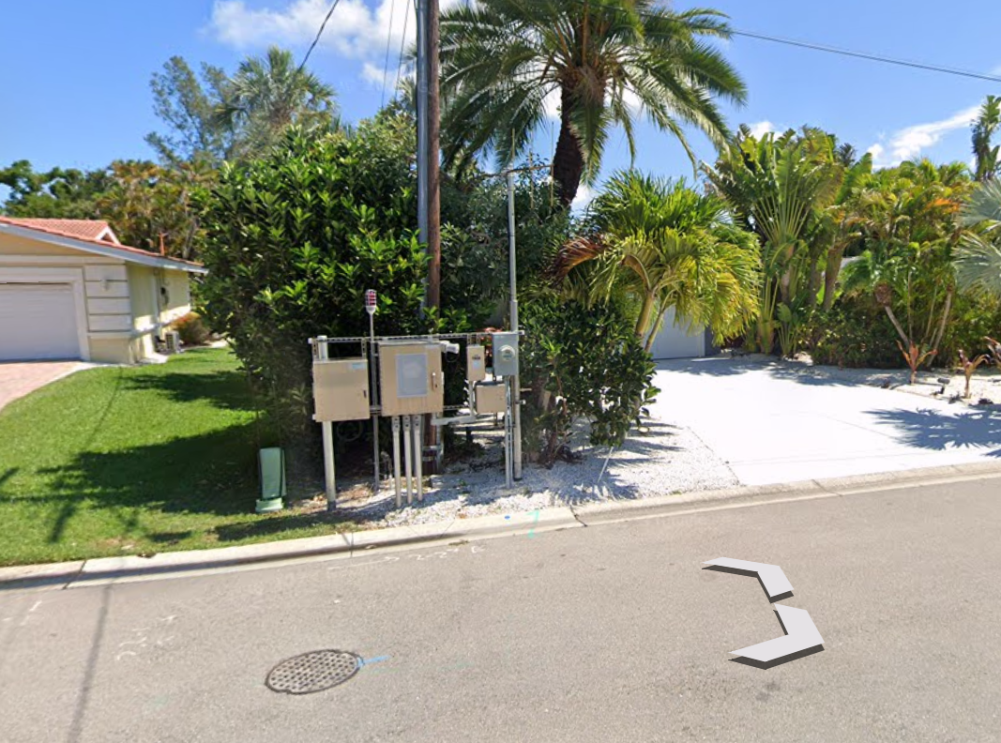
Lift Station 7C
675 Emerald Harbor Drive
27.421727, -82.665699

Slide 15
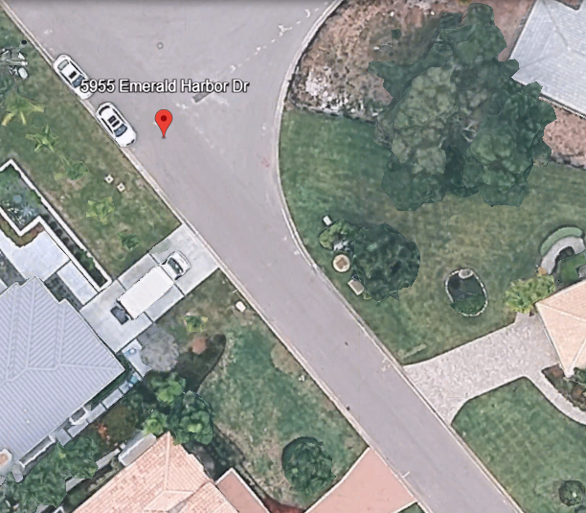
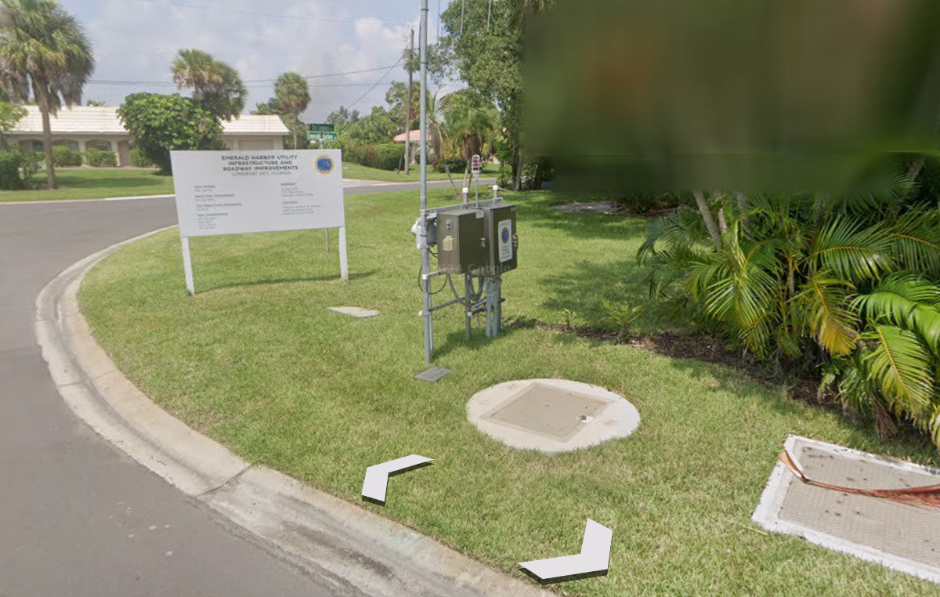
Lift Station 8C
5955 Emerald Harbor Drive
27.420001, -82.664069

Slide 16
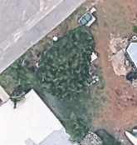
Lift Station 9C
760 Spanish Drive South
27.419105, -82.659368
NO STREET VIEW AVAILABLE

Slide 17
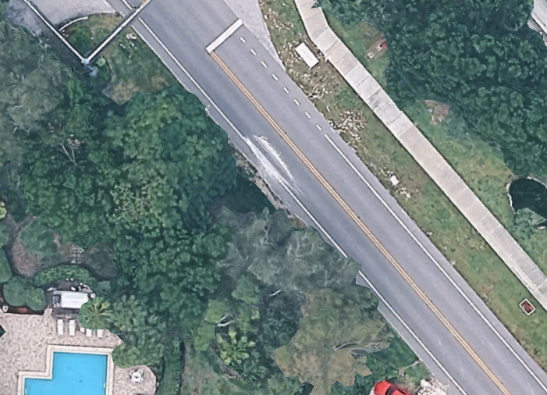
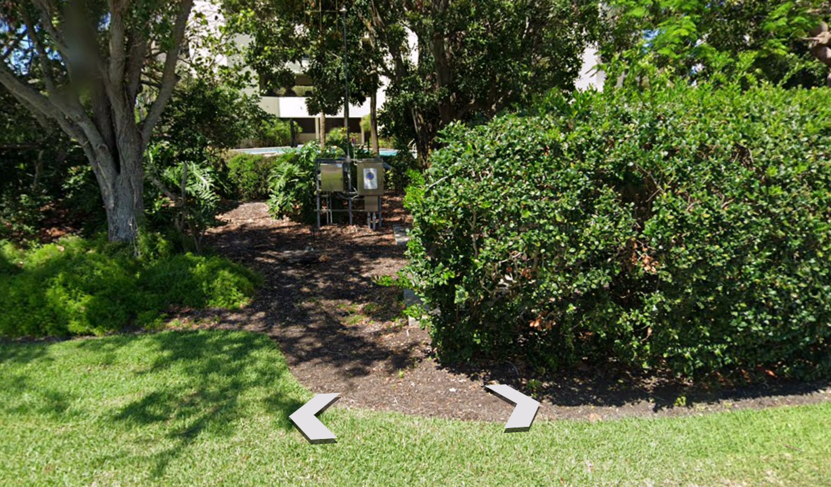
Lift Station 2D
5465 Gulf of Mexico Drive
27.411651, -82.658413

Slide 18
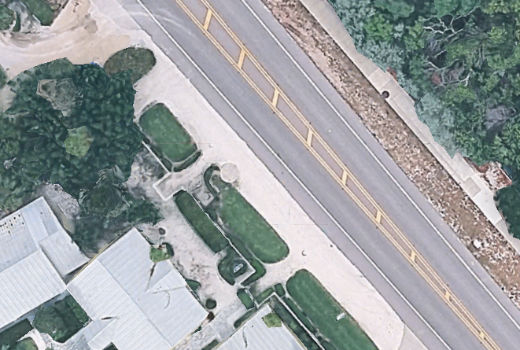
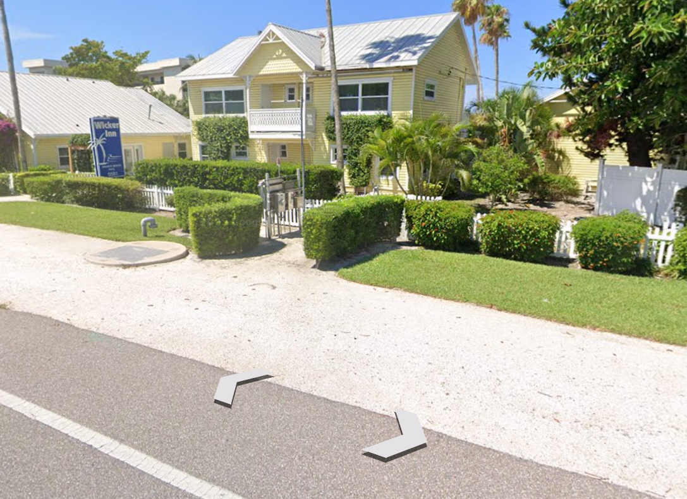
Lift Station 2D-A
5585 Gulf of Mexico Drive
27.413414, -82.660136

Slide 19
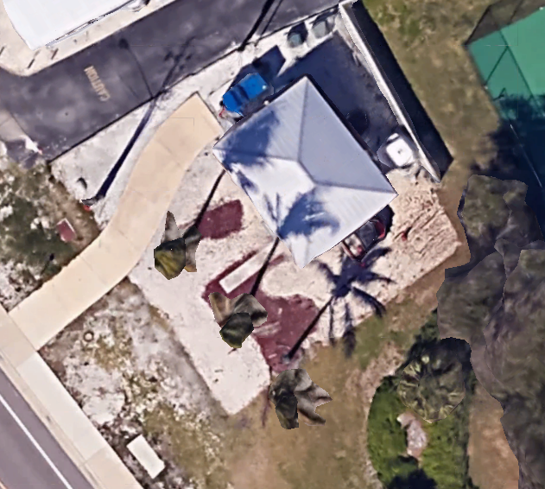
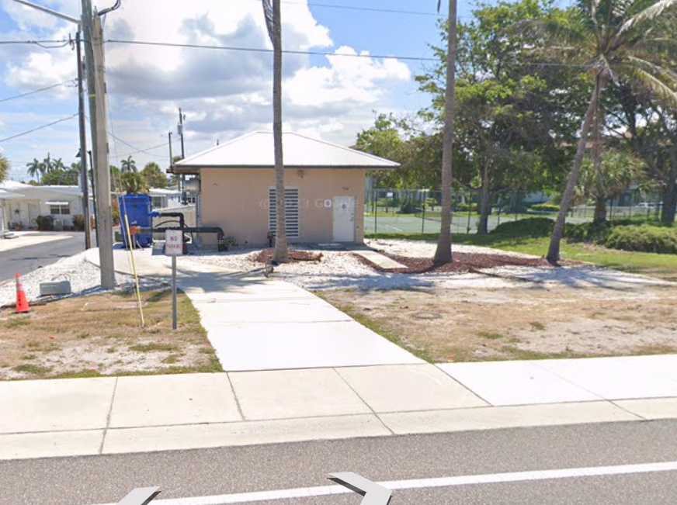
Lift Station E
3700 Gulf of Mexico Drive
27.380307, -82.636229

Slide 20
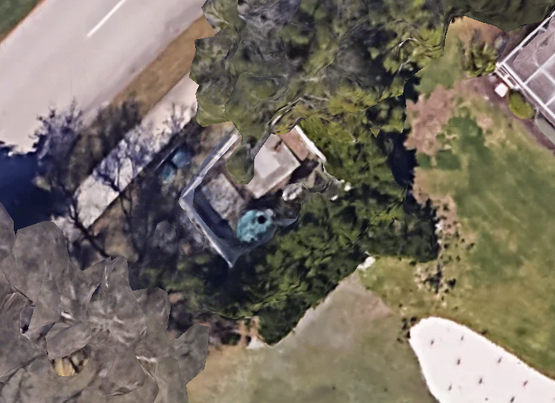
Lift Station 8F
3485 Harborside Drive
27.380177, -82.623158

Slide 21
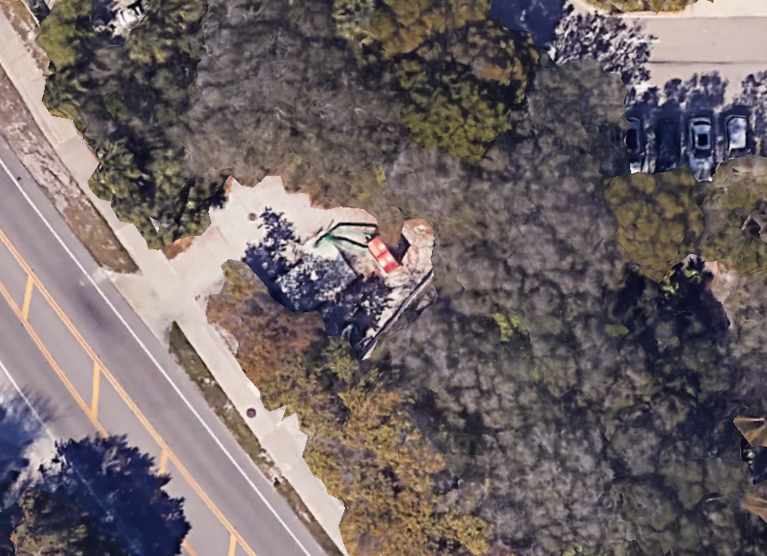
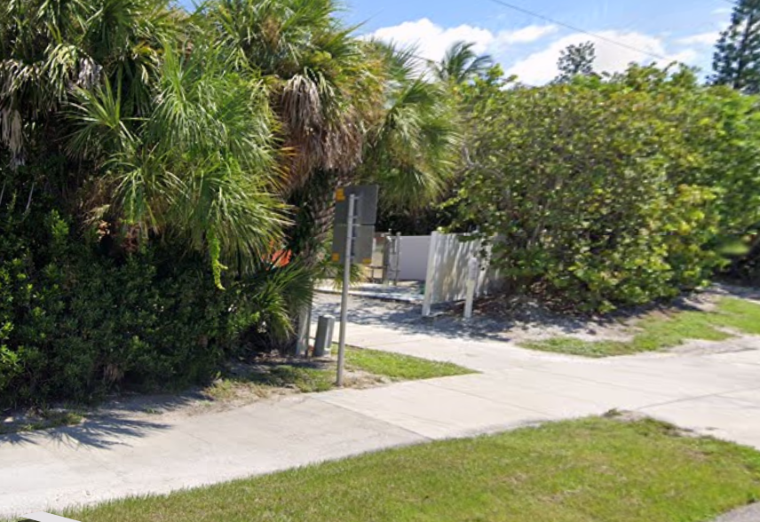
Lift Station F
2812 Gulf of Mexico Drive
27.380177, -82.623185

Slide 22
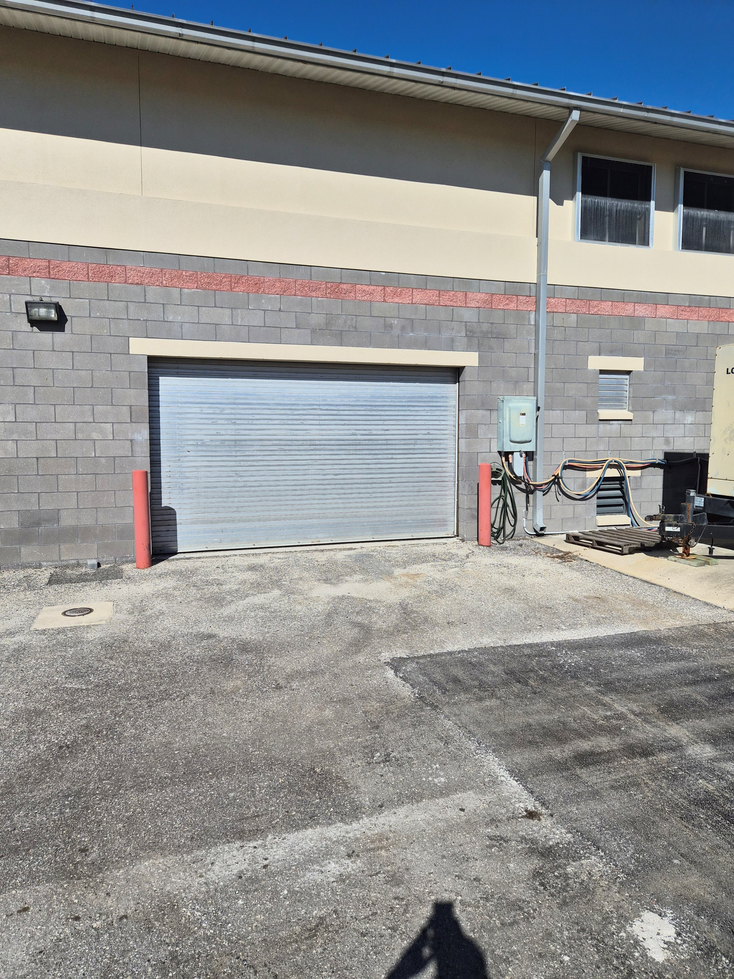
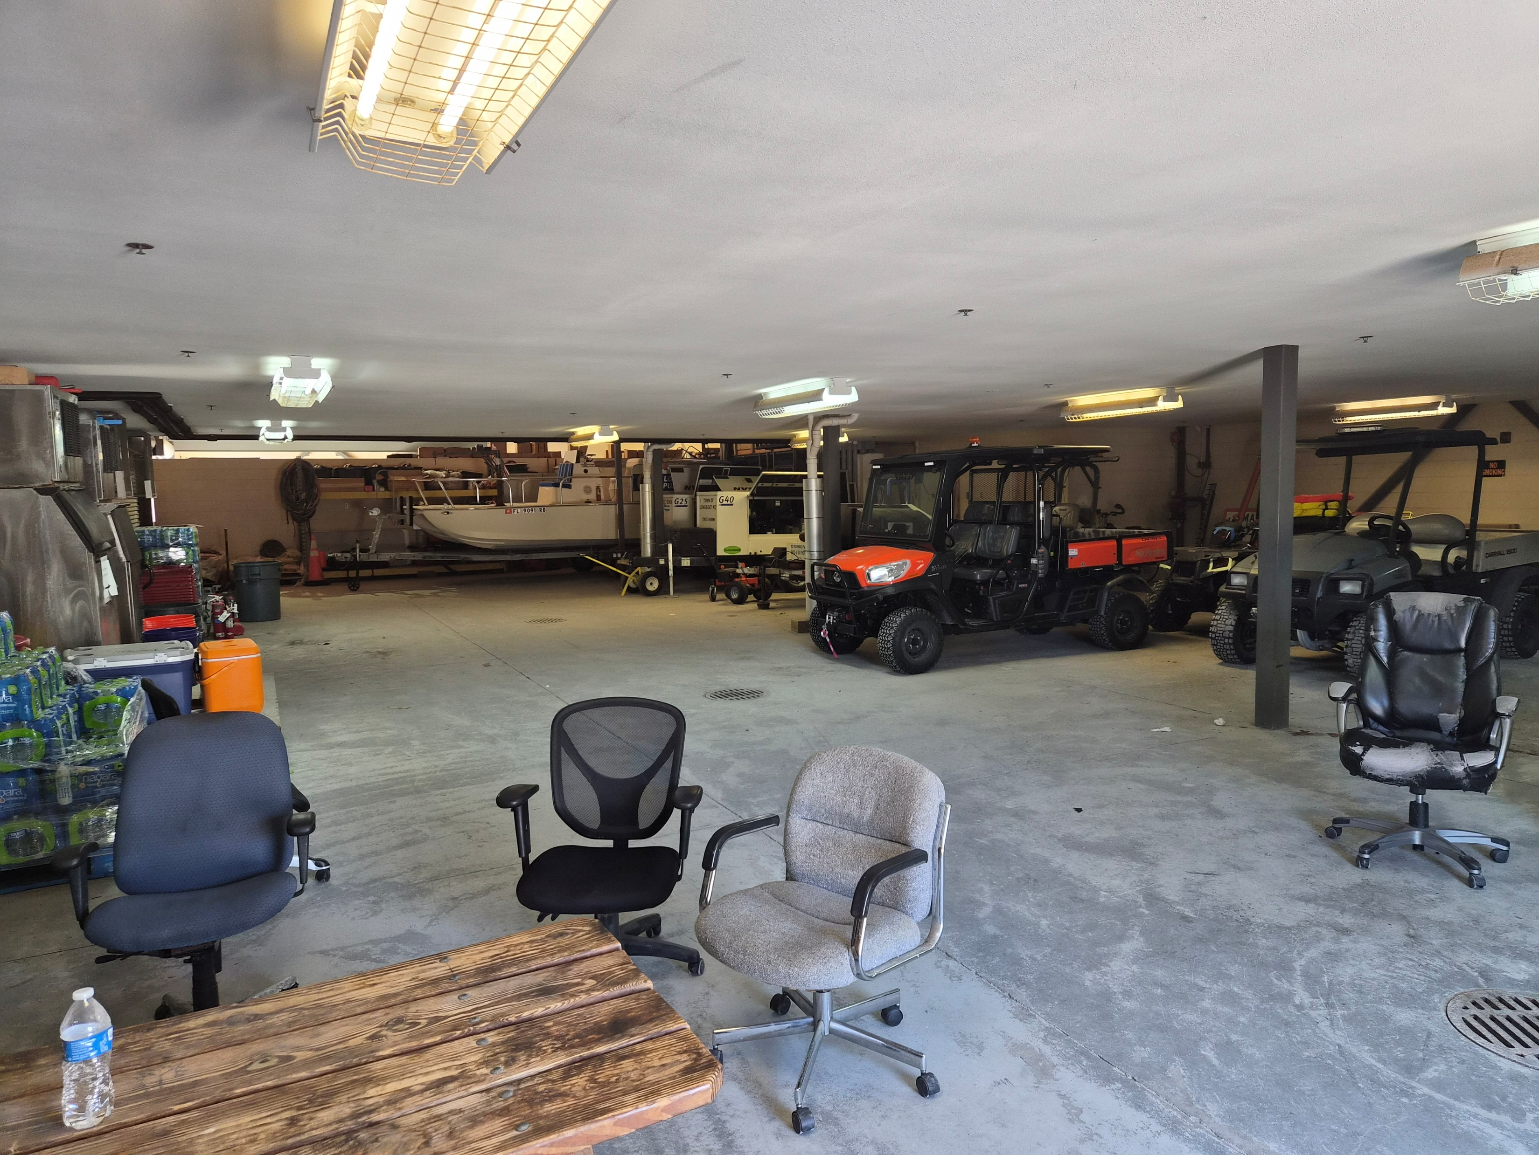
Public Works HQ
600 General Harris
Equipment Storage

