Slide 1
Longboat Pass Bridge Discussion
Town Commission Regular Workshop
March 23, 2026

Slide 2
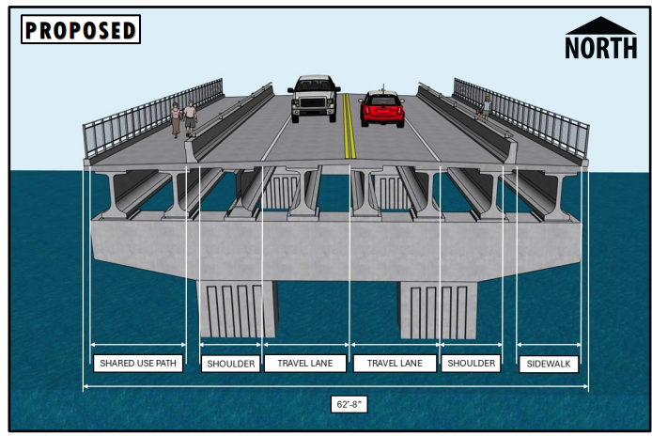
Longboat Pass Bridge Replacement
Background and PD&E Alternatives Analysis Results
Existing bridge built in 1957, improved in 2005 and 2020. Typical 50-year service life for this bridge.
FDOT began PD&E in early 2020 to analyze Bridge alternatives. Completion expected early 2026 at a cost of $2.1 million.
PD&E analyzed alternatives below (cost estimates are about a year old and need to be updated):
  Low-Level Single Leaf Bascule: $176 million
  Low-Level Double Leaf Bascule: $185 million
  Mid-Level Single Leaf Bascule: $184 million
  Mid-Level Double Leaf Bascule: $194 million
  High-Span Fixed Bridge: $138 million
Based on notable cost differences, FDOT is preferring the high-span fixed bridge alternative.
Bridge is planned for a 75-year service life.
  Bridge Notes:
  High Span: No Bridge Openings for Navigation
  Travel Lane Shoulders for flex and transit
  Shared Use Path/ Multi-Use Trail

Slide 3
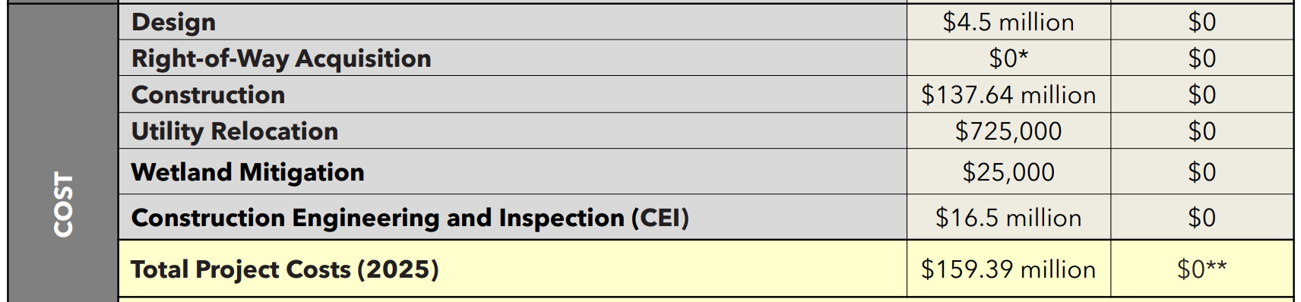
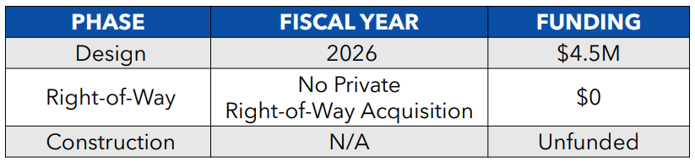
Longboat Pass Bridge Replacement
Total Project Cost Estimate (2025 dollars):
Draft Schedule:

Slide 4
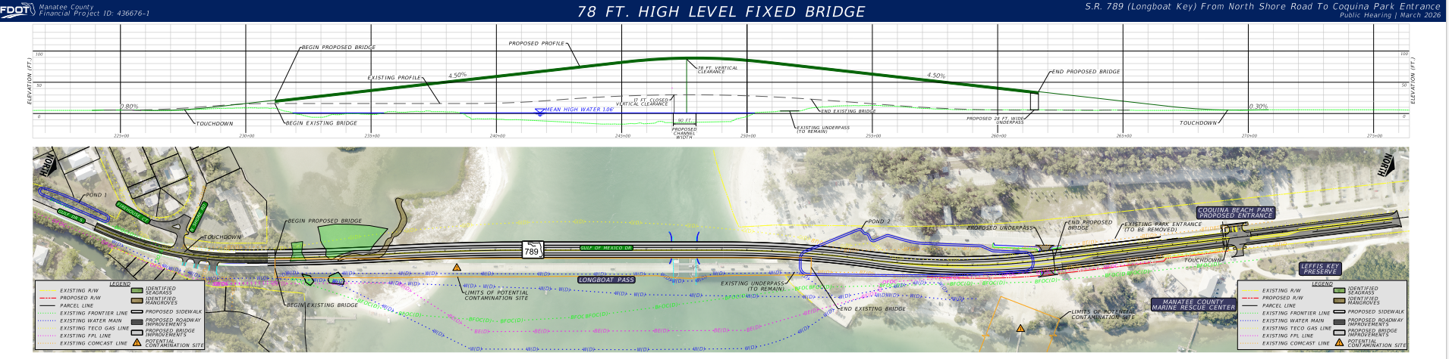
Longboat Pass Bridge Replacement

Slide 5
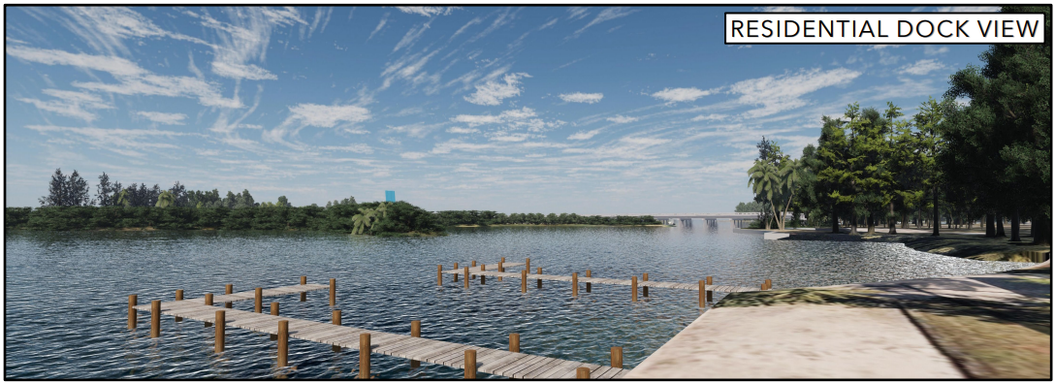
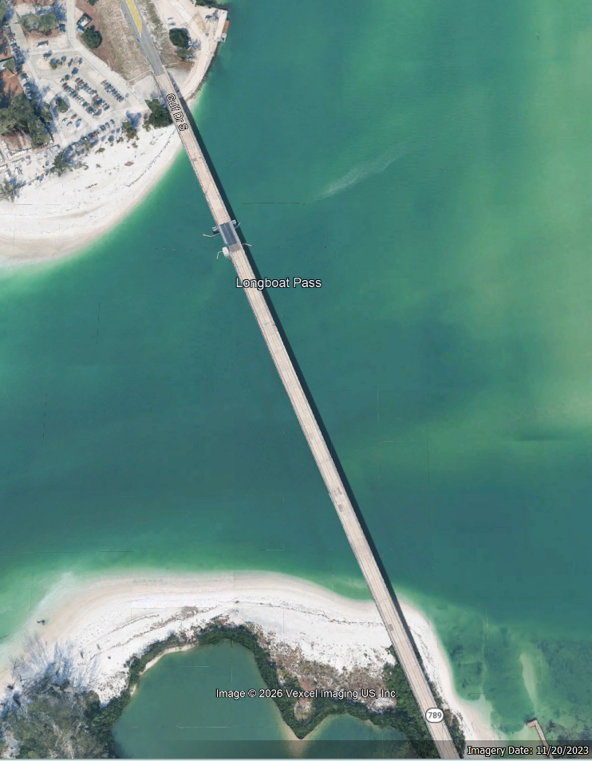
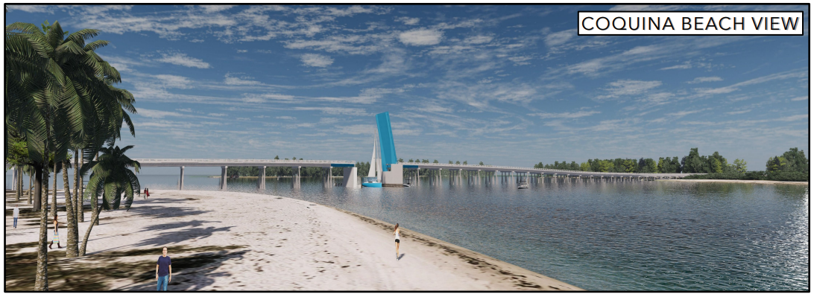
Longboat Pass Bridge Replacement
Rendered images shared at previous workshops (Existing):
Manatee County - Coquina
Longboat Key – Greer Island

Slide 6
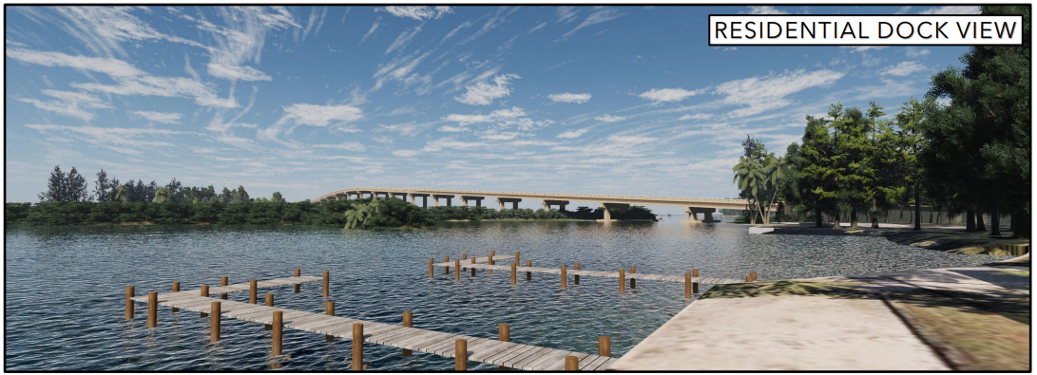
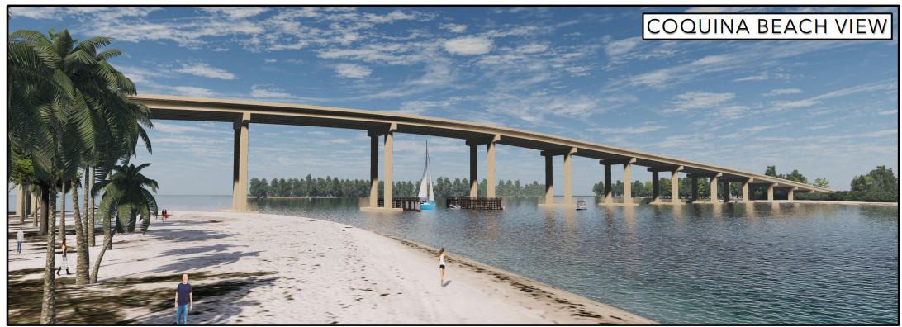
Longboat Pass Bridge Replacement
Rendered images shared at previous workshops (Proposed):
Manatee County - Coquina
Longboat Key – Greer Island

Slide 7
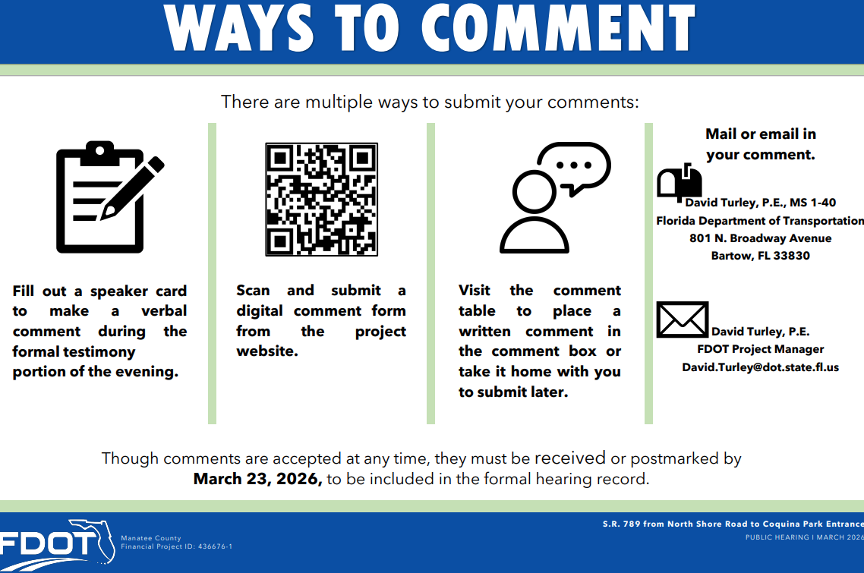
Longboat Pass Bridge Replacement
FDOT and Town, Next Steps
Final Public Meetings for the PD&E and alternative analysis were conducted by FDOT on March 12th (in-person) and March 17th (virtual).
Once PD&E is concluded, FDOT will plan the design effort. Construction currently remains unfunded.

Slide 8
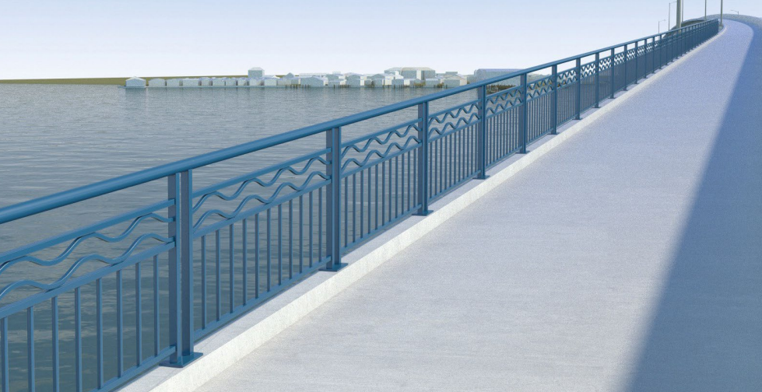

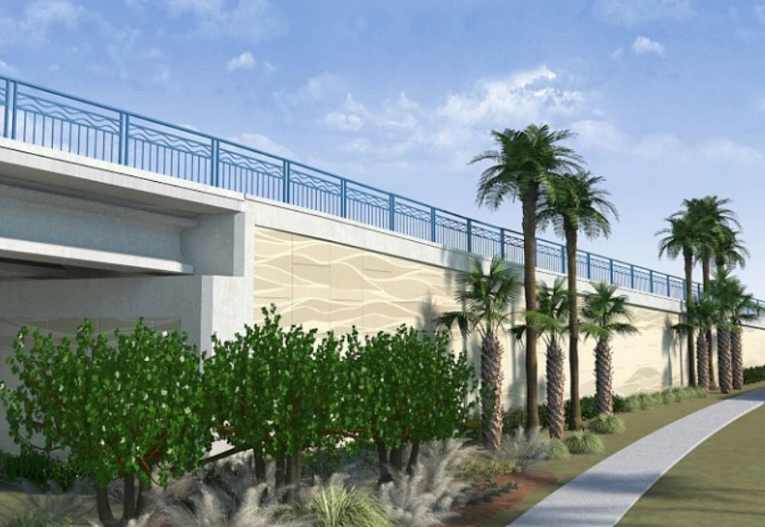
Longboat Pass Bridge Replacement
Ideas borrowed from the Cortez Bridge project. Things like:
Decorative railing
Bridge overlooks, ex. sculpted
Landscape and texture-softened retaining walls

Slide 9
Thank You!

