Slide 1
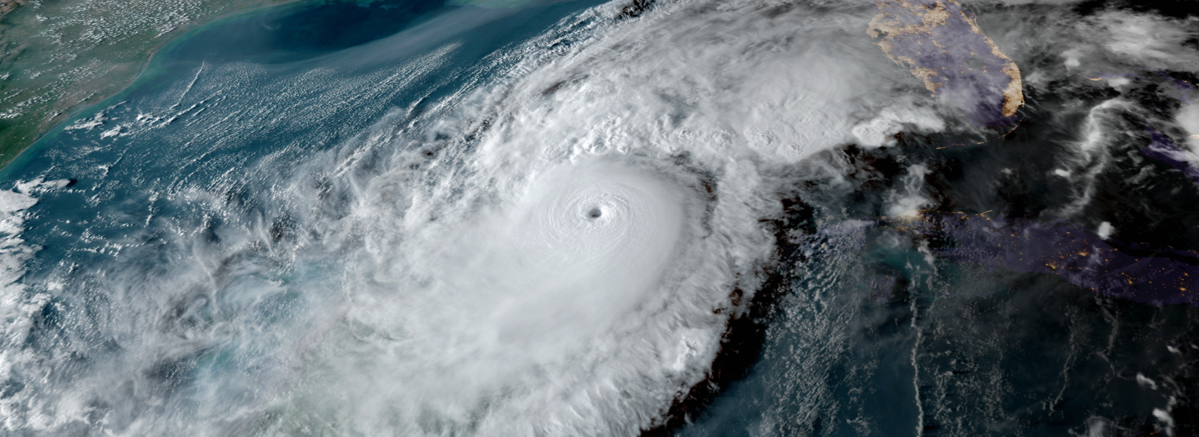
2025 Disaster Preparedness Seminar
Town Manager Howard Tipton

Slide 2
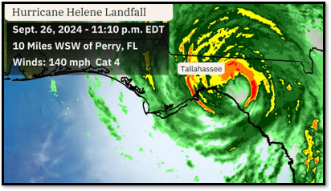
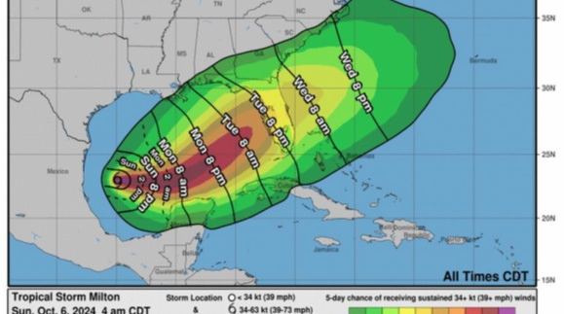
2024 Storms
Debby
Helene
Milton

Slide 3
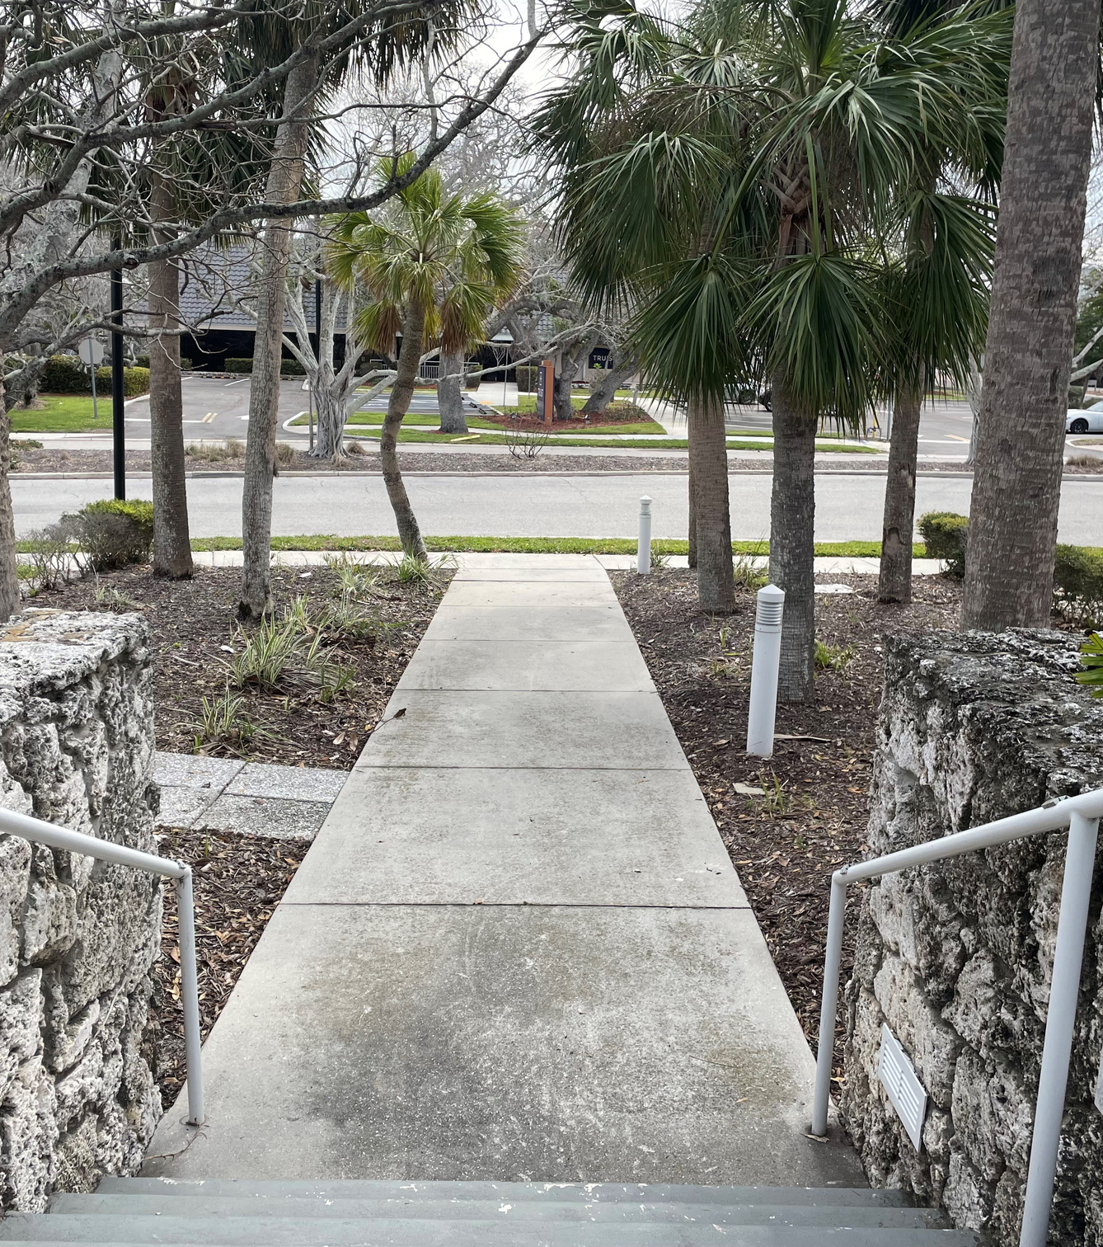

Slide 5
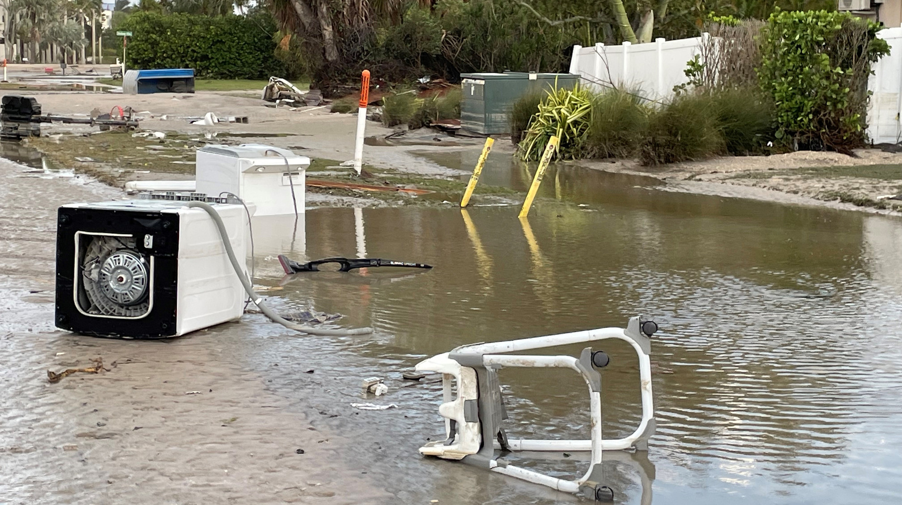
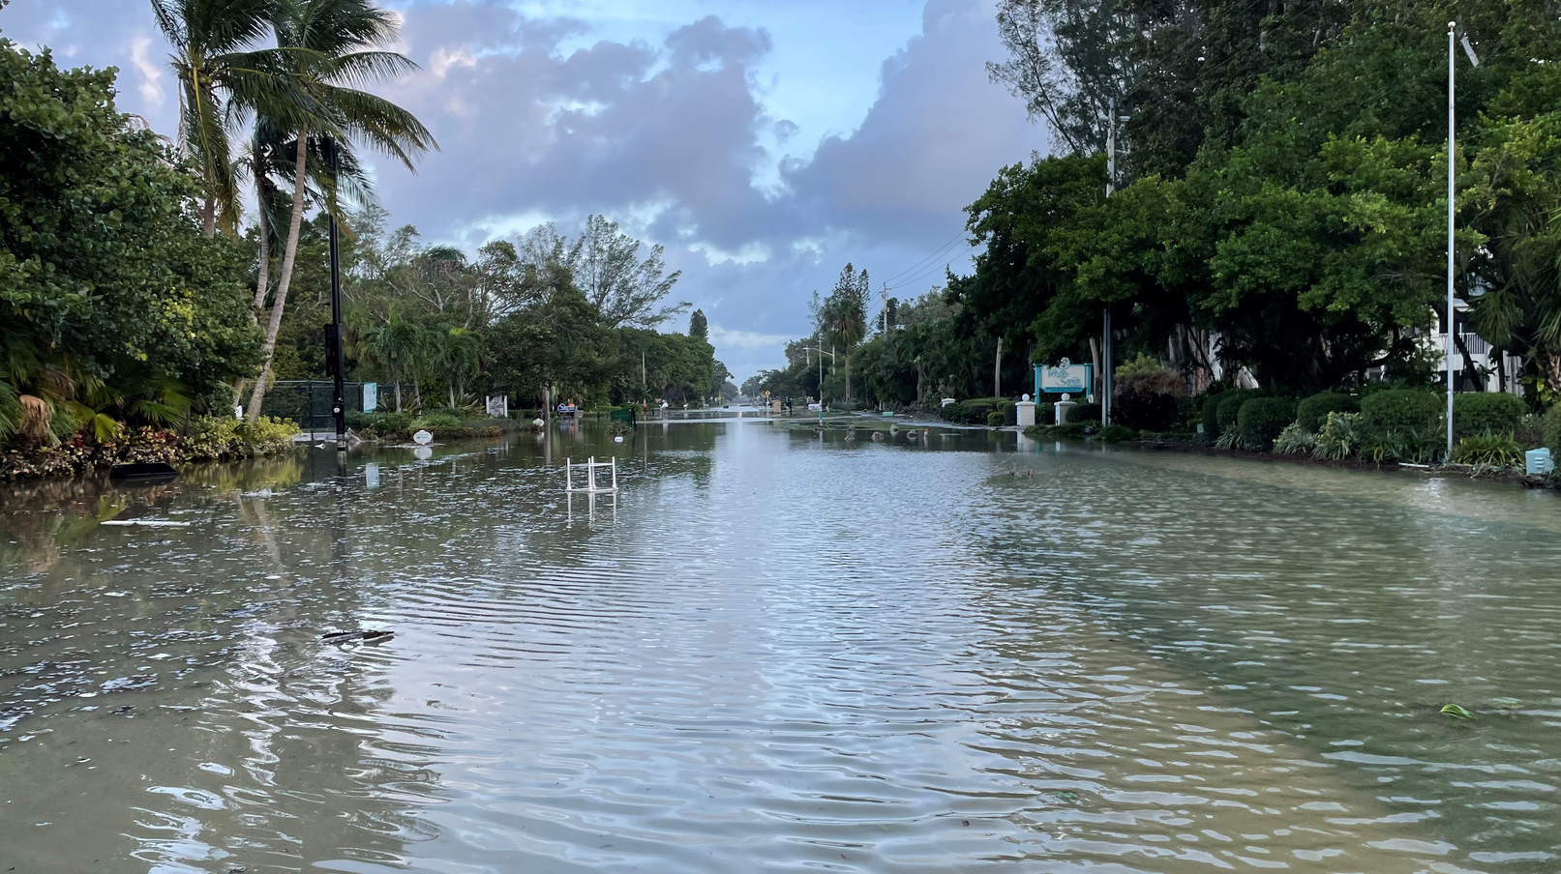
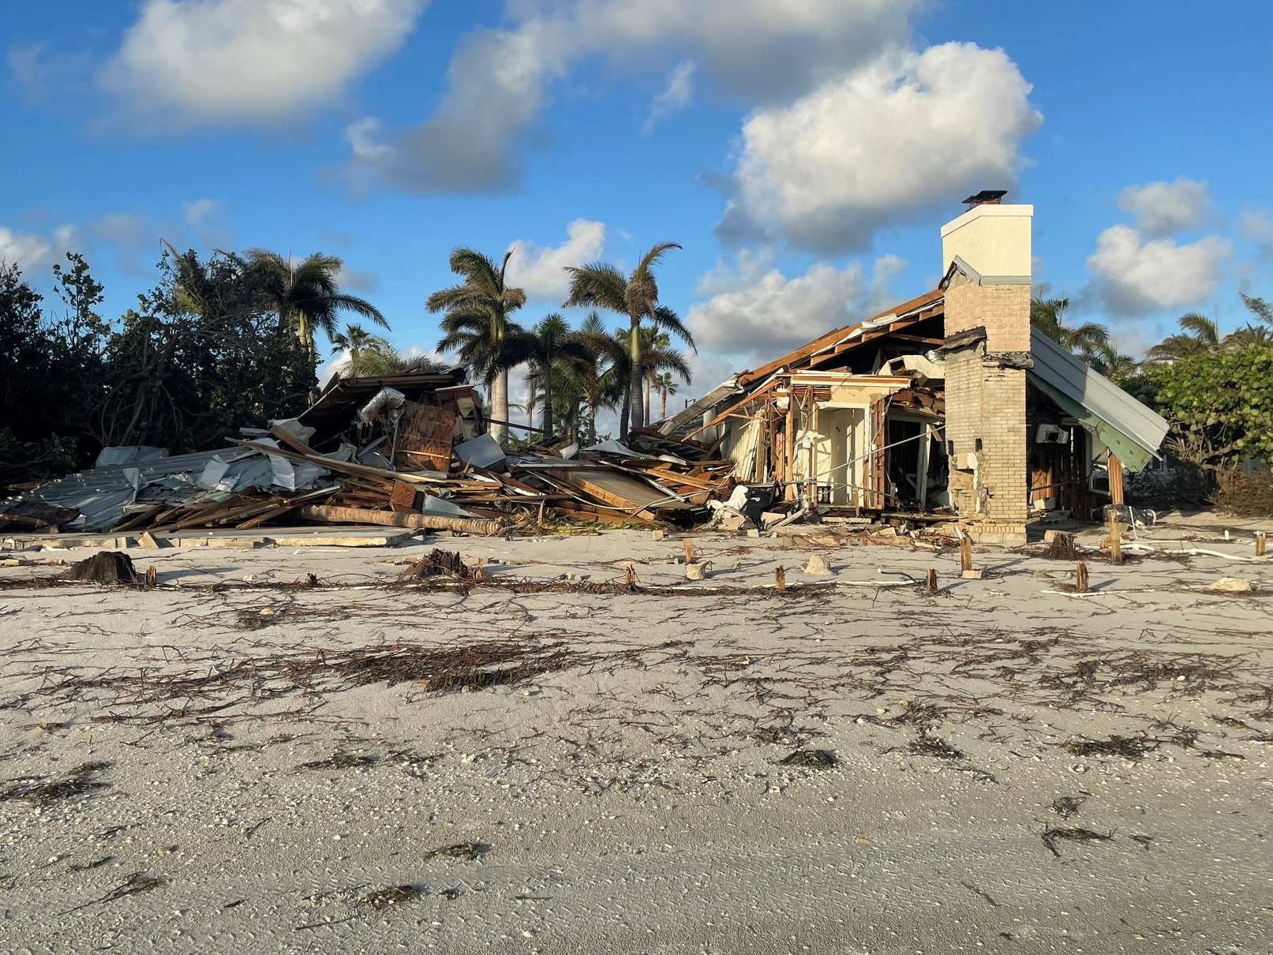
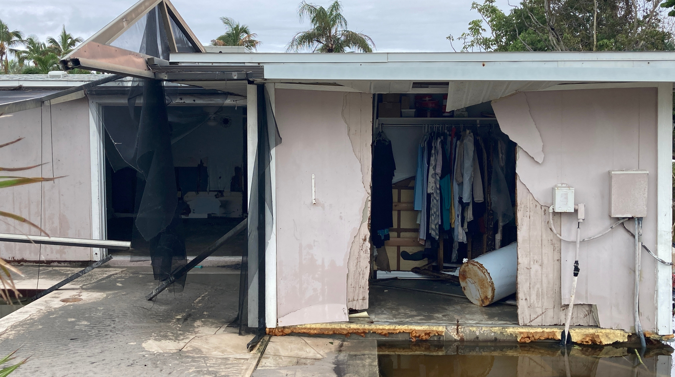

Slide 6
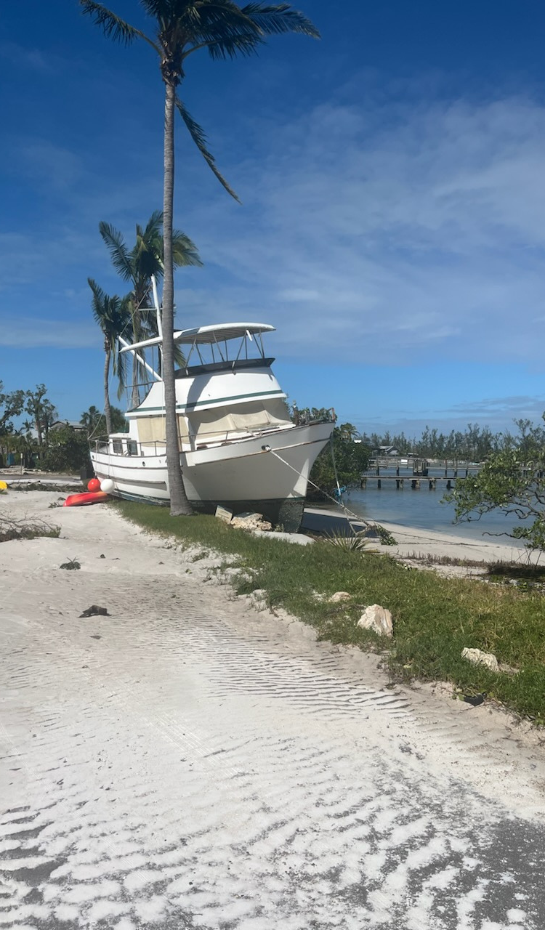
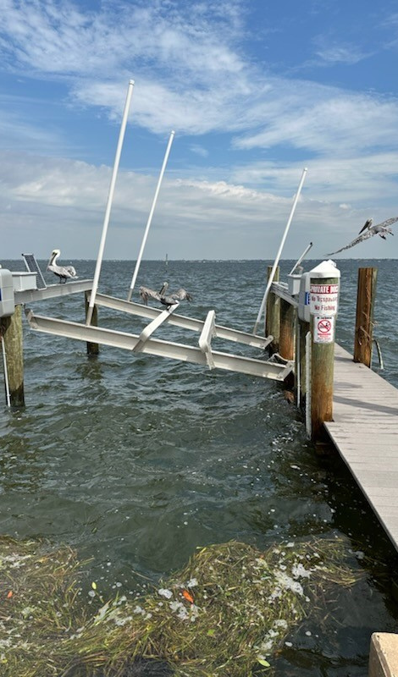
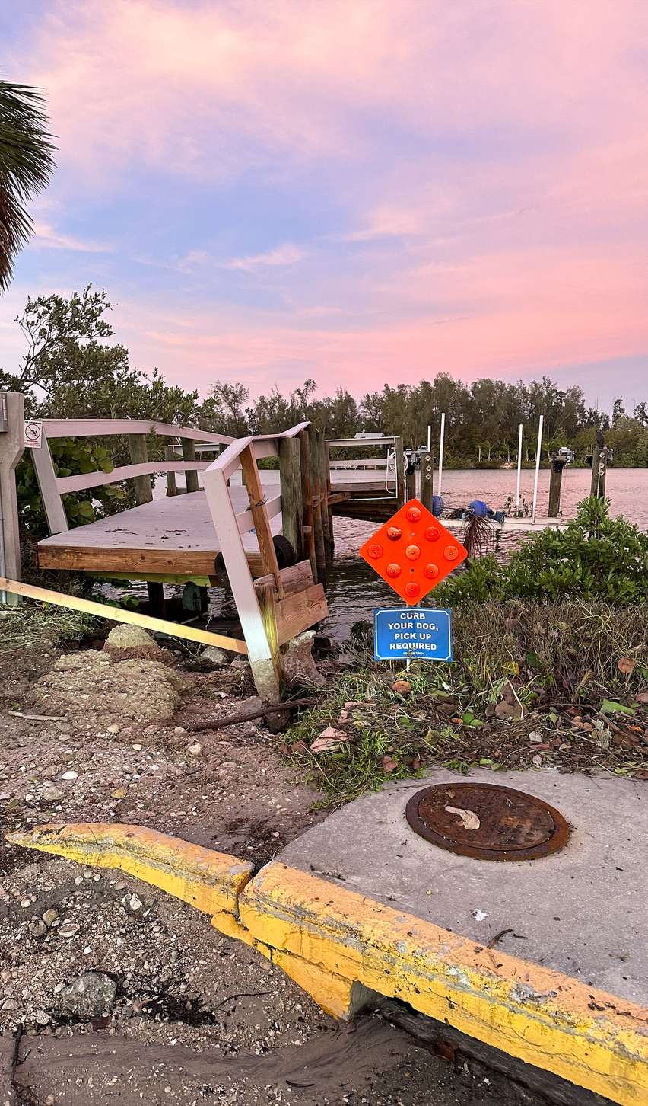

Slide 7
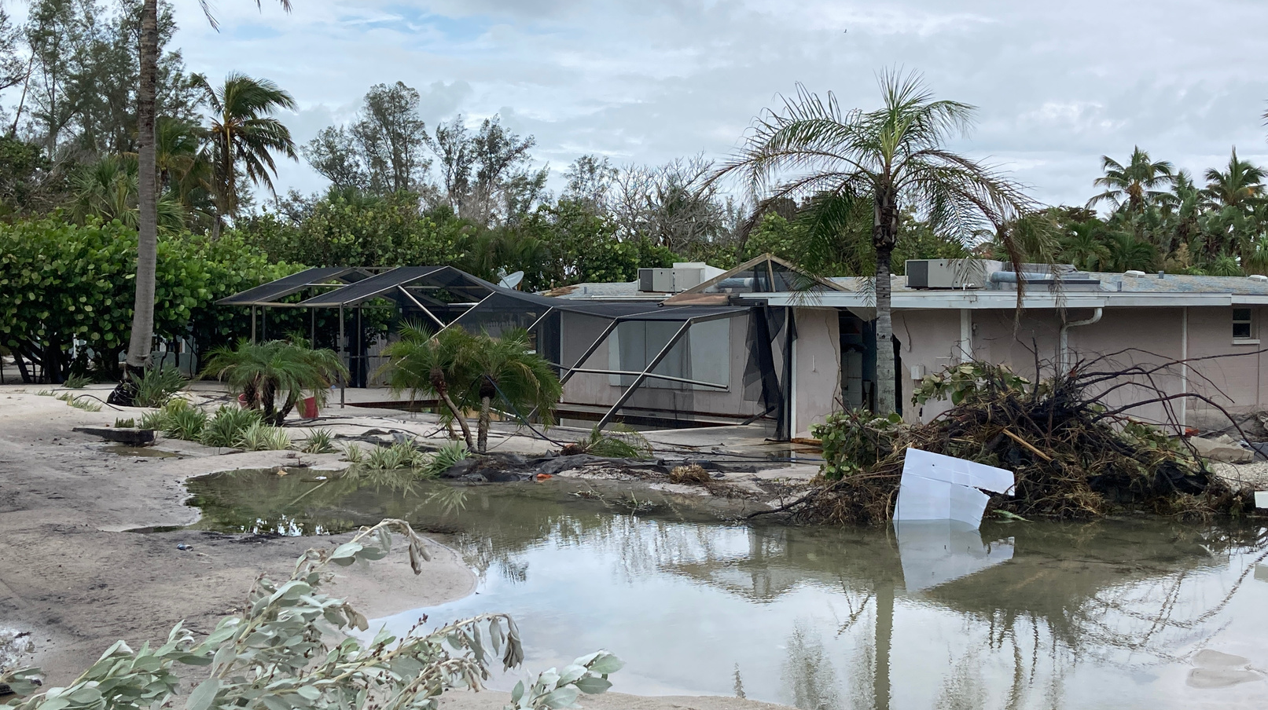
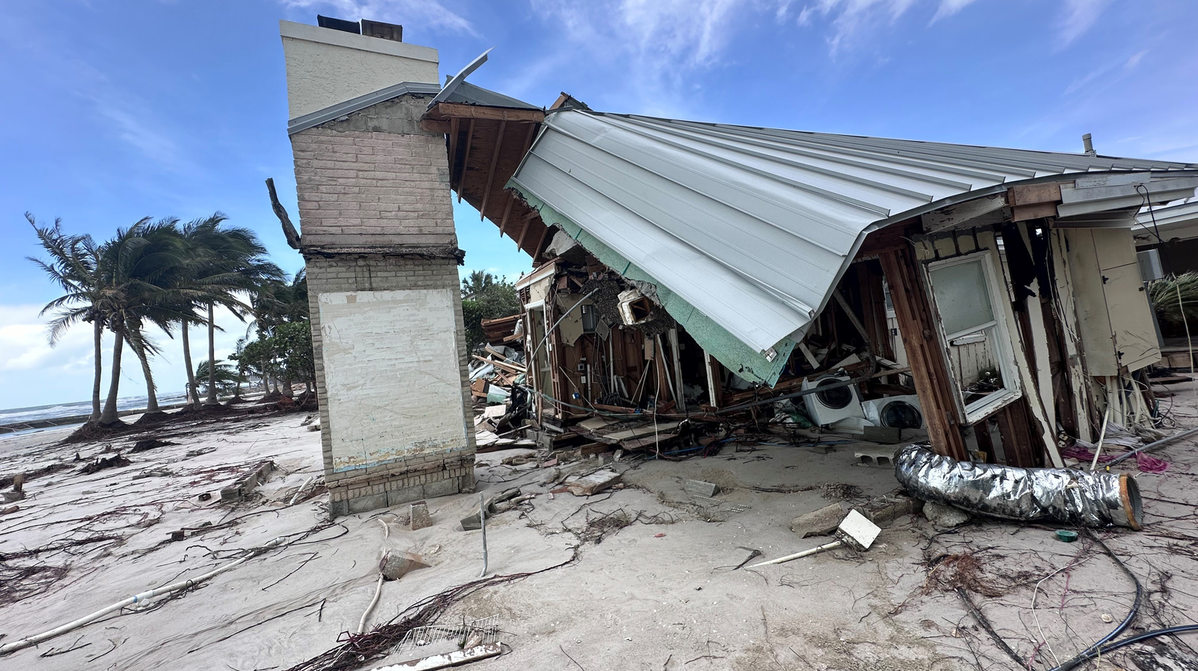
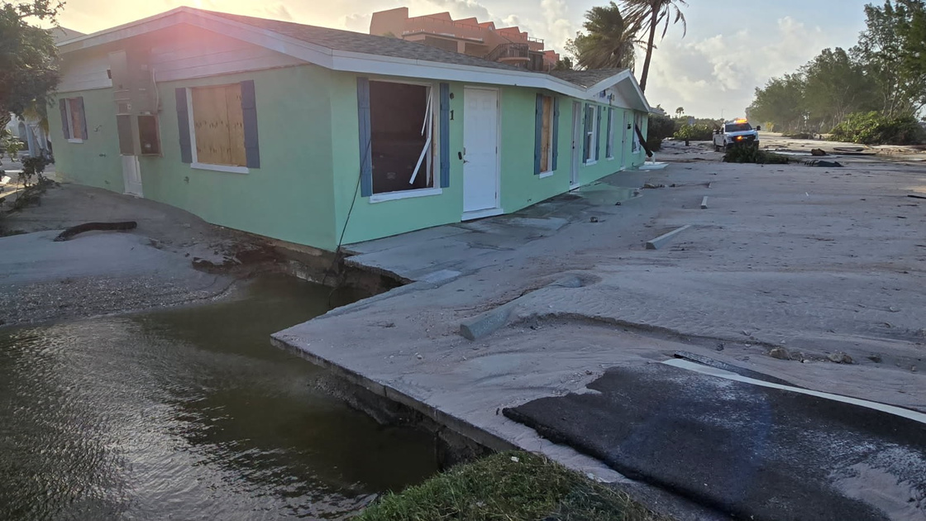

Slide 8
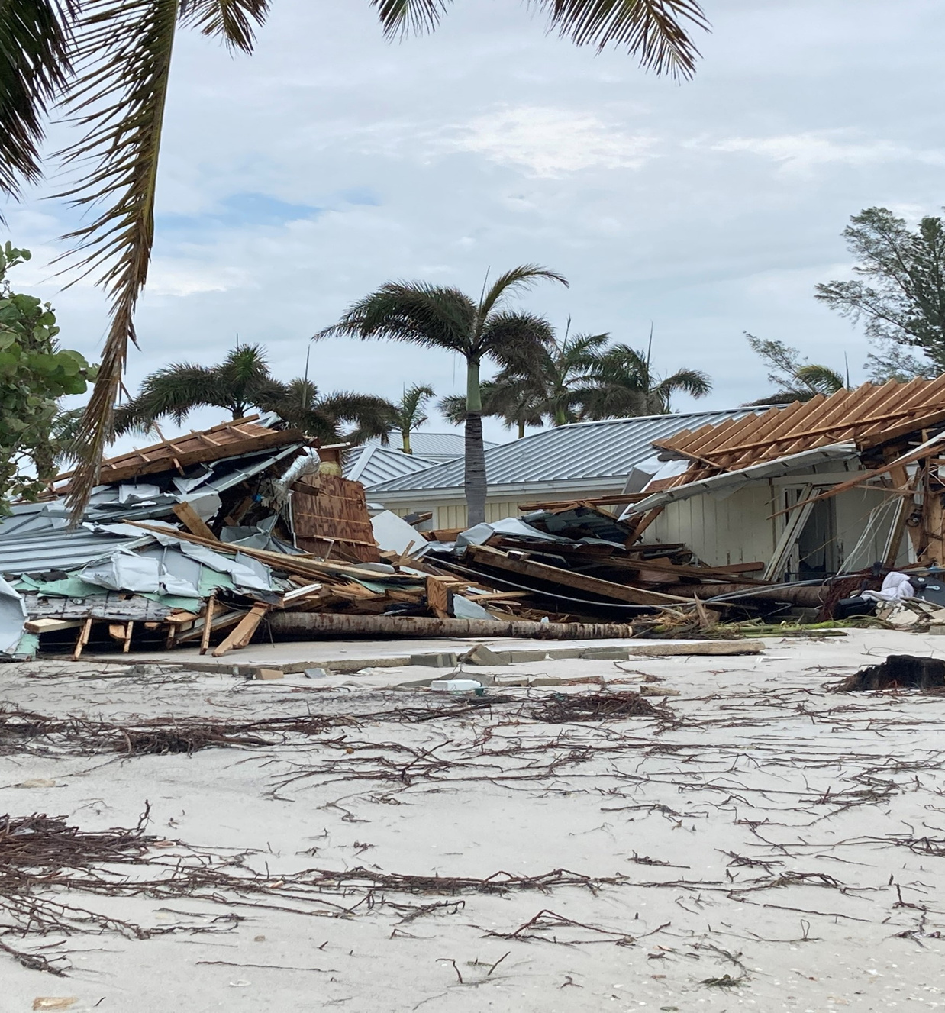
3,000 Residential Structures Assessed
1,600 damaged
Just under 800 homes received 30-40% damage
170 homes had at least 40-50% damage
More than 80 properties submitted to be demolished
Structural damages to properties exceeded $200 million

Slide 9
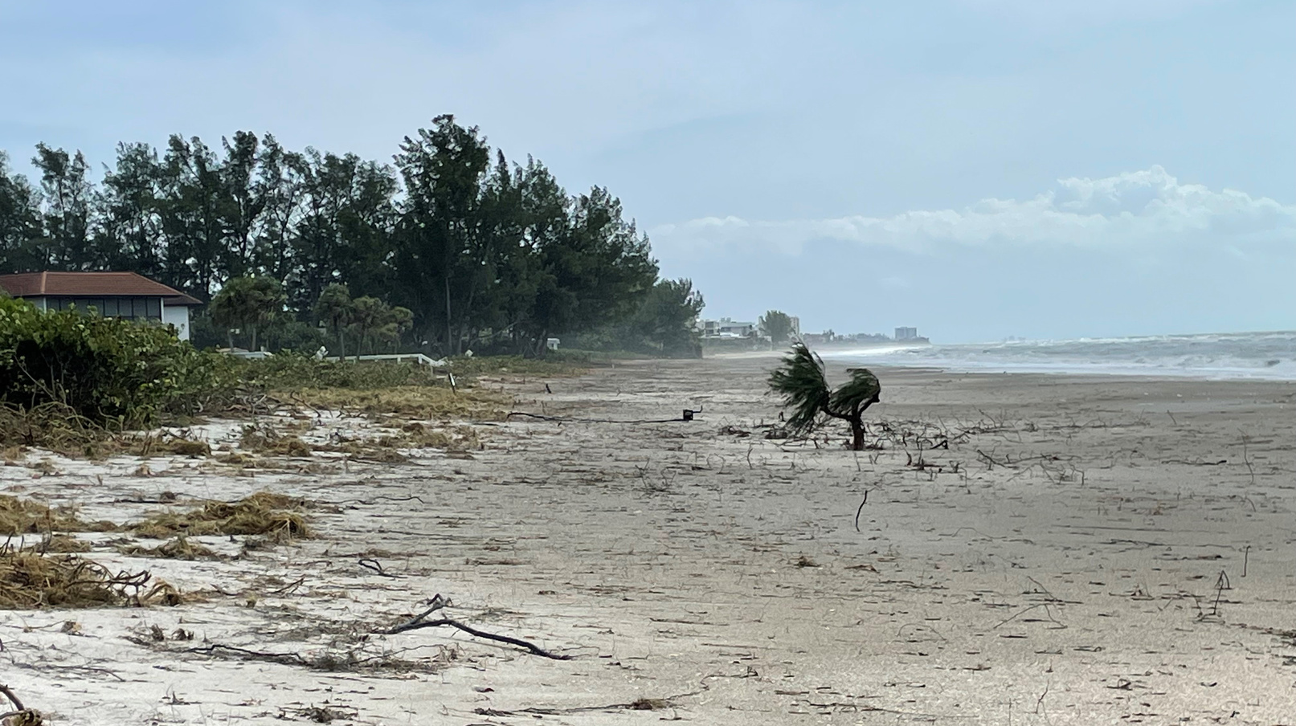
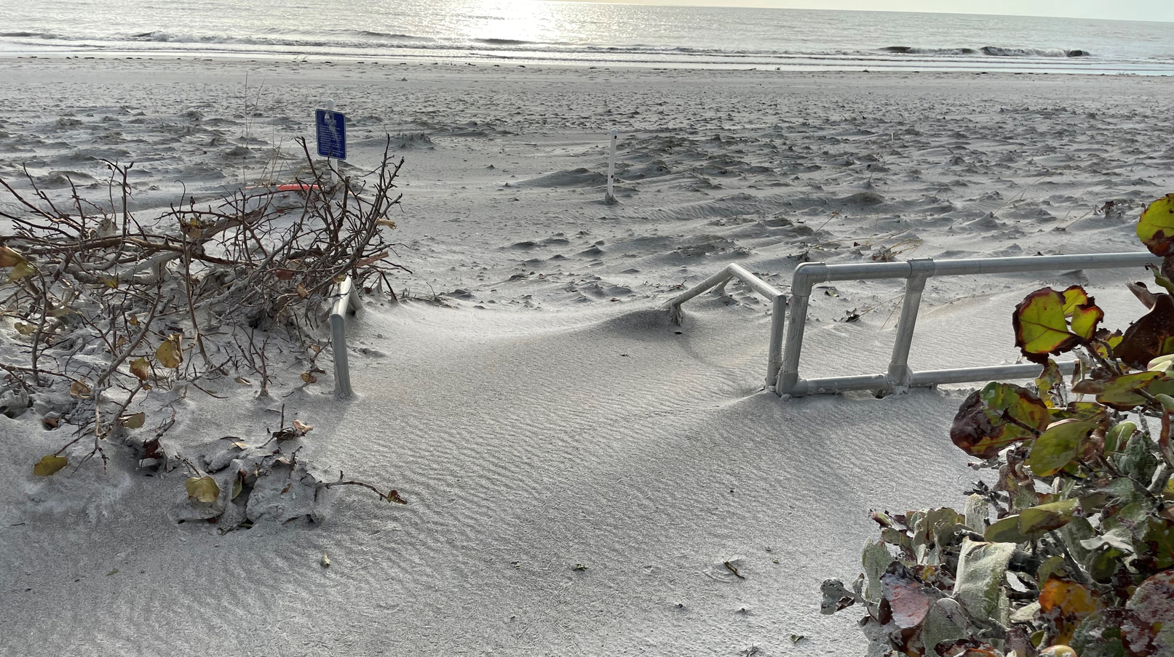
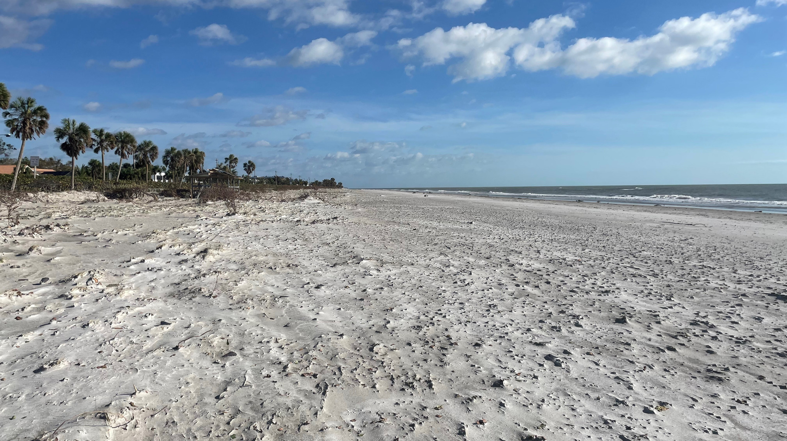

Slide 10
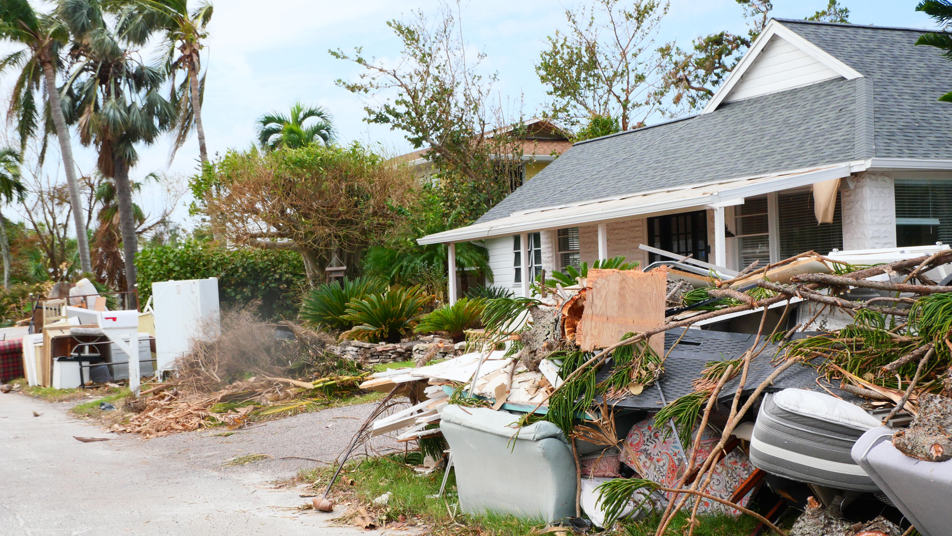
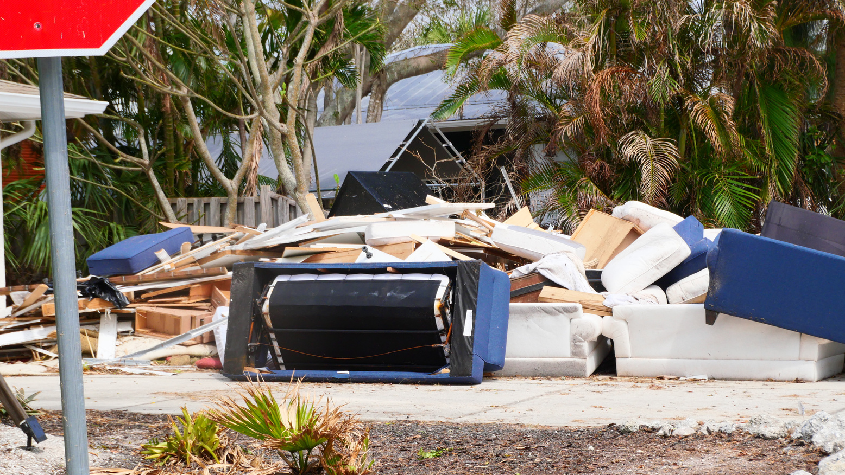

Slide 11
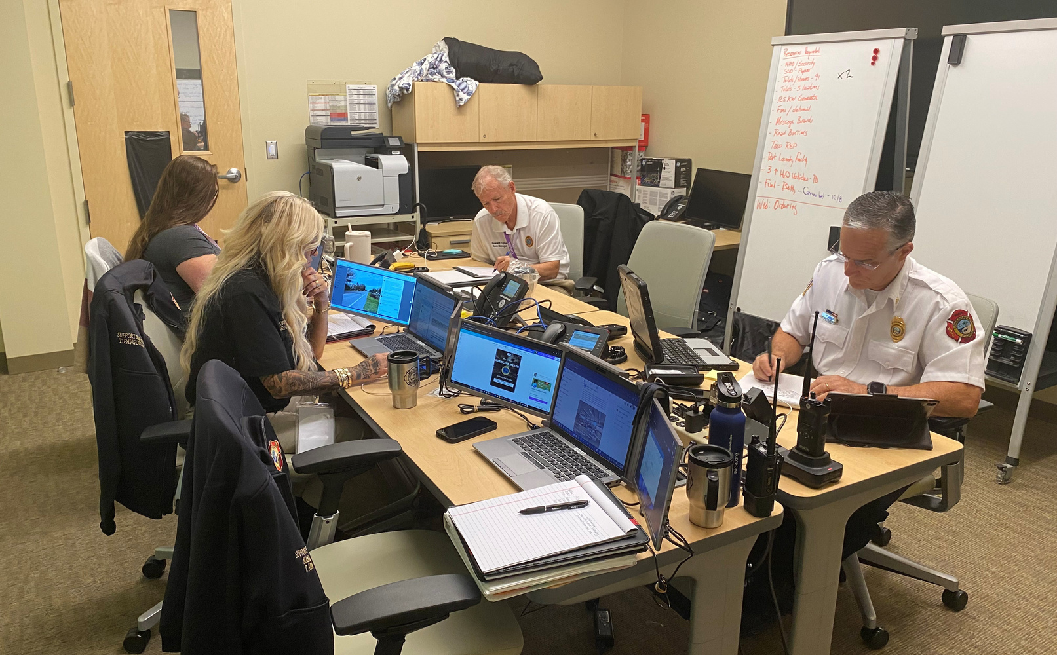
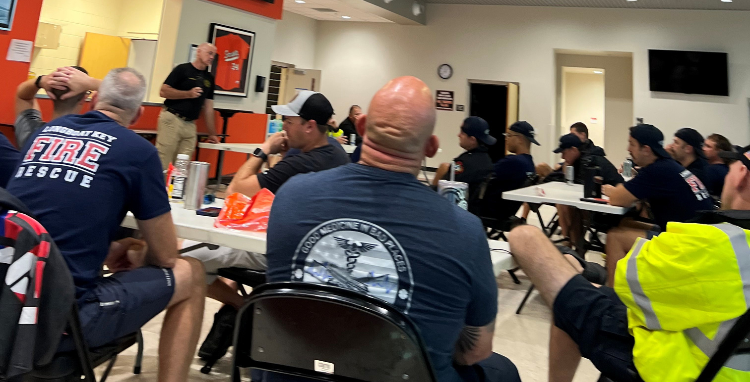
Teamwork

Slide 13
Relationships

Slide 15
Communications
Alert Longboat Key
Daily Briefings
Social Media
Website
E-Notifications
Media Relations
Sign up for E-Notifications
TownofLBK
townoflbk
TownofLBK
@longboatkey7189

Slide 16
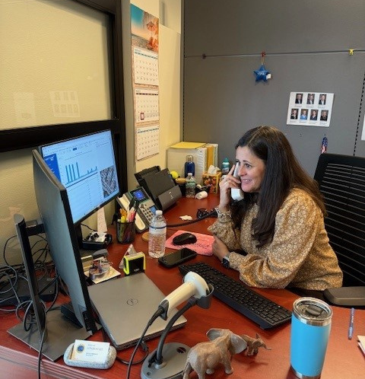
Thank you
Town Clerk’s Office
Over 7,000 calls

Slide 17
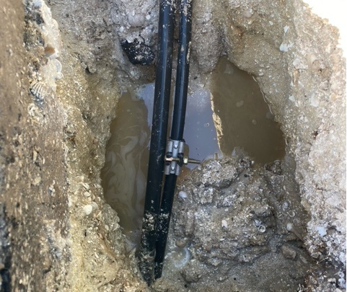
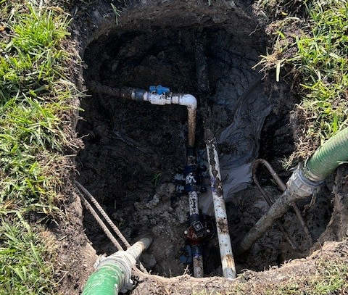
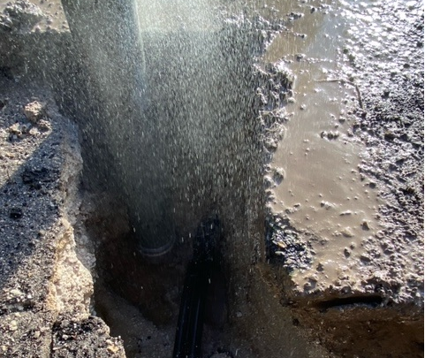

Slide 19
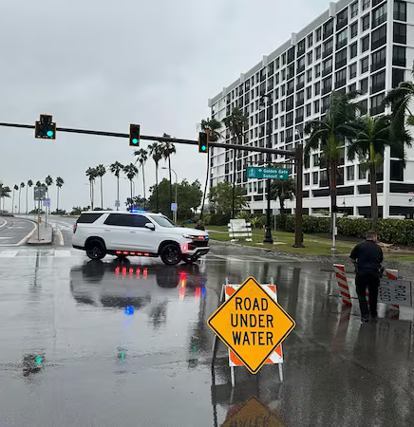
Re-entry
Tier 1: Emergency Responders to ensure the island is safe to access
Tier 2: Individuals from the public and private sectors who support the restoration of critical infrastructure to facilitate the re-entry of the public
Tier 3: Town Residents and Business Owners

Slide 21
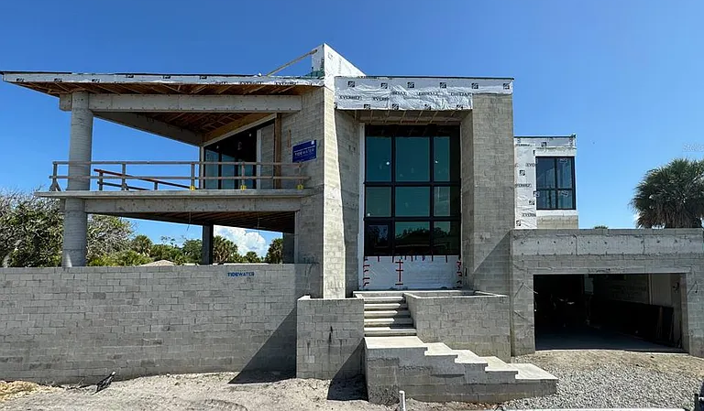
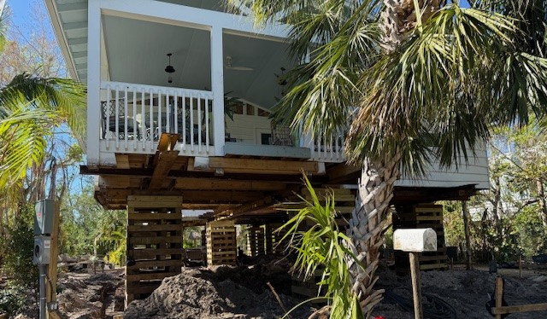
Permitting the Recovery

Slide 22
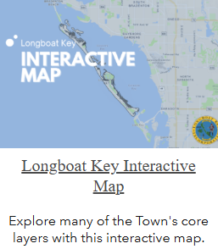
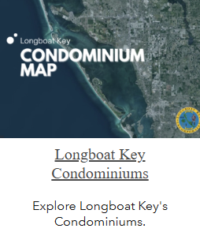
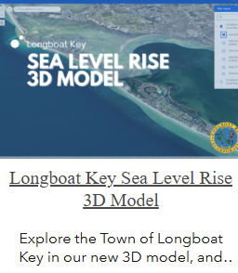
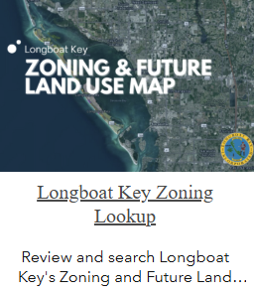
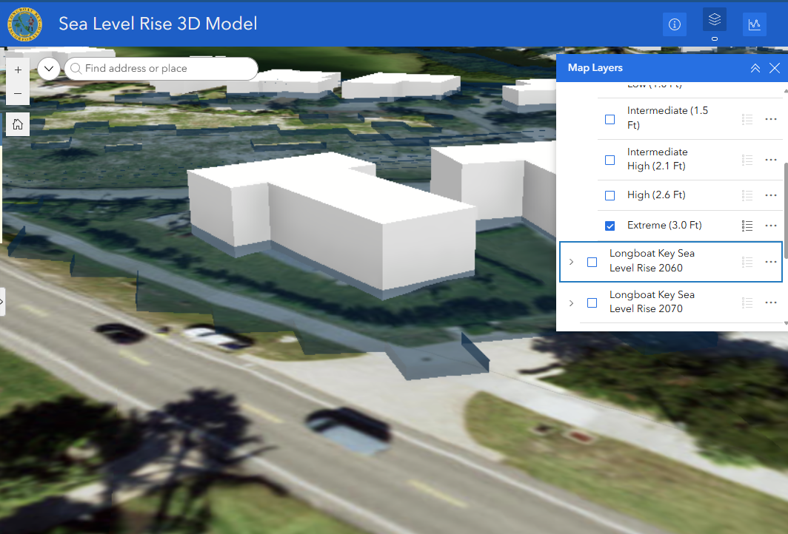
Online GIS Services Overview
Online GIS Services Overview
Online GIS Services
Search for addresses, Town Boundaries, Facilities, Condominiums, Evacuation Routes, etc.
Find information on all structures including condominiums
Find zoning information
Sea Level 3D Modeling.

Slide 23
Pastor Pals
Thank you to our faith community

Slide 24
Lessons Learned
Teamwork
Review Insurance
County and City Relationships
Asking for Assistance Early
Reserves
Communications
Evacuation Orders

Slide 25
THANK YOU

