Slide 1
Longbeach Village
Parking Options
Commission Regular Workshop
September 15, 2014

Slide 2
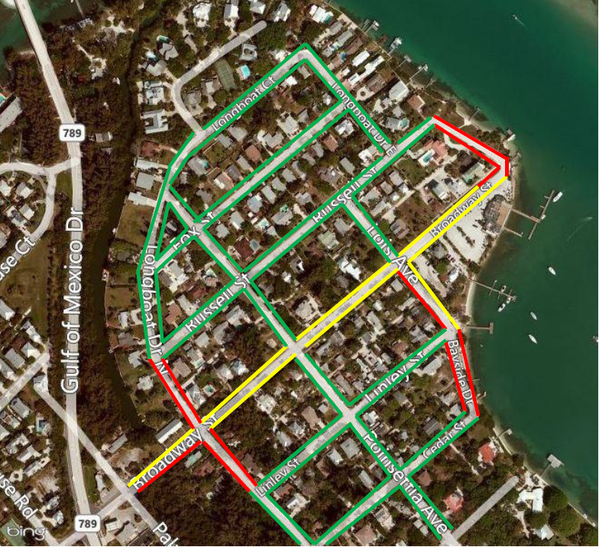
Longbeach Village Current Parking Schedule
Red: No parking; Yellow: No Parking 11pm-5am; Green: Parking Anytime

Slide 3
Longbeach Village Parking
Recent Town Commission Discussions
Sept. 24, 2012 – Business Owners Request Extended
Parking Hours
- Staff Directed to Draft Ordinance
Nov. 5, 2012 – Ordinance 2012-30 to Amend Parking Hours
- Parking to 11pm,Trial Basis until Feb. 28, 2013
Dec. 3, 2012 – Ordinance 2012-30 Amended to May 1, 2013
- Adopted Ordinance 2012-30

Slide 4
Longbeach Village Parking
Recent Town Commission Discussions
Feb. 19, 2013 – Ordinance 2013-08 Proposed
- Change Parking Hours to Year Round
Apr. 1, 2013 – Adopted Ordinance 2013-08

Slide 5
Longbeach Village Parking
Recent History
Mar. 19, 2014 – Letter of Concern from Village
Apr. 21, 2014 – Workshop to Discuss Concerns
May 6, 2014 – No Parking Here to Corner signs
installed at Broadway/Lois and
Broadway/Poinsetta

Slide 6
Longbeach Village Parking
Suggestions by Residents
Option 1: Resident Parking Sticker System
Option 2: Village Wide Program
(signs throughout village)
Option 3: Selective
(identify problem streets and blocks)
Residents recommend Option 3

Slide 7
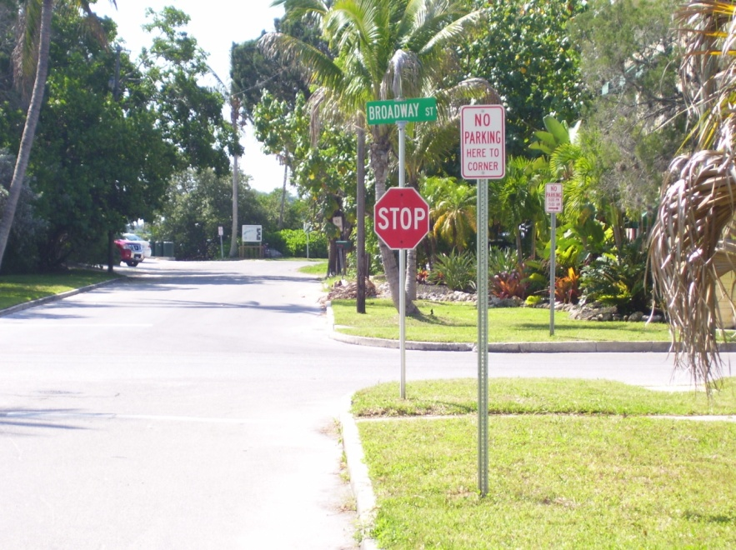
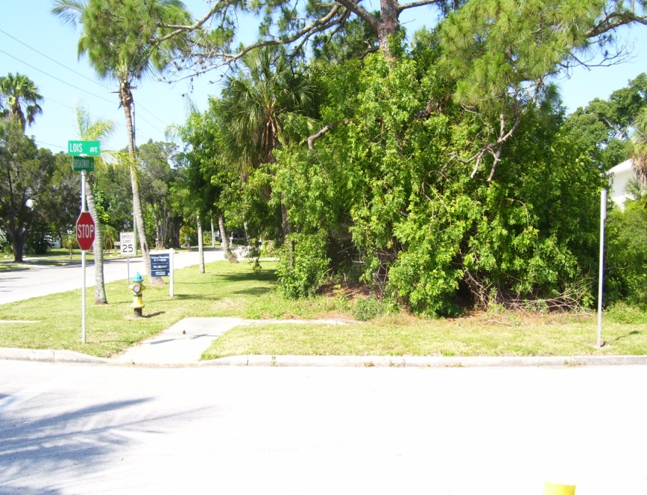
Longbeach Village Parking
No Parking Here to Corner Signs

