Slide 1
Longbeach Village Parking
Regular Meeting
November 3, 2014

Slide 2
Recent Town Commission Actions
Sept. 24, 2012 Businesses Request Extended Parking Hours
Nov. 5, 2012 Code Amended to Restrict Parking on Trial Basis from 11PM to 5AM until
Feb. 28, 2013
Dec. 3, 2012 Code Amended Extending Trial to
May 1, 2013
Feb. 19, 2013 Ordinance 2013-08 Proposed to Change Parking Hours to Year Round

Slide 3
Apr. 1, 2013 Adopted Ordinance 2013-08
Mar. 19, 2014 Letter of Concern from Residents
Apr. 21, 2014 Workshop to Discuss Concerns
Alan Moore Offers Potential Solutions
Town Commission Directs Staff to Implement New Parking Schedule
Sept. 15, 2014 Workshop Outlining Proposed Changes
Oct. 6, 2014 First Reading of Ordinance 2014-13 with
Addition of No Parking to One Side of Linley Street

Slide 4
PROPOSED PARKING SCHEDULES
SCHEDULE I: PROHIBITED PARKING
SCHEDULE II: RESTRICTED PARKING
Underline and Strikethrough indicates Additions and Deletions
Proposed amendments are highlighted in Code Sections

Slide 5
PROPOSED PARKING SCHEDULE
No parking Entire North Side of Broadway Street from Palm Drive to Bayside Drive
No Parking 11PM - 5AM Entire South Side of Broadway Street from Palm Drive to Bayside Drive
No Parking East Side of Street on Lois Street Between Broadway Street and Russell Street
No Parking East Side of Street on Poinsetta Avenue Between Broadway Street and Russell Street
No Parking North Side of Linley Street from Longboat Drive South to Lois Street

Slide 6
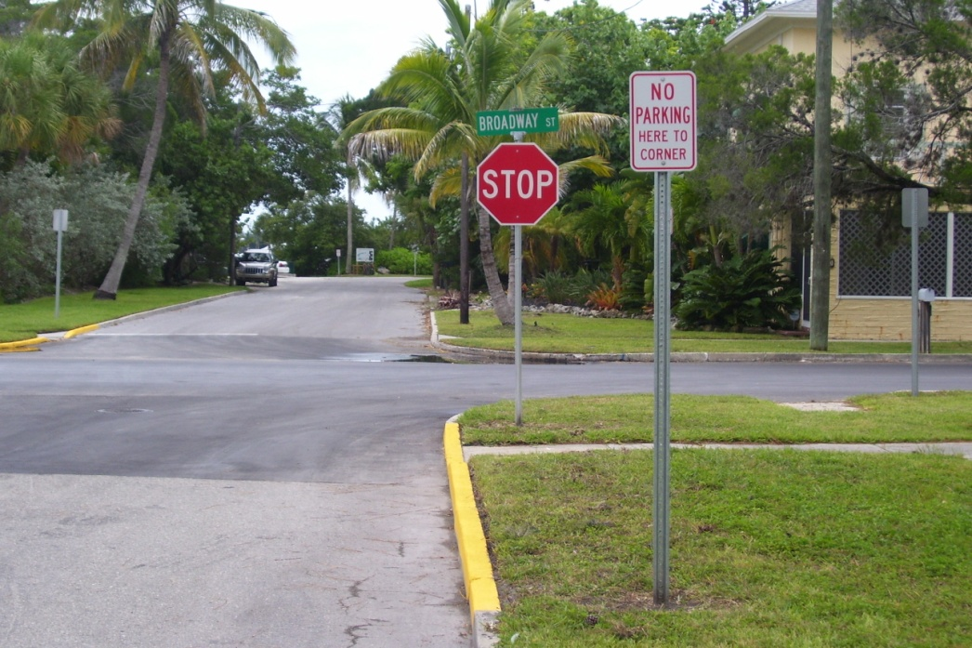
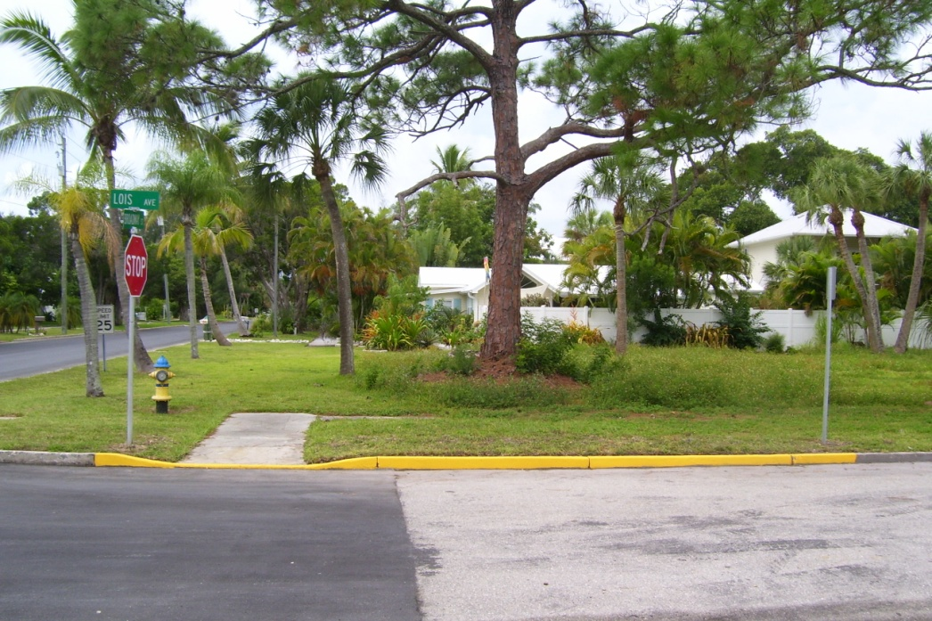
Longbeach Village Parking
"No Parking Here to Corner" Signs

Slide 7
