Slide 1
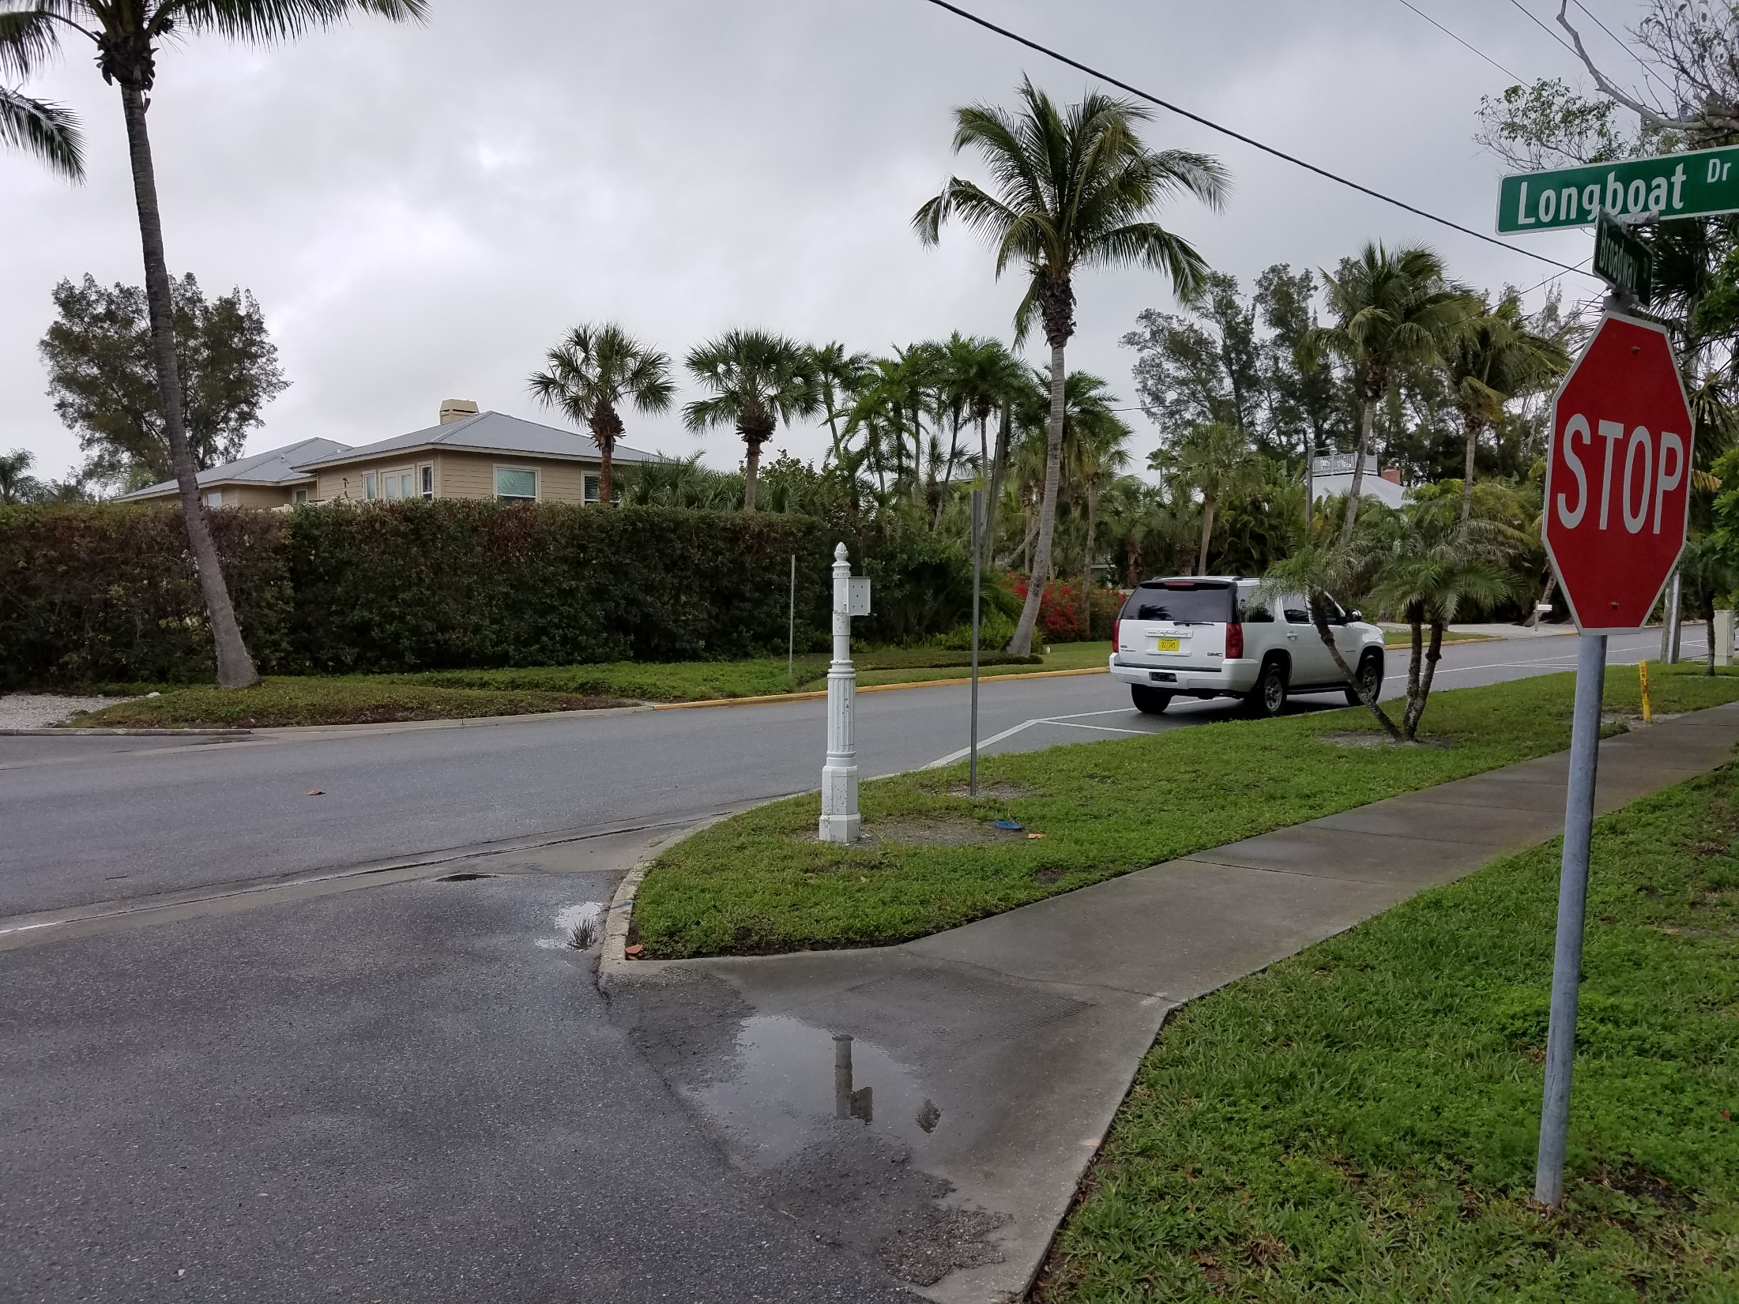
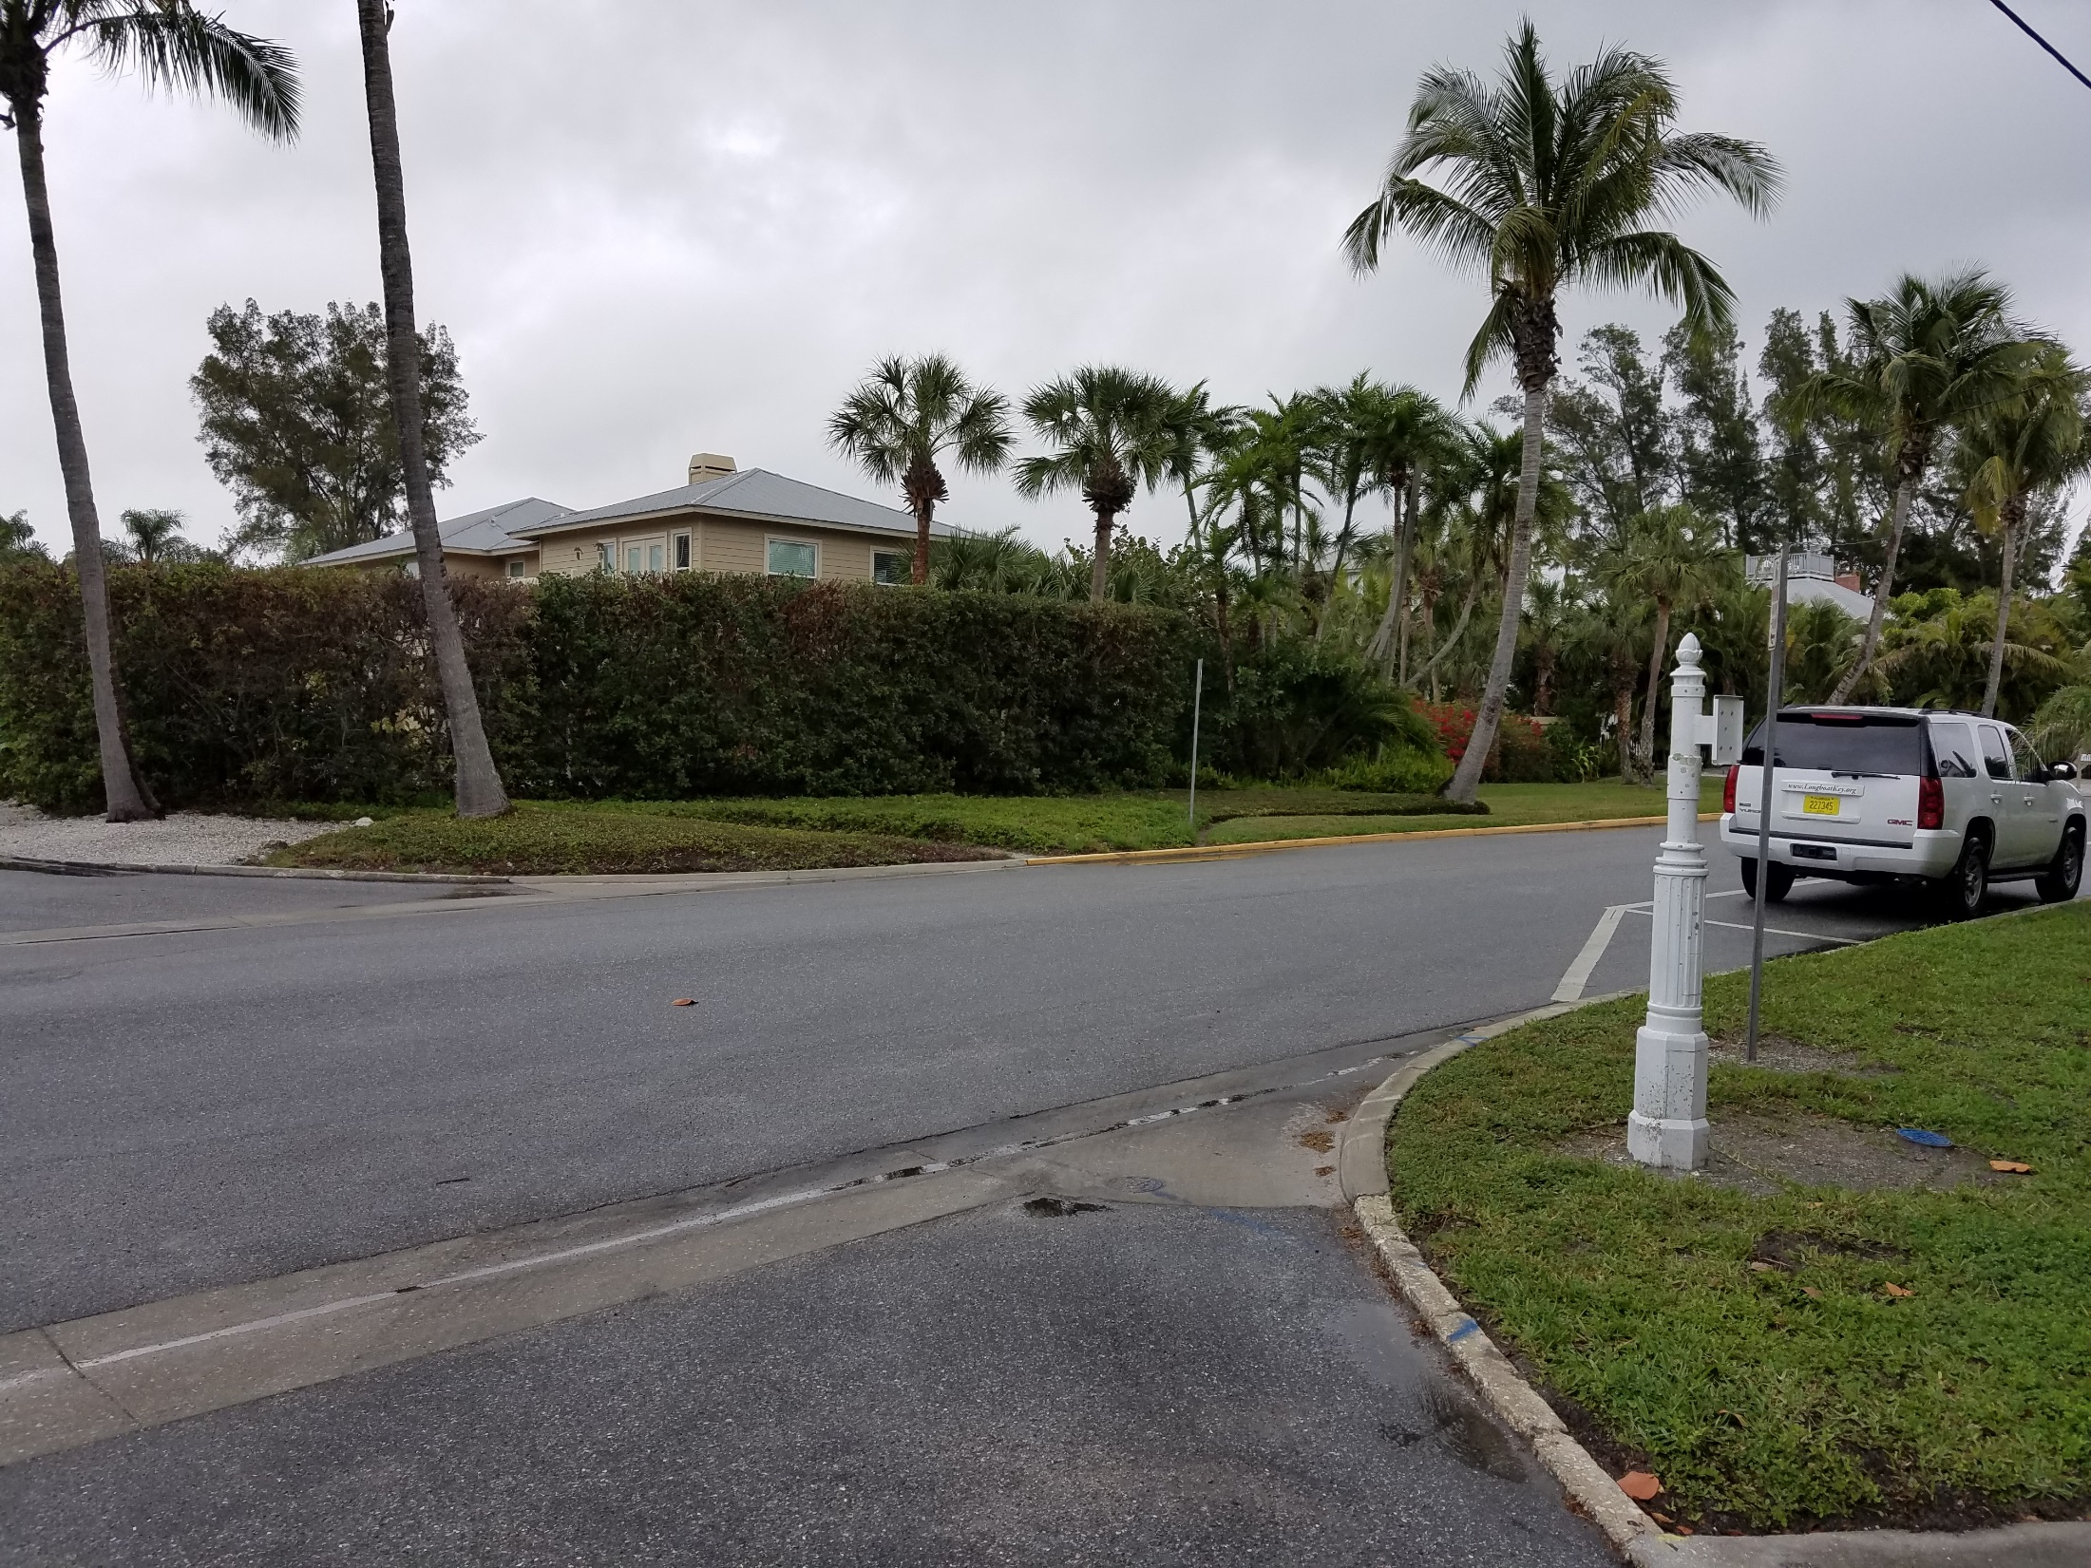
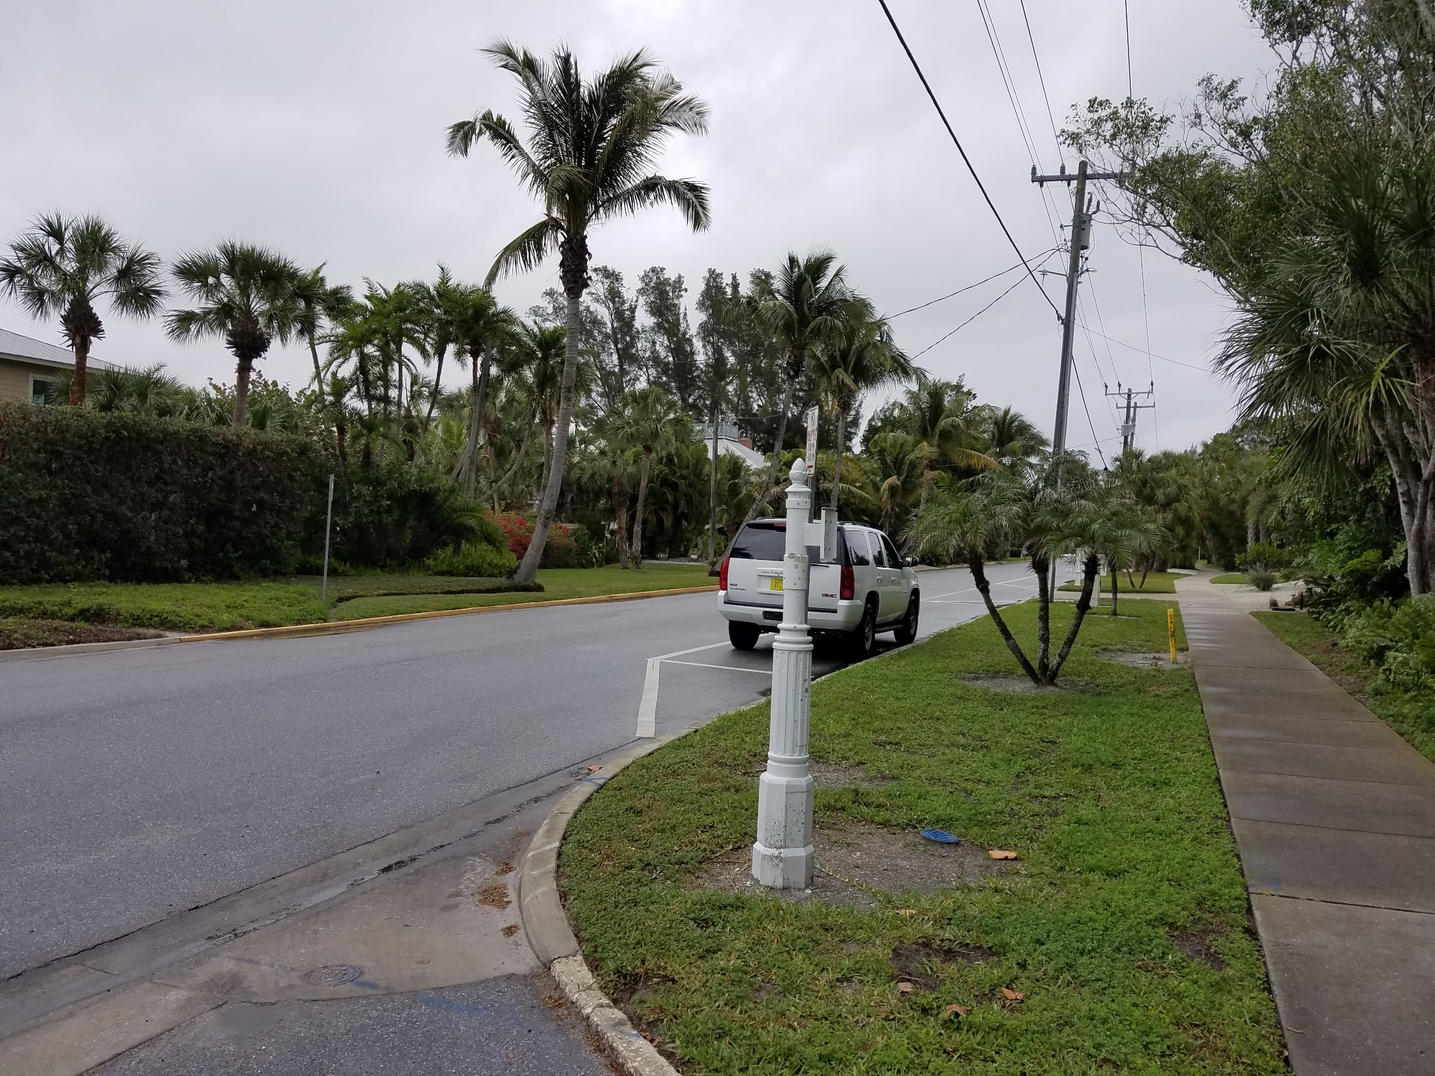
Broadway parking
Posted Speed: 25 mph

Slide 2
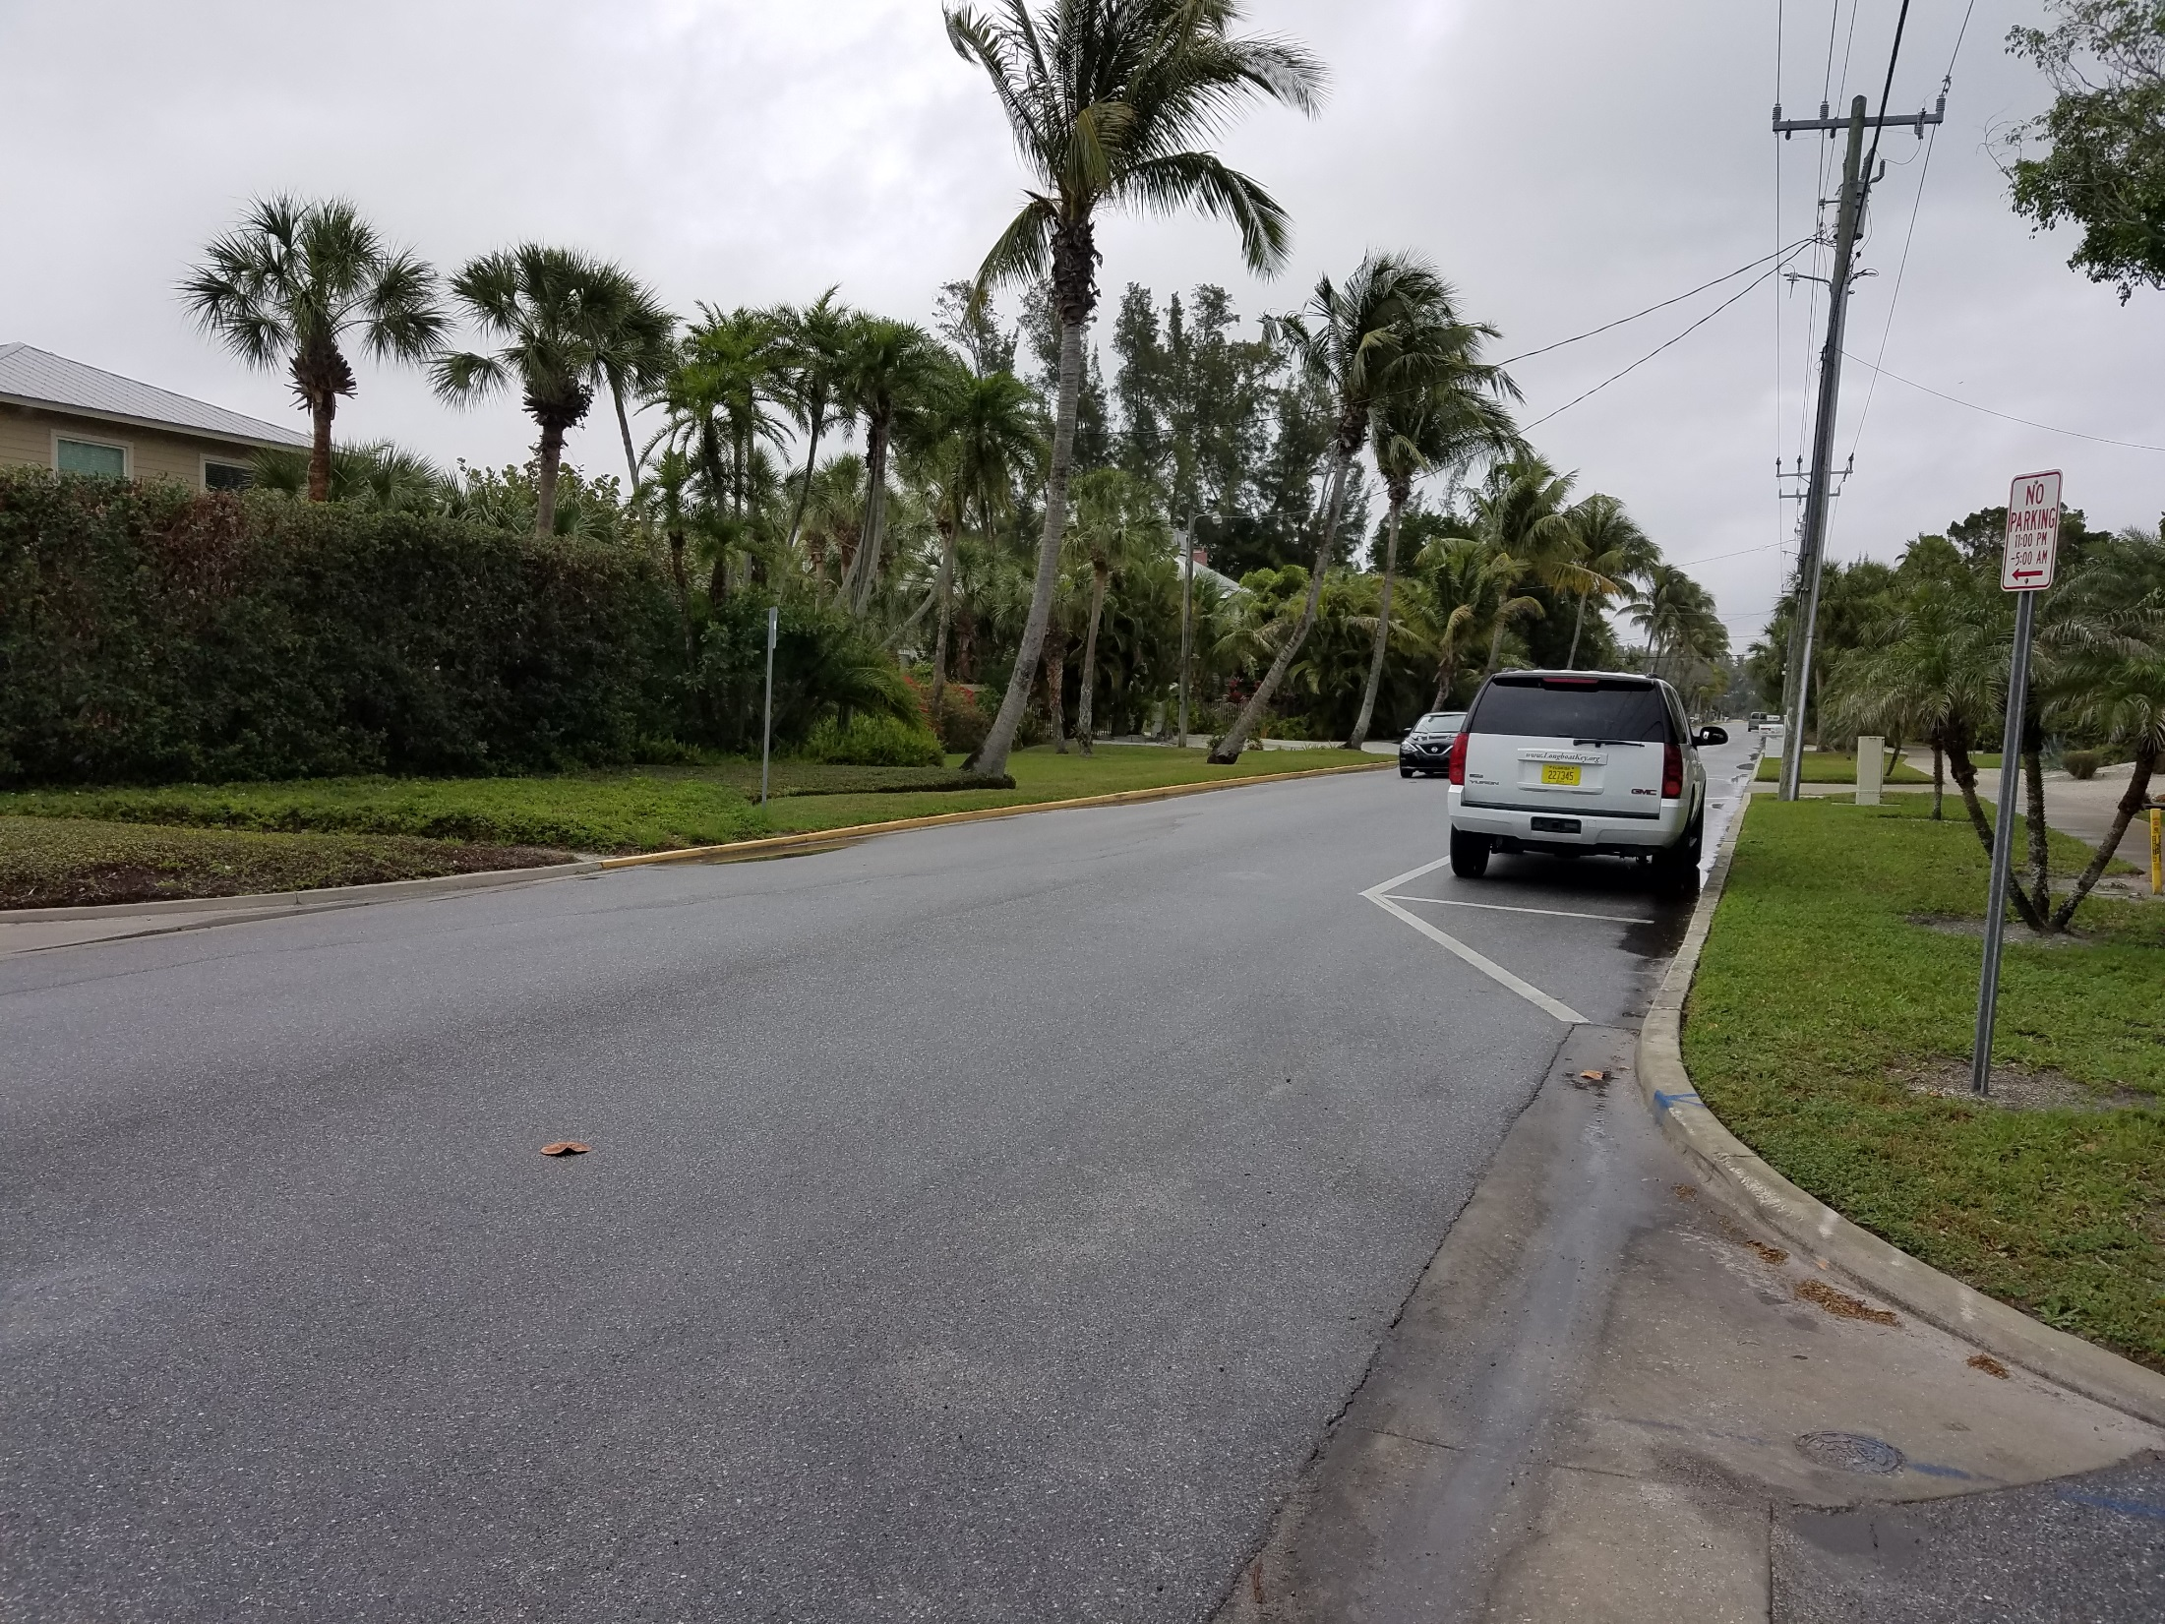
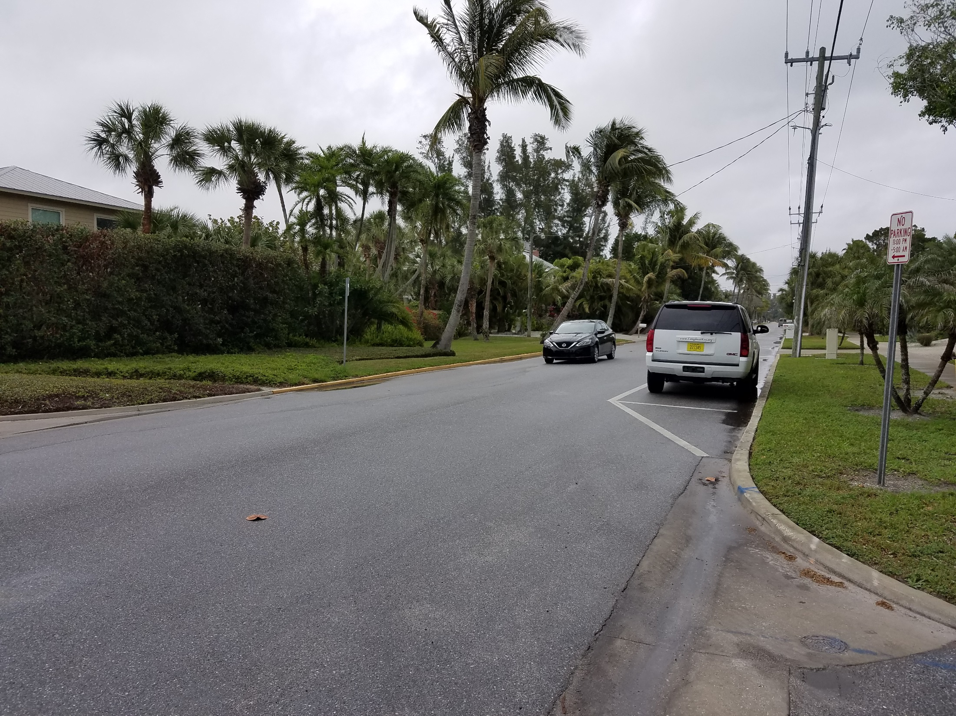
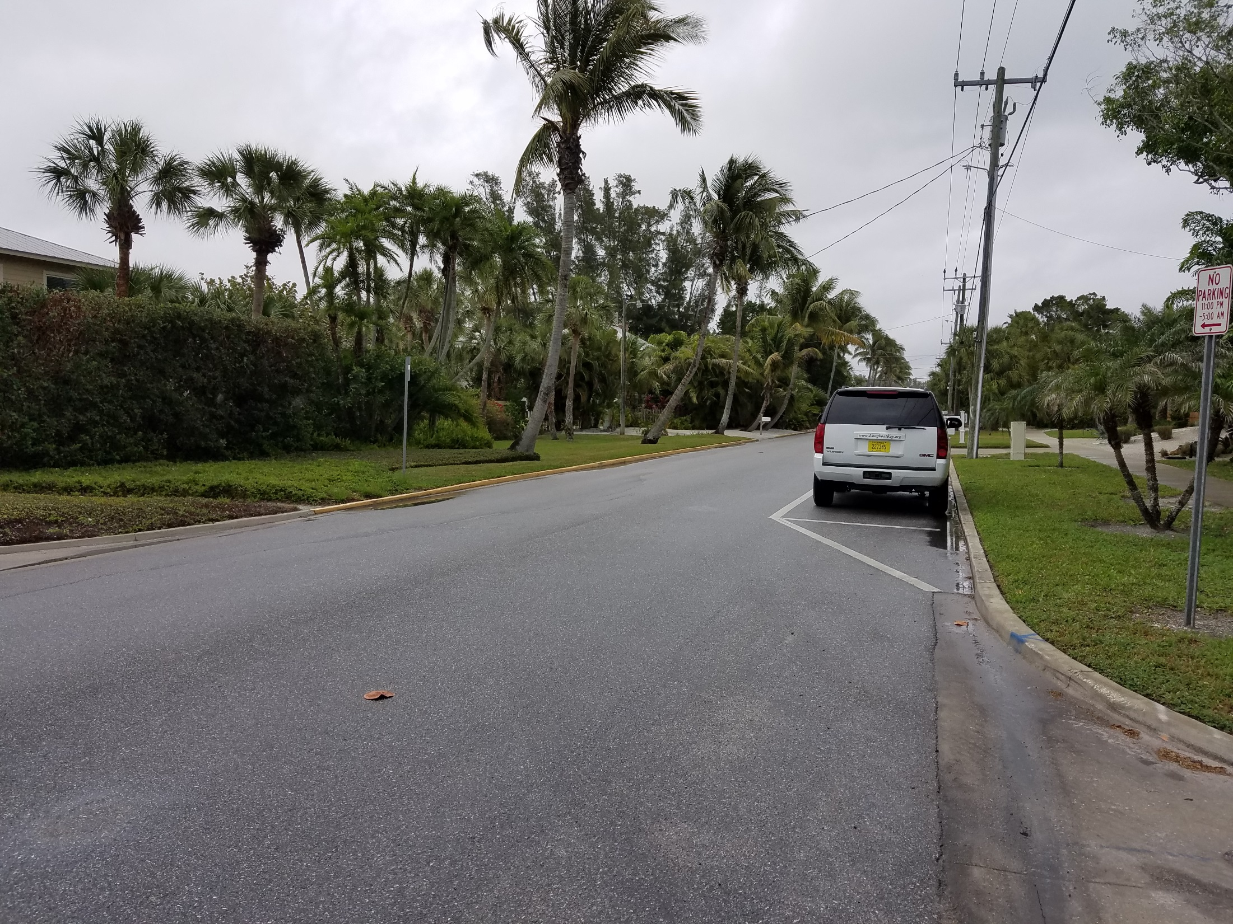
Broadway parking

Slide 3
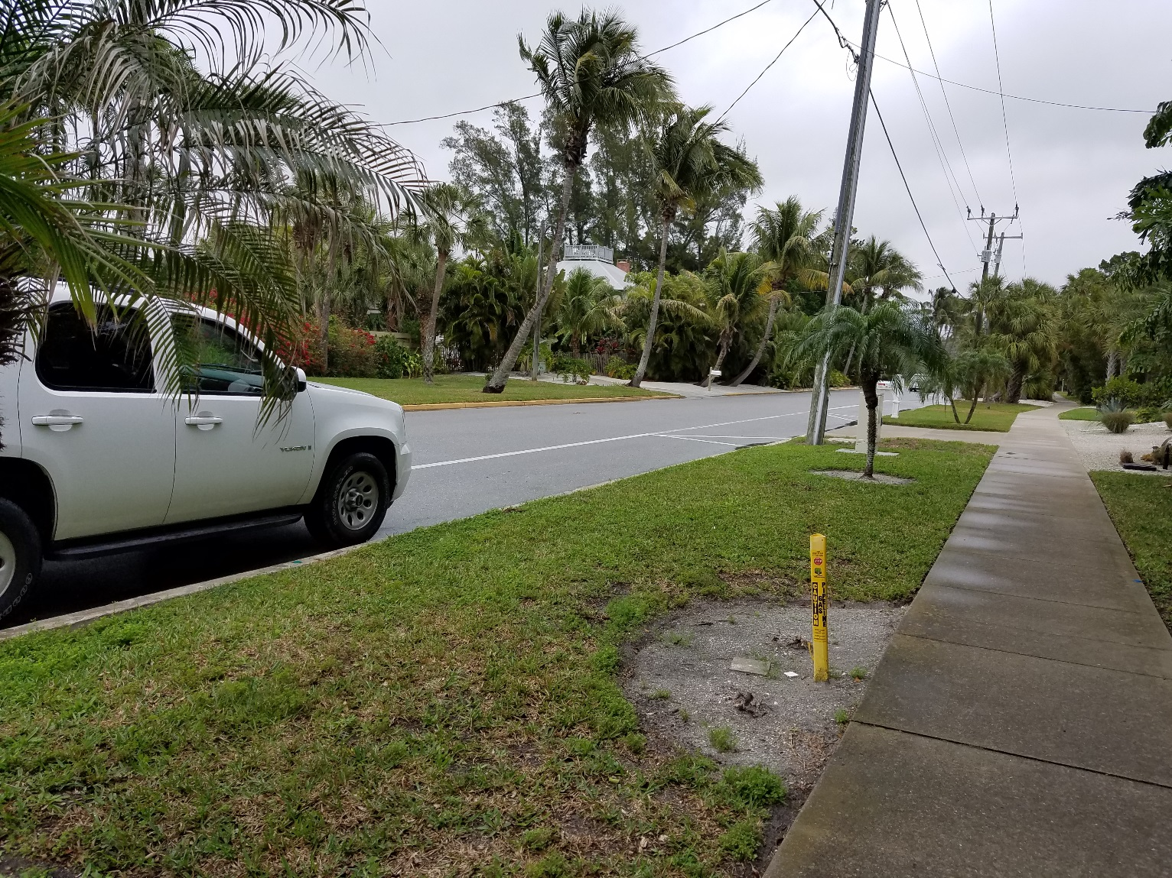
Broadway parking

Slide 4
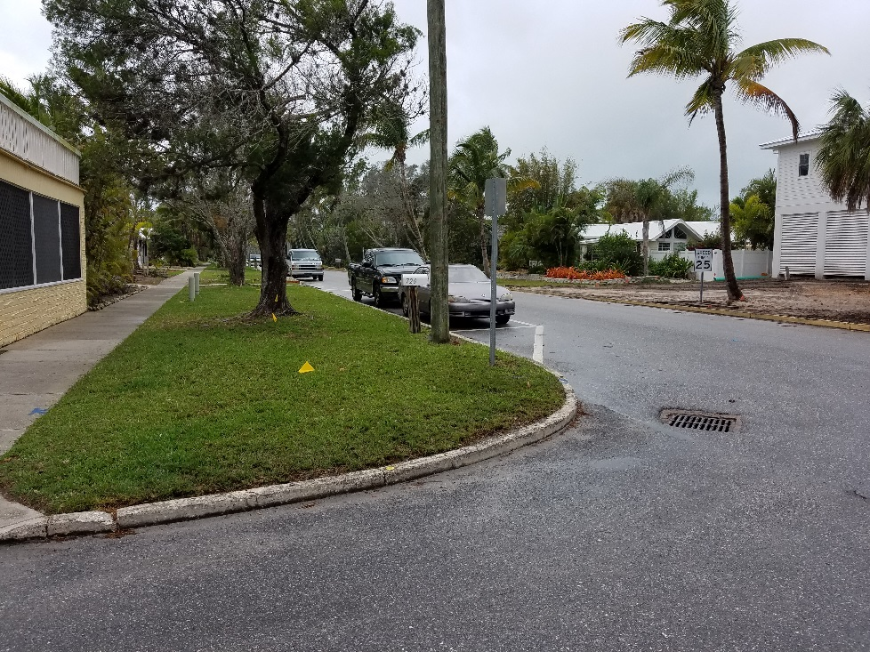
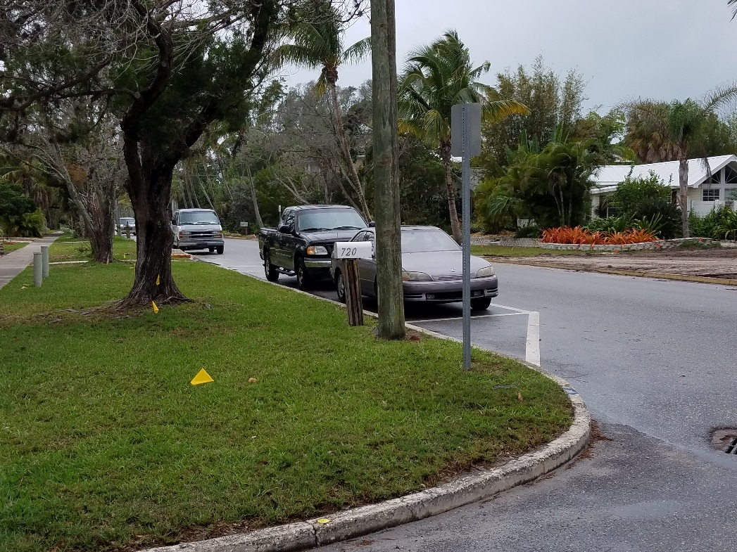
Broadway parking

Slide 5
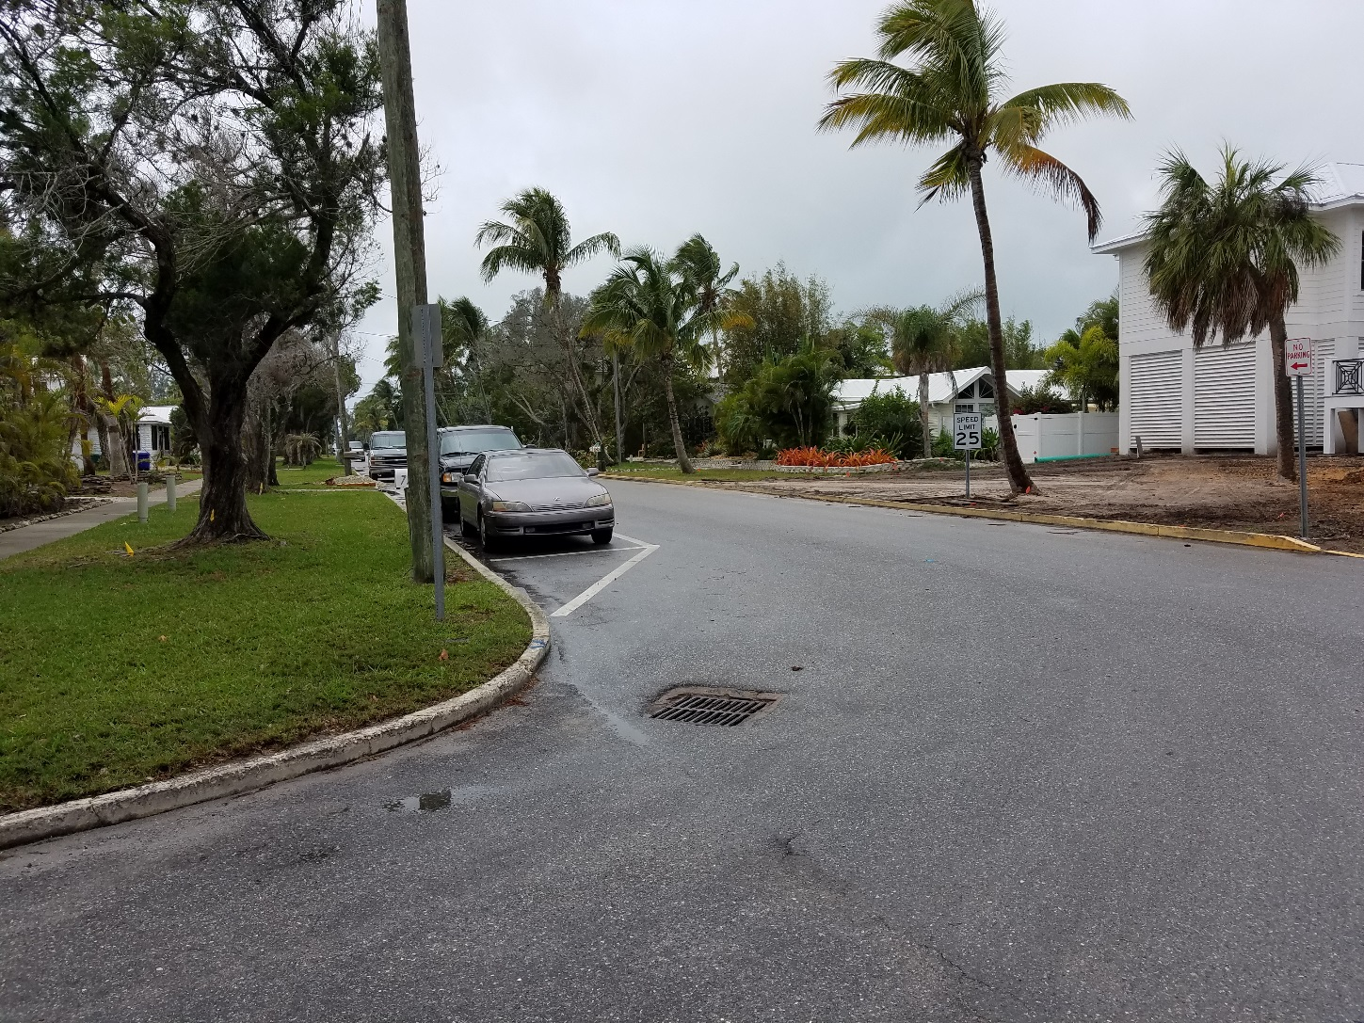
Broadway parking

Slide 6
Broadway @ gulf of mexico drive
SR 789: 35 mph (45 mph)
316.1945 Stopping, standing, or parking prohibited in specified places.—
(1) Except when necessary to avoid conflict with other traffic, or in compliance with law or the directions of a police officer or official traffic control device, no person shall:
(a) Stop, stand, or park a vehicle:
1. On the roadway side of any vehicle stopped or parked at the edge or curb of a street.
2. On a sidewalk.
3. Within an intersection.
4. On a crosswalk.
5. Between a safety zone and the adjacent curb or within 30 feet of points on the curb immediately opposite the ends of a safety zone, unless the Department of Transportation indicates a different length by signs or markings.

Slide 7
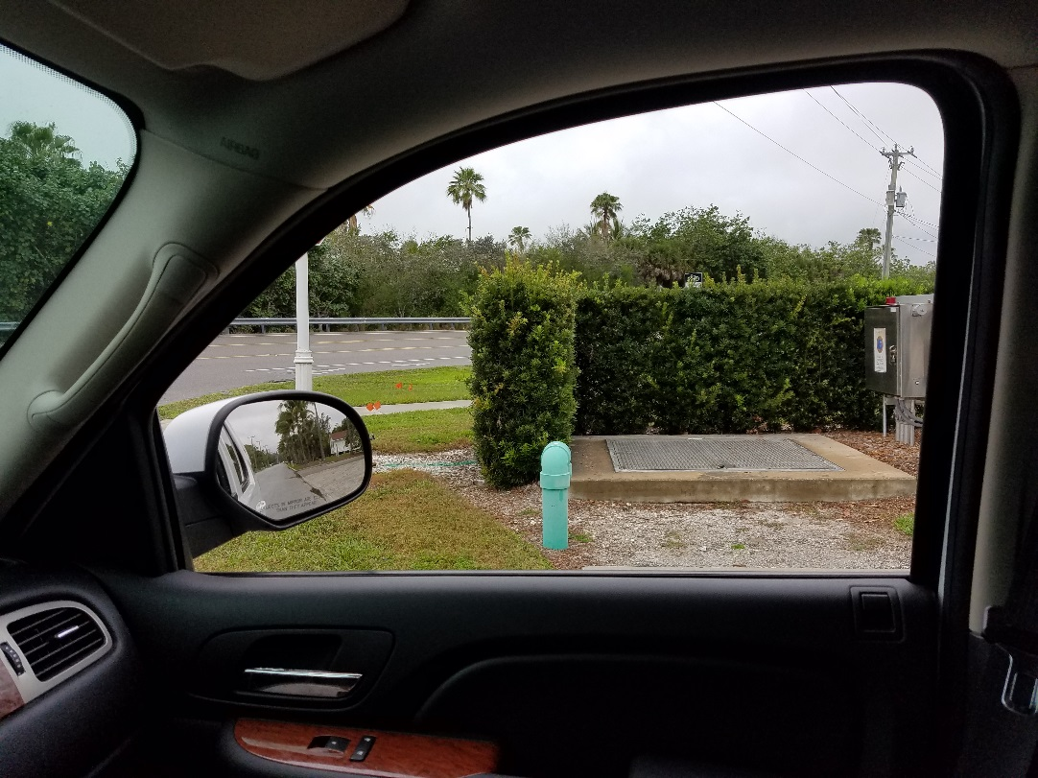
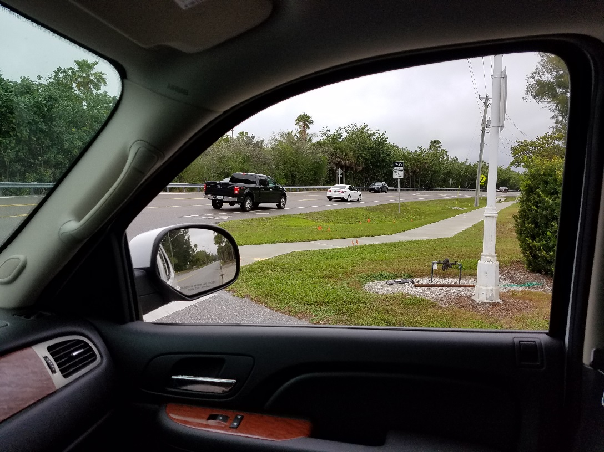
Broadway @ gulf of mexico drive
SR 789: 35 mph (45 mph)
At stop sign / stop bar
Past stop bar, not in crosswalk: roughly 430-feet (computer measure)

Slide 8
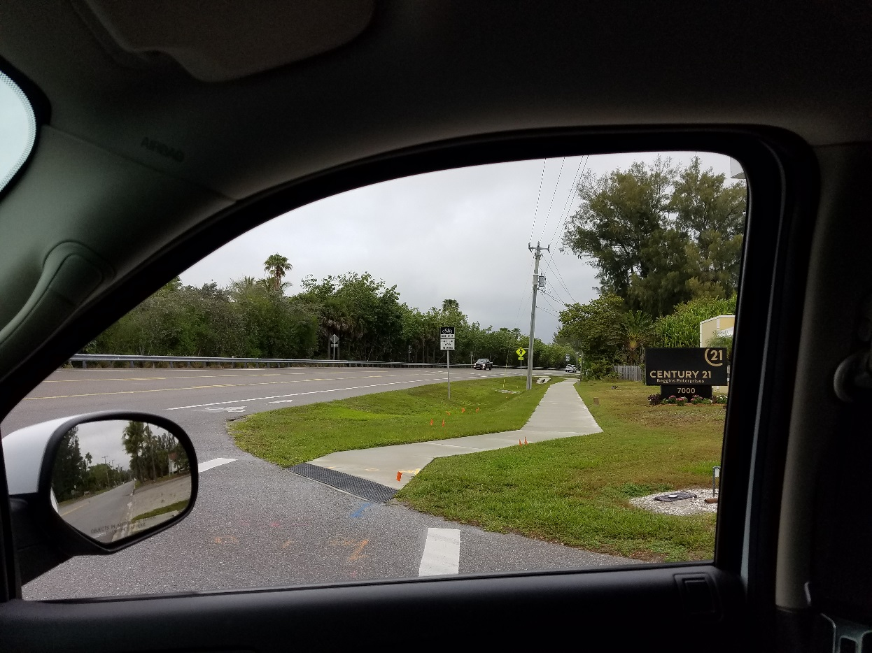
Broadway @ gulf of mexico drive
SR 789: 35 mph (45 mph)
Within crosswalk (no peds), not in bike lane:
Good visibility 600+ feet (computer measure)

Slide 9
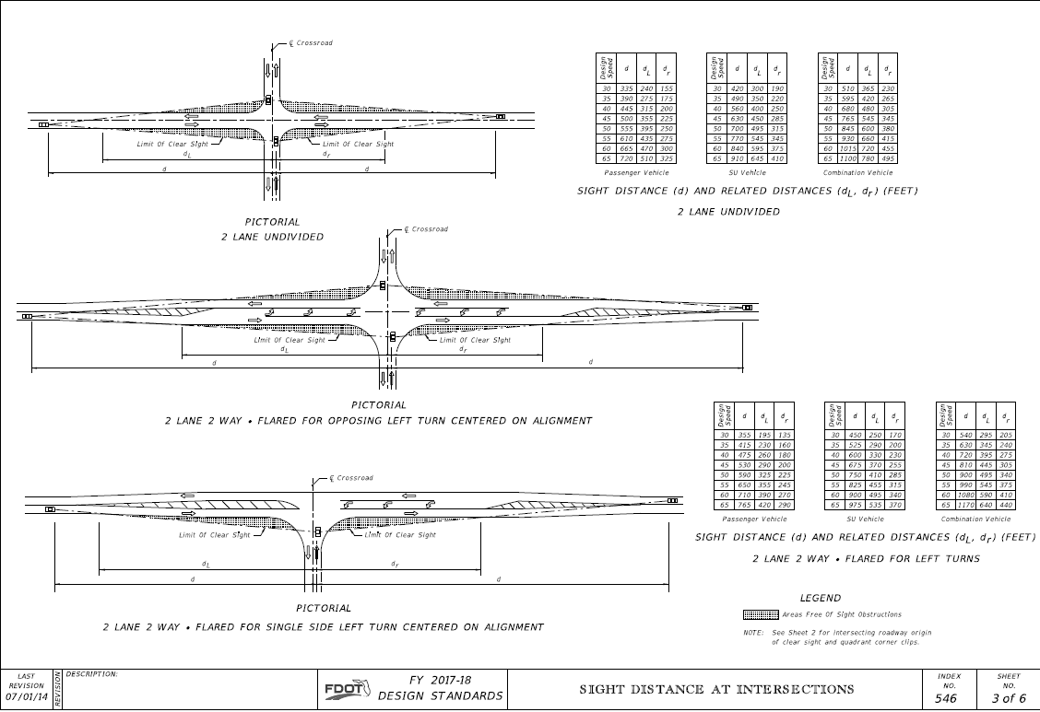
Broadway @ gulf of mexico drive
SR 789: 35 mph (45 mph)

