Slide 1
Longbeach Village Parking
Regular Meeting
October 6, 2014

Slide 2
Recent Town Commission Actions
Sept. 24, 2012 Businesses Request Extended Parking Hours
Nov. 5, 2012 Code Amended to Restrict Parking on Trial Basis from 11PM to 5AM until Feb. 28, 2013
Dec. 3, 2012 Code Amended Extending Trial to May 1, 2013
Feb. 19, 2013 Ordinance 2013-08 Proposed to Change Parking Hours to Year Round

Slide 3
Apr. 1, 2013 Adopted Ordinance 2013-08
Mar. 19, 2014 Letter of Concern from Residents
Apr. 21, 2014 Workshop to Discuss Concerns Alan Moore Offers Potential Solutions Town Commission Directs Staff to Implement New Parking Schedule
Sept. 15, 2014 Workshop Outlining Proposed Changes

Slide 4
PROPOSED PARKING SCHEDULES
SCHEDULE I: PROHIBITED PARKING
SCHEDULE II: RESTRICTED PARKING
Underline and Strikethrough indicates Additions and Deletions
Proposed amendments are highlighted in Code Sections

Slide 5
PROPOSED PARKING SCHEDULE
No parking Entire North Side of Broadway Street from Palm Drive to Bayside Drive
No Parking 11PM - 5AM Entire South Side of Broadway Street from Palm Drive to Bayside Drive
No Parking East Side of Street on Lois Street Between Broadway Street and Russell Street
No Parking East Side of Street on Poinsetta Avenue Between Broadway Street and Russell Street

Slide 6
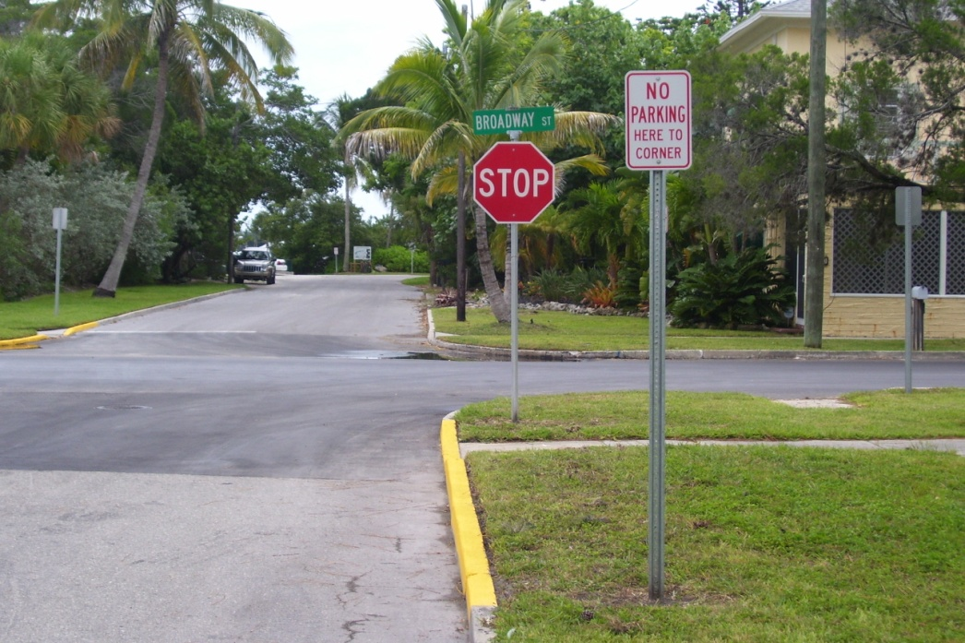
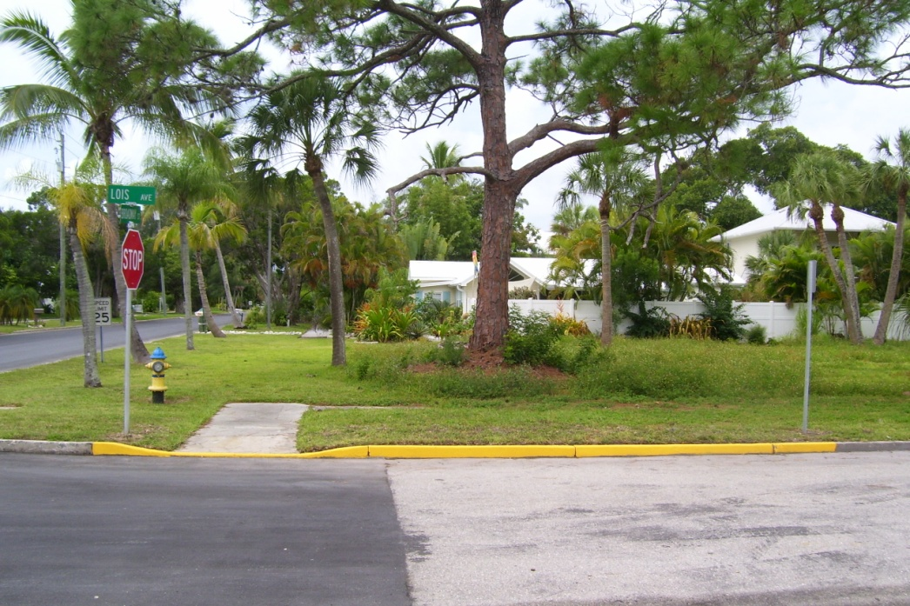
Longbeach Village Parking
"No Parking Here to Corner" Signs

Slide 7
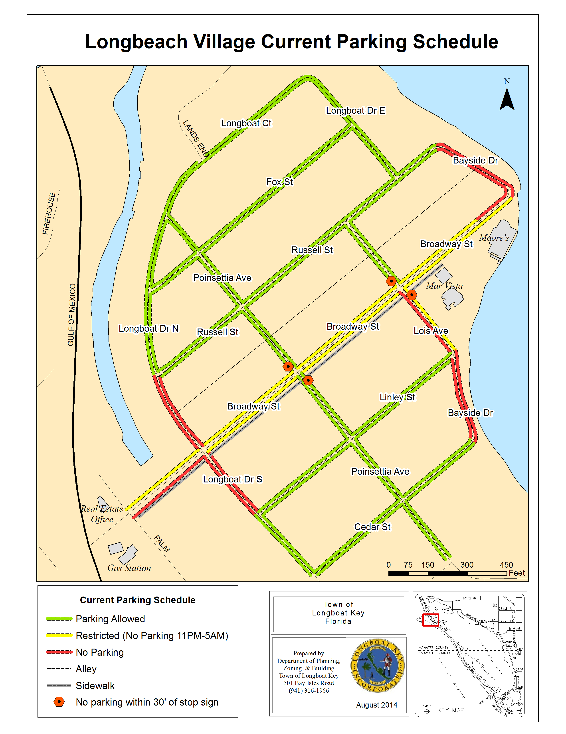

Slide 8
