Slide 1
Village Parking
Chapter 74, Parking Schedules
SCHEDULE I: PROHIBITED PARKING
SCHEDULE II: RESTRICTED PARKING

Slide 2
SCHEDULE I: PROHIBITED PARKING

Slide 3
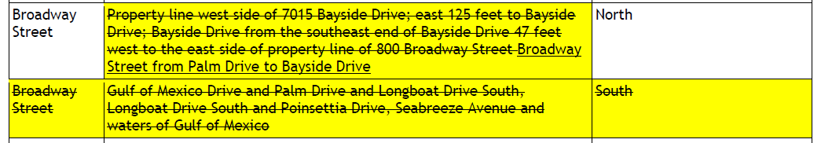

Slide 4
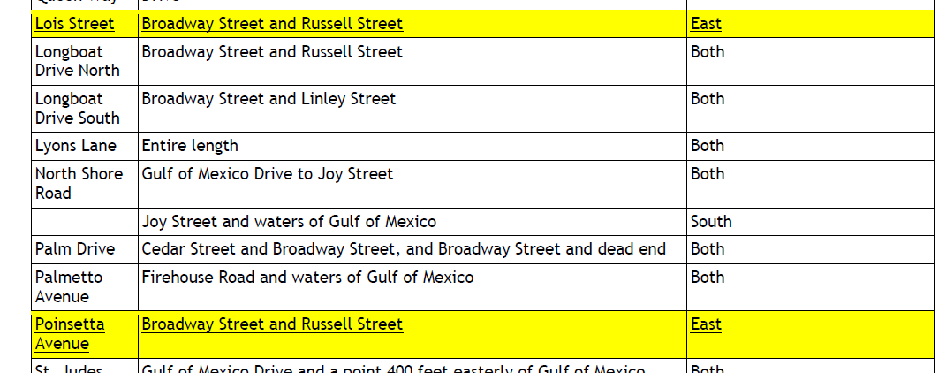

Slide 5
SCHEDULE II: RESTRICTED PARKING

Slide 6
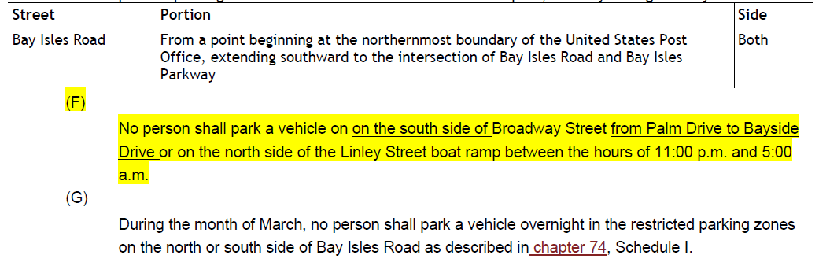
SCHEDULE II: RESTRICTED PARKING

