Slide 1
Longbeach Village Longboat Key Parking Concerns
Commission Regular Workshop
April 21, 2014

Slide 2
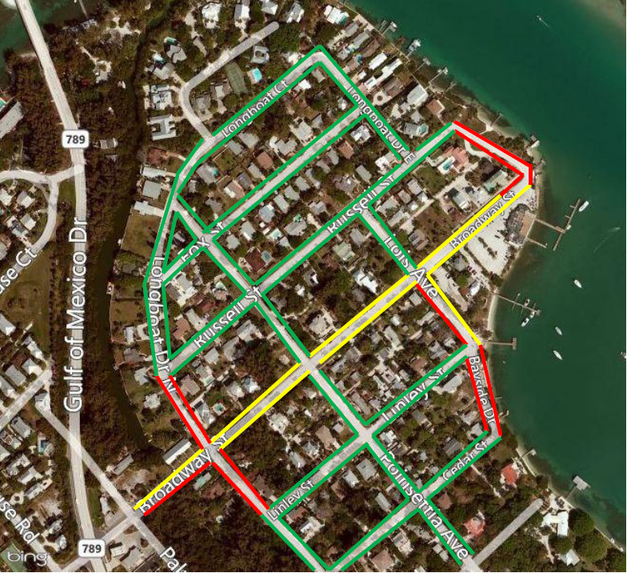
Longbeach Village Current Parking Schedule
Red: No parking, Yellow: No Parking 11pm-5am, Green: Parking Anytime

Slide 3
Longbeach Village Parking
Recent History
Nov. 2012 – Street Parking Concerns
Nov. 2012 – Restaurant Parking Request
Dec. 2012 – TCRM Discussion
Dec. 2012 – Trial Basis of New Parking Hours

Slide 4
Longbeach Village Parking
Recent History
Feb. 2013 – TCWS Proposed Ordinance 2013-08
Mar. 2013 – TCRM First Reading
Apr. 2013 – TCRM Second Reading
Apr. 2013 – Adopted Ordinance 2013-08

Slide 5
Longbeach Village Parking
Recent History
Mar. 2014 – Letter of Concern from Village
Apr. 2014 – Workshop Item Requested

