Slide 1
Longbeach Village Alleys, Longboat Key Bay Access Inventory and
Durante Park Property Line Report
Commission Regular Workshop
December 11, 2013

Slide 2
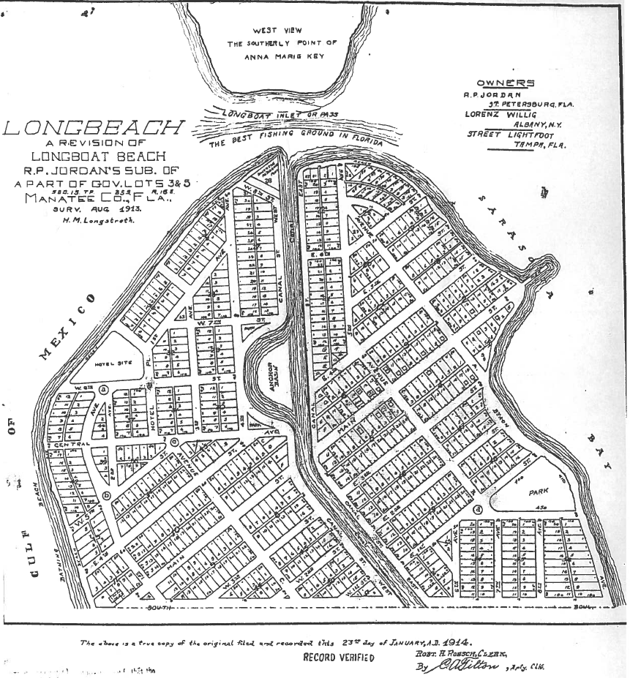
Longbeach Village Alleys

Slide 3
Longbeach Village Alleys
There are Seven Platted Alleys Located in Village
Fully Accessible
Partially Accessible
Inaccessible

Slide 4
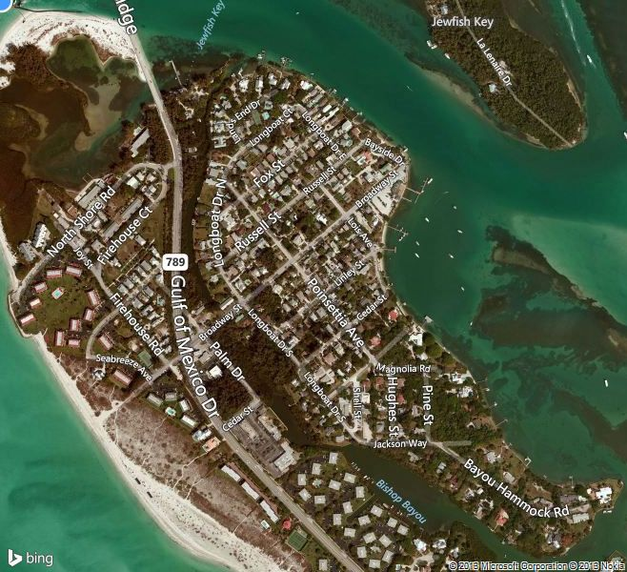
Longbeach Village Alleys
Study area is bounded by Longboat Court to the North, Gulf of Mexico to the West, Jackson Way to the South and Sarasota Bay to the East.

Slide 5
Longbeach Village Alleys Report
Fully accessible
Approximately 17.5 ft wide by 1,400 ft long
Utilized by Waste Management for Waste Collection
Encroachment by vegetation and fences from
neighboring properties is evident.
Alley#1 Located between Broadway and Russell Street from Longboat Drive North to Bayside Drive.

Slide 6
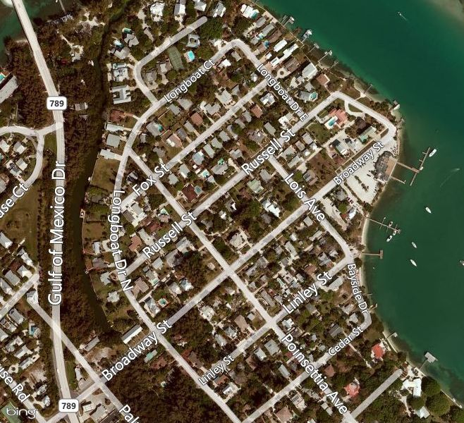
Longbeach Village Alleys Report
Alley#1

Slide 7
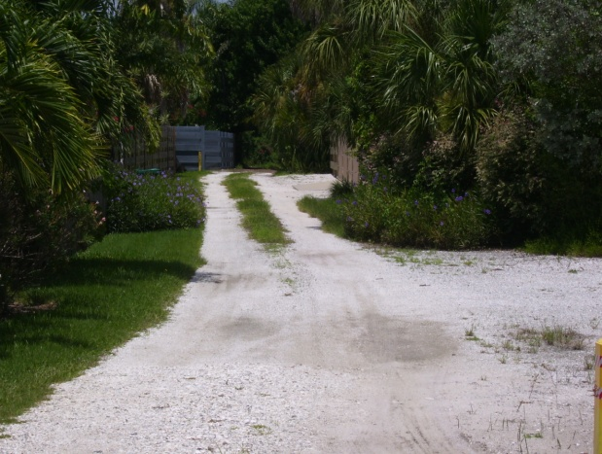
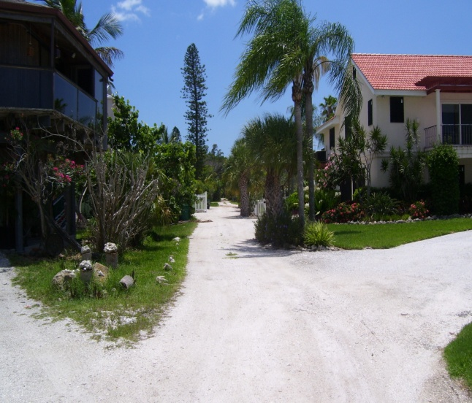
Longbeach Village Alleys
Alley #1 Located between Broadway and Russell Street from Longboat Drive North to Bayside Drive
View from Longboat Drive North
View from Bayside looking West

Slide 8
Longbeach Village Alleys
Partially accessible
Approximately 15 ft wide by 870 ft long
From Longboat Drive South, vegetation prohibits any
access and is completely undeveloped
Alley #2 Located between Broadway and Linley Street from Longboat Drive South to Lois Avenue

Slide 9
Longbeach Village Alleys
Alley #2

Slide 10
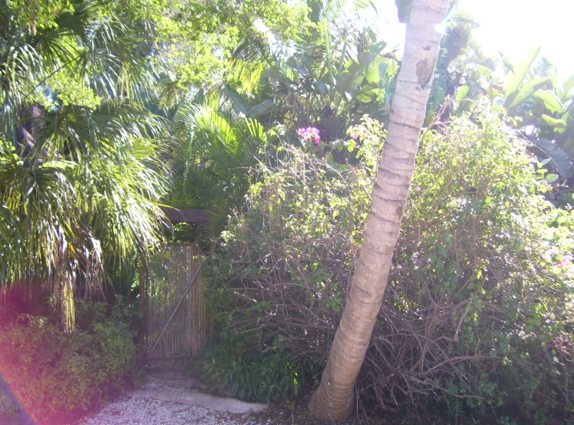
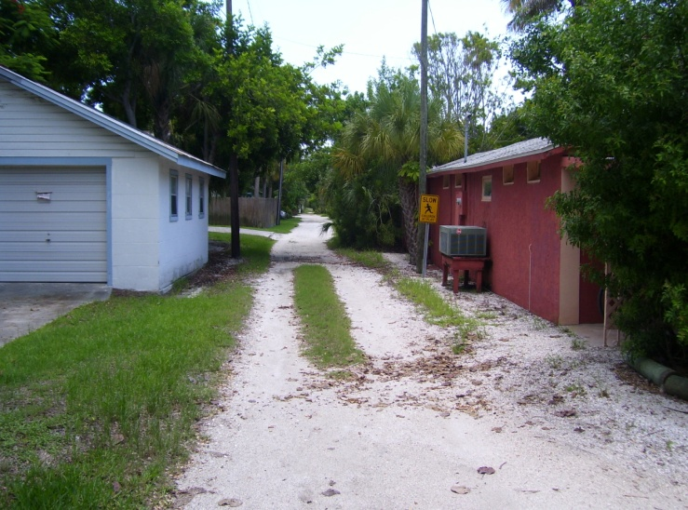
Longbeach Village Alleys
Alley #2 Located between Broadway and Linley Street from Longboat Drive South to Lois Avenue
View from Longboat Drive South
View from Lois looking West

Slide 11
Longbeach Village Alleys
Partially accessible
Approximately 15 ft wide by 720 ft long
Portions appear to be used for driveways
Vegetation prohibits any access in other areas
Alley #3 Located between Linley Street and Cedar Street from Longboat Drive South to Bayside Drive

Slide 12
Longbeach Village Alleys
Alley #3

Slide 13
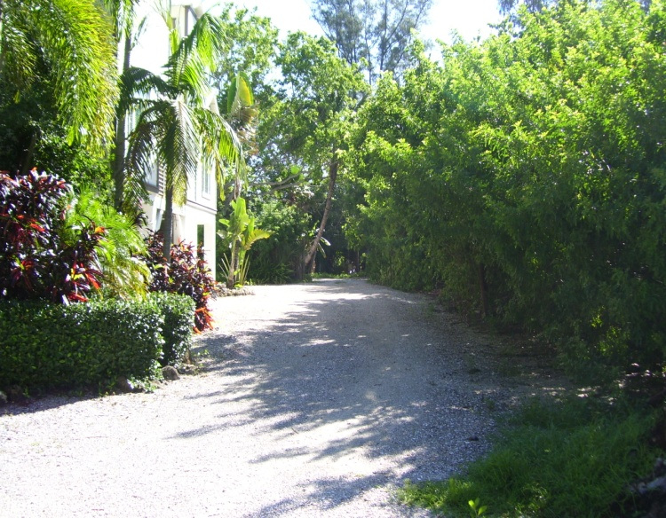
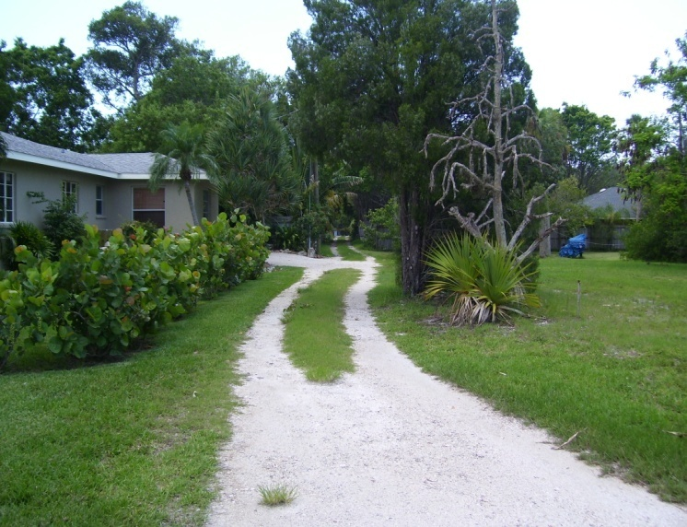
Longbeach Village Alleys
Alley #3 Located between Linley Street and Cedar Street from Longboat Drive South to Bayside Drive
View from Longboat Drive South
View from Bayside looking West

Slide 14
Longbeach Village Alleys
Inaccessible
Approximately 15 ft wide by 530 ft long
Portions appear to be used for driveways
Ordinance 2000-13 attempted to vacate this alley
Alley #4 Located between Cedar Street and Hibiscus Way from Longboat Drive South to Poinsetta Avenue

Slide 15
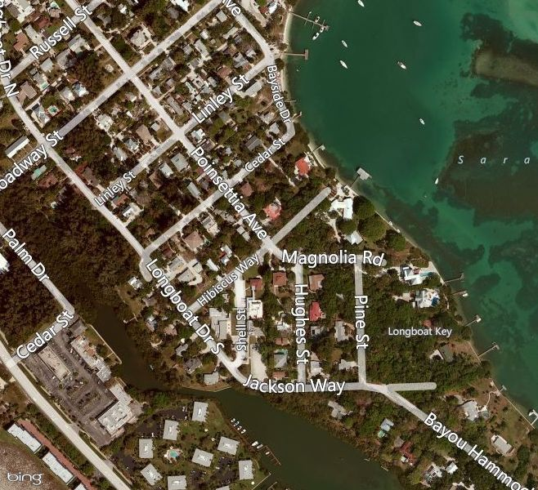
Longbeach Village Alleys
Alley #4

Slide 16
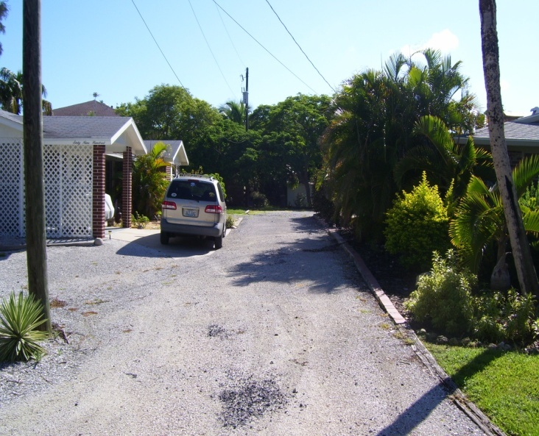
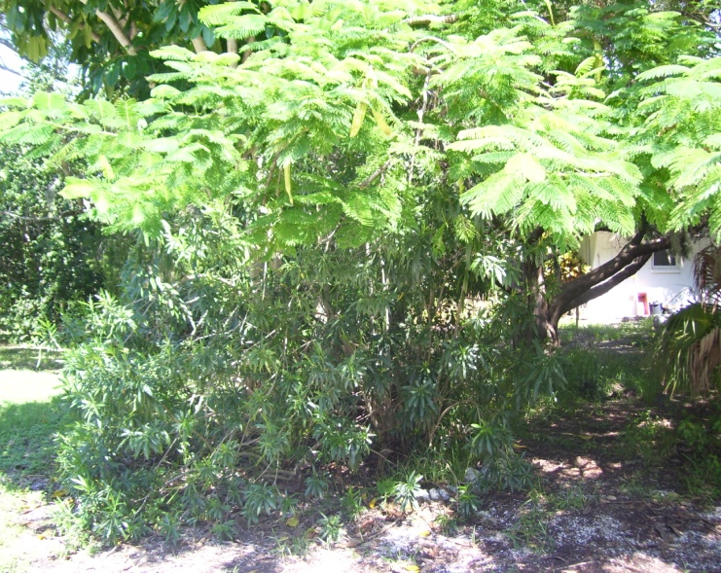
Longbeach Village Alleys
Alley #4 Located between Cedar Street and Hibiscus Way from Longboat Drive South to Poinsetta Avenue
View from Longboat Drive South
View from Poinsetta looking East

Slide 17
Longbeach Village Alleys
This alley is inaccessible
Approximately 15 ft wide by 500 ft long
Completely undeveloped (no visible pathway)
Commission Meeting minutes show this alley vacated
Alley #5 Located between Hibiscus and Hughes Street from Jackson Way to Magnolia Road

Slide 18
Longbeach Village Alleys
Alley #5

Slide 19
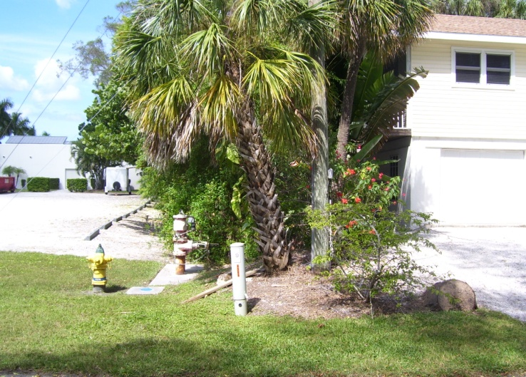
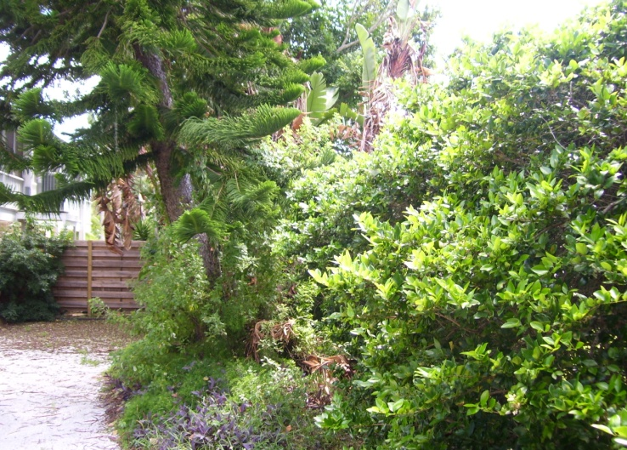
Longbeach Village Alleys Report
Alley #5 Located between Hibiscus and Hughes Street from Jackson Way to Magnolia Road
View from Jackson Way
View from Magnolia Road

Slide 20
Longbeach Village Alleys
Inaccessible
Approximately 15 ft wide by 500 ft long
Vegetation encroaches all areas
Completely undeveloped ( no signs of pathway)
Alley #6 Located between Hughes Street and Pine Street from Jackson Way to Magnolia Road

Slide 21
Longbeach Village Alleys
Alley #6

Slide 22
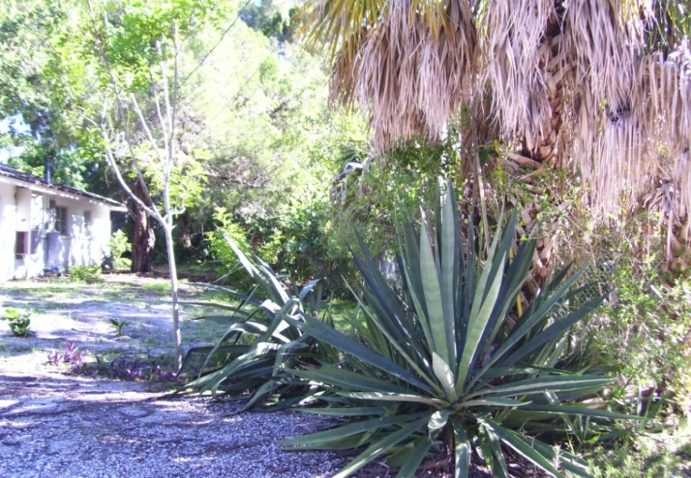
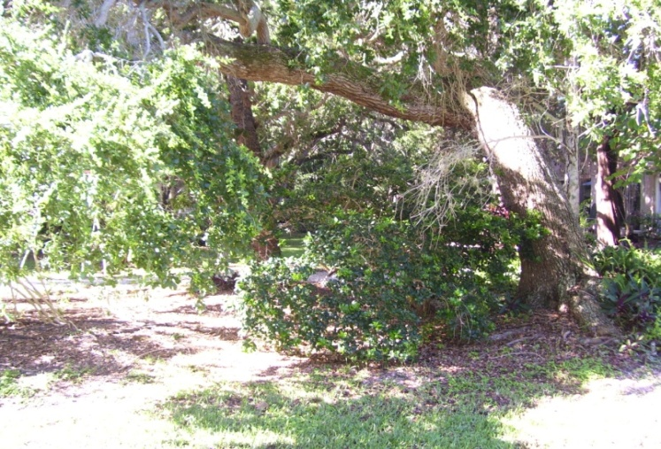
Longbeach Village Alleys
Alley #6 Located between Hughes Street and Pine Street from Jackson Way to Magnolia Road
View from Jackson Way
View from Magnolia looking West

Slide 23
Longbeach Village Alleys Report
Inaccessible
Approximately 15 ft wide by 510 ft long
Vegetation encroaches all areas
Completely undeveloped ( no signs of pathway)
Alley #7 Located between Pine Street and the Sarasota Bay from Jackson Way to Magnolia Road

Slide 24
Longbeach Village Alleys Report
Alley #7

Slide 25
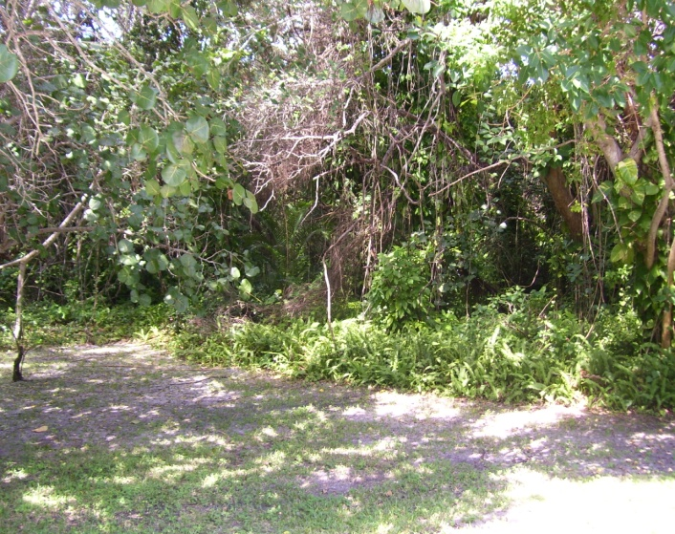
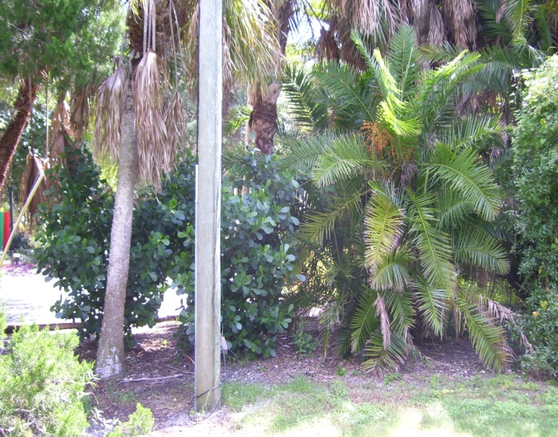
Longbeach Village Alleys
Alley #7 Located between Pine Street and the Sarasota Bay from Jackson Way to Magnolia Road
View from Jackson Way
View from Magnolia Road

Slide 26
Longbeach Village Alleys Report
Yellow: accessible alleys, Red: inaccessible alleys, Blue: vacated alleys
Alley #1
Alley #2
Alley #3

Slide 27
Longbeach Village Alleys Report
Yellow: accessible alleys, Red: inaccessible alleys, Blue: vacated alleys
Alley #4
Alley #5
Alley #6
Alley #7

Slide 28
Longboat Key Bay Access Inventory
There are Sixteen Bay Accesses
Accessible w/ Parking
Accessible w/o Parking
Inaccessible

Slide 29
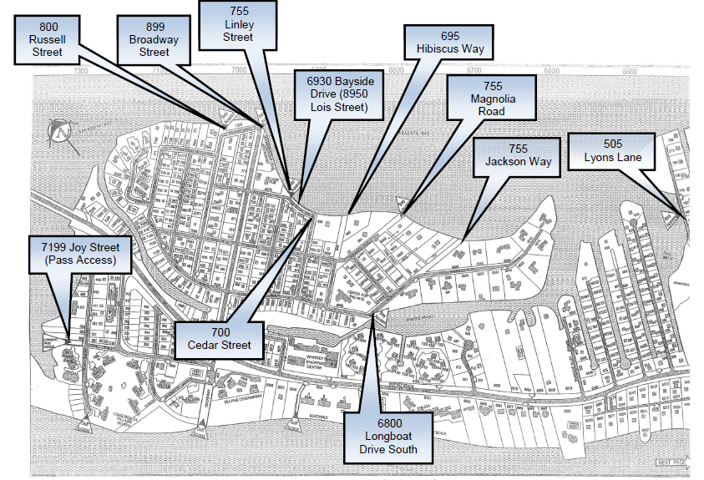
Longboat Key Bay Access Inventory
Bay Access Map
Emergency Services Map created by PZB Department 2000

Slide 30
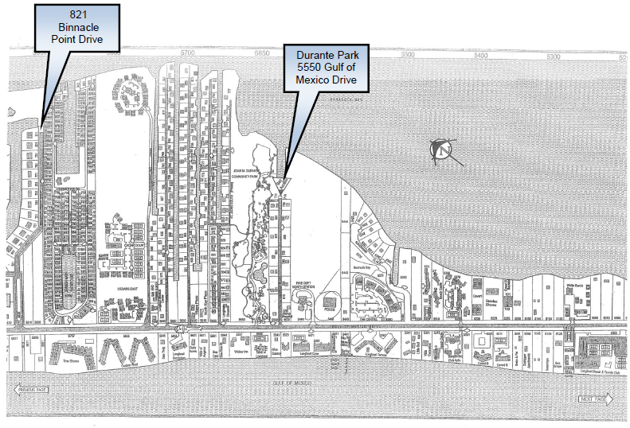
Longboat Key Bay Access Inventory
Bay Access Map
Emergency Services Map created by PZB Department 2000

Slide 31
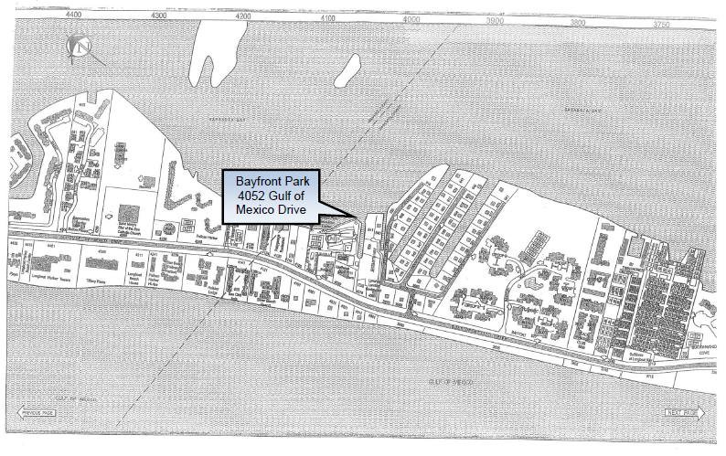
Longboat Key Bay Access Inventory
Bay Access Map
Emergency Services Map created by PZB Department 2000

Slide 32
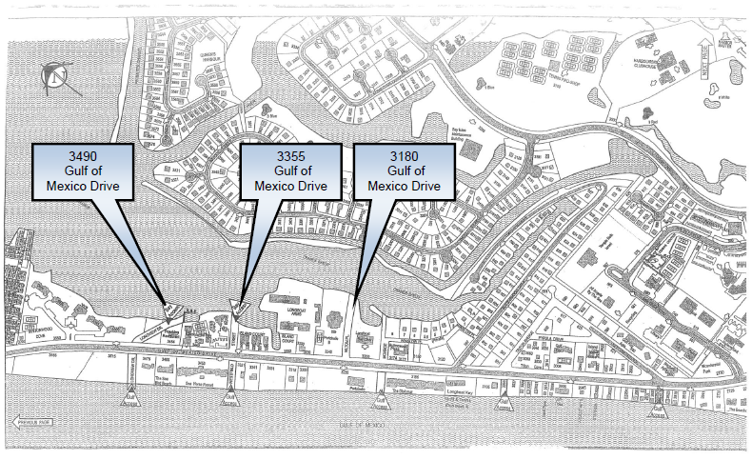
Longboat Key Bay Access Inventory
Emergency Services Map created by PZB Department 2000

Slide 33
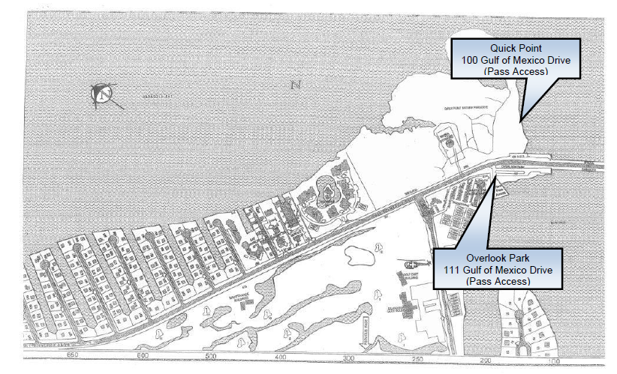
Longboat Key Bay Access Inventory
Emergency Services Map created by PZB Department 2000

Slide 34
Longboat Key Bay Access Inventory
Bay Access #1 Located at 800 Russell Street
Excellent Access
No Parking
Approximately 50 ft wide by 50 ft long

Slide 35
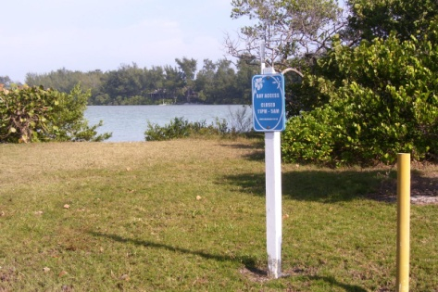
Longboat Key Bay Access Inventory
Bay Access #1 Located at 800 Russell Street

Slide 36
Longboat Key Bay Access Inventory
Bay Access #2 Located at 899 Broadway Street
Limited Access
Limited Parking
Approximately 50 ft wide by 15 ft long

Slide 37
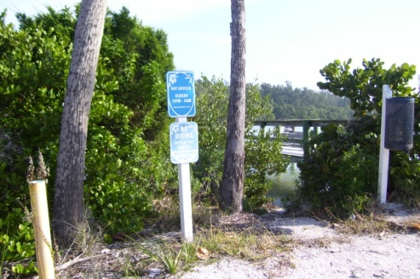
Longboat Key Bay Access Inventory
Bay Access #2 Located at 899 Broadway Street

Slide 38
Longboat Key Bay Access Inventory
Bay Access #3 Located at 755 Linley Street
Excellent Access
Limited Parking
Approximately 15 ft wide by 10 ft long

Slide 39
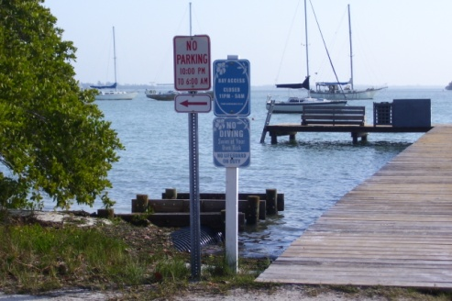
Longboat Key Bay Access Inventory
Bay Access #3 Located at 755 Linley Street

Slide 40
Longboat Key Bay Access Inventory
Bay Access #4 Located at 6930 Bayside Drive
Excellent Access
No Parking
Approximately 50 ft wide by 20 ft long

Slide 41
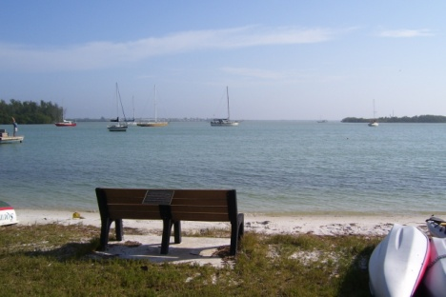
Longboat Key Bay Access Inventory
Bay Access #4 Located at 6930 Bayside Drive

Slide 42
Longboat Key Bay Access Inventory
Bay Access #5 Located at 700 Cedar Street
No Access (mangroves)
No Parking
Approximately 50 ft wide by 20 ft long

Slide 43
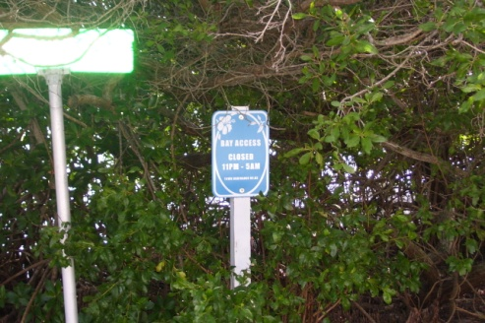
Longboat Key Bay Access Inventory
Bay Access #5 Located at 700 Cedar Street

Slide 44
Longboat Key Bay Access Inventory
Bay Access #6 Located at 695 Hibiscus Way
No Access (mangroves, Brazilian peppers, palms)
No Parking
Approximately 50 ft wide by 378 ft long

Slide 45
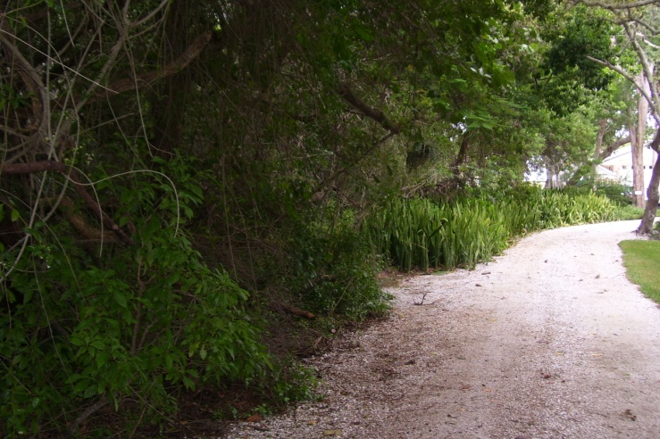
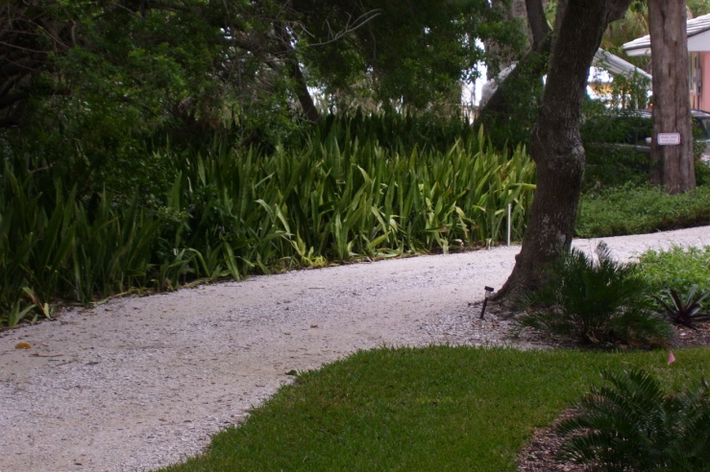
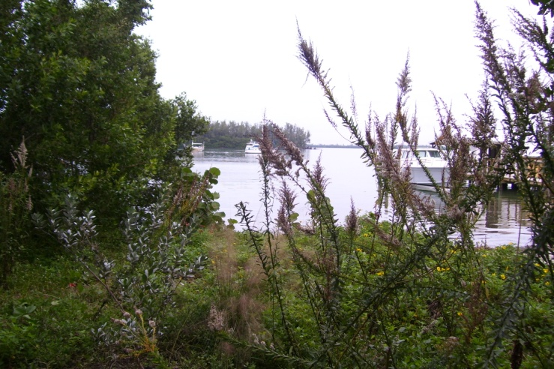
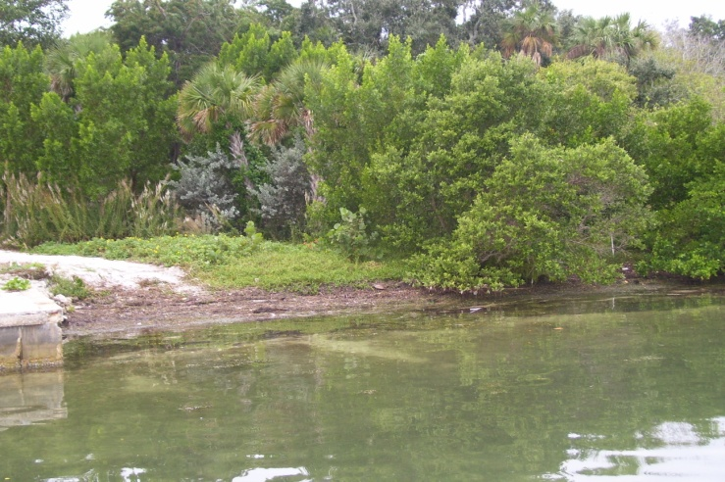
Longboat Key Bay Access Inventory
Bay Access #6 Located at 695 Hibiscus Way

Slide 46
Longboat Key Bay Access Inventory
Bay Access #7 Located at 6800 Longboat Drive South
Minimal Access due to mangroves
No Parking
Approximately 50 ft wide by 8 ft long

Slide 47
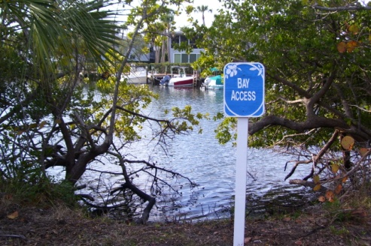
Longboat Key Bay Access Inventory
Bay Access #7 Located at 6800 Longboat Drive South

Slide 48
Longboat Key Bay Access Inventory
Bay Access #8 Located at 755 Magnolia Road
Excellent Access
Minimal Parking
Approximately 50 ft wide by 290 ft long

Slide 49
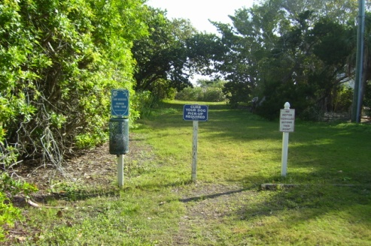
Longboat Key Bay Access Inventory
Bay Access #8 Located at 755 Magnolia Road

Slide 50
Longboat Key Bay Access Inventory
Bay Access #9 Located at 755 Jackson Way
Excellent Access
No Parking
Approximately 50 ft wide by 470 ft long

Slide 51
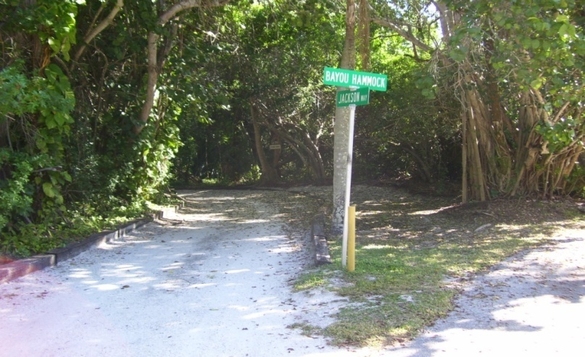
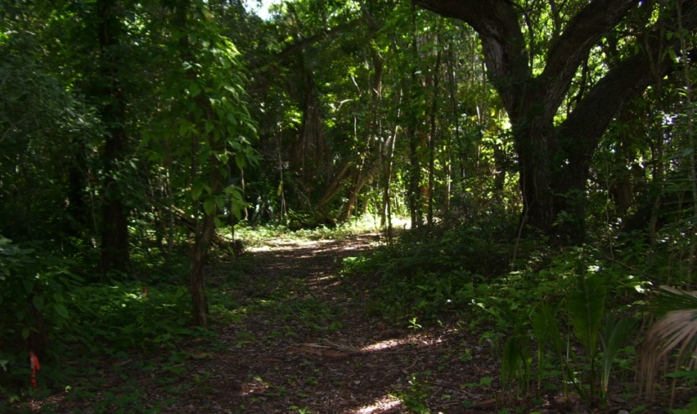
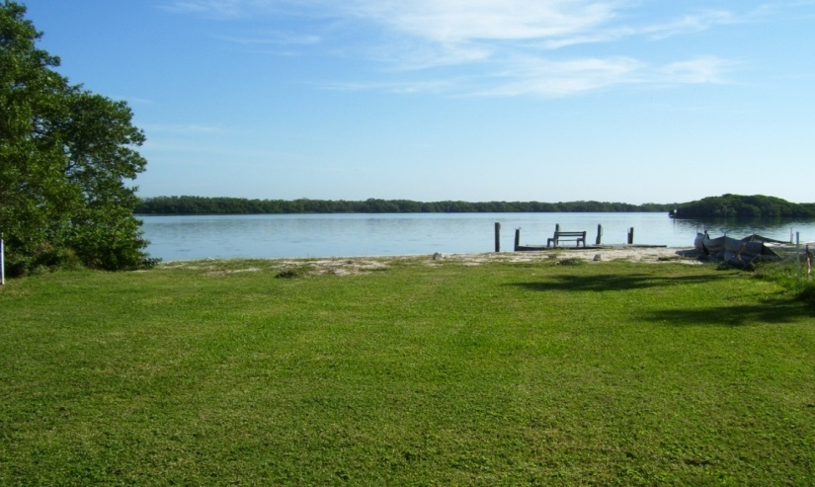
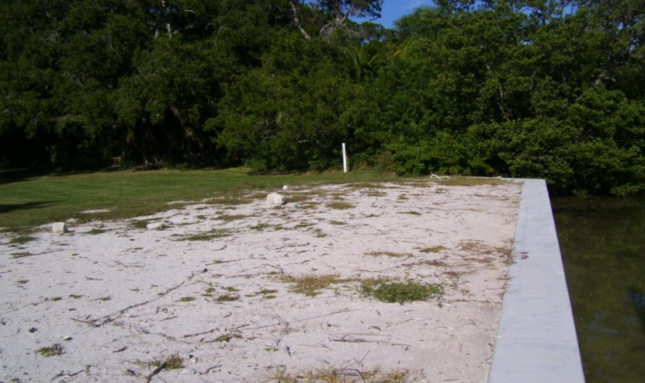
Longboat Key Bay Access Inventory
Bay Access #9 Located at 755 Jackson Way

Slide 52
Longboat Key Bay Access Inventory
Bay Access #10 Located at 505 Lyons Lane
No Access (mangroves)
No Parking
Approximately 3000 ft wide by 2150 ft long
Mitigation Bank Agreement/Ritz Carlton Hotel

Slide 53
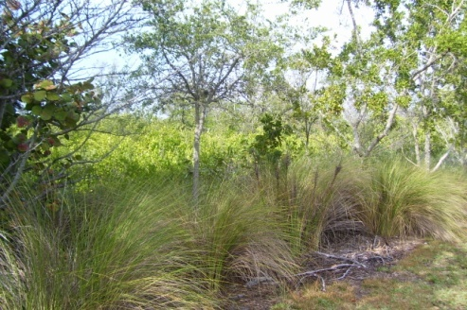
Longboat Key Bay Access Inventory
Bay Access #10 Located at 505 Lyons Lane

Slide 54
Longboat Key Bay Access Inventory
Bay Access #11 Located at 821 Binnacle Point Drive
No Access (mangroves)
No Parking
Approximately 50 ft wide by 40 ft long

Slide 55
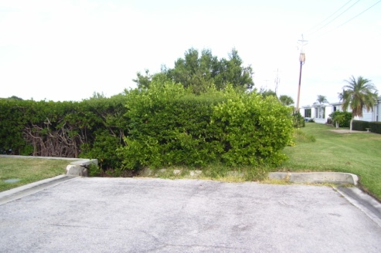
Longboat Key Bay Access Inventory
Bay Access #11 Located at 821 Binnacle Point Drive

Slide 56
Longboat Key Bay Access Inventory
Bay Access #12 Located at 5550 Gulf of Mexico Drive
Excellent Access (Durante Park)
Parking
Three accesses located within Park

Slide 57
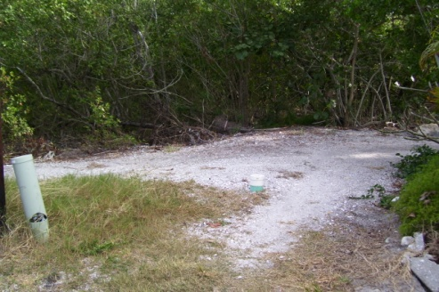
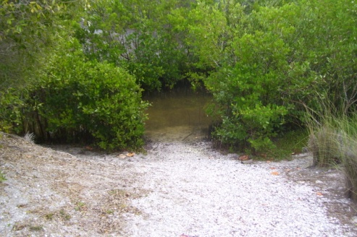
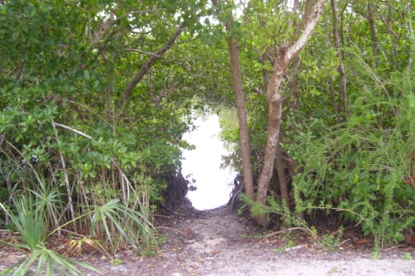
Longboat Key Bay Access Inventory
Bay Access #12 Located at 5550 Gulf of Mexico Drive

Slide 58
Longboat Key Bay Access Inventory
Bay Access #13 Located at 4052 Gulf of Mexico Drive
Excellent Access (Bayfront Park)
Parking
Floatable Dock

Slide 59
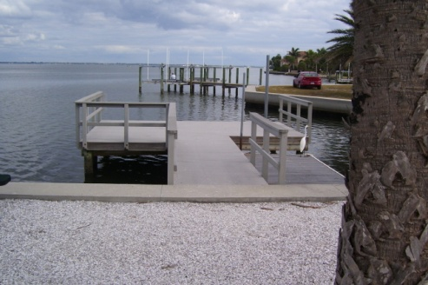
Longboat Key Bay Access Inventory
Bay Access #13 Located at 4052 Gulf of Mexico Drive

Slide 60
Longboat Key Bay Access Inventory
Bay Access #14 Located at 3490 Gulf of Mexico Drive
Excellent Access
Parking
Approximately 50 ft wide by 160 ft long

Slide 61
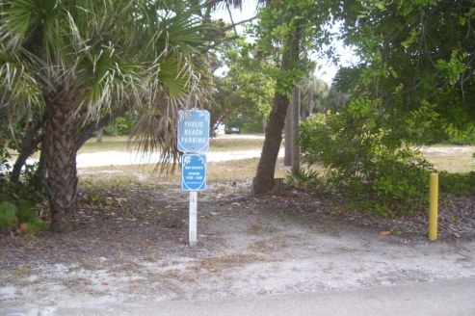
Longboat Key Bay Access Inventory
Bay Access #14 Located at 3490 Gulf of Mexico Drive

Slide 62
Longboat Key Bay Access Inventory
Bay Access #15 Located at 3410 Gulf of Mexico Drive
No Access (mangroves, Brazilian peppers, Australian
pines)
No Parking
Approximately 50 ft wide by 270 ft long

Slide 63
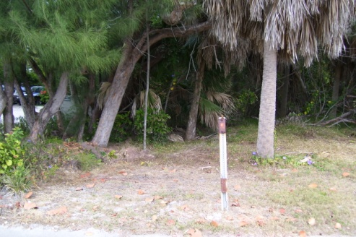
Longboat Key Bay Access Inventory
Bay Access #15 Located at 3410 Gulf of Mexico Drive

Slide 64
Longboat Key Bay Access Inventory
Bay Access #16 Located at 3180 Gulf of Mexico Drive
No Access (mangroves, Brazilian peppers, Australian
pines)
No Parking
Approximately 50 ft wide by 350 ft long

Slide 65
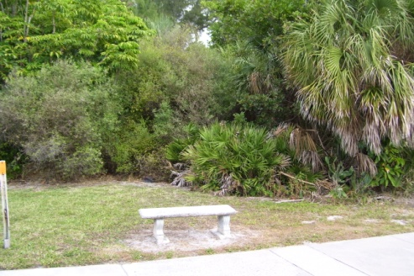
Longboat Key Bay Access Inventory
Bay Access #16 Located at 3180 Gulf of Mexico Drive

Slide 66
Durante Park Property Line Adjacent to St. Judes Drive South
Adjacent to St. Judes Drive South (private road)
Property Owners Storing and Parking Trailers

Slide 67
Durante Park Property Line Adjacent to St. Judes Drive South
Durante Park

Slide 68
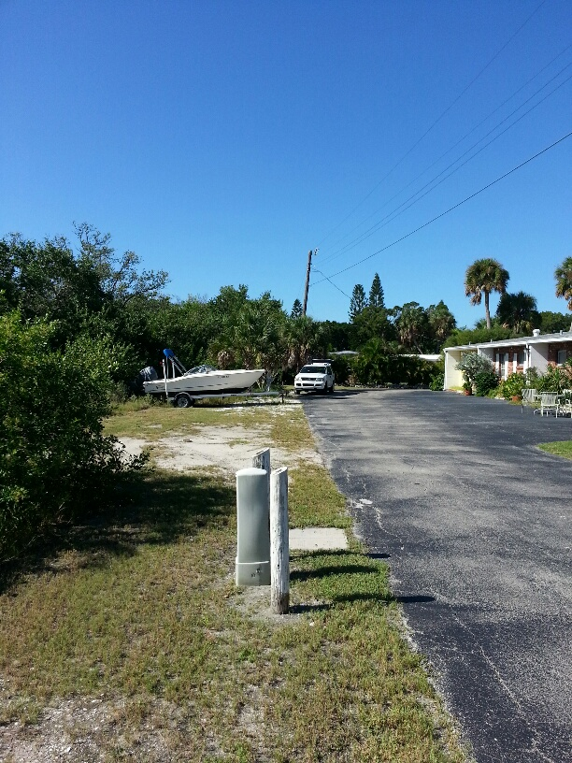
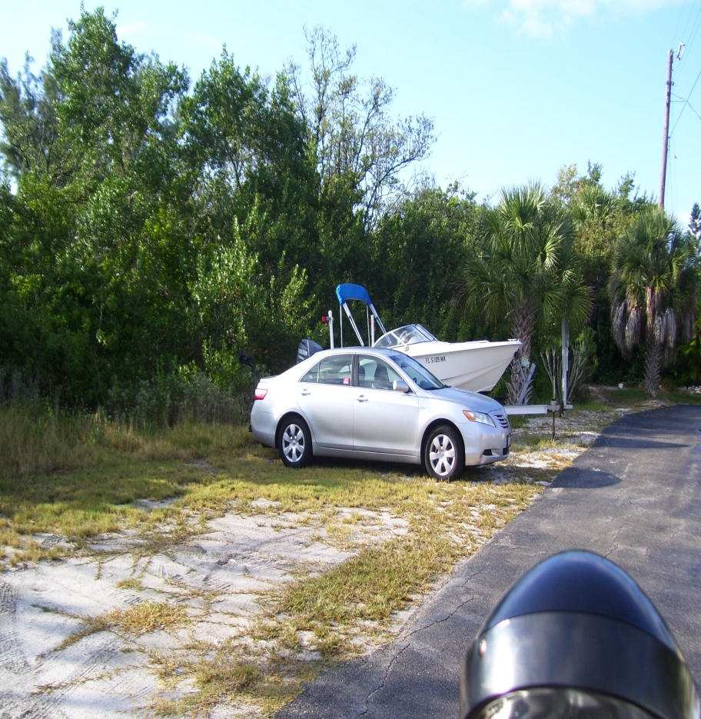
Durante Park Property Line

Slide 69
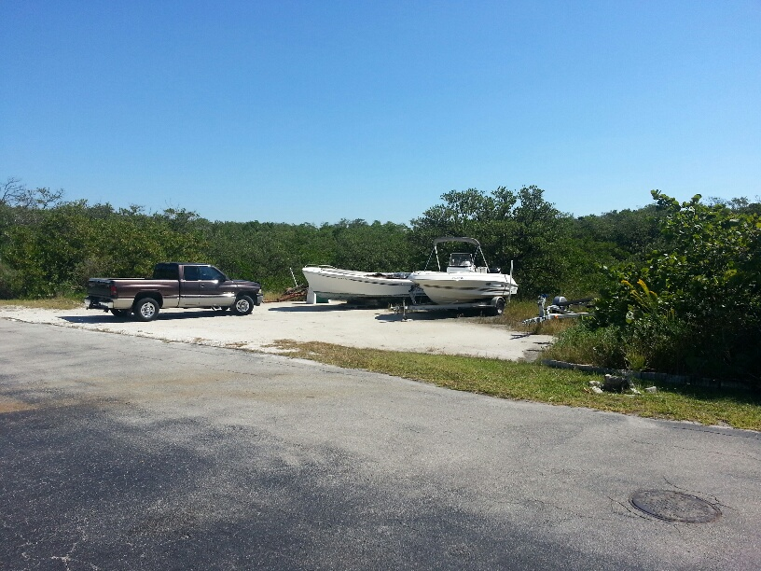

Durante Park Property Line

Slide 70


Durante Park Property Line

