Slide 1

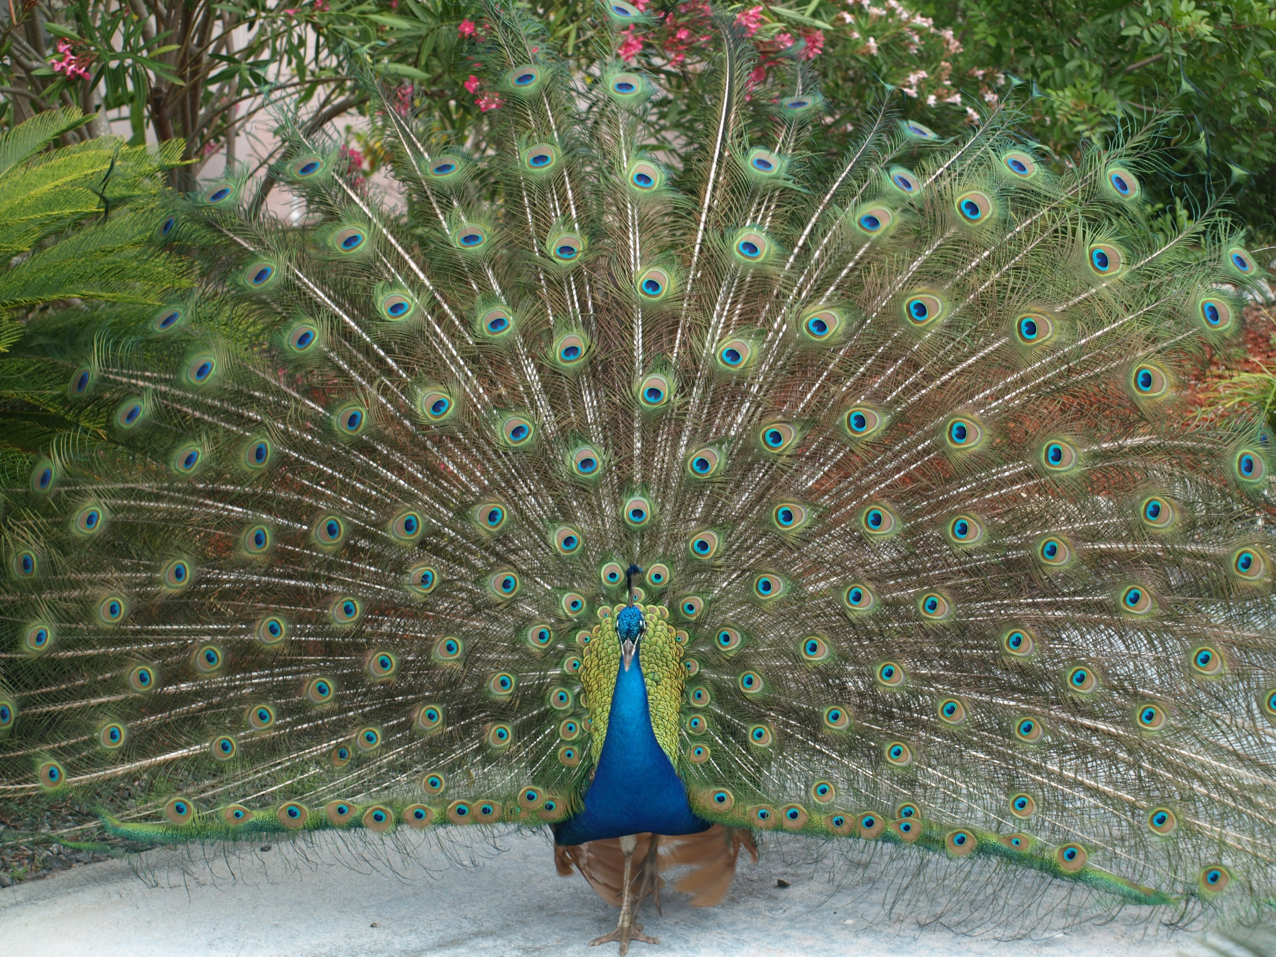

VILLAGE PEAFOWL
TOWN OF LONGBOAT KEY
Town Commission Meeting
July 6, 2015

Slide 2

Summary of Findings
TOWN OF LONGBOAT KEY
Current Peafowl Population – 100+/-
20 Year Life Expectancy, 40-50 if Fed
5 – 15 Eggs per Nest
2011 Latest Large Scale Removal
No Known Peafowl Predators on LBK

Slide 3
Summary of Findings
TOWN OF LONGBOAT KEY
FWC Classified as Domestic Livestock, same as chickens
Protected by FL State Animal Cruelty Laws
Need Licensed Trapper to Relocate
Mostly Confined to LB Drive North, Fox St., Russell St., Broadway

Slide 4
Summary of Findings
TOWN OF LONGBOAT KEY
Removal of All Peahens Only Option Available to Achieve Constant Number of Birds
Ongoing Monitoring and Removal of Peahens Must Occur Regularly
Initial Costs Unknown at this Time
Recurring Costs of Continuous Monitoring/Trapping Relatively Small

Slide 5
Seeking Commission Direction
TOWN OF LONGBOAT KEY
Obtain Costs this Summer
Present to Commission in the Fall
Amend Budget as Directed

Slide 6

TOWN OF LONGBOAT KEY
Discussion/Questions
6

