Slide 1
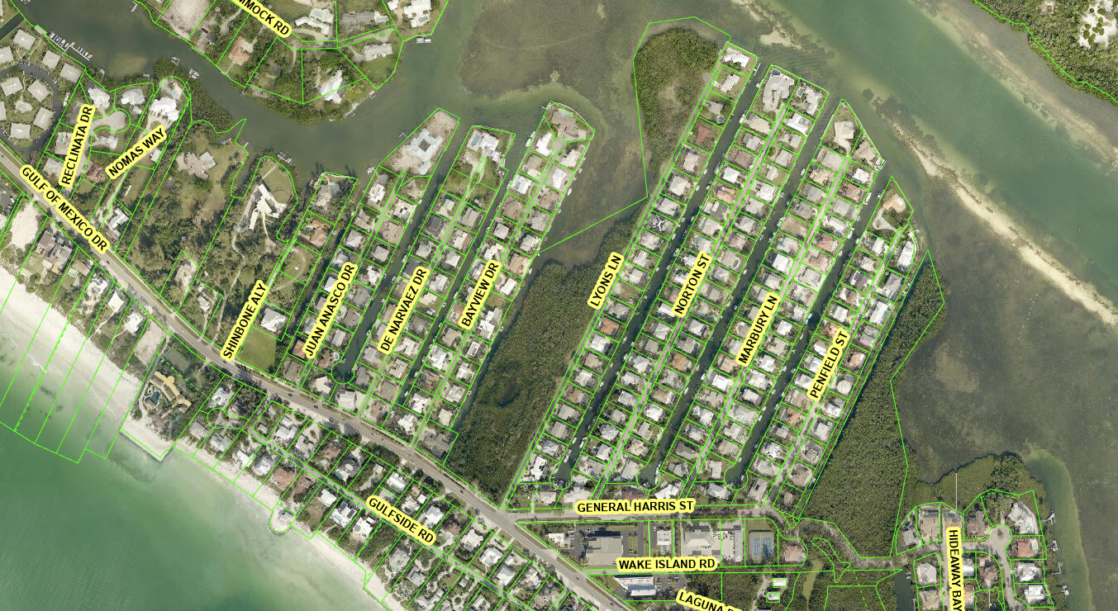
Photo Map Bayview Dr/Penfield St Storm Drain Project
3
4
4
5
3
2
2
1
1
6
Photos of Bayview Project Area
6
Photos of Penfield Project Area
All photos were taken on 3/26/2024 unless otherwise labeled. Arrow indicates the direction of photo and number box indicates the position.

Slide 2
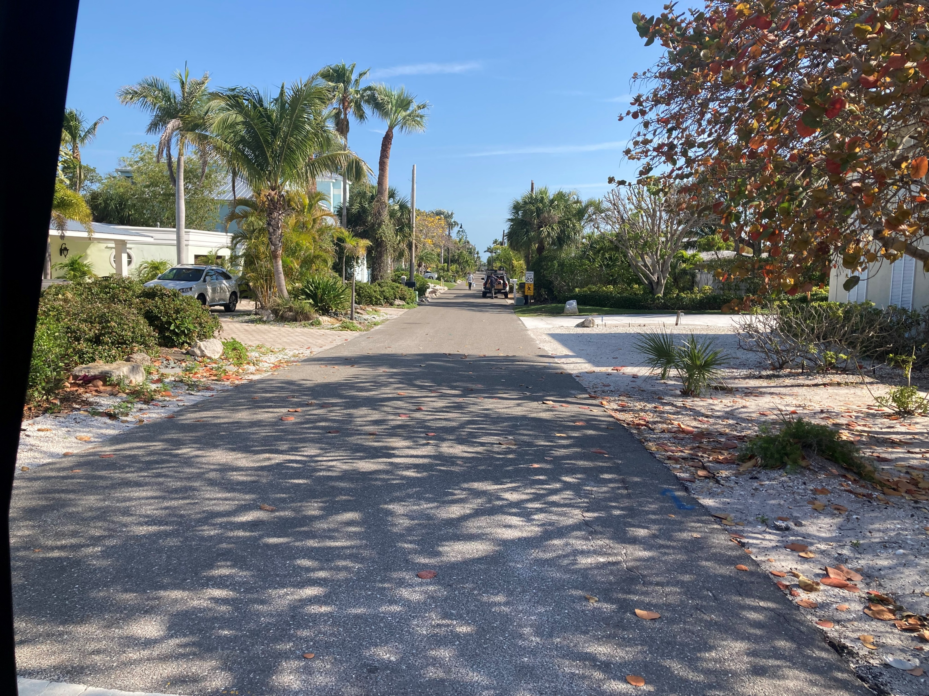
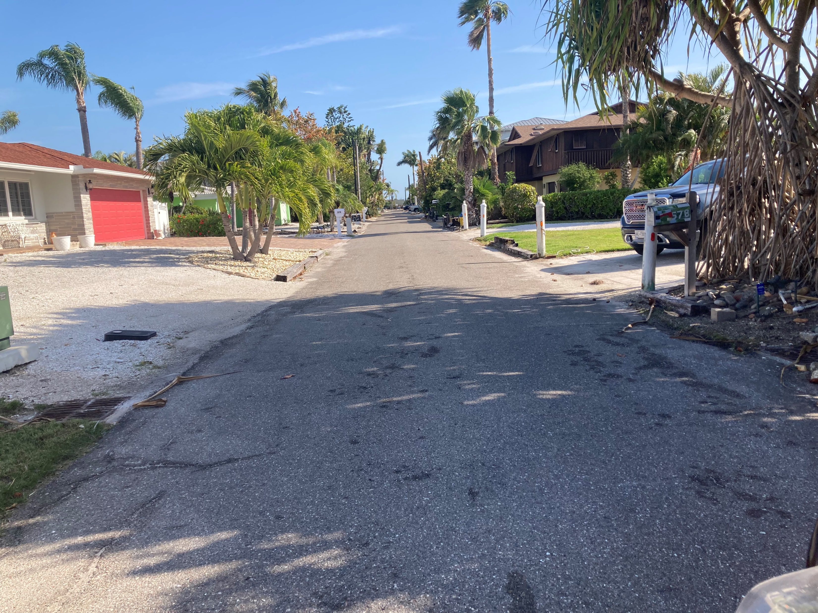
Photos Bayview Dr Stormwater Project
Photo 1 of Bayview Dr. Dry Conditions. Facing N/E.
Photo 2 of Bayview Dr. Dry Conditions. Facing N/E. With existing Storm Drains

Slide 3
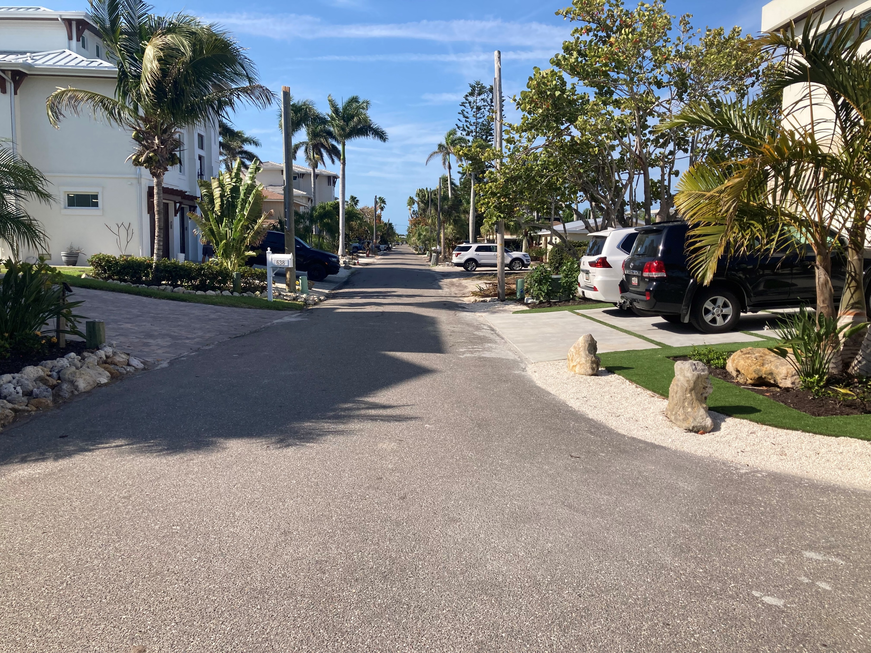
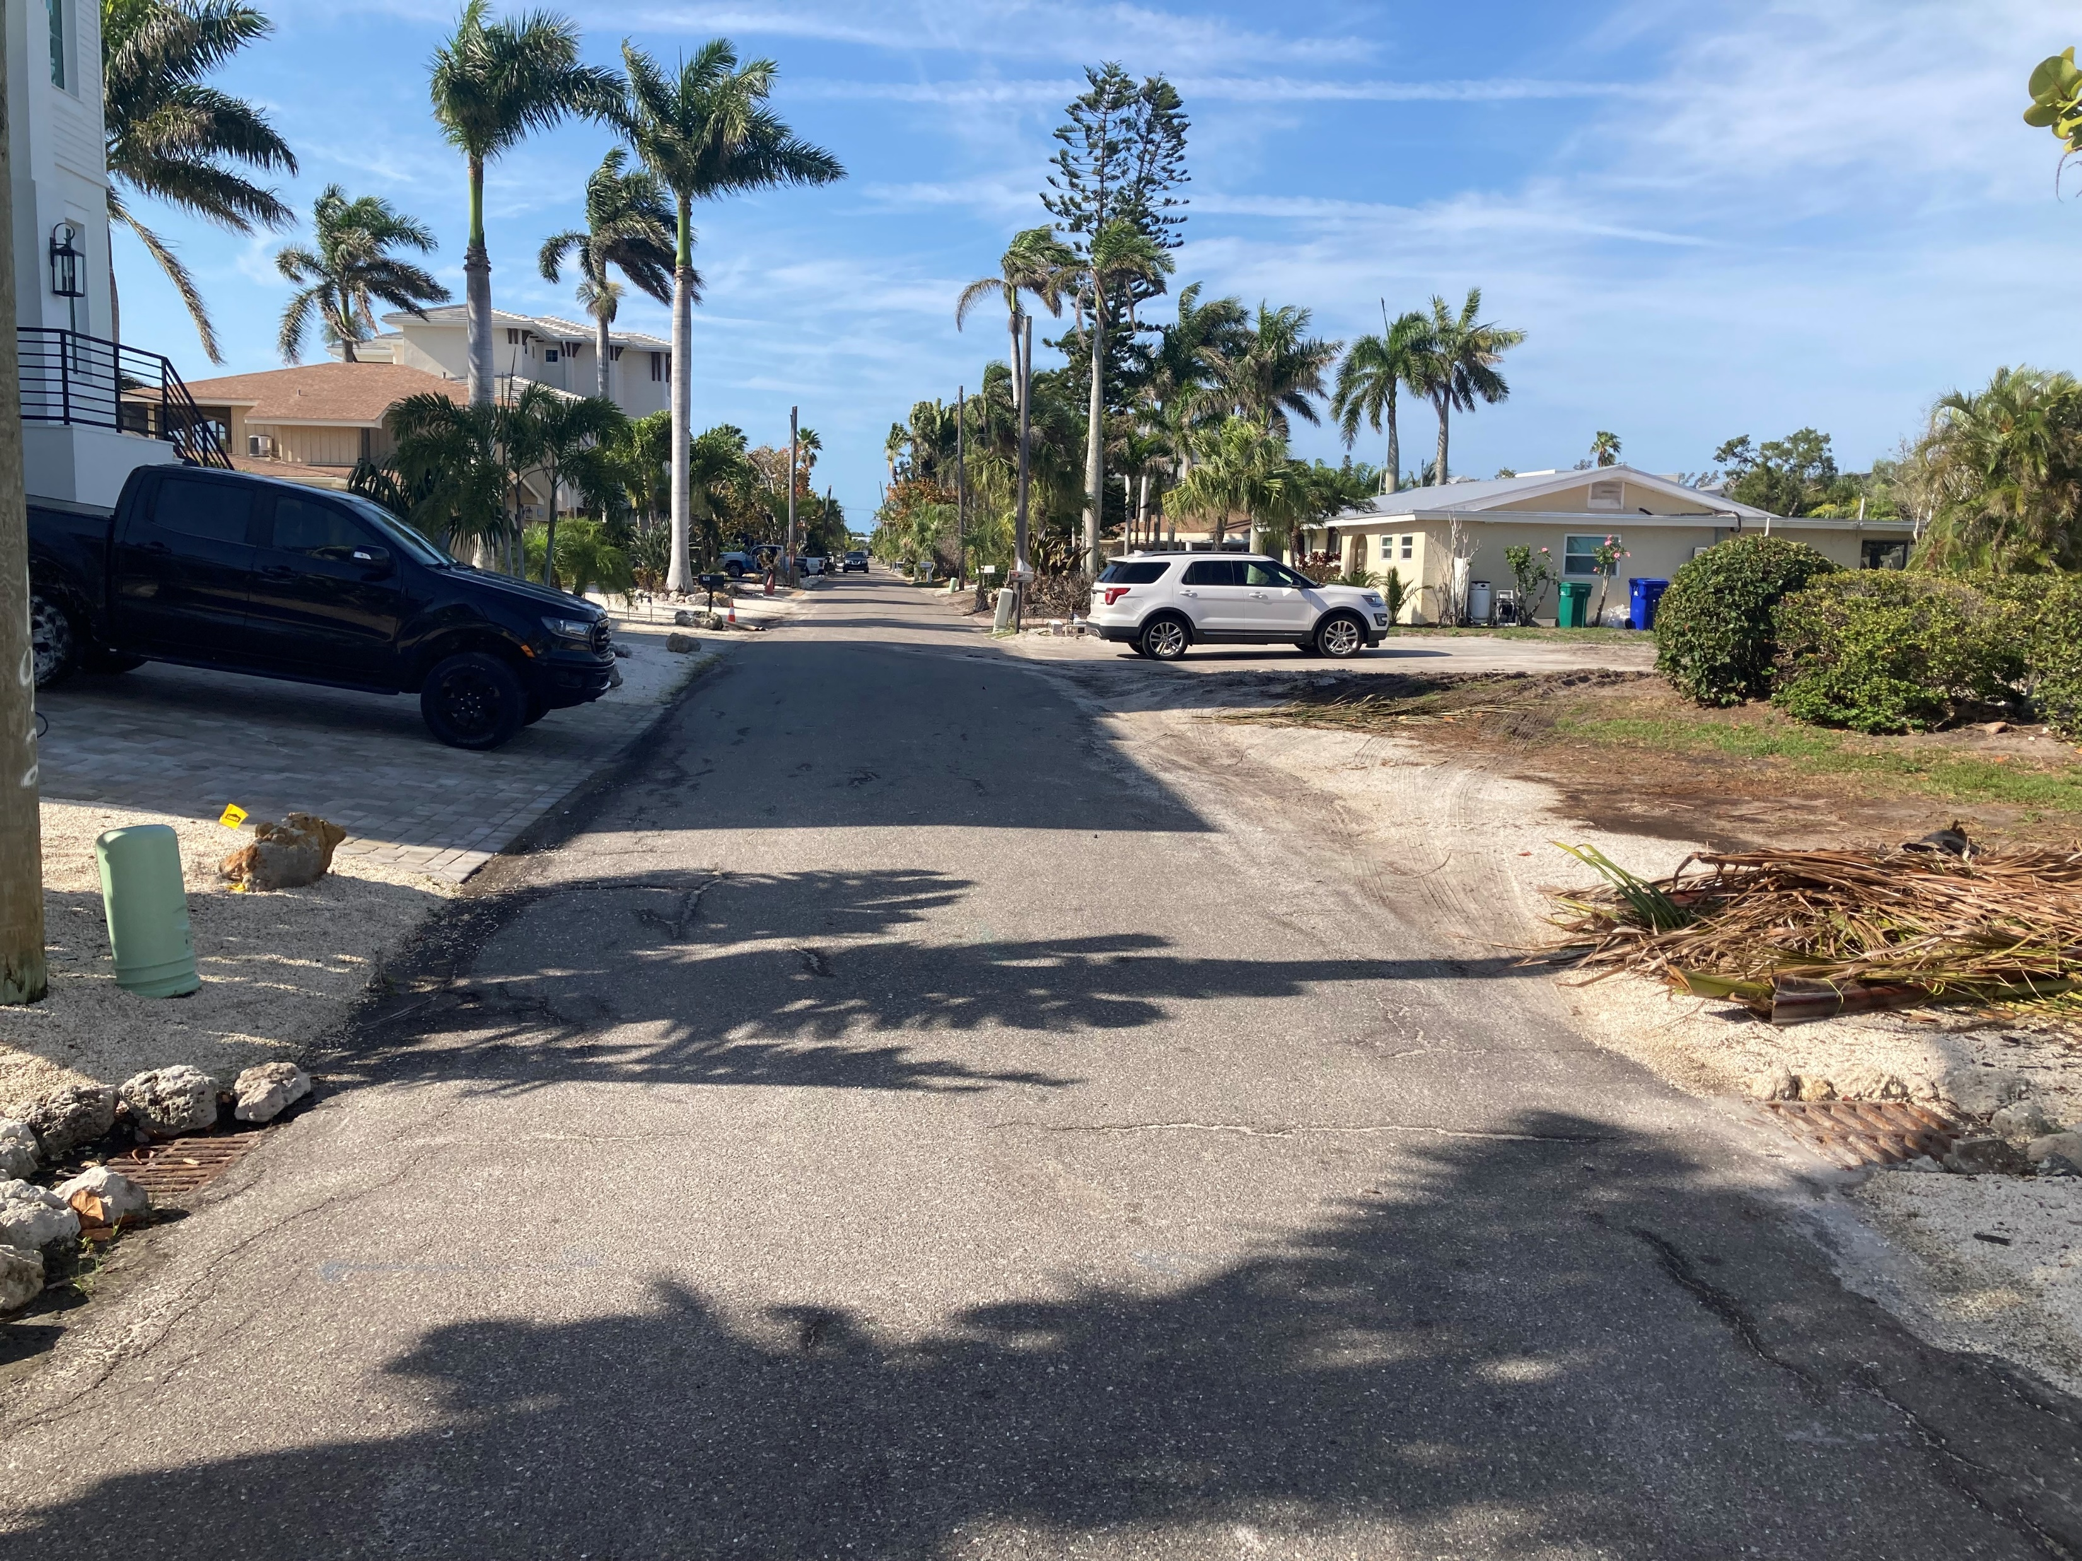
Photos Bayview Dr Stormwater Project
Photo 3 of Bayview Dr. Dry Conditions. Facing S/W.
Photo 4 of Bayview Dr. Dry Conditions. Facing S/W. With Existing Storm Drains

Slide 4
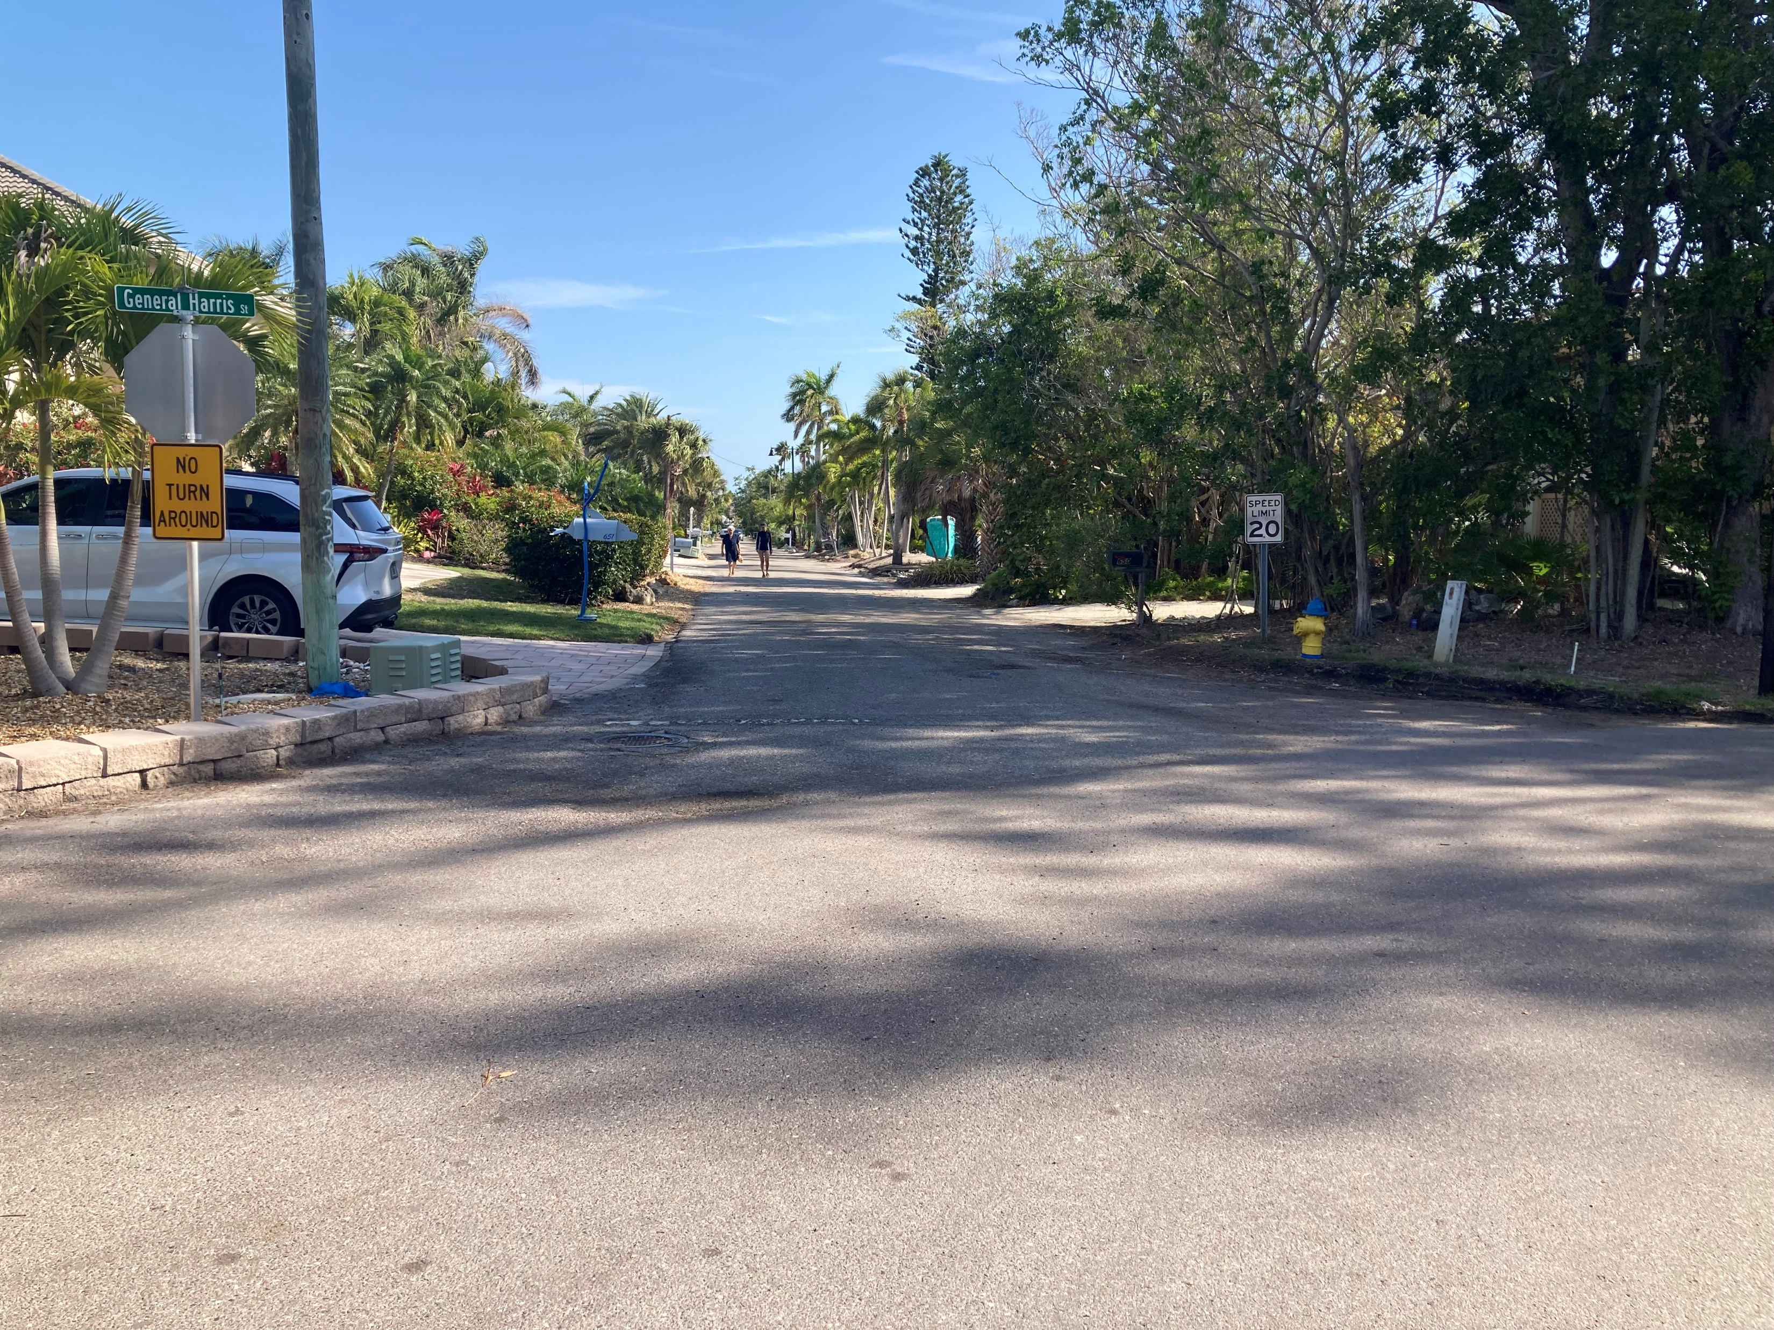
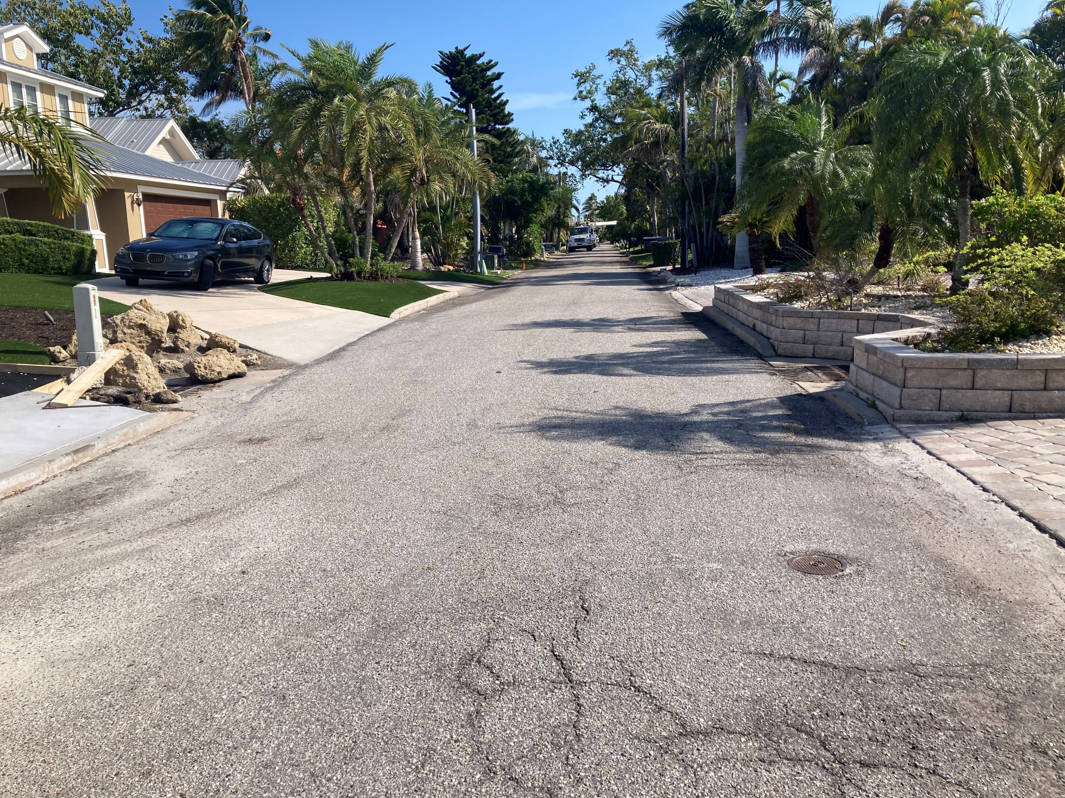
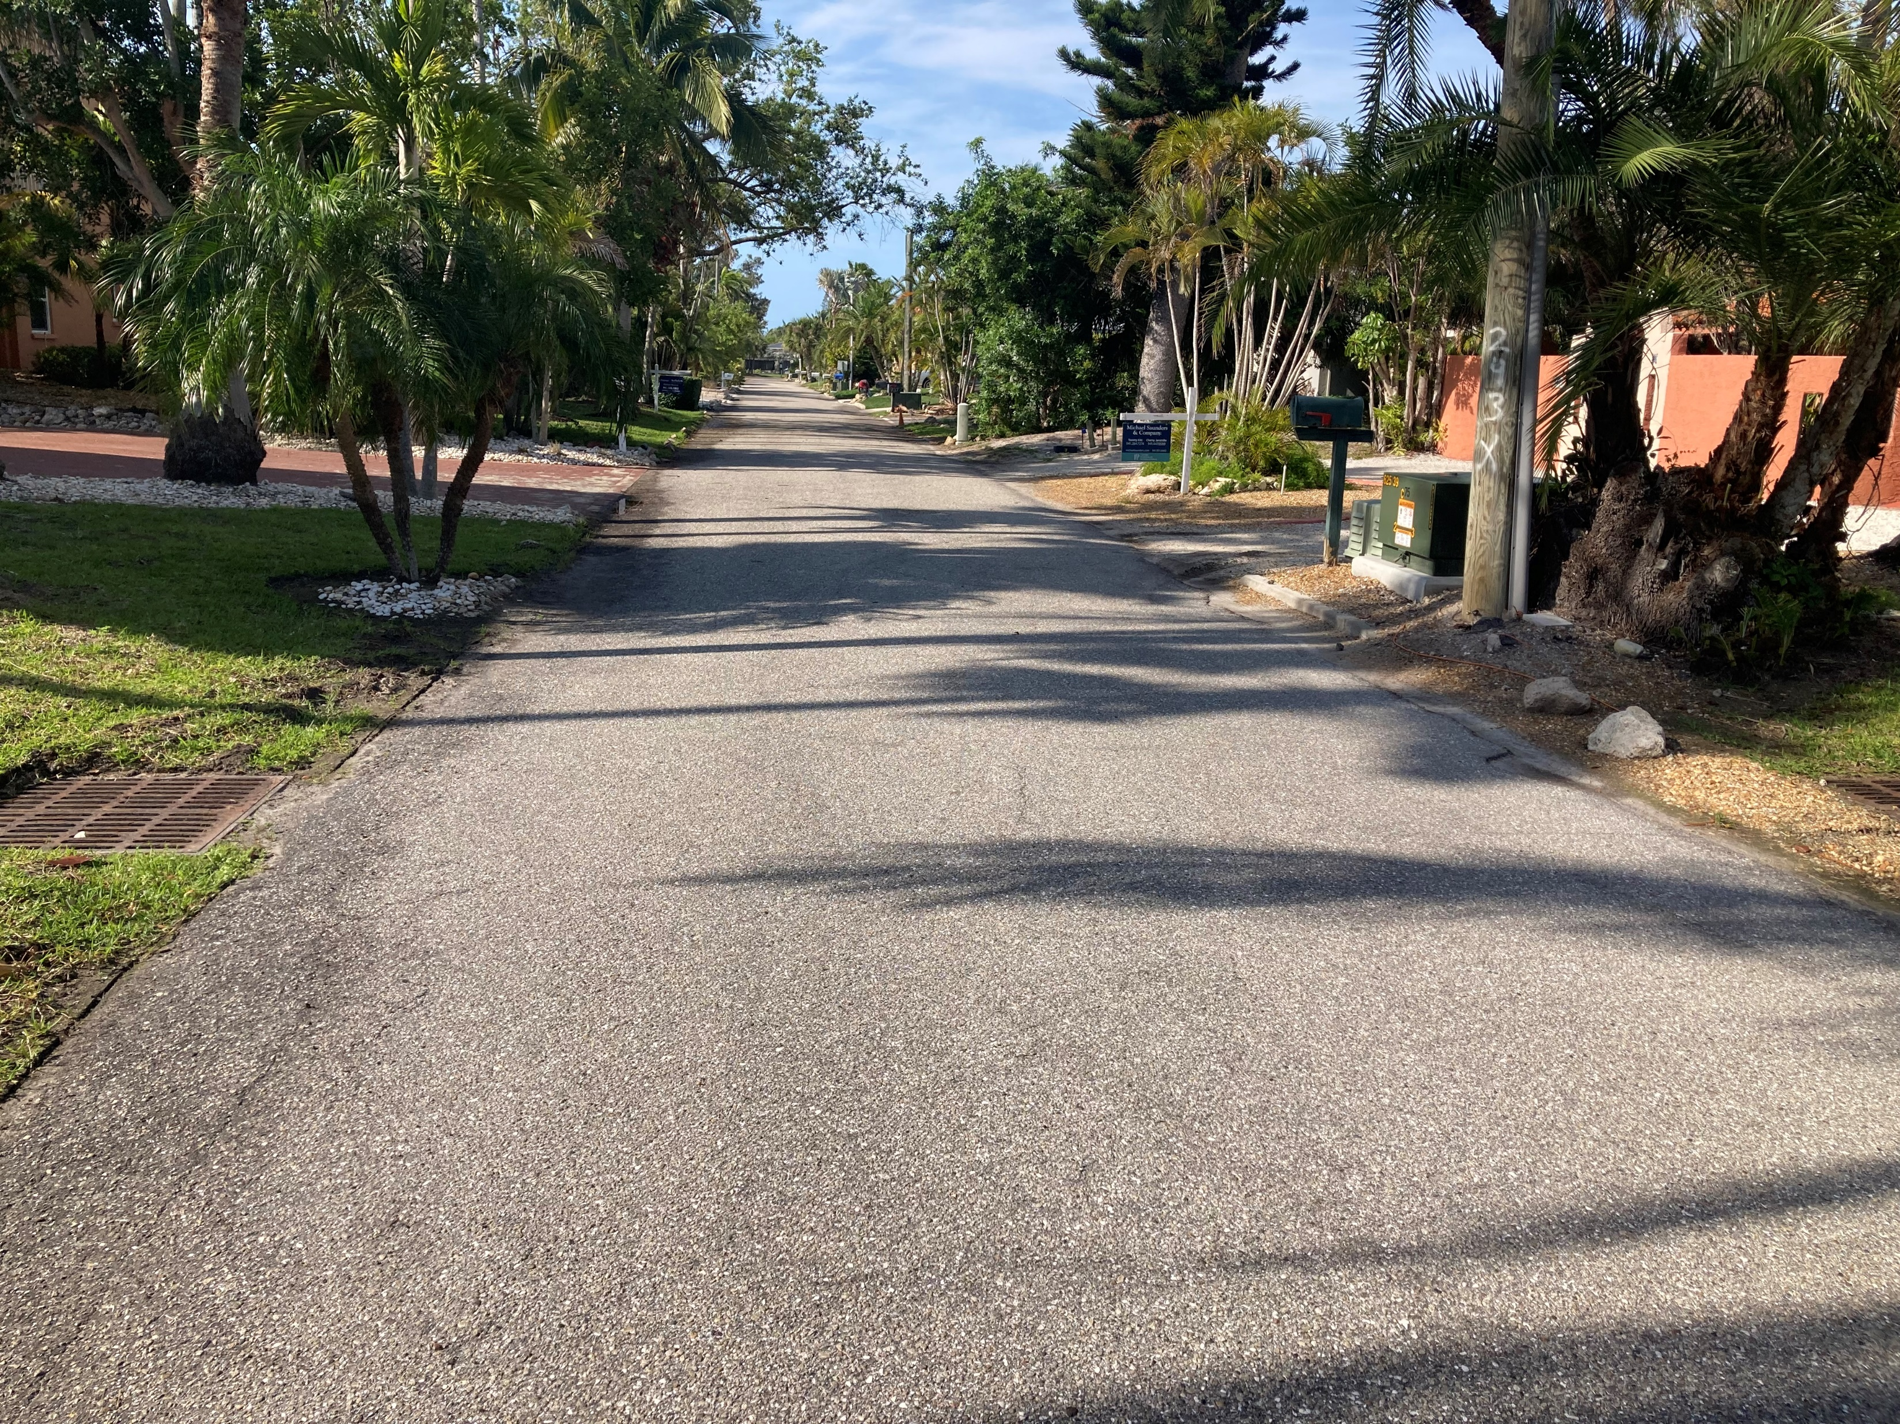
Photos Penfield St. Stormwater Project
Photo 1 of Penfield Project Area. Facing N/E. Dry Conditions
Photo 2 of Penfield Project Area. Facing N/E. Dry Conditions. With Existing Storm Drains
Photo 3 of Penfield Project Area. Facing S/W. Dry Conditions

Slide 5
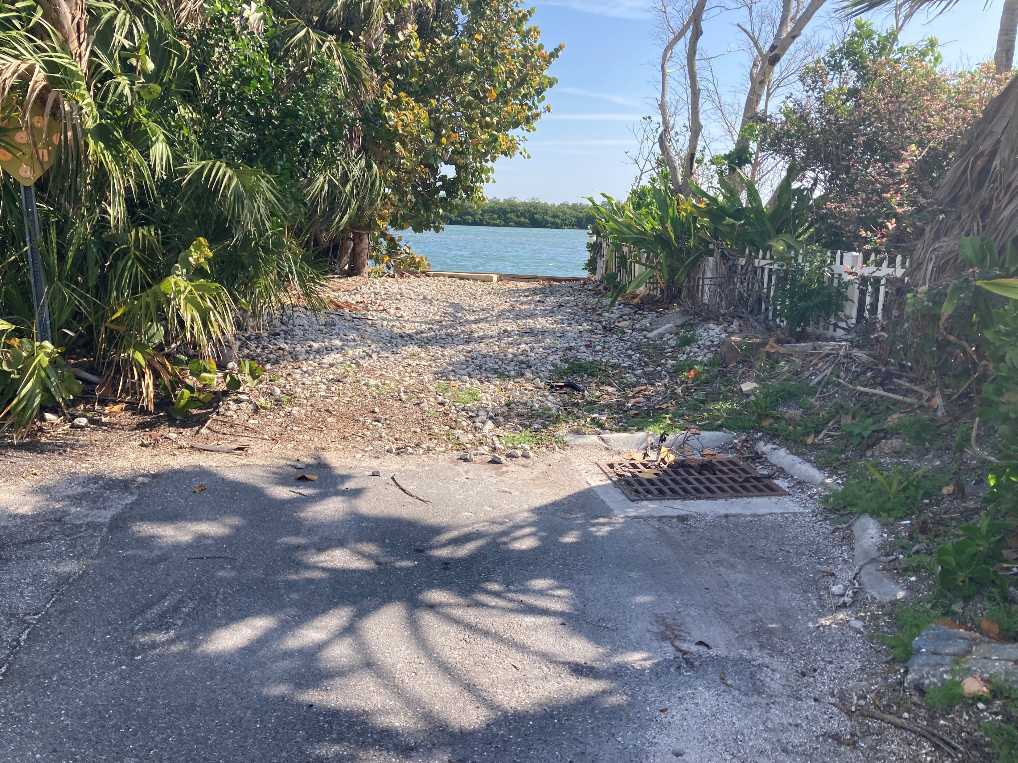
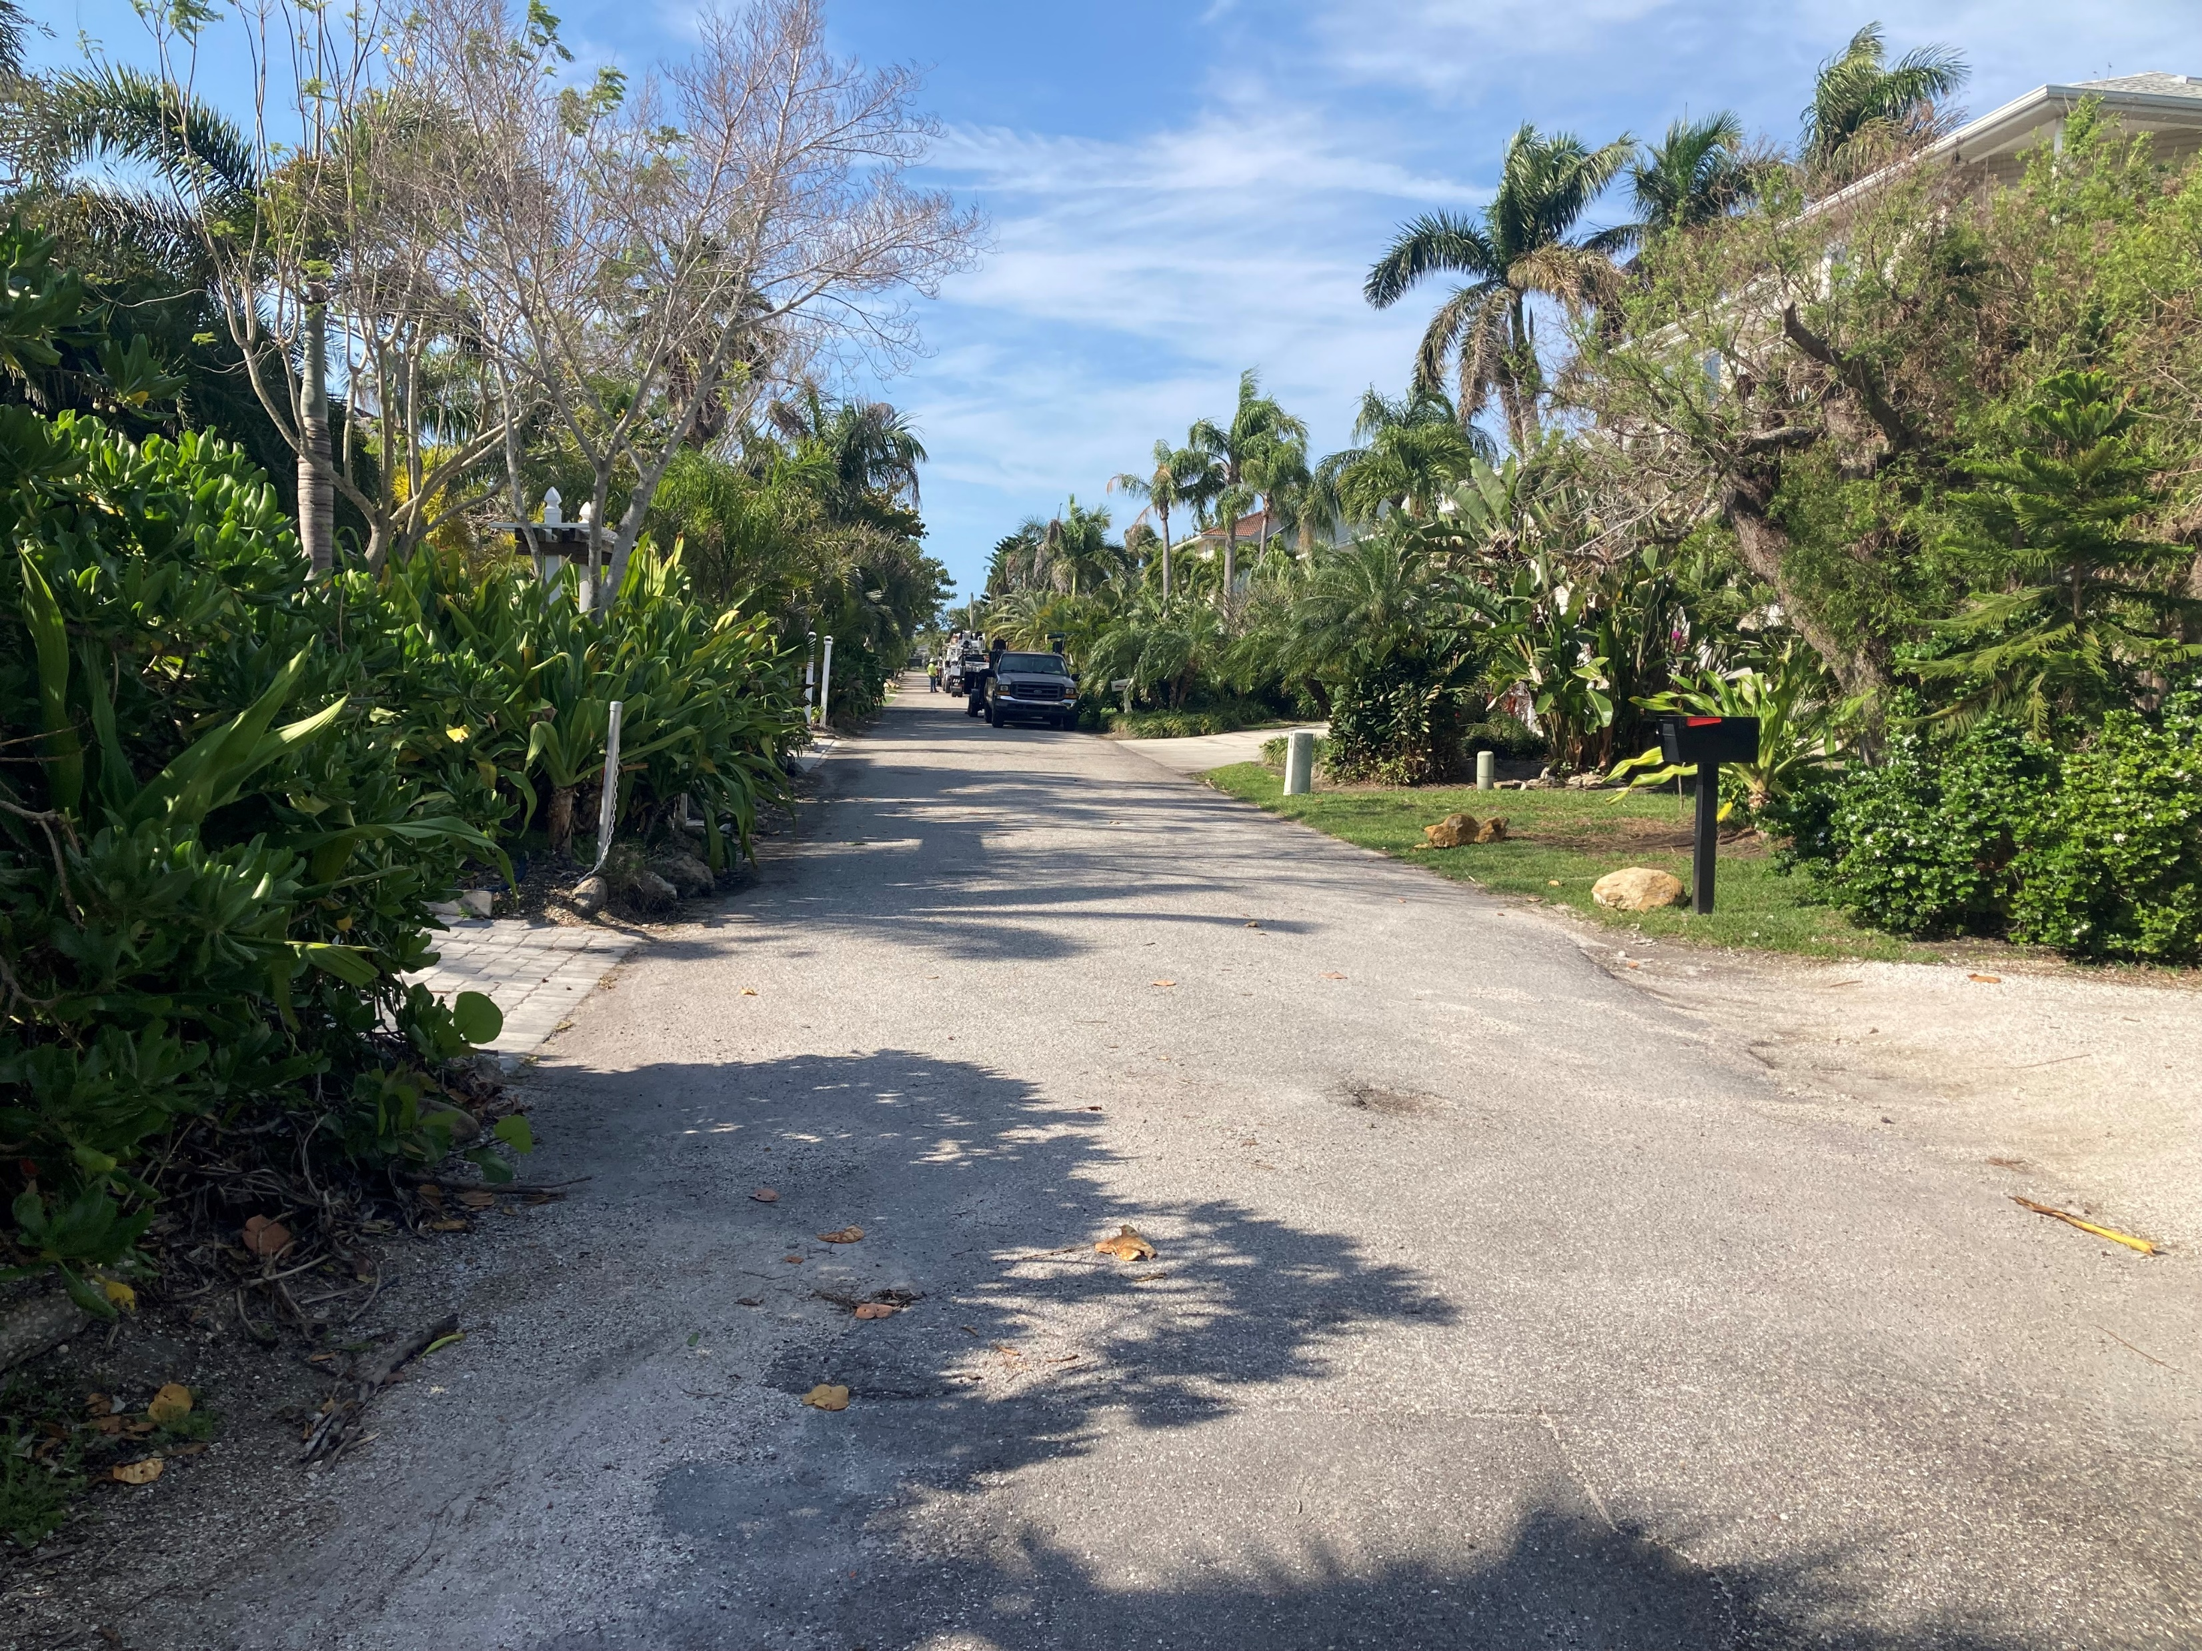
Photos Penfield St. Stormwater Project
Photo 4 at End of Penfield Project Area. Facing N/E. Dry Conditions. With Existing Storm Drains
Photo 5 of Penfield St. Dry Conditions. Facing S/W.

