Slide 1
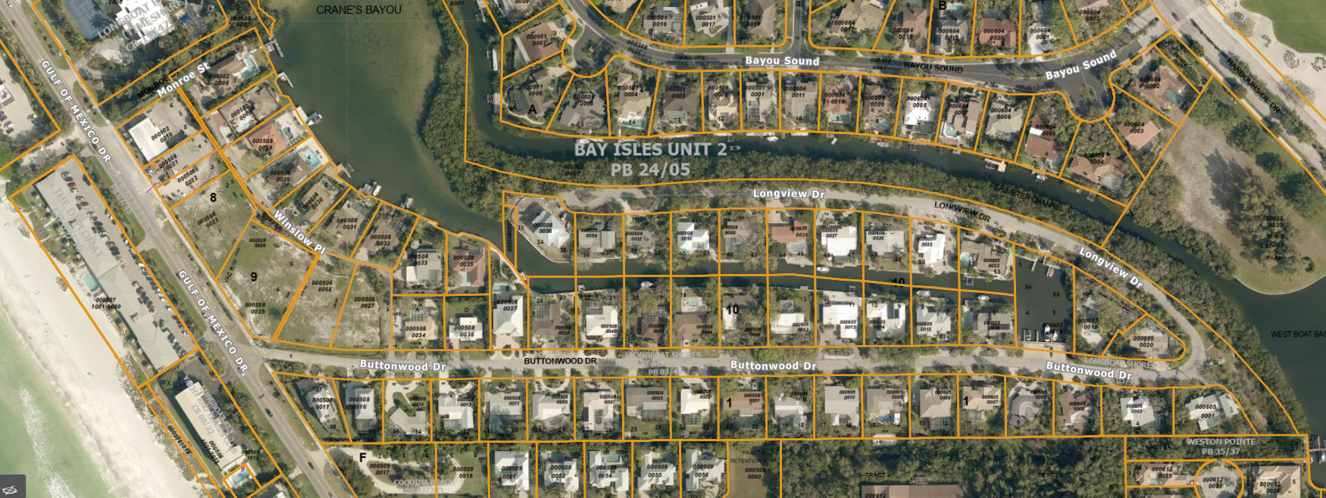
Photo Map Buttonwood Projects 4, 5, & 6
4
3
1
2
8
7
6
5
4
3
2
1
1
2
3
4
6
Photos of Project 4
1
Photos of Project 5
All photos were taken on 3/25/2024 unless otherwise labeled. Arrow indicates the direction of photo and number box indicates the position.
1
Photos of Project 6

Slide 2
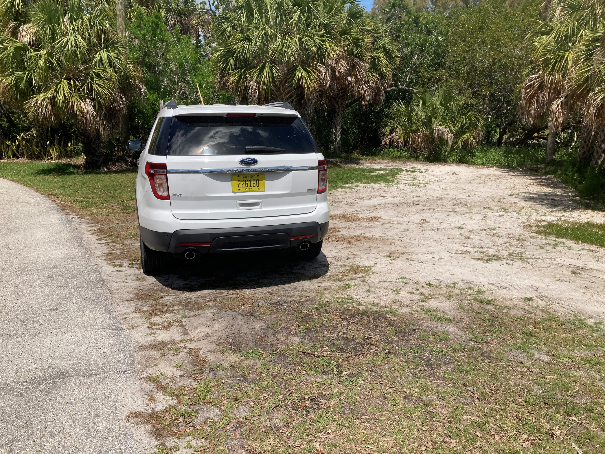
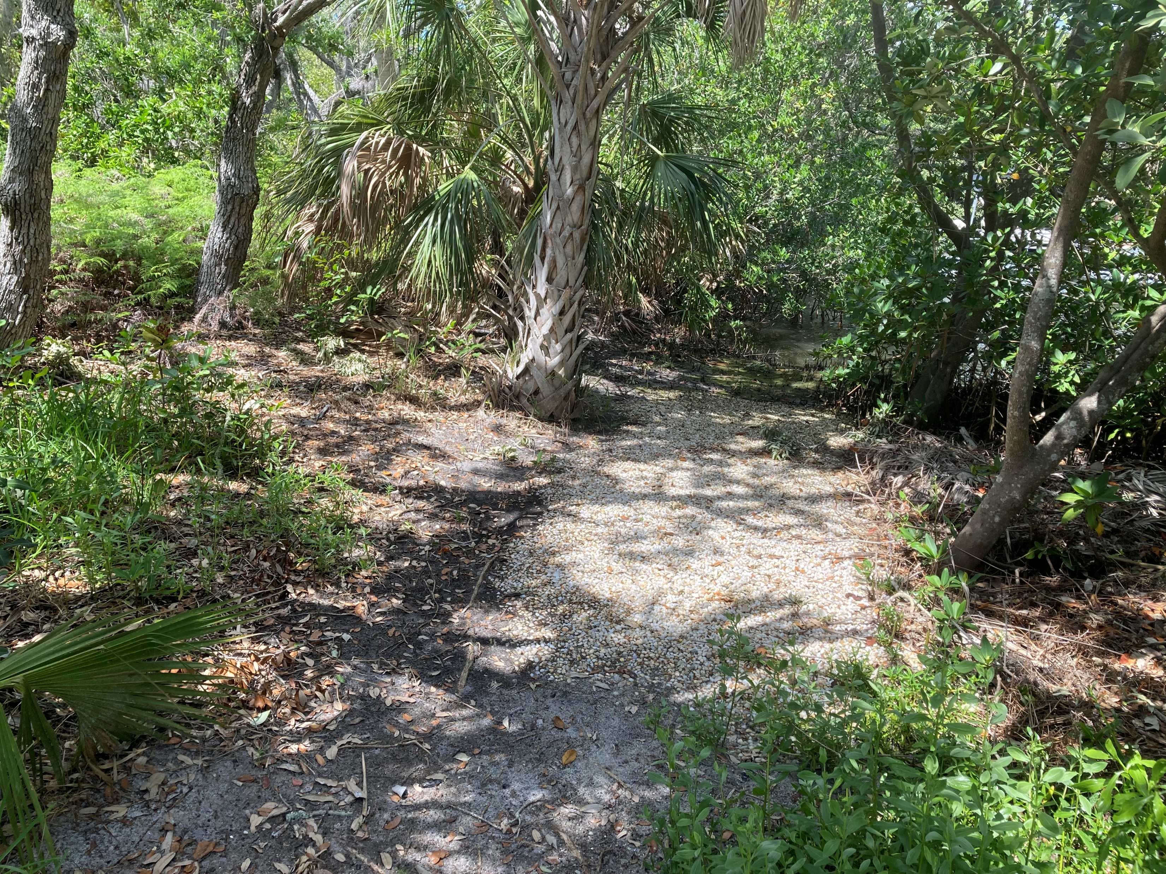
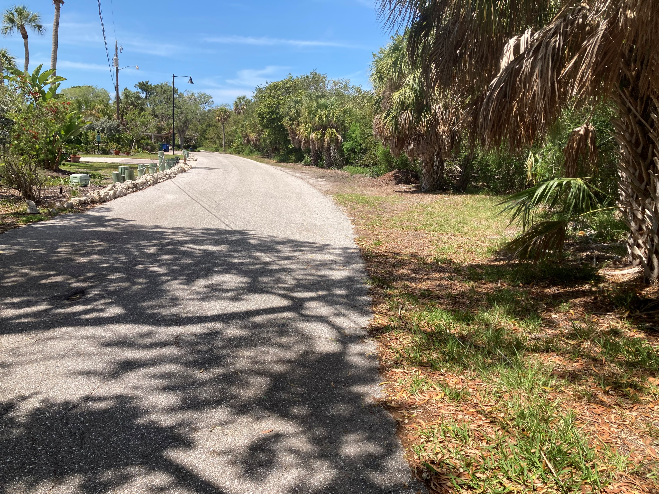
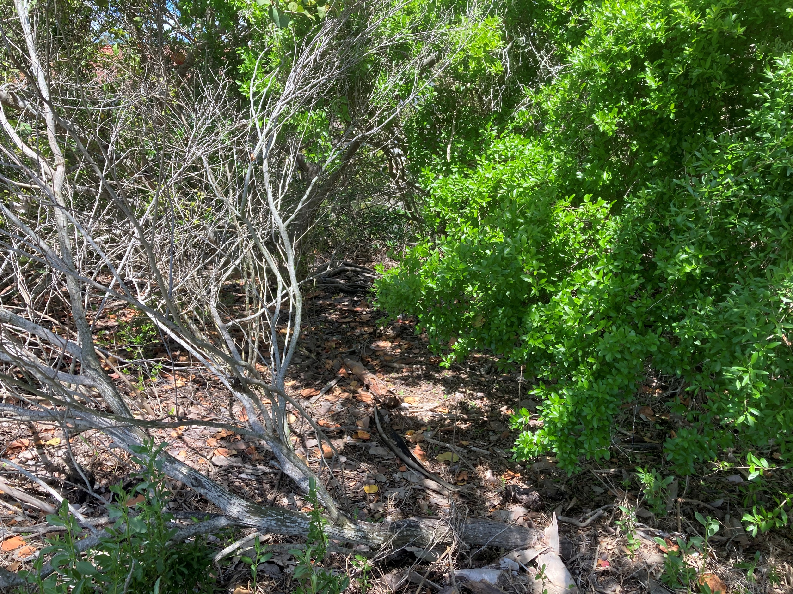
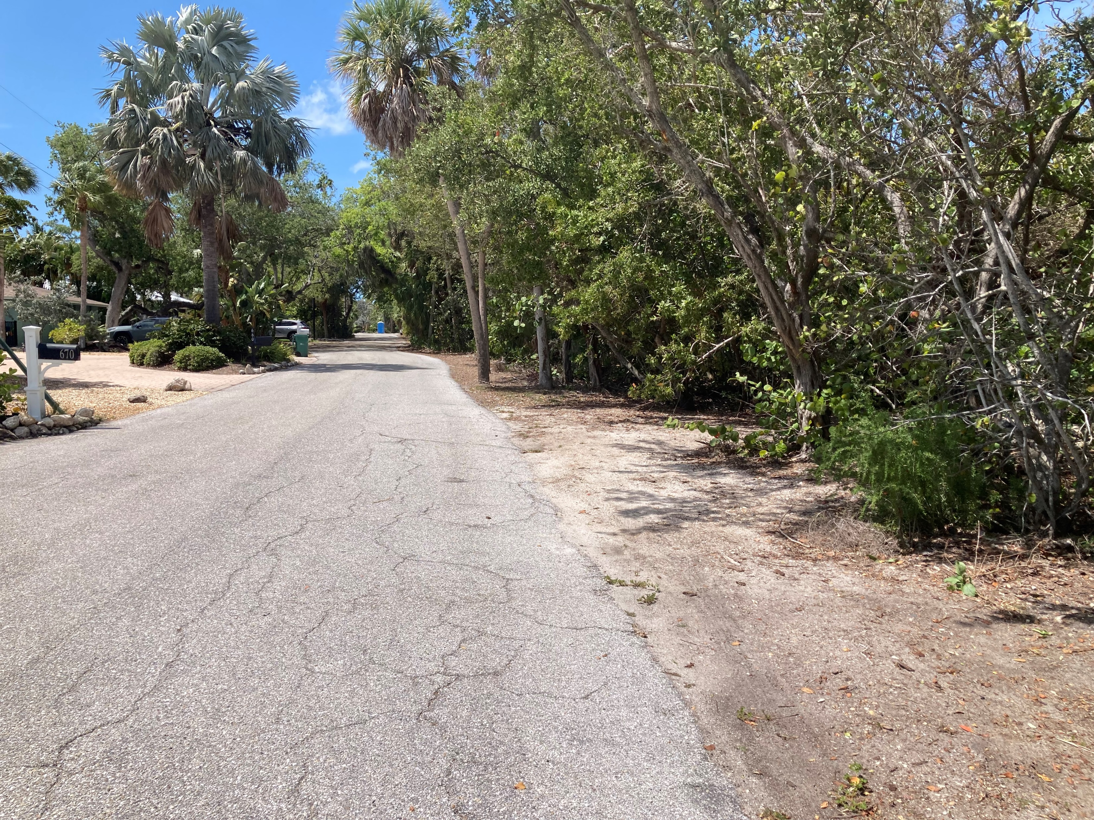
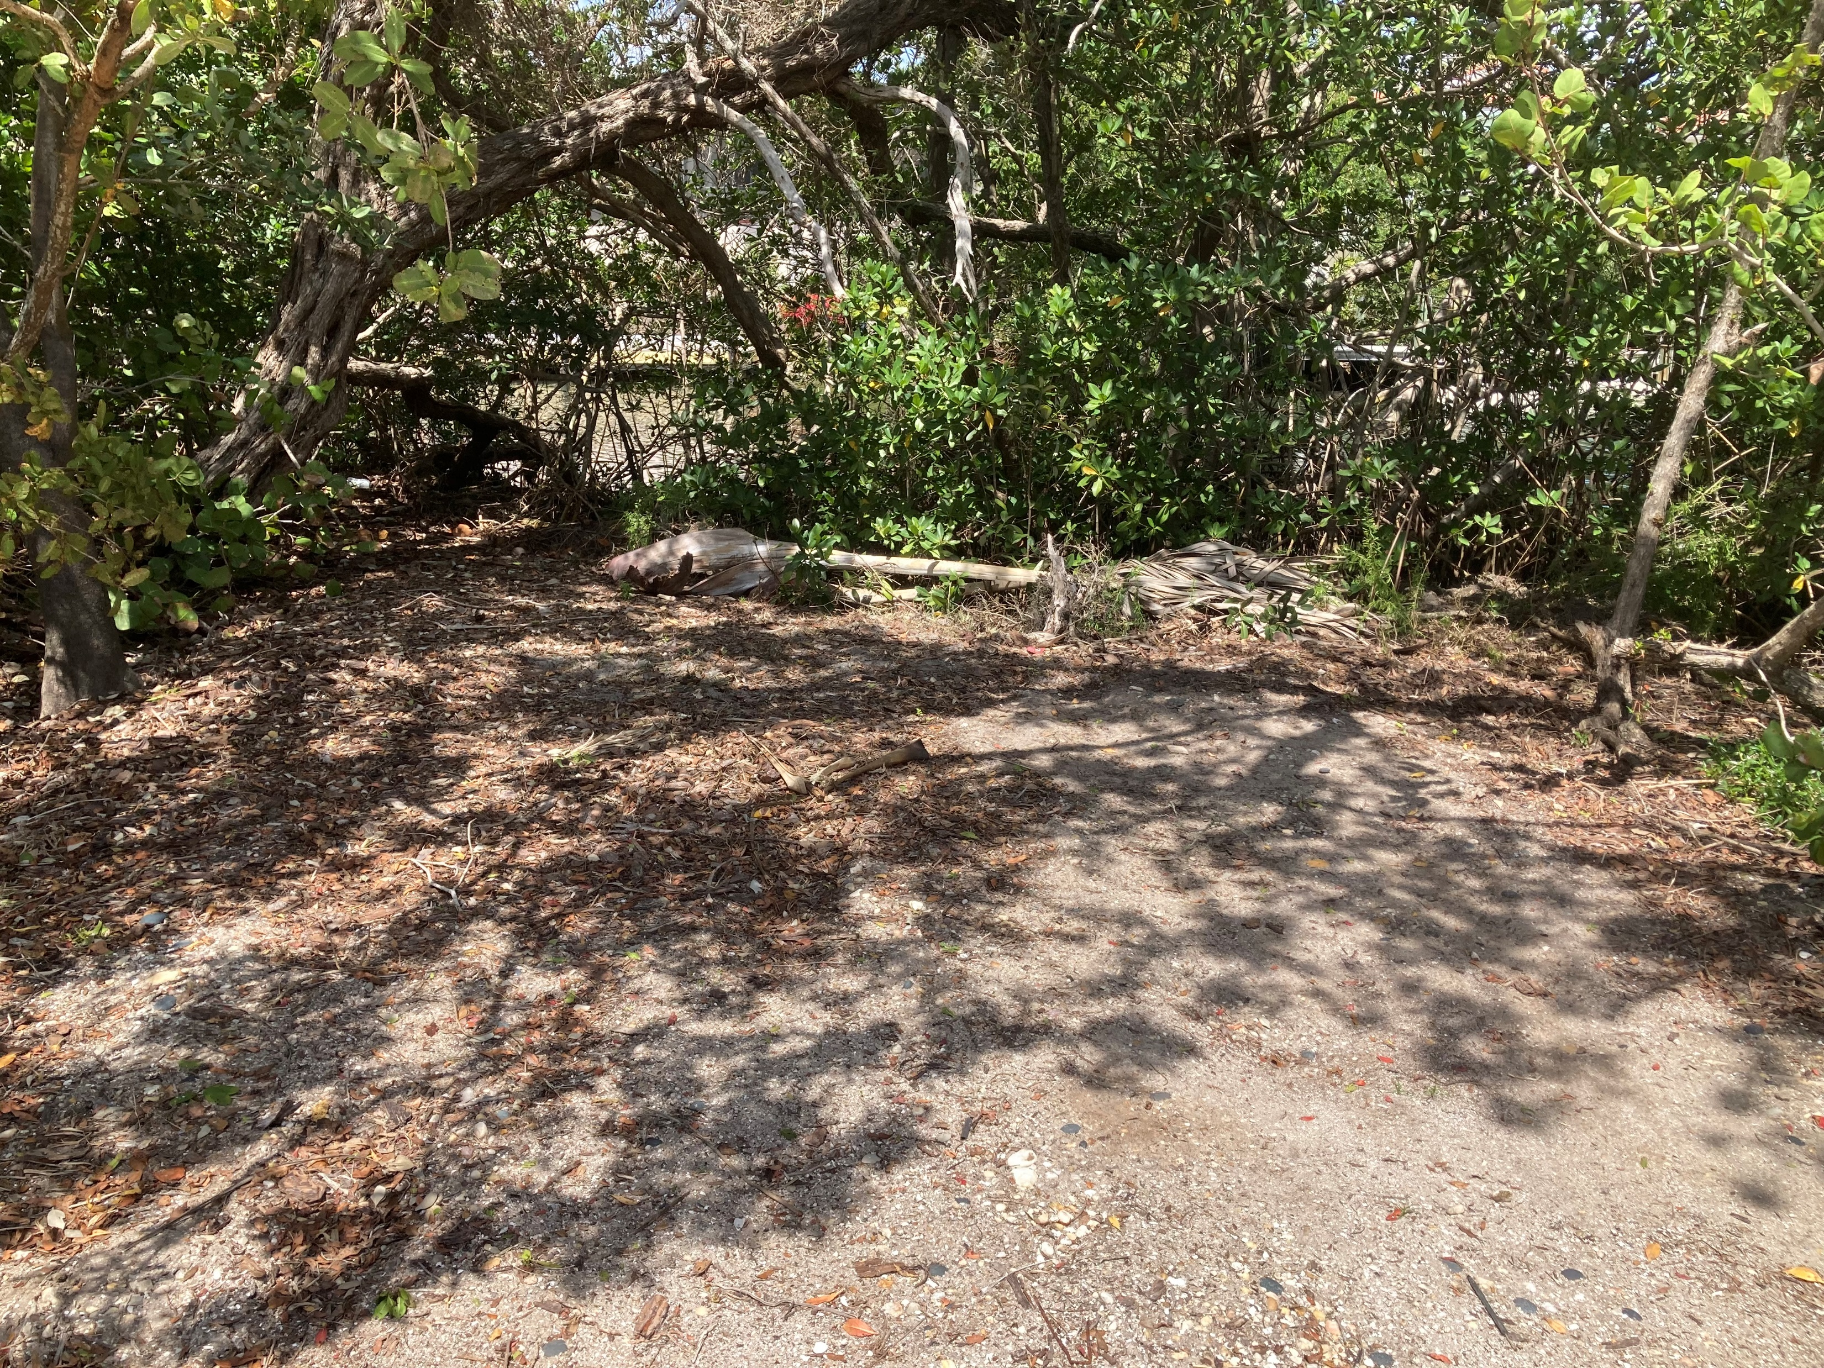
Photos Buttonwood Project 4
Photo 1 of Project 4 East Road Edge and Bank
Photo 2 of Project 4 East Bank
Photo 3 of Project 4 N/E Road Edge and Bank
Photo 4 of Project 4 N/E Bank
Photo 5 of Project 4 North Road Edge and Bank
Photo 6 of Project 4 North Bank

Slide 3
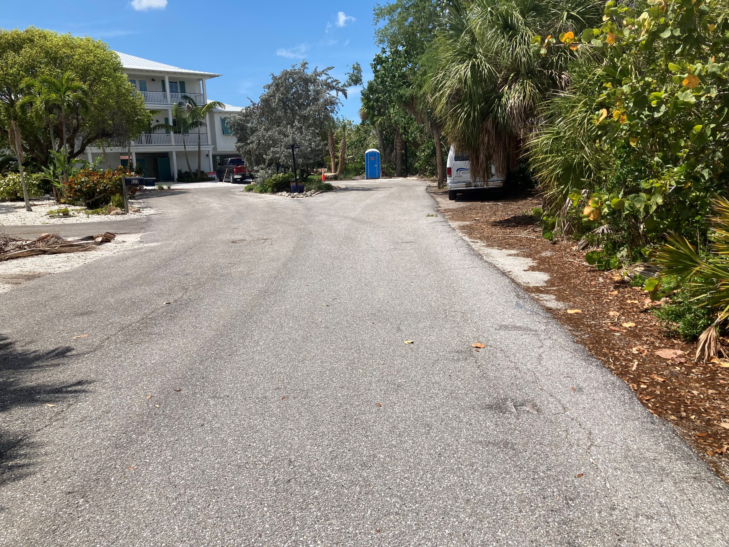
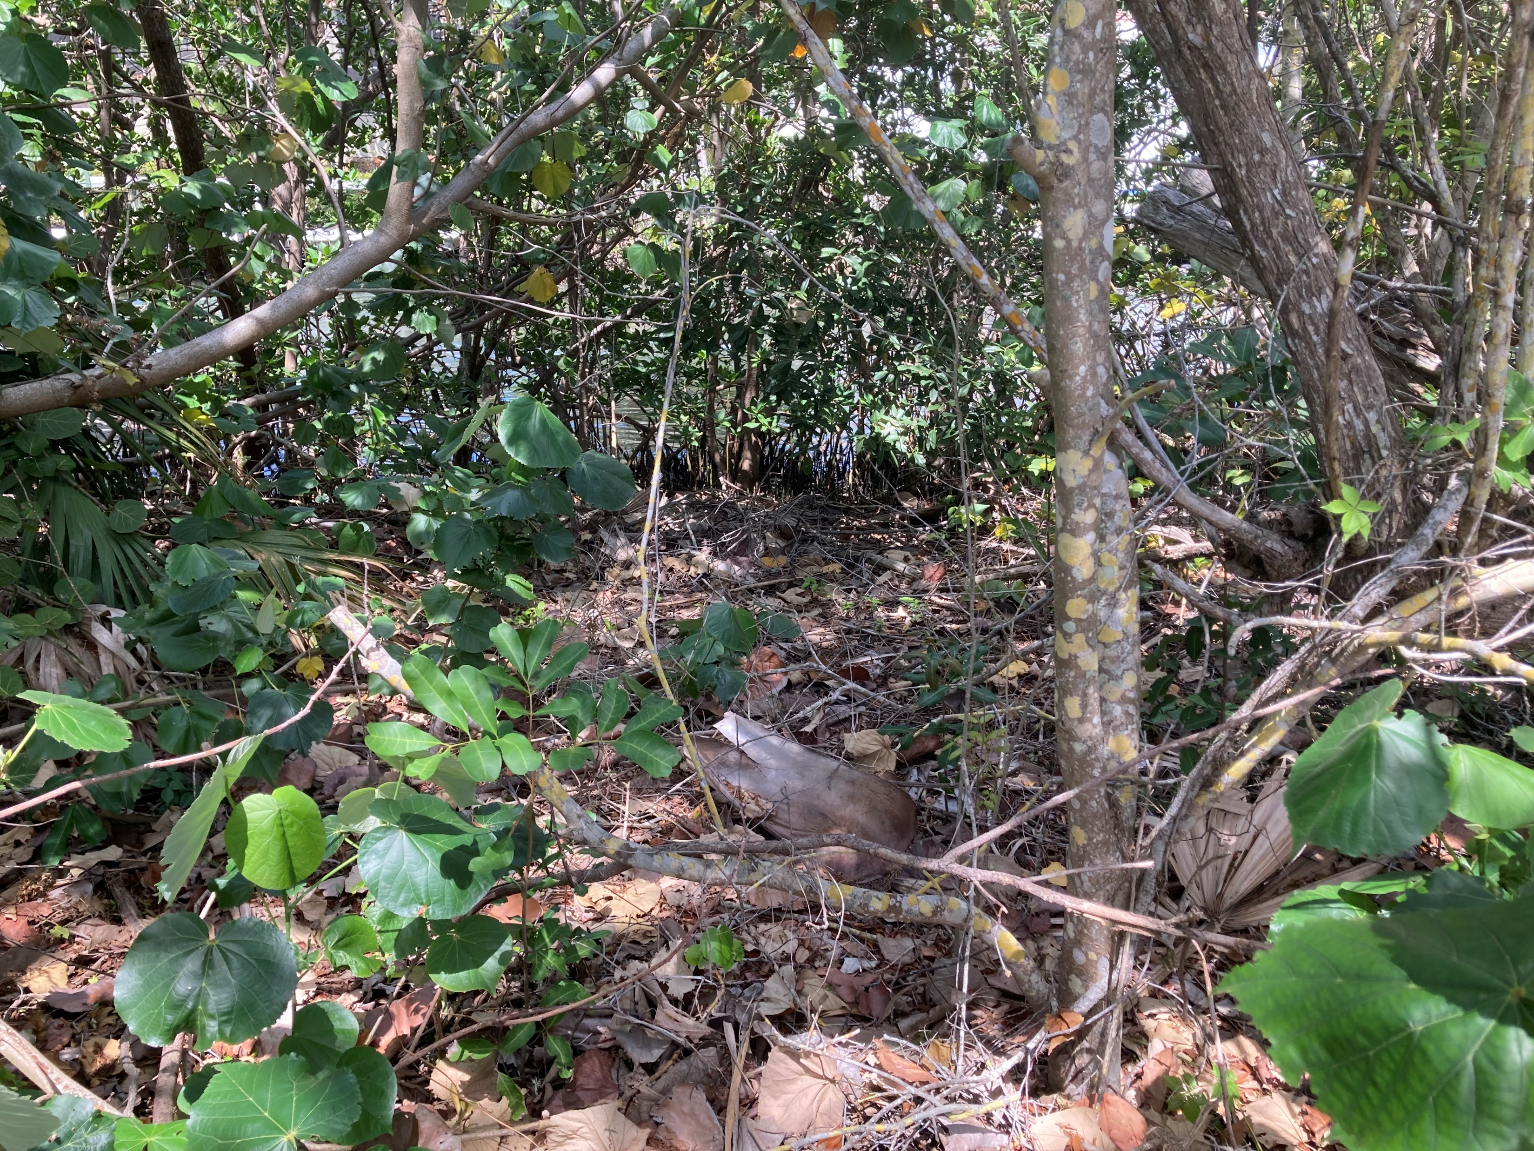
Photos Buttonwood Project 4 Cont.
Photo 7 of Project 4 North Road Edge and Bank
End of Longview Dr.
Photo 8 of Project 4 North Bank End of Longview Dr.

Slide 4
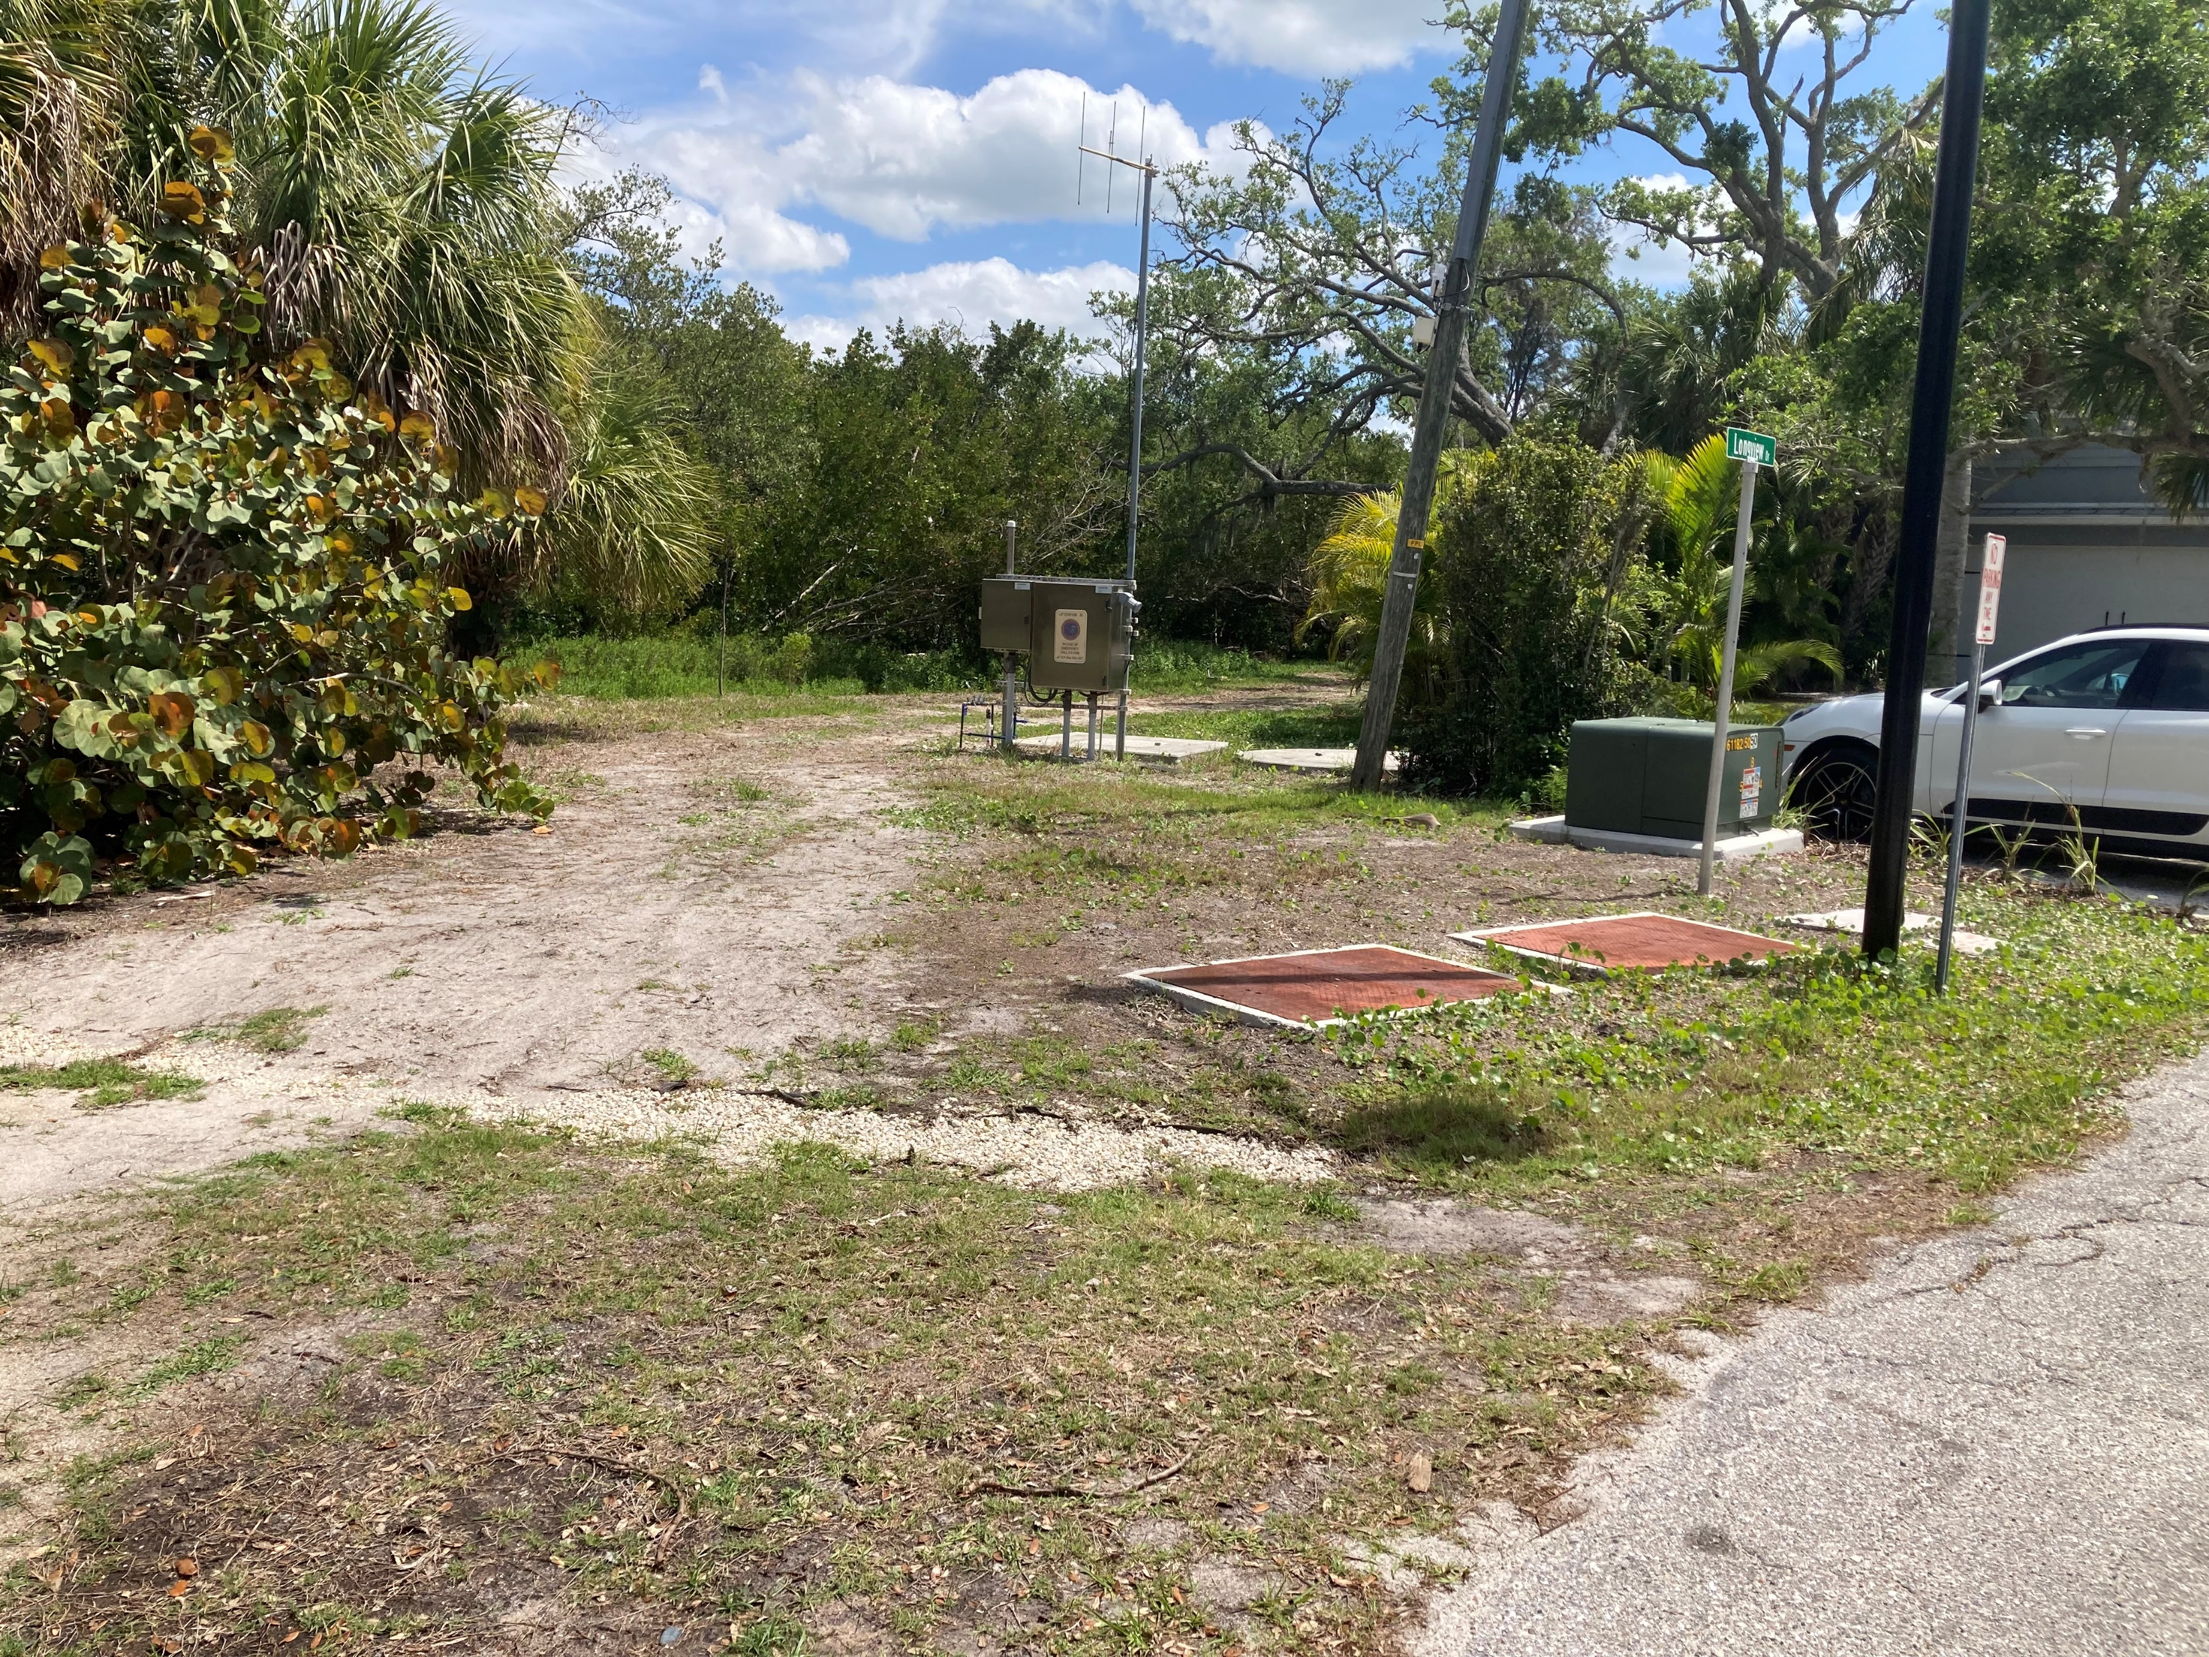
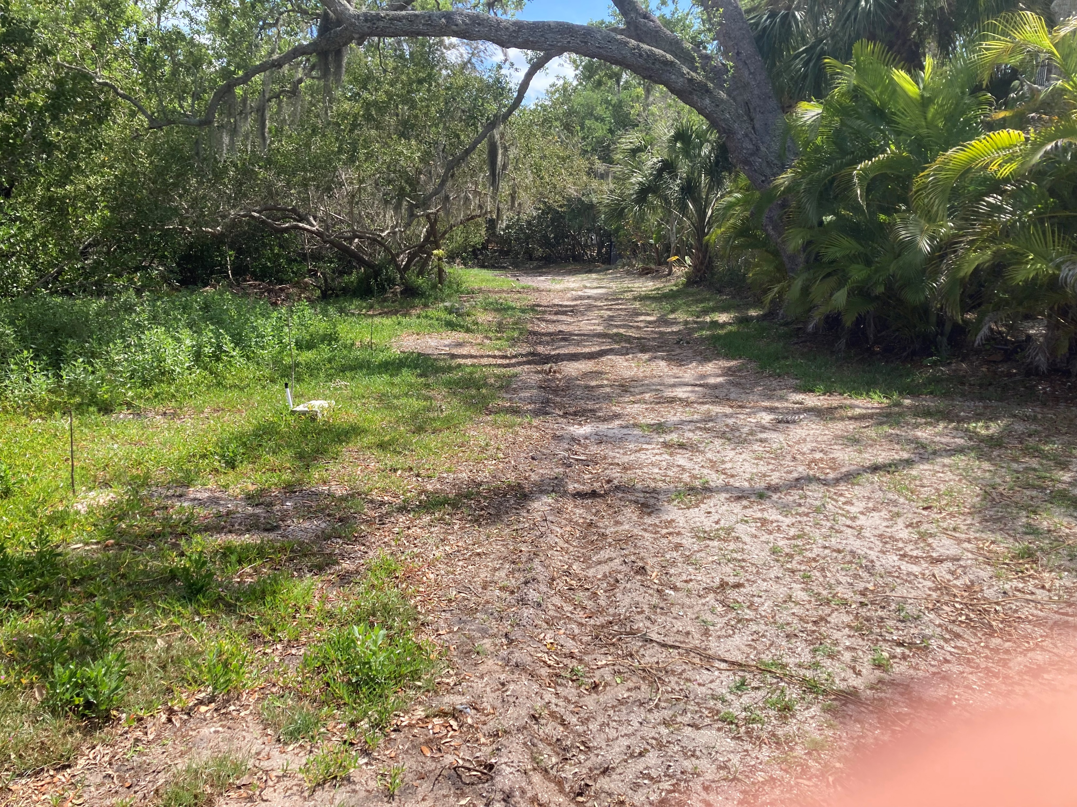
Photos Buttonwood Project 5
Photo 2 of Project 5 East Bank End of Buttonwood Dr.
Photo 1 of Project 5 East Road Edge and Bank
End of Buttonwood Dr.

Slide 5
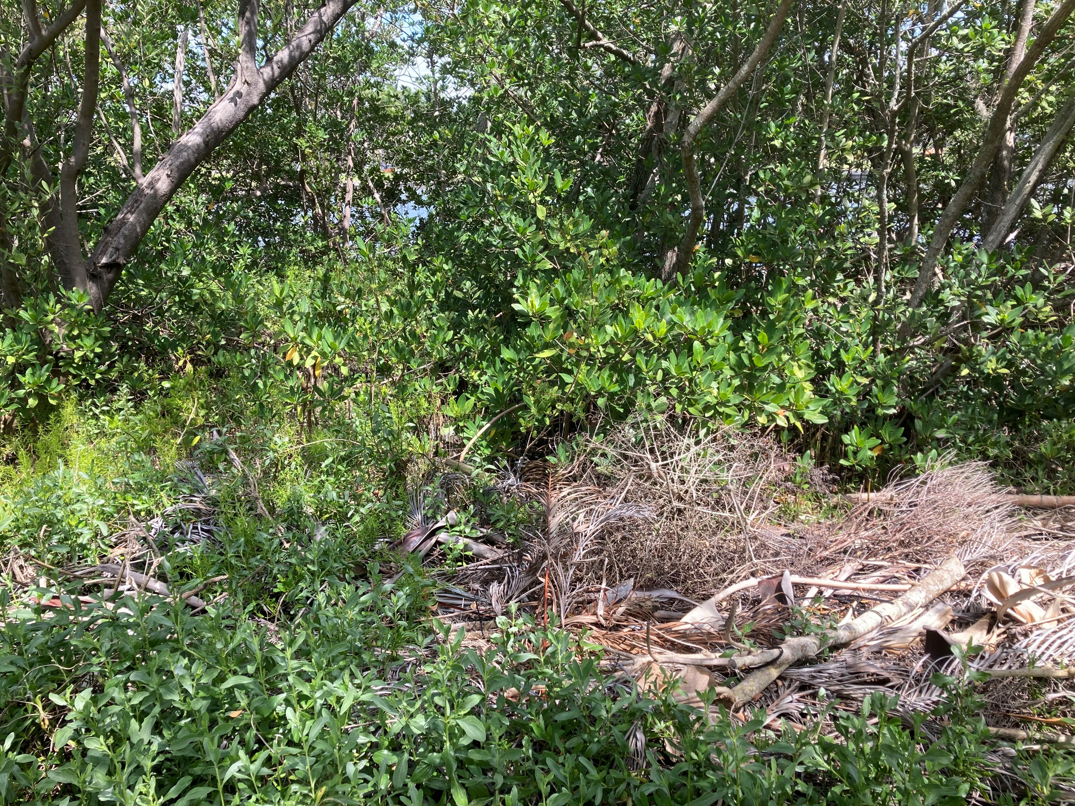
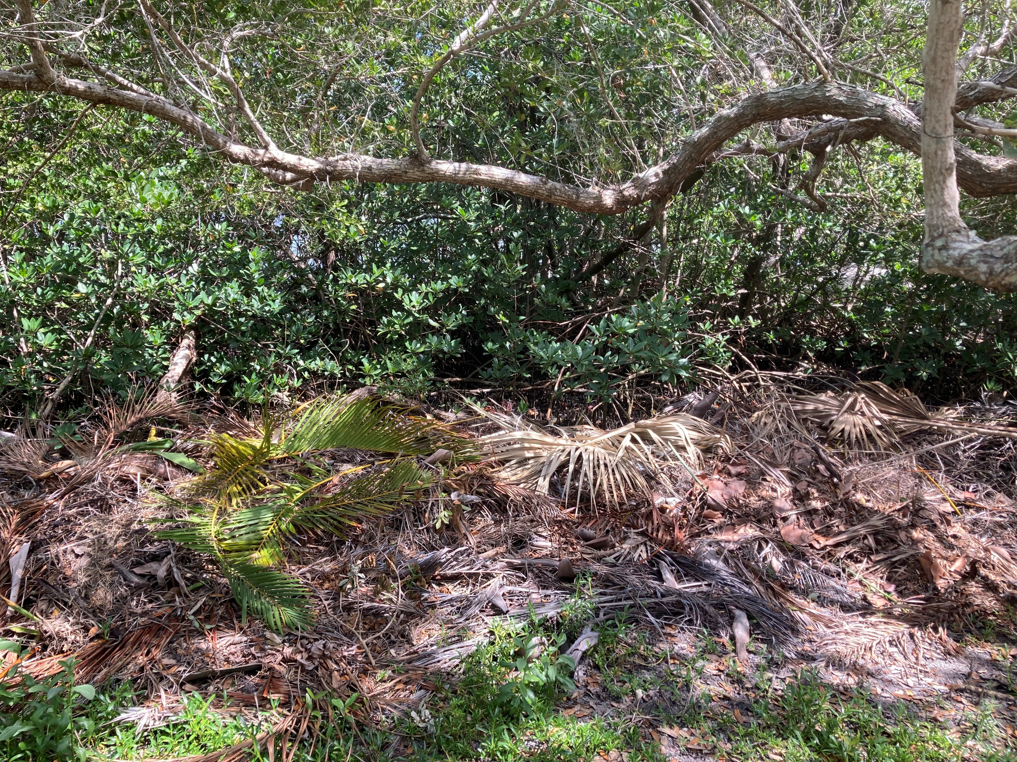
Photos Buttonwood Project 5 Cont.
Photo 3 of Project 5 East Bank End of Buttonwood Dr.
Photo 4 of Project 5 East Bank End of Buttonwood Dr.

Slide 6
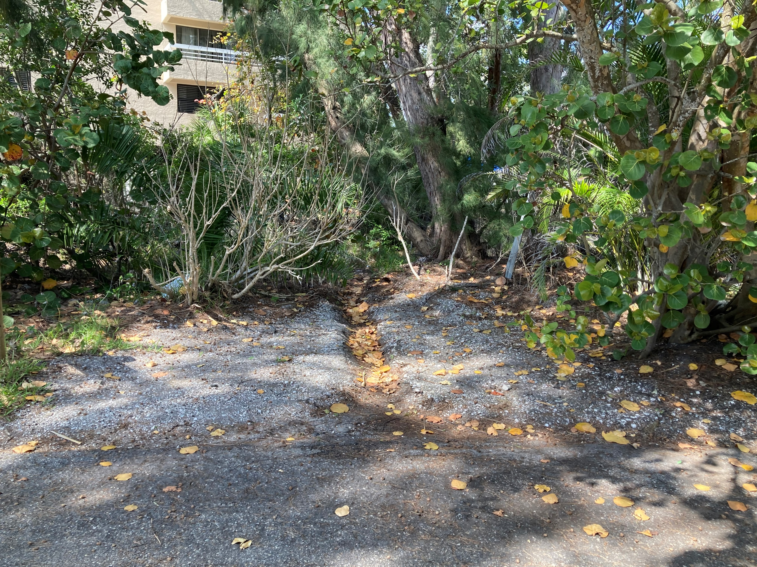
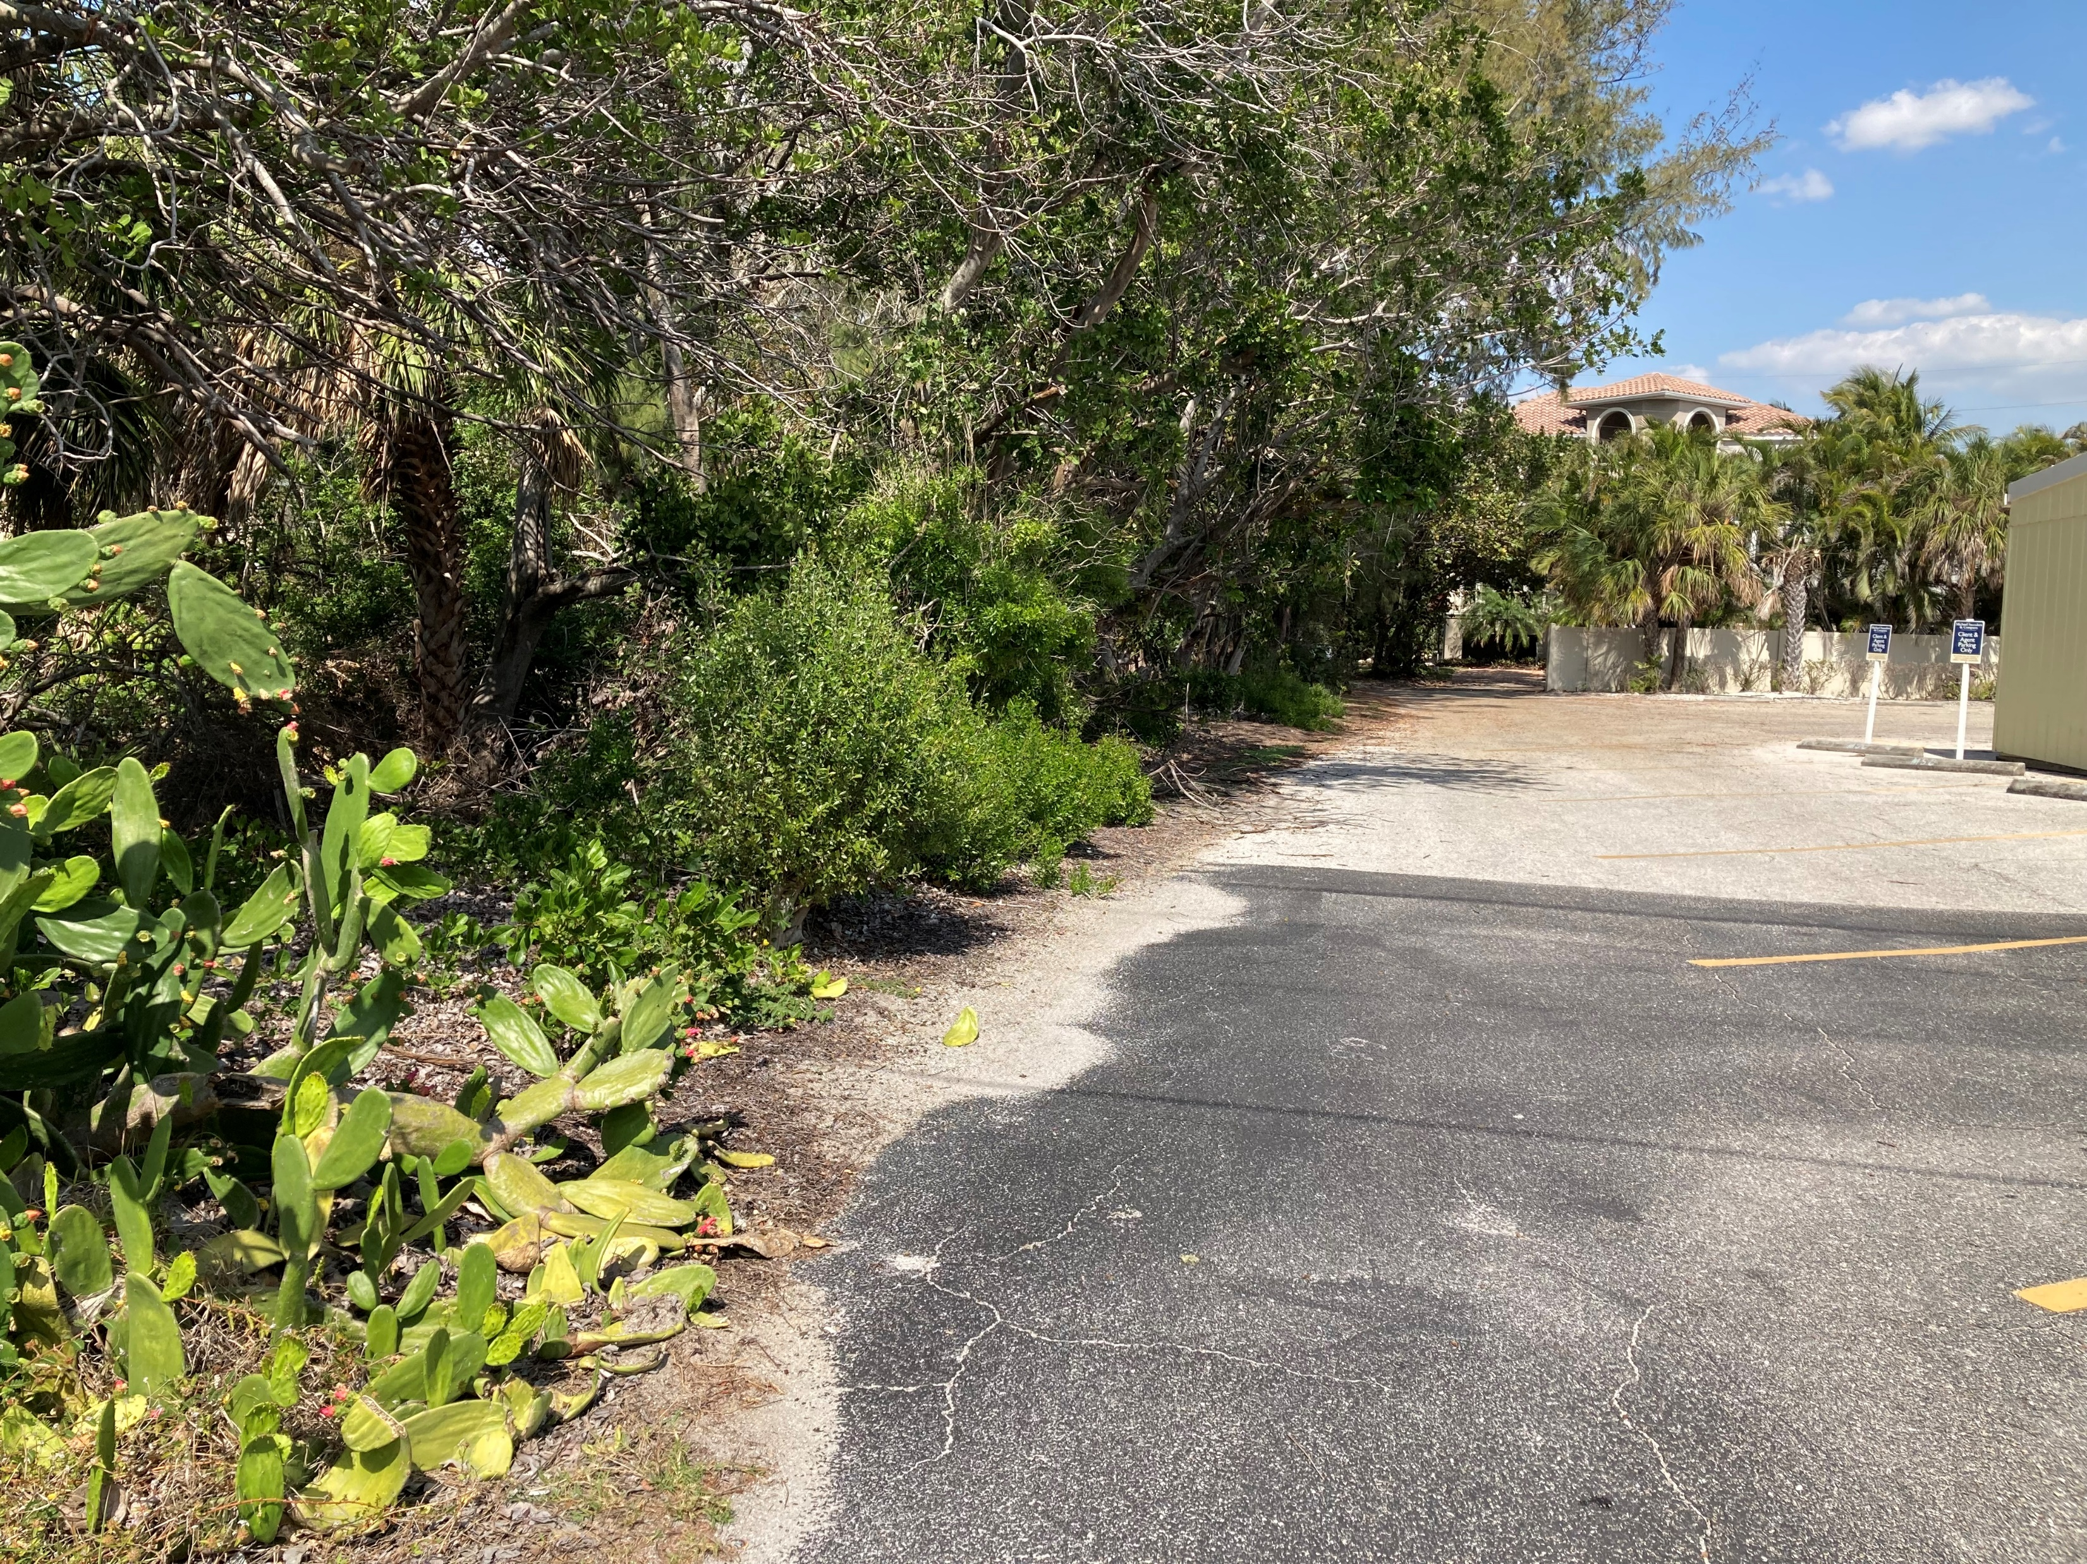
Photos Buttonwood Project 6
Photo 1 of Project 6 Drainage Area End of Wilslow PL.
Photo 2 of Project 6 Road Edge and Drainage Area End of Monroe St.

Slide 7
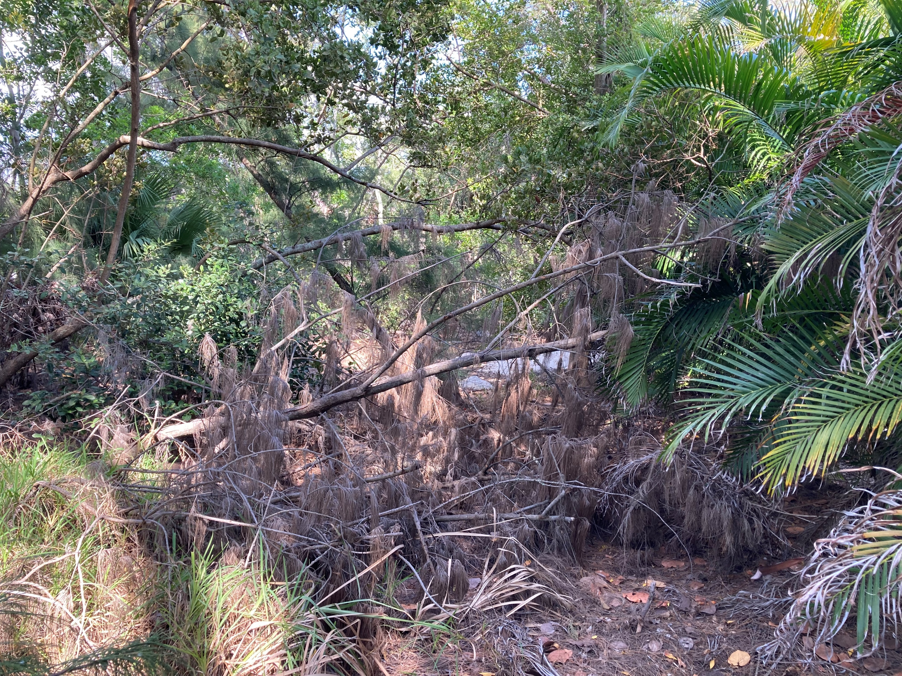
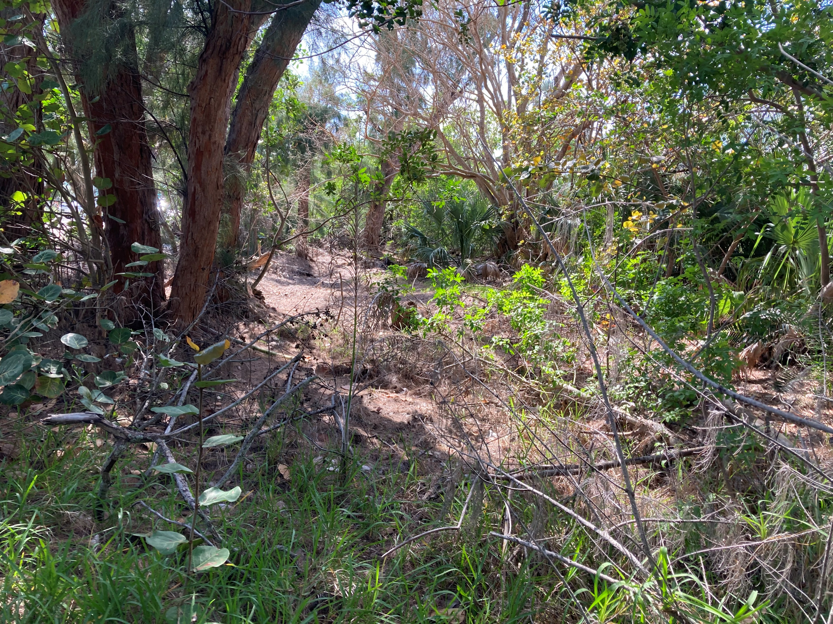
Photos Buttonwood Project 6 Cont
Photo 3 of Project 6 Drainage Area Facing West
Photo 4 of Project 6 Drainage Area Facing West

