Slide 1



Welcome!

Slide 2
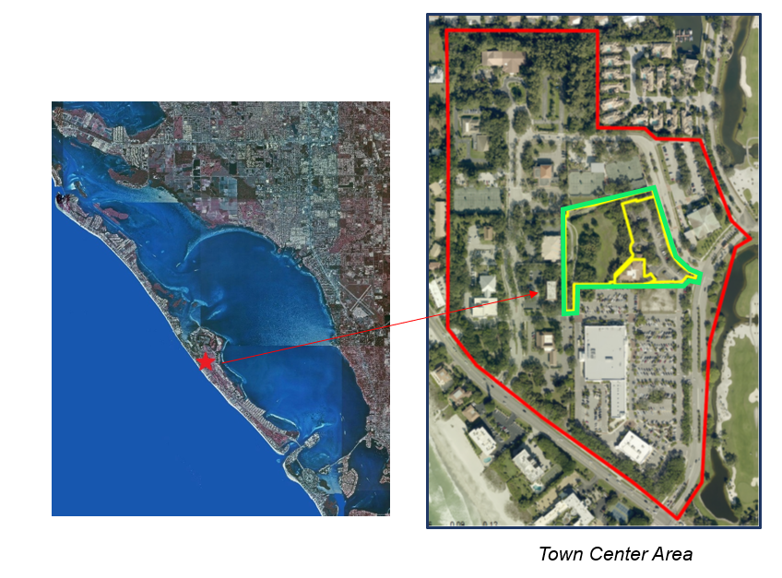
Background
Town bought:
Bay Isles Enclave Acquisition, LLC
May 5, 2014 (2.80-acres)
W. Howard Rooks
March 31, 2017 (1.65-acres)
Cavalier Investments I, Inc.
March 31, 2017 (0.36-acres)
Total site area: 4.81 acres
Land investment: $3.7M

Slide 3
Concept Plan

Slide 4
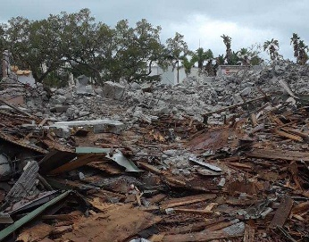
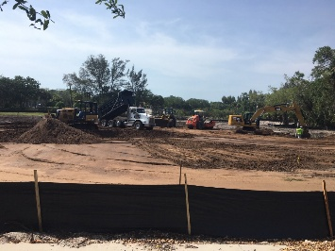
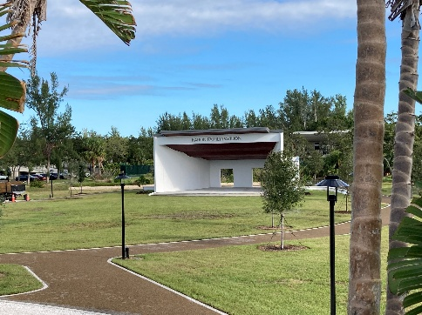
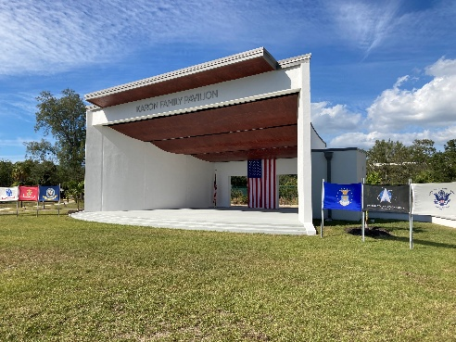
“Community Gathering Space”
Actively developed…
Phase 1: 2020 for $854,000
Demolition of abandoned restaurant
Raise site and initial grading
Sarasota County grant of $400,000
Phase 2: 2023 for $2.3 million
Elevate Site, Add Master Stormwater,
Event ‘Green’, Oval walkway, AND
Donor-funded Outdoor Performance stage:
Karon Family Pavilion $800,000
Town Site & Park Enhancements: $1.5 million

Slide 5
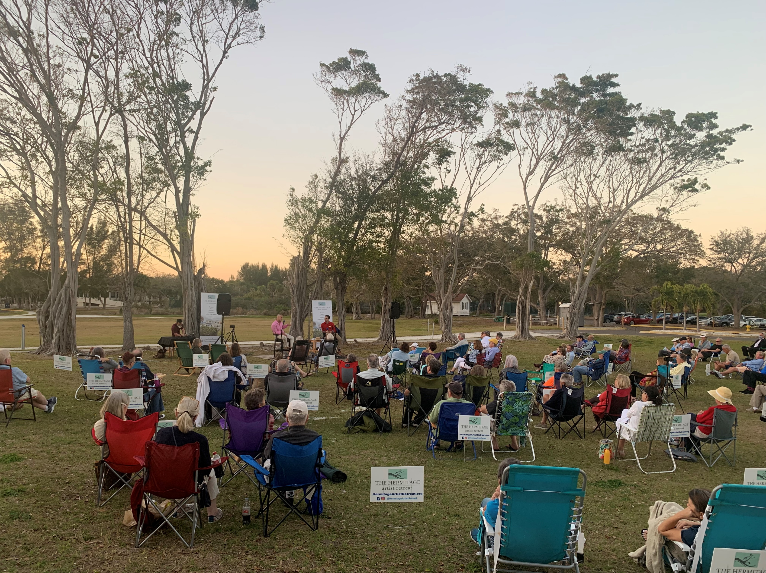
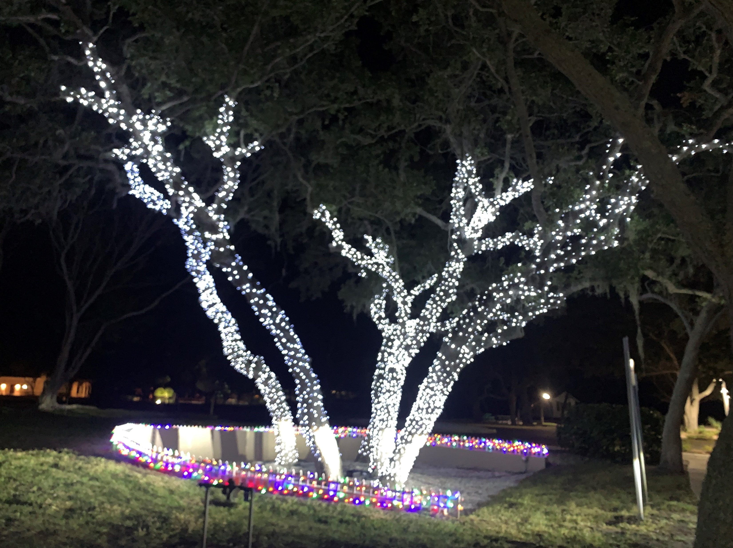
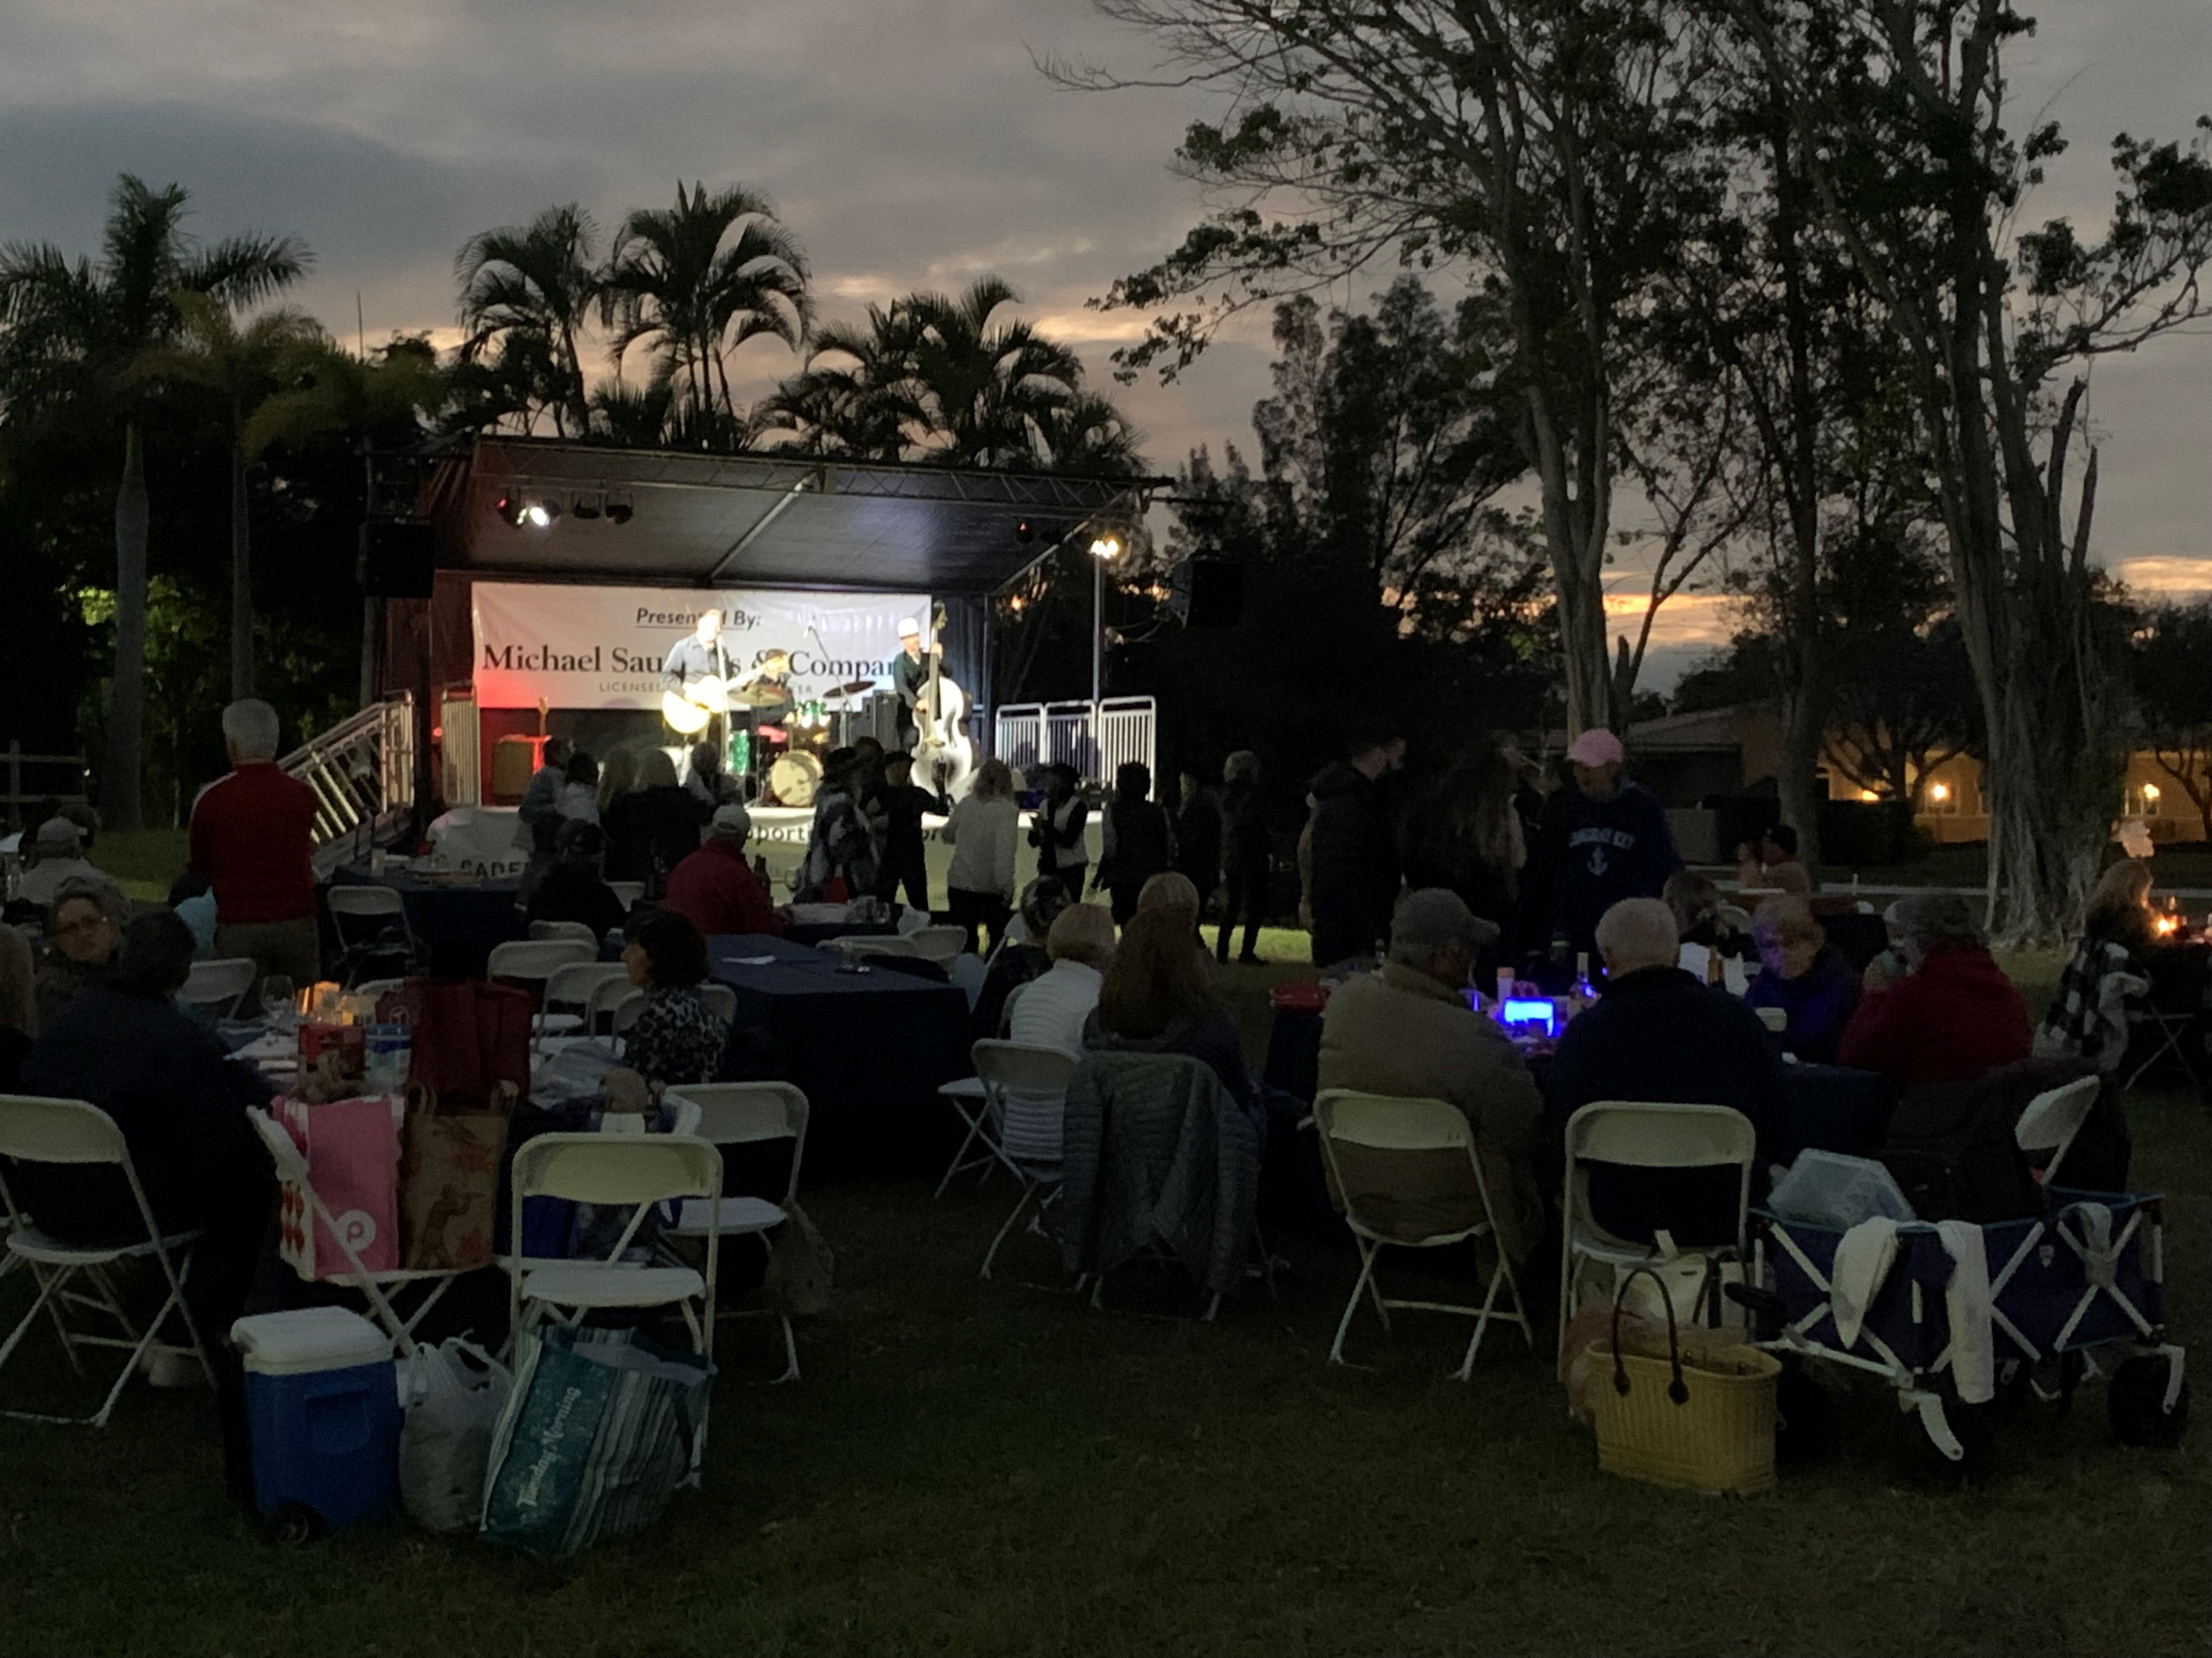
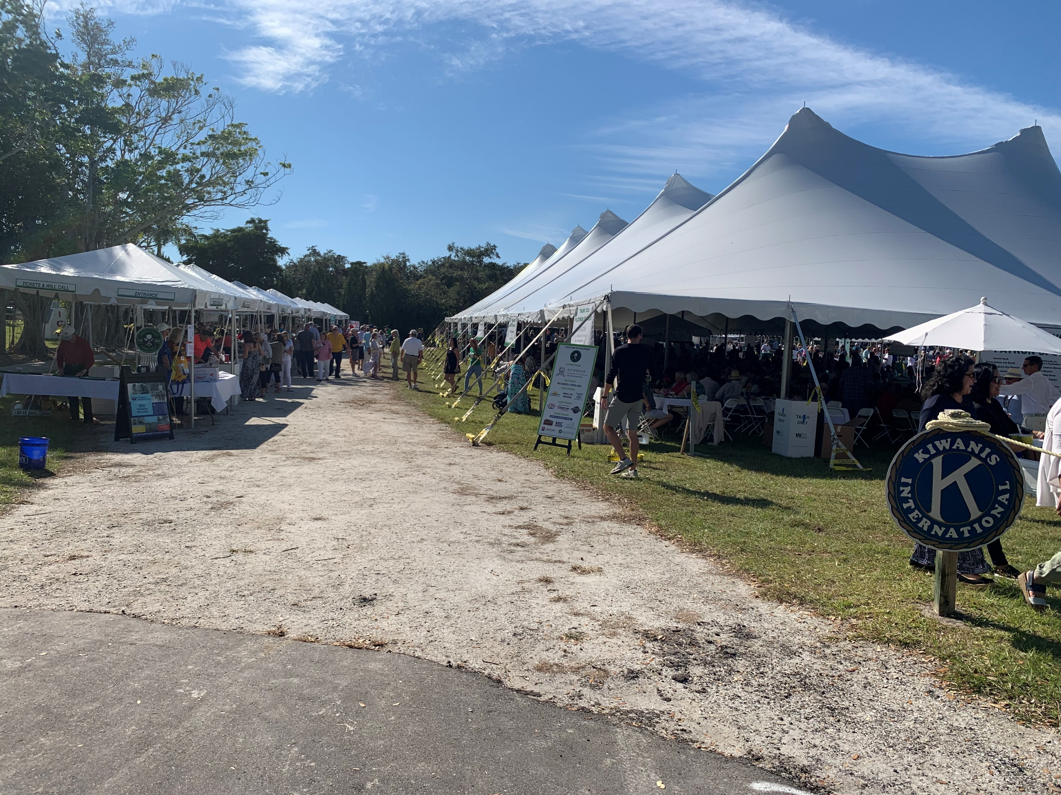

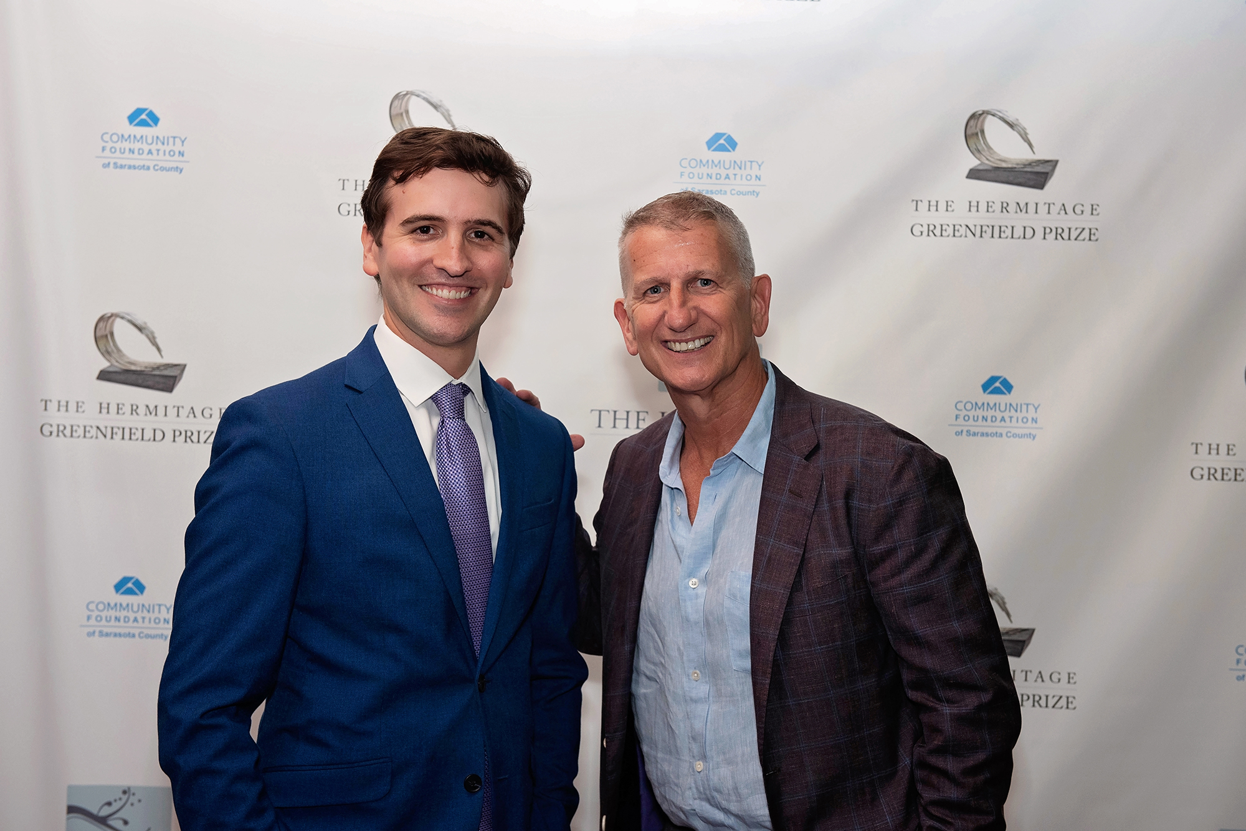
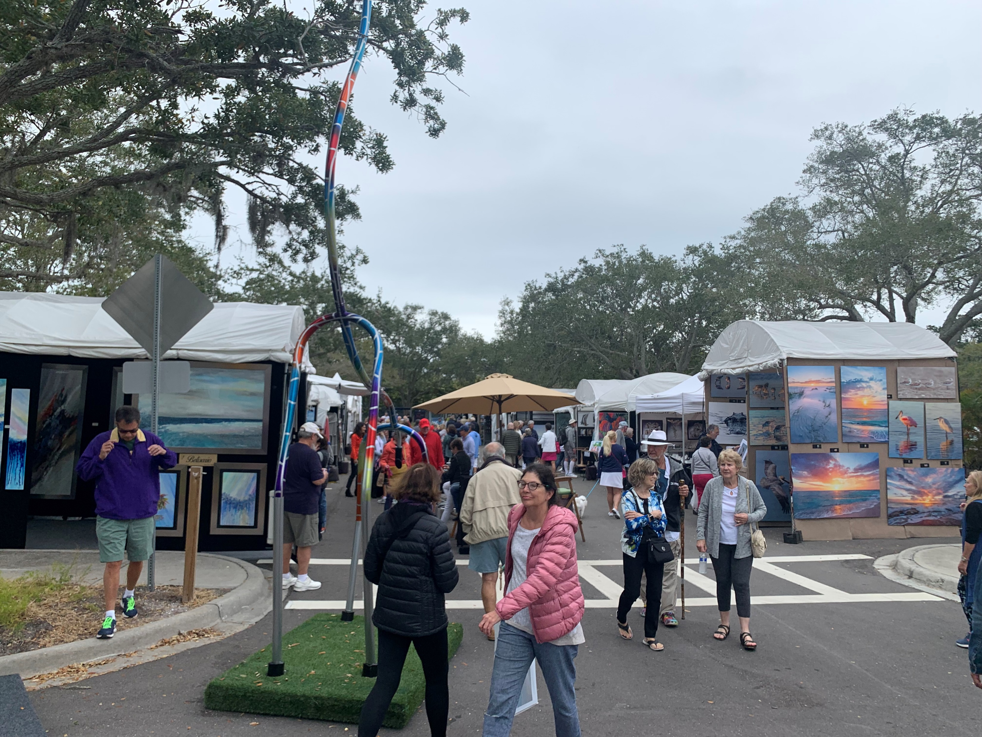
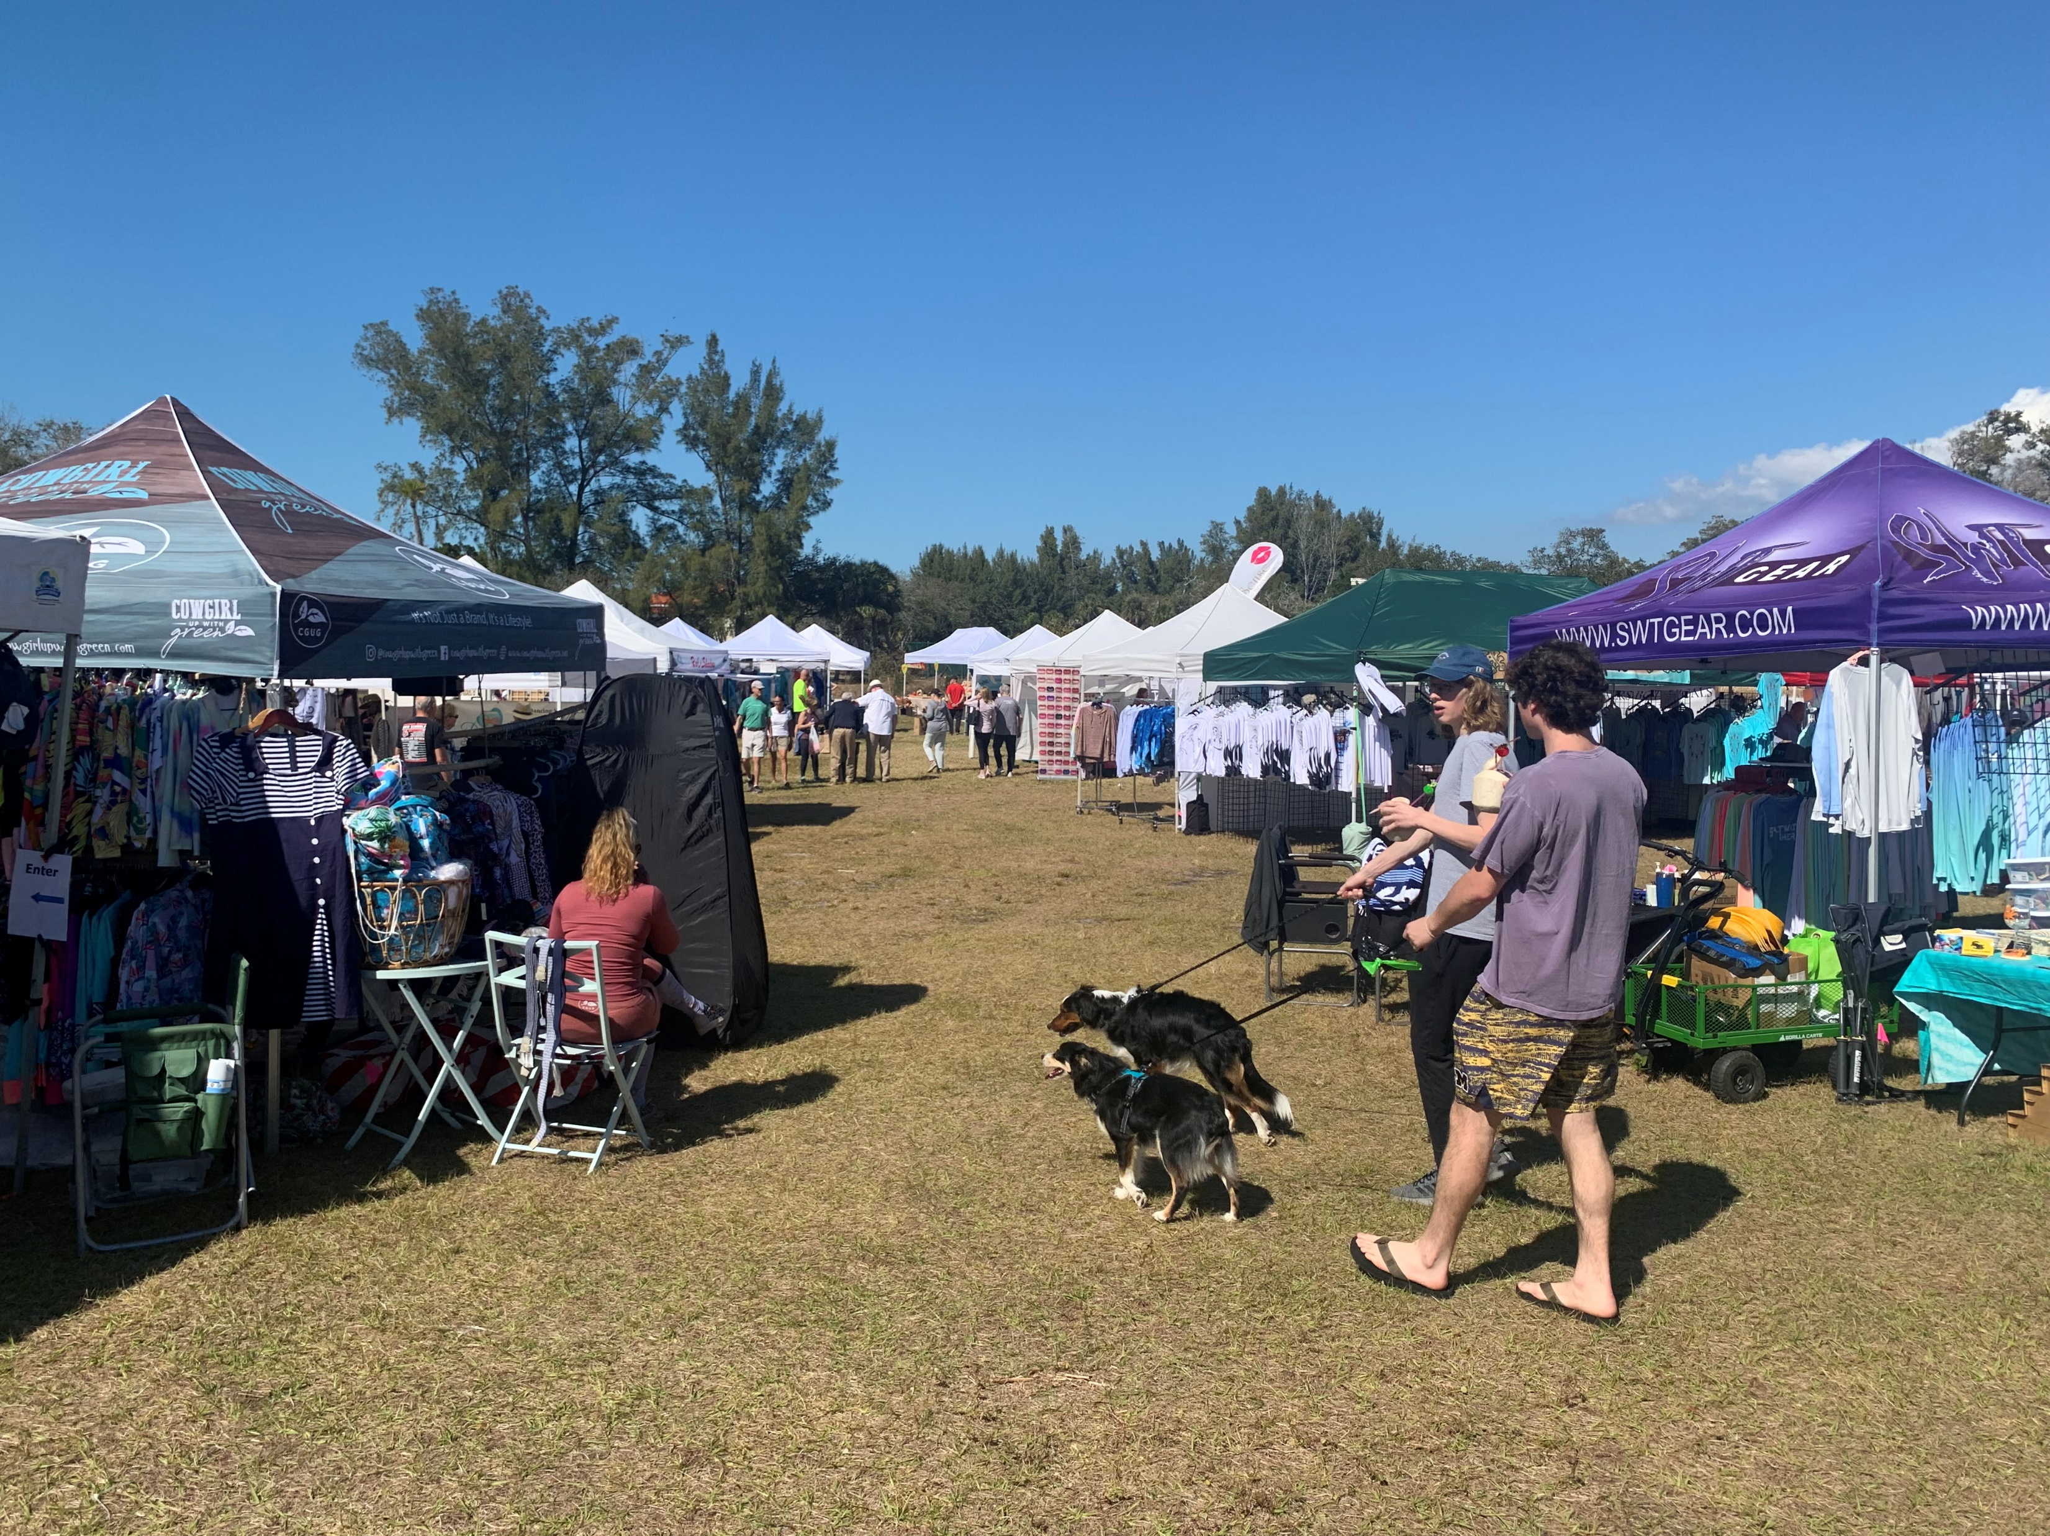
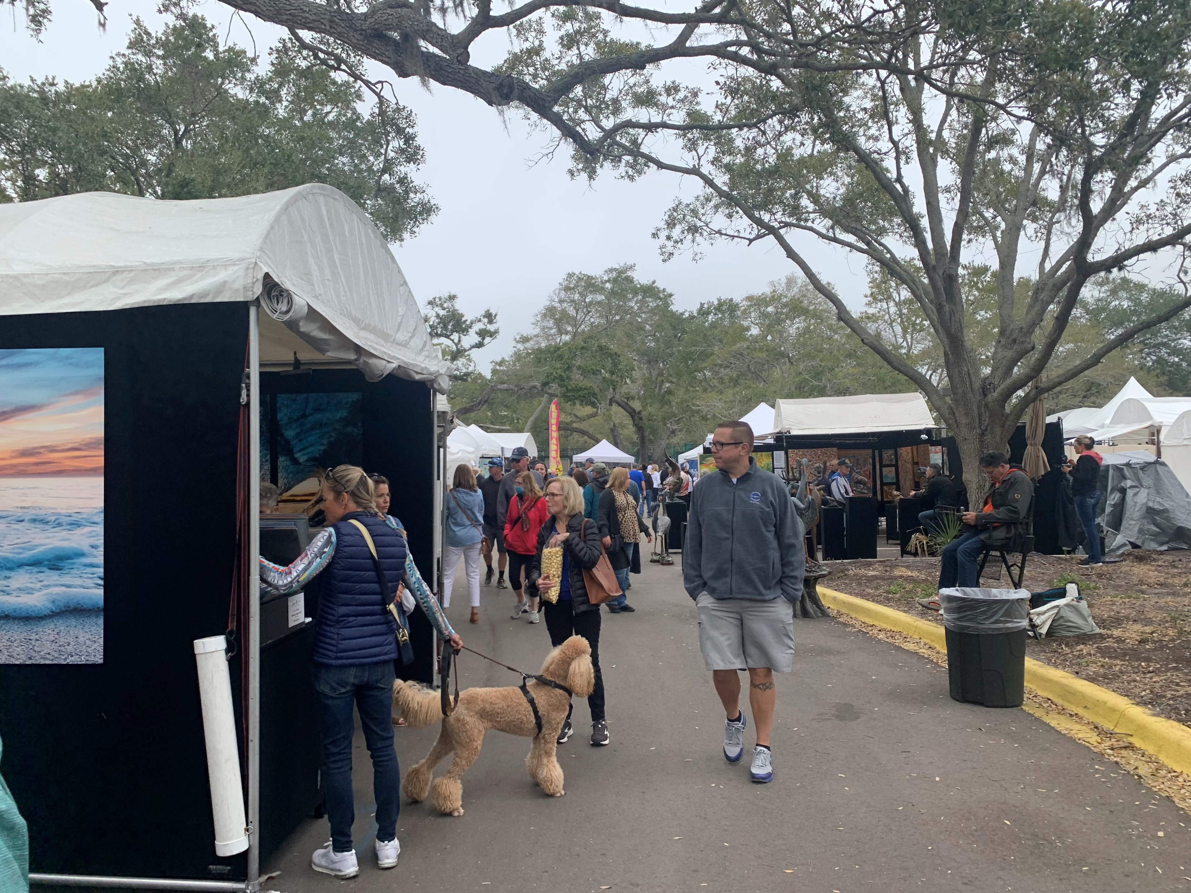


Successful Events

Slide 6



“Not-so-Successful”

Slide 7
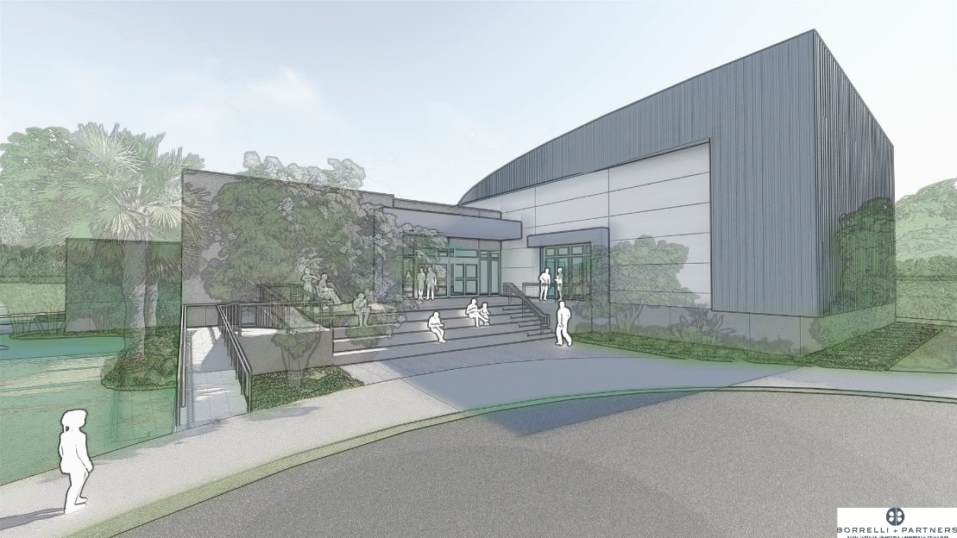
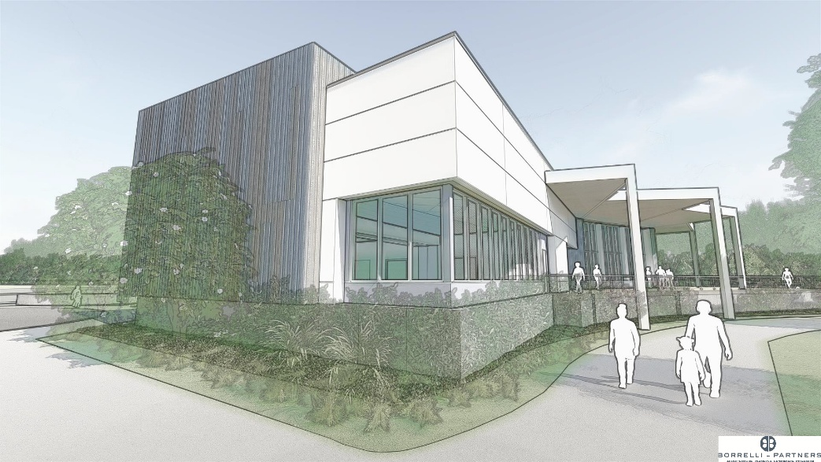
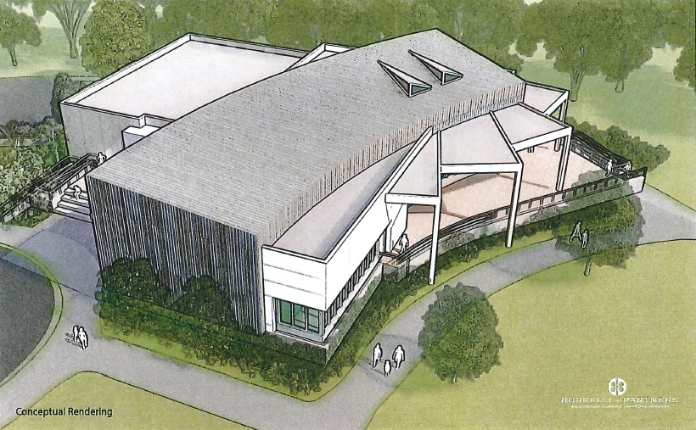
Partnership
Town and Sarasota County:
County commits $11 million towards new Longboat Key Library, plus operating.
Community desires to expand space, marketed as “Community Hall” spaces both indoor and outdoor.

Slide 8
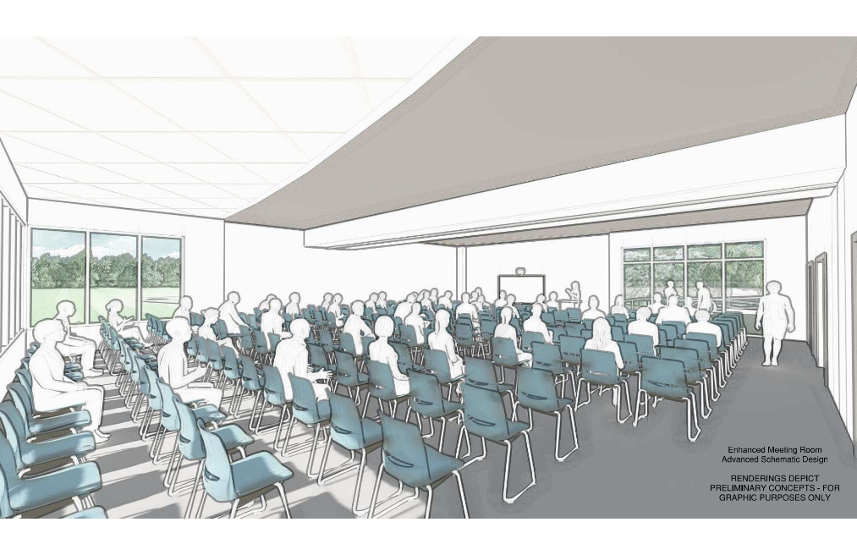
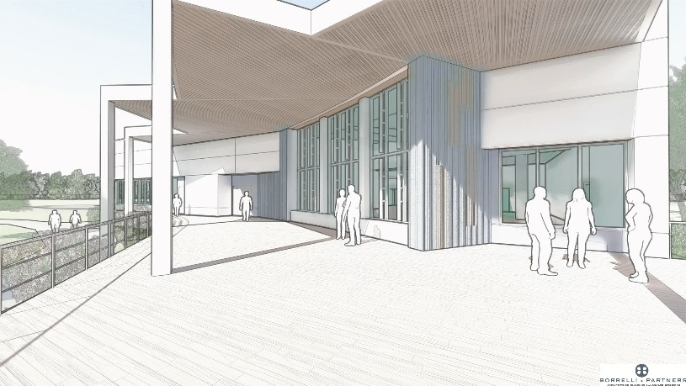
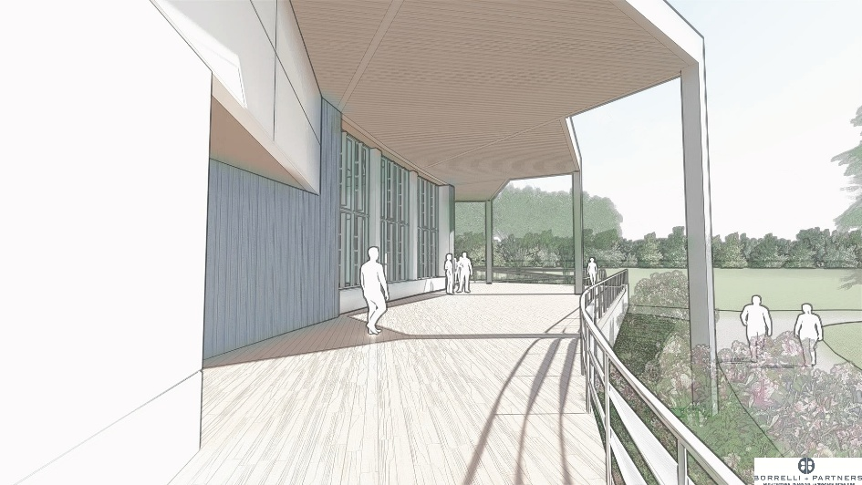
Town Donors
Original Budget Estimate for Base Library: $11 Million
“Complete the Green”:
Town Donors have achieved
$4 Million!
Remarkable considering most donations pledged AFTER the 2024 storm season impacts and during recovery.
Naming rights in various spaces for
$1,000,000 and $500,000, respectively.

Slide 9


Partners
Renee’ DiPilato
Sarasota County Libraries & Historical Resources
“Provide opportunities for lifelong learning, vibrant cultural experiences, and enriching activities for all ages.”
Alisa Mitchell
Library Foundation for Sarasota County
“Libraries…serve as community gathering places, social support centers and creativity labs, where education is accessible for every member of our community.”

Slide 10
Status and Schedule
Project Phase, Progress and Milestones:
Project is currently in Design Development Phase, including:
  Building system engineering and envelope specifications.
  Interior design in progress
  Preliminary renderings for Indoor Community Room and Outdoor Terrace (subject to change)
Design Development (60%) is due late February
Overall County Project Schedule:
Permitting (PUD Amendment & Site Development): February 2026 through August 2026
Construction Documents for Bidding/Building Permit: September 2026
Permitting (Building) / Bidding / GMP Amendment: March 2027
Construction: March 2027 – May 2028
Work with county to accelerate milestones and conduct ceremonial “Soft Groundbreaking”
Fall / Winter 2026.

Slide 11
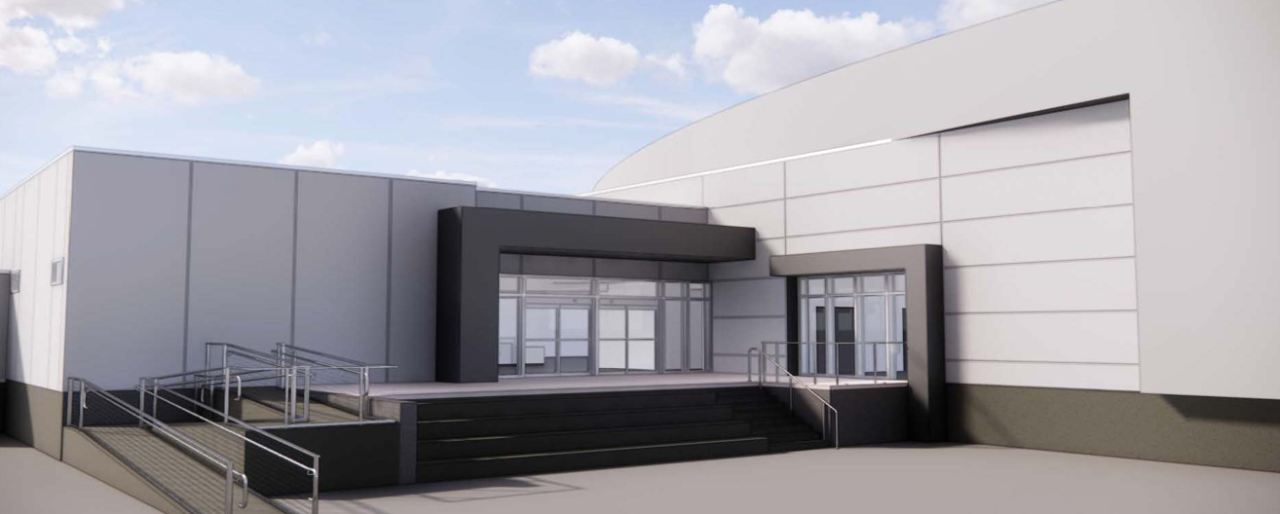
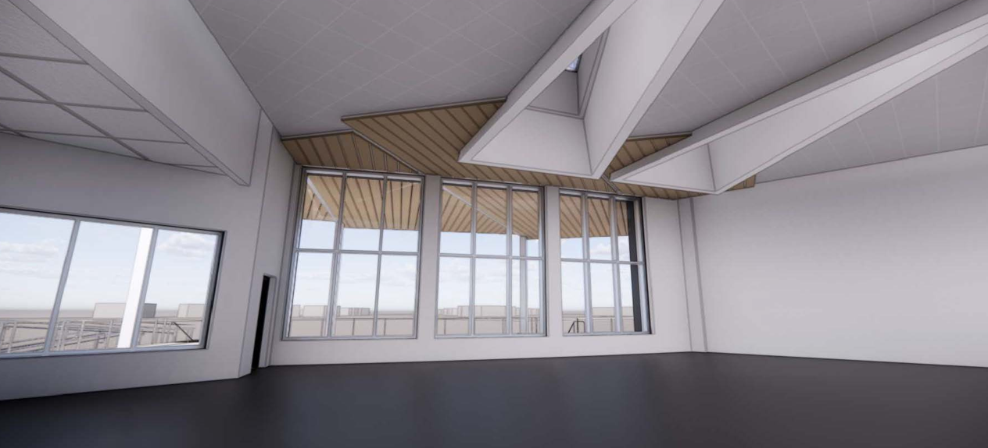
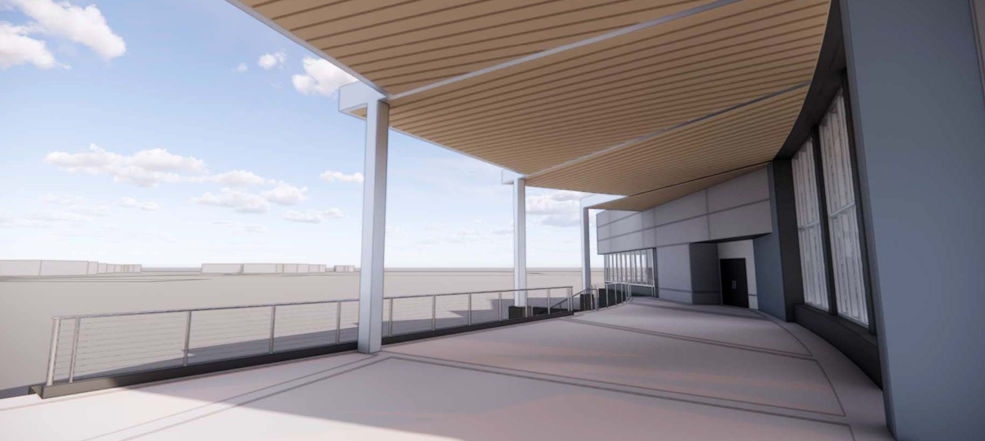
THANK YOU!!

