Slide 1
Canal Navigation Maintenance Program Update
Town Commission Regular Workshop
March 22, 2021

Slide 2
Background
Purpose of Meeting
Bring back data requested at Feb. 18, 2020 Regular Workshop
Continue to develop plans for a sustainable canal funded program
  Long term solution
  A current Commission initiative (2021 Strategic Plan Initiatives)
Update on Current efforts
  History, Inventory, Program Start Up Cost Estimate
Discuss overall approach, funding strategies, and related legal concepts
Interim Solution
Next Steps

Slide 3
Background
Town Vision & Mission
“Longboat Key is a beautiful place to live, work, and visit, where the natural assets of a barrier island combine with cultural and recreational amenities, visionary planning, and proactive leadership to enhance your way of life.”
“To vigorously maintain and preserve Longboat Key’s status as a premier residential and visitor destination that supports the historic balance between residential, recreational, tourism, and commercial attributes, through a commitment to long-term and short-term planning excellence and measurable results.”
Town Core Expectations
6. The town will maintain Longboat Key as a premier vacation destination and enhance year round tourism through continued revitalization, development, and maintenance of tourism-oriented businesses and amenities such as; lodging, cultural attractions, restaurants, golf courses, tennis facilities and beaches.
7. The town will maintain and improve the quality and variety of island-based recreational and educational opportunities, including a high-quality community center, and will support and promote off-island recreational, cultural and urban attractions.
11. The town recognizes the need to provide suitable amenities for visitors and residents of all ages.

Slide 4
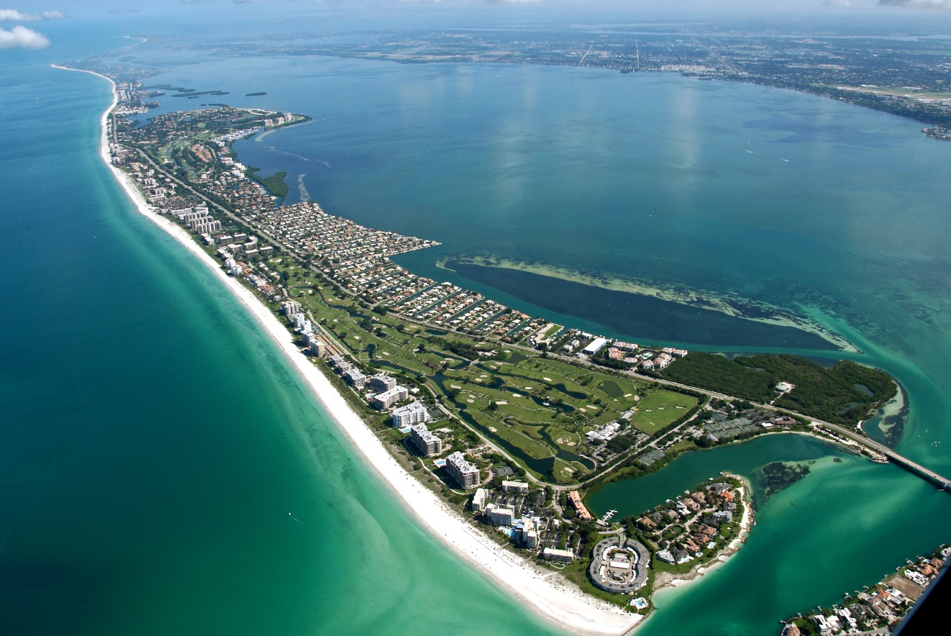
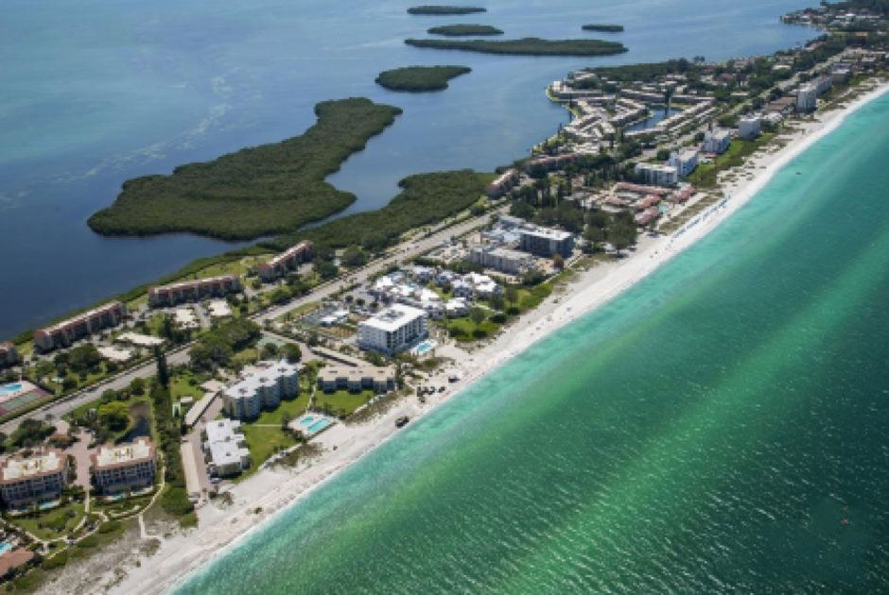
Background
Island Amenity and Ambiance
As an island, (def. “…land surrounded by water…”),waterway and bay access for navigation and recreation is an important element to the overall quality of island life as an amenity enhancing the ambiance on Longboat Key.
Wholistic Benefit
Portions of the Channel / Canal system can be considered as providing an overall benefit to the residents of the Town, as a recreational amenity to the island.
Some canals may have an overall Town-wide benefit and some have a more private benefit (canal fronting properties)

Slide 5
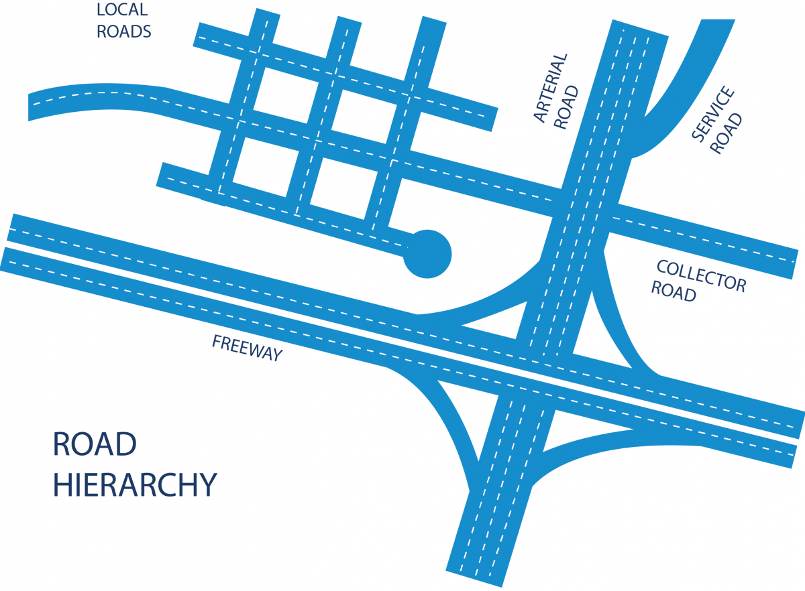
Complexity of Canal System
Canals can be categorized into
three (3) primary types:
  Access channels, generally perpendicular to the island, to the Bay and Intercoastal Waterway [Arterial] (A)
  Perimeter channels, generally parallel to the island, connecting/collecting residential canals, restaurants, and commercial marinas to the rest of the island and to the bay access channels [Collectors] (P). Also for recreational fishing access (flats).
  Local, residential canals, typically dead end, and serving a specific group of residences [Local].
    Some canals are public and some are private
https://www.cnu.org/our-projects/street-networks/street-networks-101
Can compare canal types to roadway types in a network, though, not everyone requires access by boat.

Slide 6

Canal Dredging Program History
Public vs. Private
Legal Review and determine
  1990s
    Based off of Plat Dedications
    Based off of Benthic Ownership
Canal Dredge Widths and Depths
  Based off old permit limitations
History
  Program Discussion since the 1990s
  Last Time Dredged 2003
https://www.lse.ac.uk/International-History/Degrees/why-study-history

Slide 7
Canal Dredging Program Update
Next Steps from Prior Presentation (2/18/20)
Verify Inventory of Canals (81 Canals)
  Public Vs. Private
  History
Determine Approach:
Localized, Town Wide or Geographic Area
Establish Service Levels
Funding Levels
Funding Approach
Permit History
58-01637883-001 FDEP Issued Feb 2001
58-01637883-002 FDEP Issued Aug 2002
41-0380753-001-EI 2020 FDEP Permit
20000050 ACOE Issued Jun 2002
62-341.490 Notice General Permit for WCIND (Note: Not dredged)

Slide 8
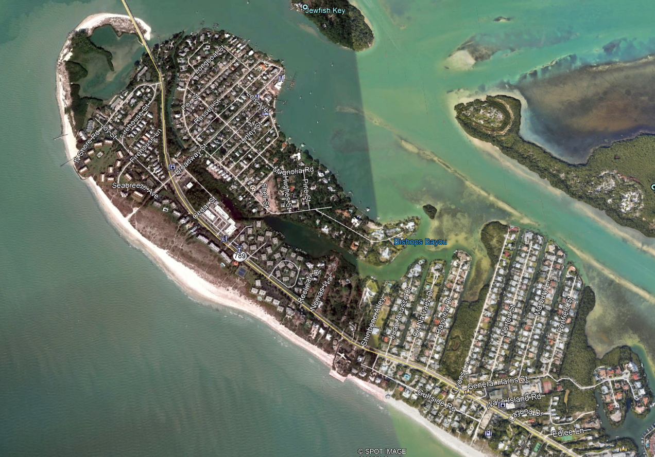
Canal 1 – 10 (North End to Sleepy Lagoon)
# | LOCATION | PUB VS PVT | PERMIT | DEPTH | WIDTH
1 | GMD & Longboat DR N | PUB | 58-01637883-001/41-0380753-001-EI | -4 MLW | 20 FT
1P | Bayside of North Village | PUB | No Permit History
2 | Bishop Bayou | PUB | 58-01637883-002/41-0380753-001-EI | -5 MLW | 20 FT
2A | Bayside of South Village | PUB | 58-01637883-002 | -5 MLW | 50 FT
2B | Bayside of Sleepy Lagoon North | PUB | 58-01637883-002/41-0380753-001-EI | -5 MLW | 20 FT
3 | Shinbone & Juan Anasco | PVT | 58-01637883-002 | -5 MLW | 15 FT
4 | Juan Anasco & De Narvez | PVT | 58-01637883-002 | -5 MLW | 20 FT
5 | De Narvez & Bayview | PUB | 58-01637883-001 | -5 MLW | 20 FT
6 | Bayviey & Lyons | PUB | 58-01637883-001/41-0380753-001-EI | -4 MLW | 20 Ft
7 | Lyons & Norton | PVT | 58-01637883-001 | -5 MLW | 20 FT
7A | Bayside of Sleepy Lagoon South | PVT | No Permit History | -5 MLW | 30 FT
8 | Norton & Marbury | PVT | 58-01637883-001 | -5 MLW | 20 FT
9 | Marbury & Penfield | PVT | 58-01637883-001 | -5 MLW | 20 FT
10 | South of Penfield | PVT | 58-01637883-001 | -5 MLW | 20 FT
1P
1
2A
2B
7A
2
7
4
5
6
3
8
9
10

Slide 9
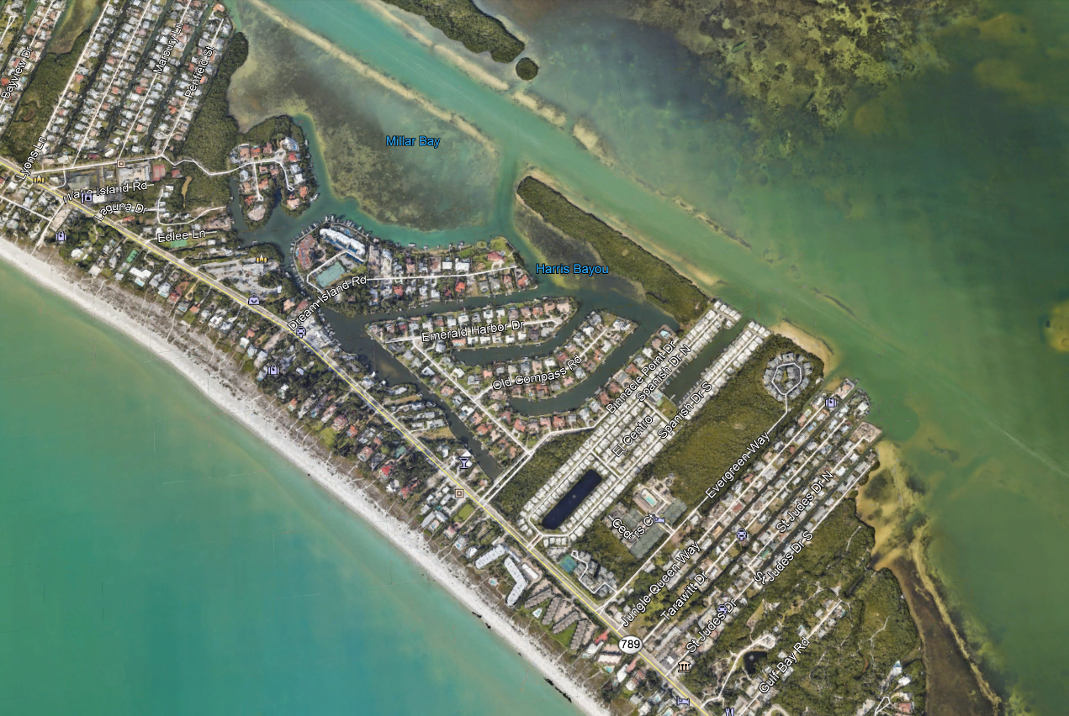
Canal 11 – 19 (Edlee Ln to St. Judes Dr S)
# | LOCATION | PUB VS PVT | PERMIT | DEPTH | WIDTH
11 | Millar Bay & Hideaway Bay | PUB | No Permit History | -5 MLW | 20 FT
11 A | Harris Bayou | PUB | 58-01637883-002 | -5 MLW | 20 FT
12 | Dream Island & Emerald Harbor | PVT | 58-01637883-001 | -5 MLW | 20 Ft
13 | Emerald Harbor & Old Compass | PUB | 58-01637883-001 | -5 MLW | 20 FT
14 | Old Compass & Binnacle Point | PUB | 20000050 | -5 MLW | 20 FT
14B | Spanish N & Spanish S | PVT | No Permit History
15N | N Side of Dream Island | PUB | 58-01637883-001 | -5 MLW | 20 FT
15S | S Side of Dream Island | PUB | 58-01637883-001 | -5 MLW | 20 FT
16 | Evergreen & Jungle Queen | PUB | 58-01637883-001 | -5 MLW | V Cut
16A | Connector 16 - 19 | PUB | 62-341.490 | -5 MLW | 20 FT
17 | Jungle Queen & Tarawitt | PVT | 58-01637883-001 | -3 MLW | 10 FT
18 | Tarawitt & St. Judes N | PVT | 58-01637883-001 /41-0380753-001-EI | -3 MLW | 10 FT
19 | St Judes N & St. Judes S | PVT | 58-01637883-001 | -4.5 MLW | 10 Cut
11A
11
15N
12
15S
14B
13
16A
14
16
18
19
17

Slide 10
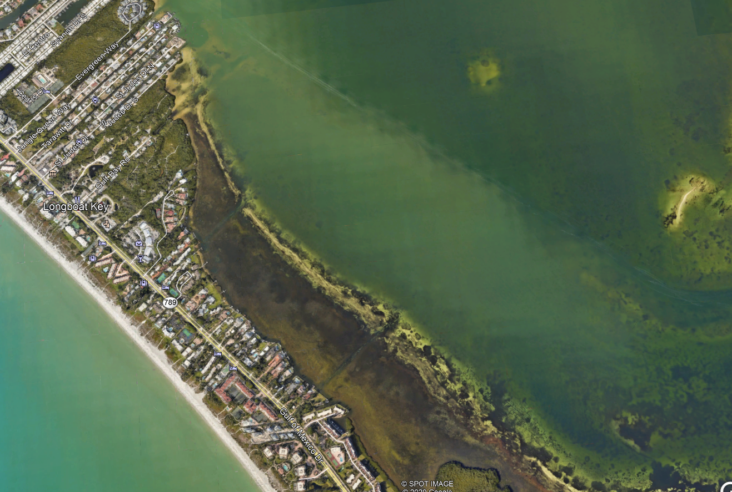
Canal 20 – 24 (Gulf Bay Rd to 4960 GMD)
# | LOCATION | PUB VS PVT | PERMIT | DEPTH | WIDTH
20 | E of Gulf Bay | PUB | 20000050 | -5 MLW | 20 FT
20A | Access to Gulf Bay | PUB | No Permit History
20P | Gulf Bay to Sandhamn Place | PUB | No Permit History
21 | Sandhamn Place | PUB | 20000050 | -5 MLW | 20 FT
21A | Access to Sandhamn Place | PUB | 58-01637883-001 / 41-0380753-001-EI | -5 MLW | 20 FT
21P | Sandhamn Place to 5056 GMD | PUB | 20000050 / 41-0380753-001-EI | -5 MLW | 20 FT
22 | 5056 and 5050 GMD | PUB | 58-01637883-001 | -5 MLW | 20 FT
22P | 5050 to 5000 GMD | PUB | 58-01637883-001 | -5 MLW | 20 FT
22A | Access to 5056 to 5000 GMD | PUB | 20000050 / 41-0380753-001-EI | -5 MLW | 20 FT
23 | 5000 GMD | PUB | 58-01637883-001 | -5 MLW | 20 FT
23P | 4960 GMD | PUB | 58-01637883-001 | -5 MLW | 20 FT
24 | Windward Bay Marina North | PVT | 58-01637883-003 | -4 MLW | 20 FT
20A
20
20P
21A
21
21P
22A
22P
22
23P
23
24

Slide 11
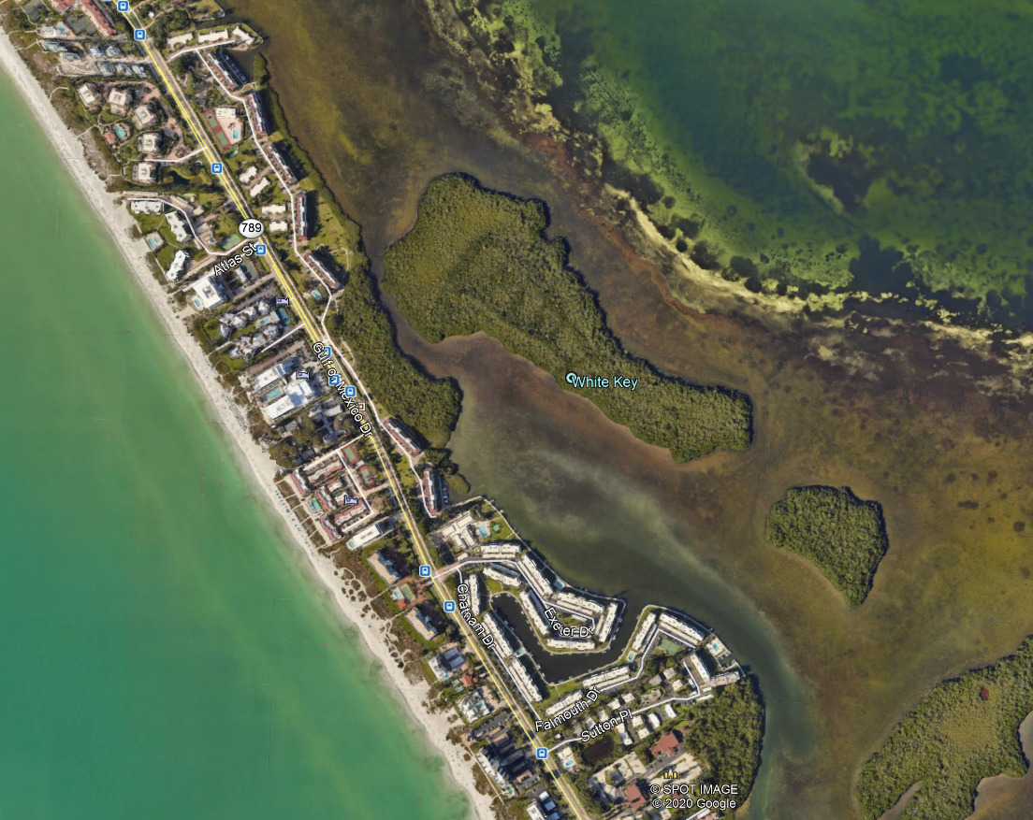
Canal 24P – 26 (Windward Bay Marina North to Longboat Harbour Marina)
# | LOCATION | PUB VS PVT | PERMIT | DEPTH | WIDTH
24P | Windward Bay Marina North to Longboat Harbour Marina | PUB | No Permit History
25 | Windward Bay Marina South | PVT | 58-01637883-003 | -4 | 20 FT
26 | Longboat Harbour Marina | PVT | 20000050 | -5 MLW | 20 FT
24P
25
26

Slide 12
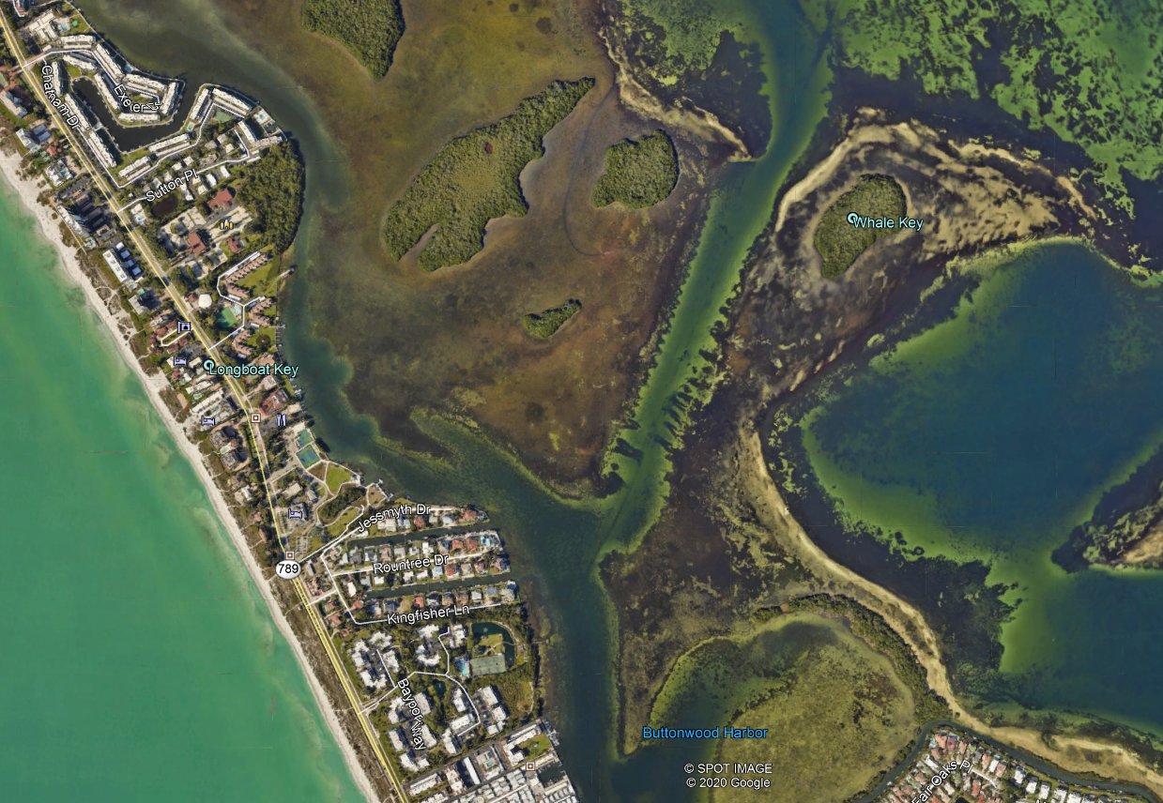
Canal 26P – 31A (Longboat Harbour Marina to Beach Harbor Club)
# | LOCATION | PUB VS PVT | PERMIT | DEPTH | WIDTH
26P | Longboat Harbour Marina to Longboat Estates Access | PUB | No Permit History
27 | Bayfront Park | PUB | 58-01637883-002 | -3 MLW | 20 FT
28 | N of Jessmyth | PUB | 58-01637883-001 | -3 MLW | 20 FT
29 | Jessmyth & Roundtree | PVT | 58-01637883-002 | -5 MLW | 20 FT
30 | Roundtree & Kingfisher | PVT | 58-01637883-002 | -5 MLW | 20 FT
31A | Access to Longboat estates S to Beach Harbor Club | PUB | 62-341.490
26P
28
27
29
30
31A

Slide 13
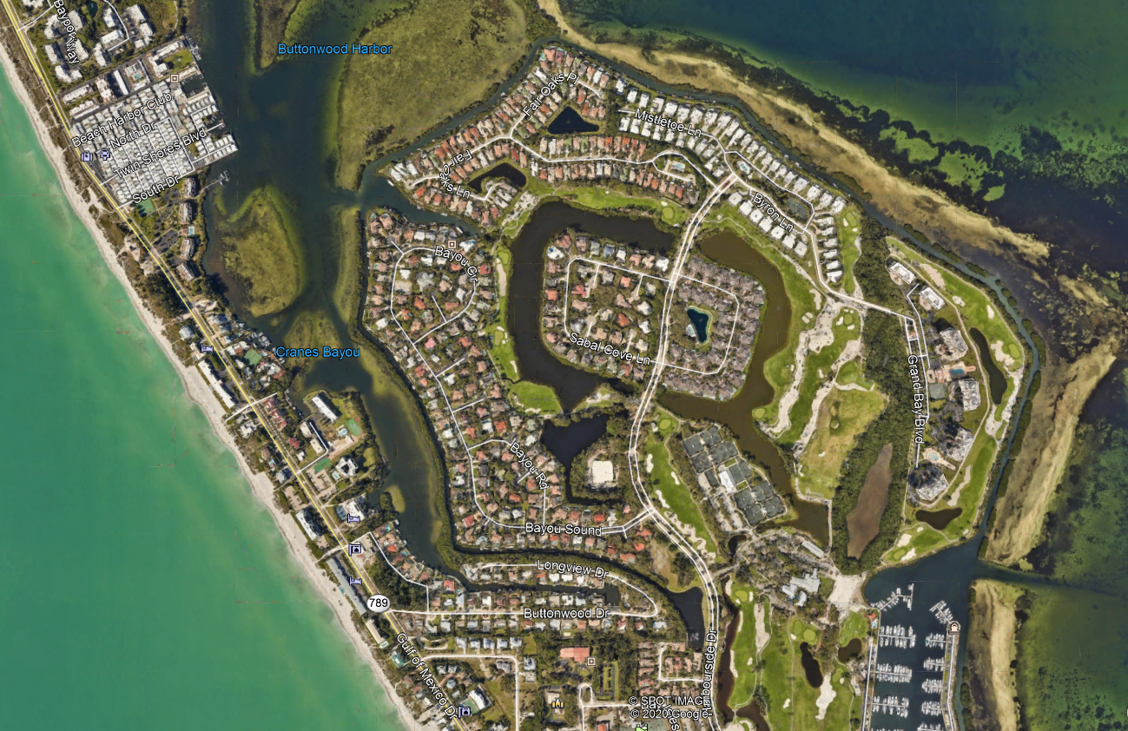
Canal 31 – 32P (Beach Harbor Club to Longboat Key Club Moorings)
# | LOCATION | PUB VS PVT | PERMIT | DEPTH | WIDTH
31 | Beach Harbor Club through Cranes Bayou | PUB | 20000050 | -5 MLW | 20 FT
32 | Longview & Buttonwood | PUB | 58-01637883-001 | -5 MLW | 20 FT
32A | Longboat Key Club Moorings Access | PUB | 62-341.490
32B | Fair Oaks & Bayou | ??? | No Permit History
32P | Perimeter Canal for LBKC Harbourside | PUB/PVT | 41-0380753-001-EI | -5 MLW | 20 FT
32P
32B
31
32
32A

Slide 14
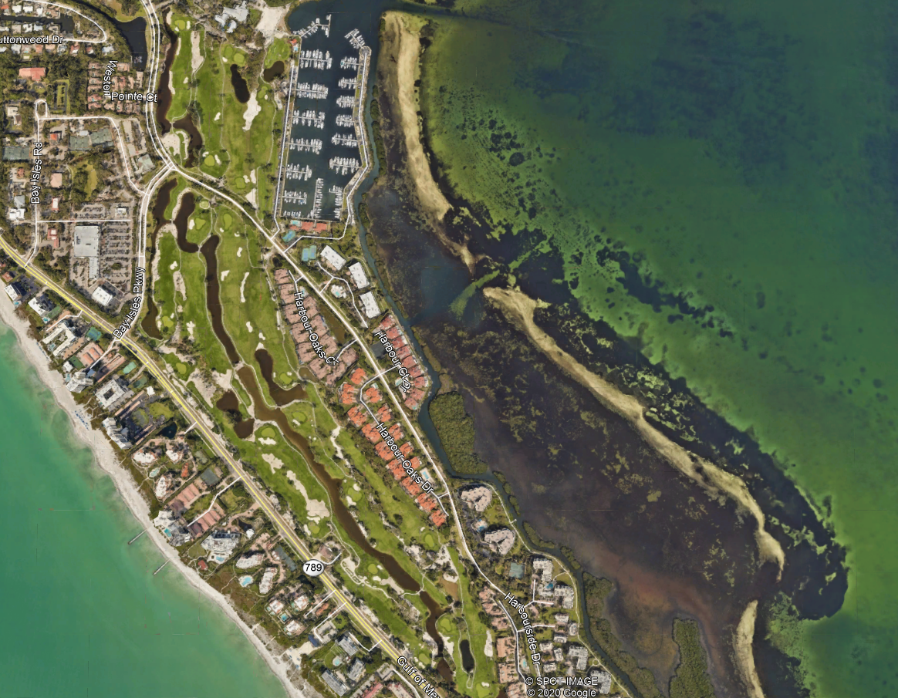
Canal 33A and 33 B (Longboat Key Club Moorings South to Harbour Oak Dr)
# | LOCATION | PUB VS PVT | PERMIT | DEPTH | WIDTH
33A | Access to 33B | PUB | No Permit History
33B | Longboat Key Club Moorings South to Harbour Oak Dr Intersects with 33 (Putter Lane | PUB | No Permit History
33A
33B

Slide 15
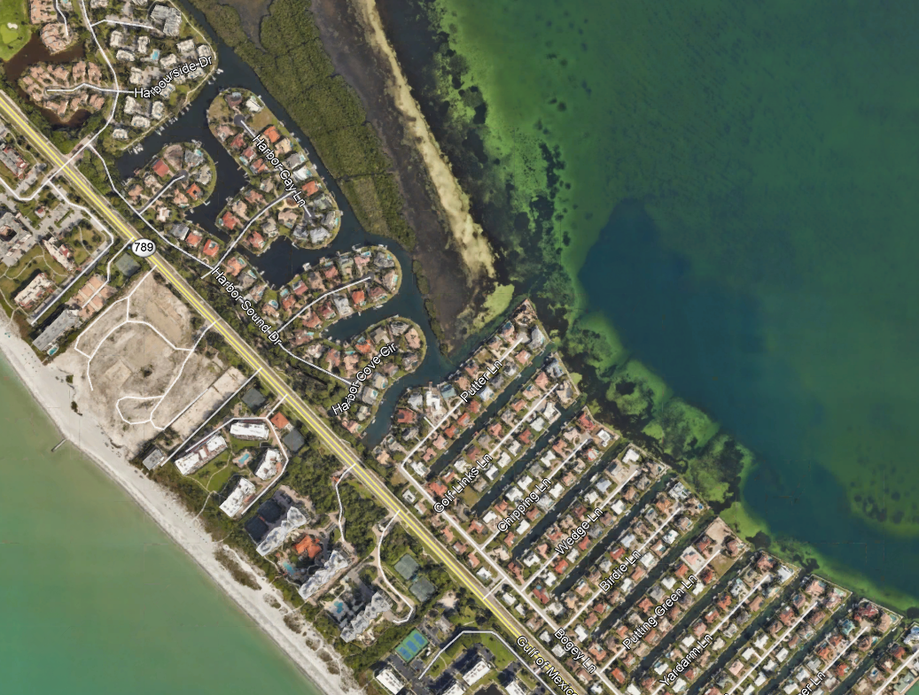
Canal 33 and 39 (Harbour Oak Dr to Yardarm)
# | LOCATION | PUB VS PVT | PERMIT | DEPTH | WIDTH
33C | Harbourside to Harbor Cove | PUB | No Permit History
33 | Harbor Cove & Putter | PUB | 58-01637883-001 | -5 MLW | 40 FT
34 | Putter & Golf Links | PUB | 58-01637883-001 | -6 MLW | 30 FT
35 | Golf Links & Chipping | PUB | 58-01637883-001 | -6 MLW | 30 FT
36 | Chipping & Wedge | PUB | 58-01637883-001 | -6 MLW | 30 FT
37 | Wedge & Birdie | PUB | 58-01637883-001 | -6 MLW | 30 FT
38 | Birdie & Putting Green | PUB | 58-01637883-001 | -6 MLW | 30 FT
39 | Putting Green & Yardarm | PUB | 58-01637883-001 | -5 MLW | 30 FT
33C
33
34
35
36
37
38
39

Slide 16
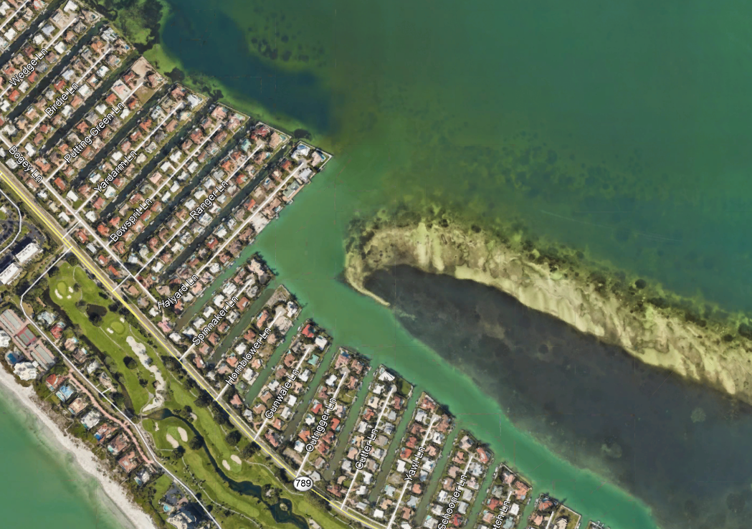
Canal 40 - 48 and 54 (Yardarm to Yawl)
# | LOCATION | PUB VS PVT | PERMIT | DEPTH | WIDTH
40 | Yardarm & Bowsprit | PUB | 58-01637883-001 | -5 MLW | 30 FT
41 | Bowsprit & Ranger | PUB | 58-01637883-001 | -5 MLW | 30 FT
42 | Ranger & Halyard | PUB | 58-01637883-001 | -5 MLW | 30 FT
43 | Halyard & Spinnaker | PUB | 58-01637883-001 | -5 MLW | 40 FT
44 | Spinnaker & Hornblower | PUB | 58-01637883-001 | -5 MLW | 40 FT
45 | Hornblower & Gunwale | PUB | 58-01637883-001 | -5 MLW | 40 FT
46 | Gunwale & Outrigger | PUB | 58-01637883-001 | -5 MLW | 40 FT
47 | Outrigger & Cutter | PUB | 58-01637883-001 | -5 MLW | 40 FT
48 | Cutter & Yawl | PUB | 58-01637883-001 | -5 MLW | 40 FT
54 | Halyard South to Sarasota Bay | PUB | No Permit History
40
41
42
43
44
45
46
47
48
54
39

Slide 17
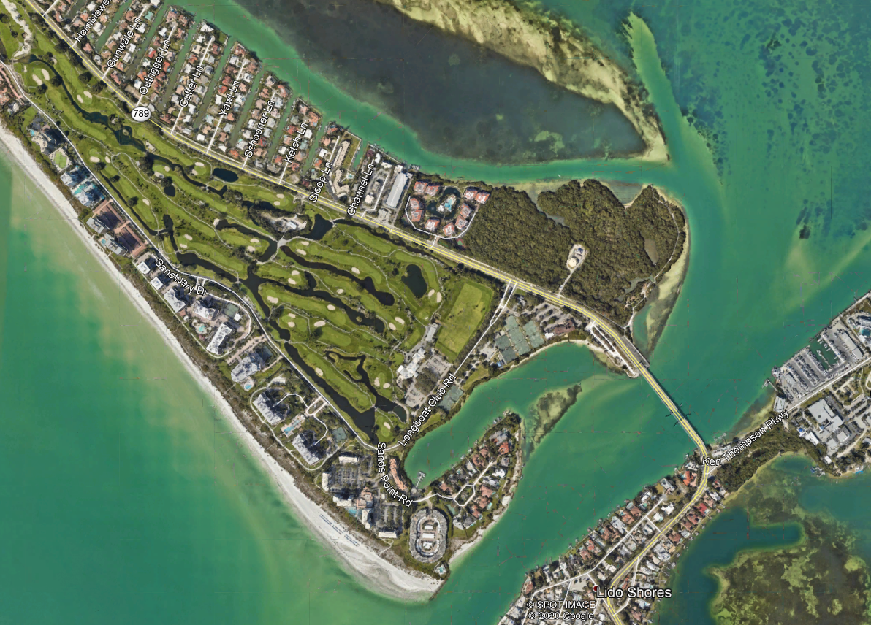
Canal 49 – 54 (Yawl LN to New Pass)
# | LOCATION | PUB VS PVT | PERMIT | DEPTH | WIDTH
49 | Yawl & Schooner | PUB | 58-01637883-001 / 41-0380753-001-EI | -5 MLW | 40 FT
50 | Schooner & Ketch | PUB | 58-01637883-002 | -5 MLW | 40 FT
51 | Ketch & Sloop | PUB | 58-01637883-001 | -5 MLW | 40 FT
52 | Sloop & Channel | PUB | 20000050 | -5 MLW | 35 FT
53 | Boathouse Marina | PUB | 20000050 | -5 MLW | 30 FT
54 | Halyard South to Sarasota Bay | PUB | No Permit History
55 | Sands Point to New Pass | PUB | 41-0380753-001-EI | - 5 MLW | 15 FT
55A | Lighthouse Point to New Pass | PUB | 41-0380753-001-EI | -5 MLW | 2 FT
50
49
51
52
54
53
55
55A

Slide 18
Program Approach
Localized Approach Example
North Mid Key
Canals Have Been Permitted and Dredged in the Past
Have Similar Location, Widths and Depths (Levels of Service)
Have a Common Organization to Funnel Communications (Homeowner’s Group)
Could find Properties Under Construction to use as Spoil
Construction Travel by Water minimized
Less economy of Scale
Managing Many Small Districts Difficult
11A
11
15N
12
15S
14B
13
16A
14
16
18
19
17

Slide 19
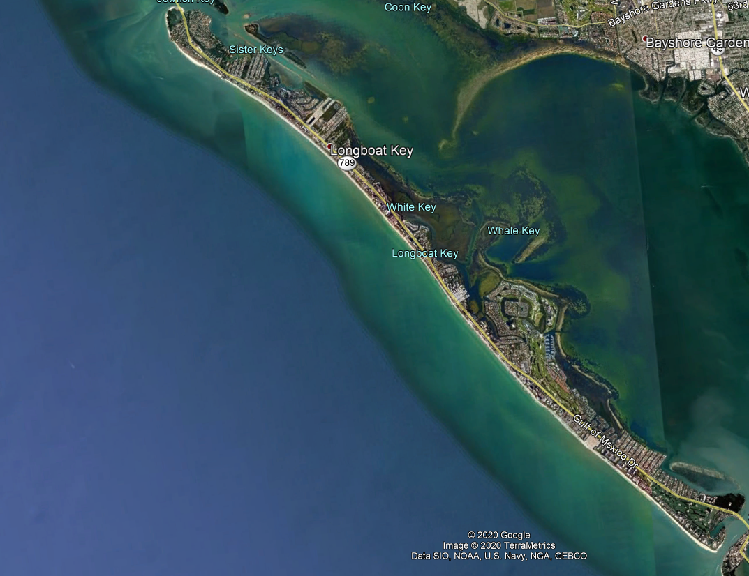
Program Approach
Town Wide
Some Canals Have Been Permitted and Dredged in the Past
Have Differing Widths and Depths (Levels of Service)
No Common Organization to Funnel Communications (Homeowner’s Group)
Management of Spoil Sites Problematic
Up to 5 - 7 miles of Construction Travel by Water
Who gets prioritization of Effort?
Can Public Funds be used to improve Private property?
Town Wide Approach Example

Slide 20
Program Approach
Mid Key
Some Canals Have Been Permitted and Dredged in the Past
Have Differing Widths and Depths (Levels of Service)
No Single, Common Organization to Funnel Communications (Homeowner’s Group)
Perimeter / Access Channels 26P and 31A could be funded by all (General benefit)
Residential Canals funded by Waterfront Property Owners (Specific benefit)
Can Minimize Construction Travel by Water
Coordination of effort between General and Specific benefit canals
Geographic Area Approach Example
26P
28
27
29
30
31A

Slide 21
Town Staff Recommendation
Staff Recommends a Geographic Area Approach to the Canal Navigation Maintenance Program.
  Two categories of projects
    Channels that serve a Town-wide benefit
    Groups of canals that serve canal fronting properties
      Property Owner Supported
  Geographic Areas
    Depending on Location - look for synergy and economies of scale
    Prior Permits and Dredging Efforts set Levels of Service
    Potential Spoil Sites are local
    Length of Impact / Disruption Caused by Construction
    Utilization of the Access Channels

Slide 22
Big Picture
Canal Dredge Program carries a cost:
Preliminary Budget Estimate for initial program start-up
$11.4 million
Plus management overhead
For approx. 100,000 CY
Funding strategy to accomplish a program needs to be developed

Slide 23
Funding - Who pays?
Legal/Funding Structures
  Ad valorem versus Assessment
    Different standards and tests
  Millage supported/General Fund
    Uniform
    Can’t pay for private canals
  Assessment Supported
    Benefit based
  Limited grant funds may be available- not for local or private canals
  Surtax may be able to help offset some costs for those canals that have a Town-wide benefit
Goal - ongoing funded program
    Maintains a service level
    Good for canal fronted property values

Slide 24
Town Staff Recommendation
Staff Recommends an Assessment Approach to the Funding of the Town Navigation Maintenance Program for Canals
  For Local, Residential Canals
    Assessment applies to all property owners along canal
    Can be based on simple formula (for example, linear foot of seawall or per lot)
  For Perimeter and Access Channels
    Assessment applies to all Town taxpayers
    Consultant to Determine Fair and Equitable formula

Slide 25
Interim Solution
If Program takes too long to establish and fund over time…
  What can the Town Assist with in the short term?
Privately Initiated and Funded Dredging
  The Town can share existing/prior permit data with perspective citizens looking to conduct dredging on their own.
  The Town can share information related to Consultants that can assist in establishing and permitting individual projects.
  The Town can provide contact information on Dredging Contractors.
  The Town Could allow filling of Mitigation site with acceptable material from Individual projects
    Town help support cost of initial sea grass planting?
  Town can assist in the coordination of this use as well as the use of other Town Properties

Slide 26
Next Steps
Steps Needed To Advance Plan
Commission identify preferred Program Concept including approach and funding strategy.
Staff engage Consultant to advance Program Concept and approach with Funding Model(s)
  Refine cost estimates
  Legal input: establish in accordance with State statute and Town Code
  Provide Recommendations on Program parameters and funding methodology
Present Program Options Developed by Consultant to Town Commission
  Specifics Recommendations by Third Party
  Commission and Public Workshop(s)/ Outreach
Commission Program Decision
  Program Approach Recommended Frequency and Priority
  Funding Methodology
  Finalize Model and Move Forward

Slide 27
Questions?

