Slide 1
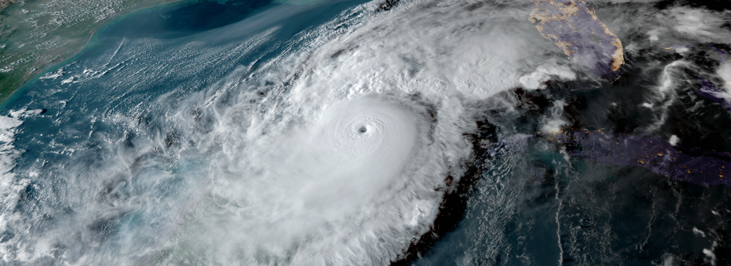
2025 Disaster Preparedness Seminar
Howard Tipton, Town Manager

Slide 2
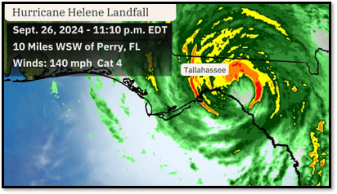
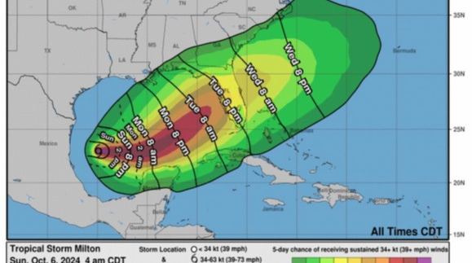
2024 Storms
Debby
Helene
Milton

Slide 3
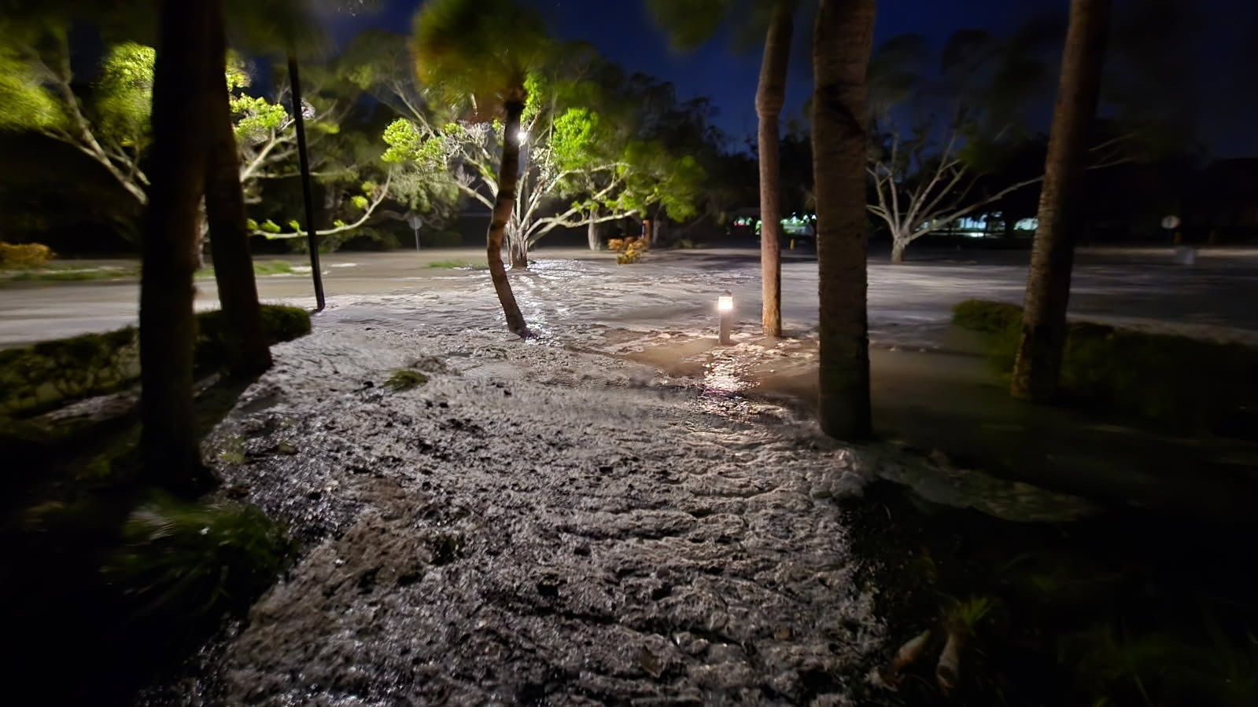
Town Hall
Hurricane Helene

Slide 5
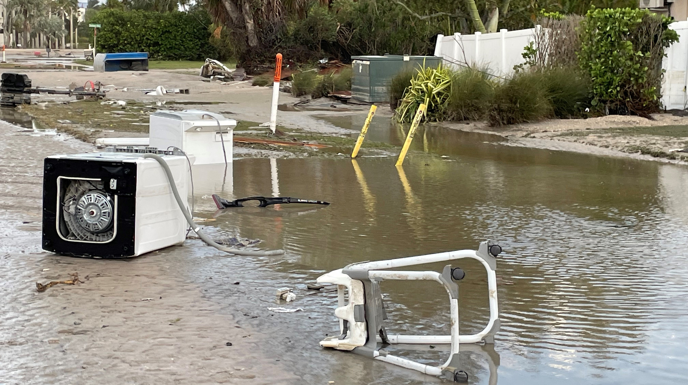
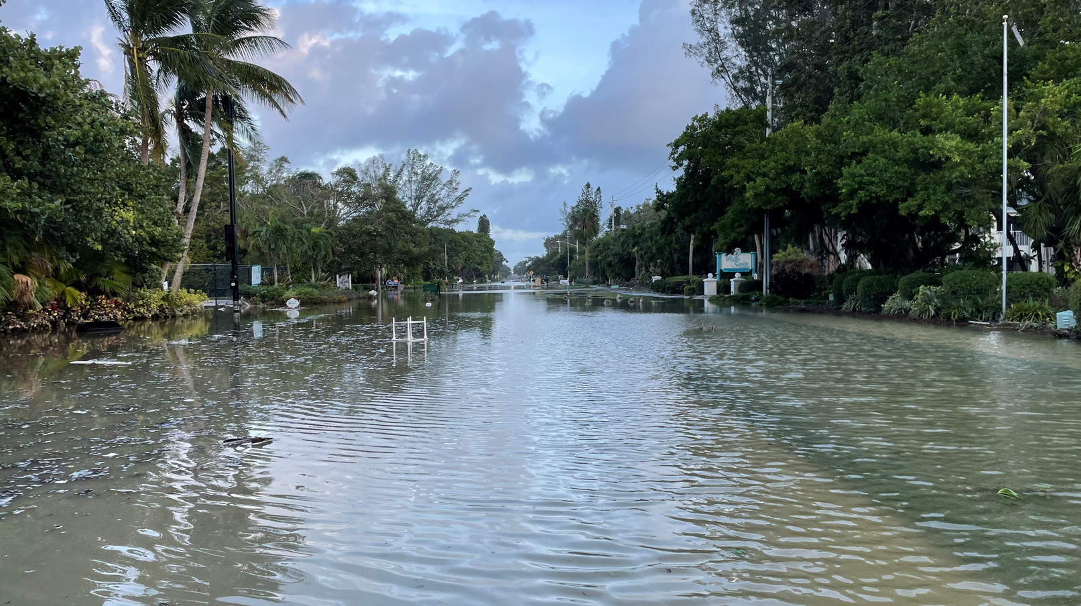
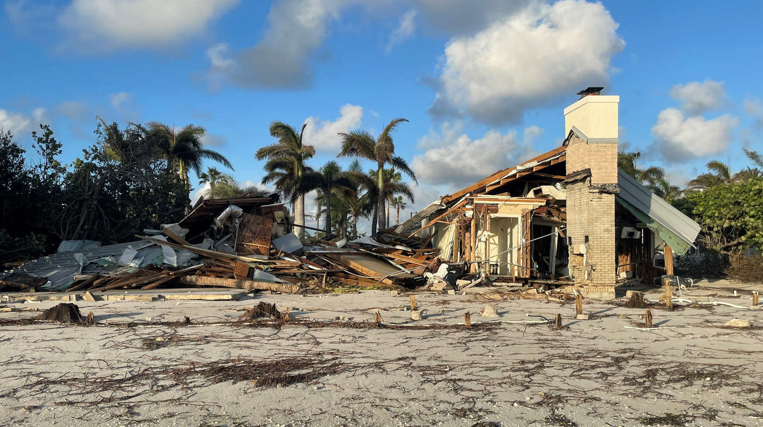
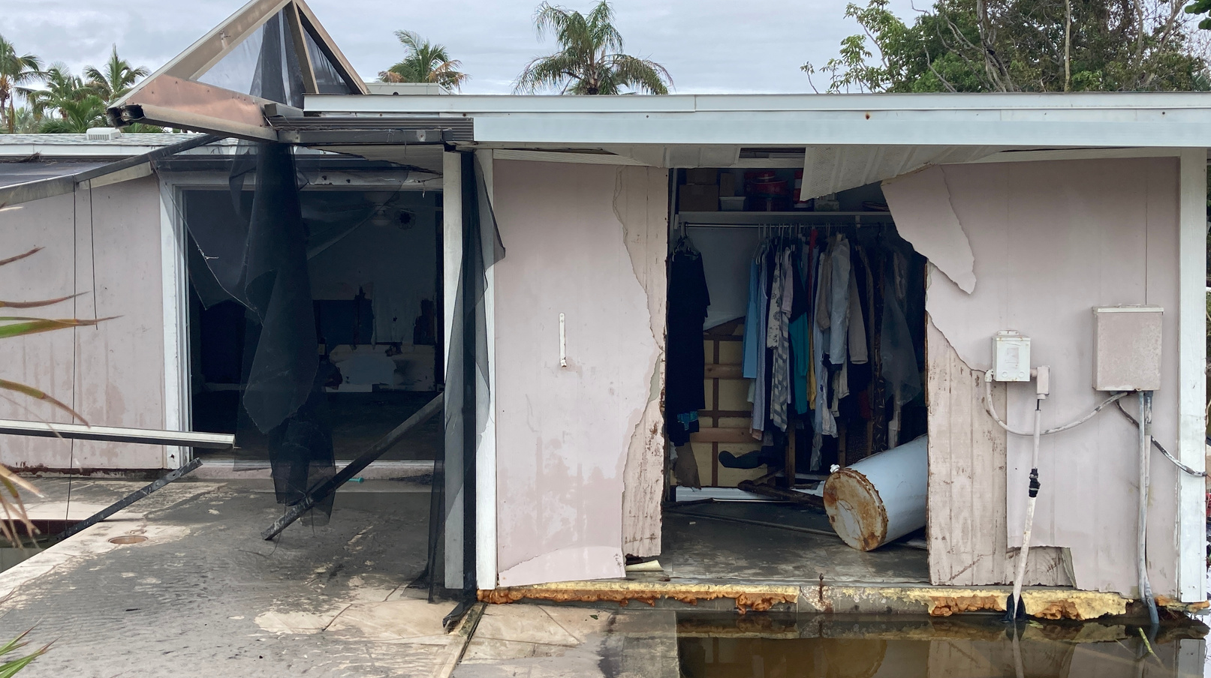

Slide 6
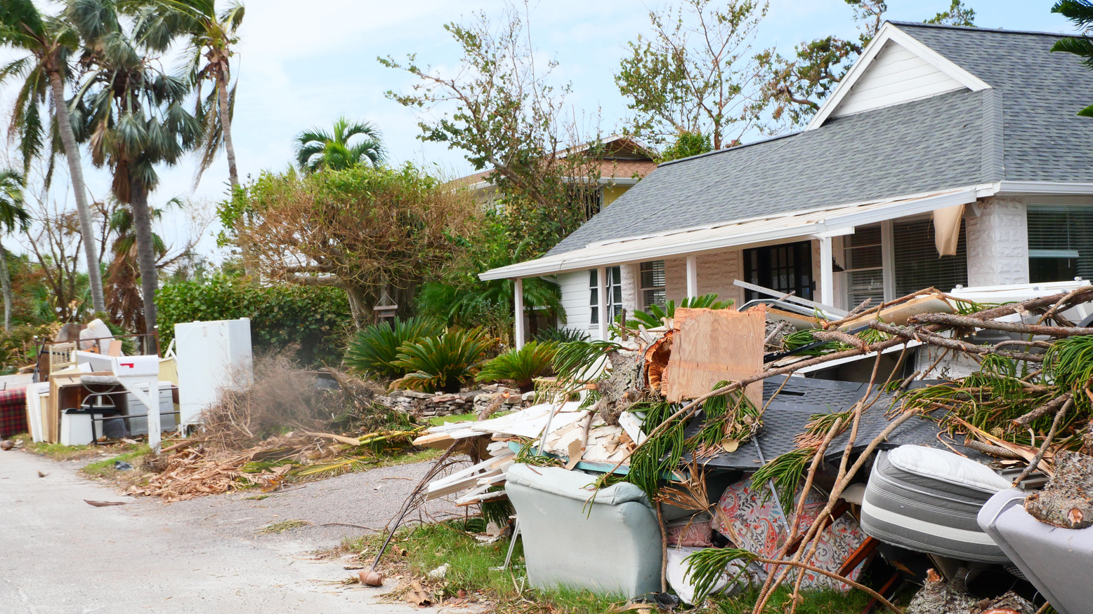
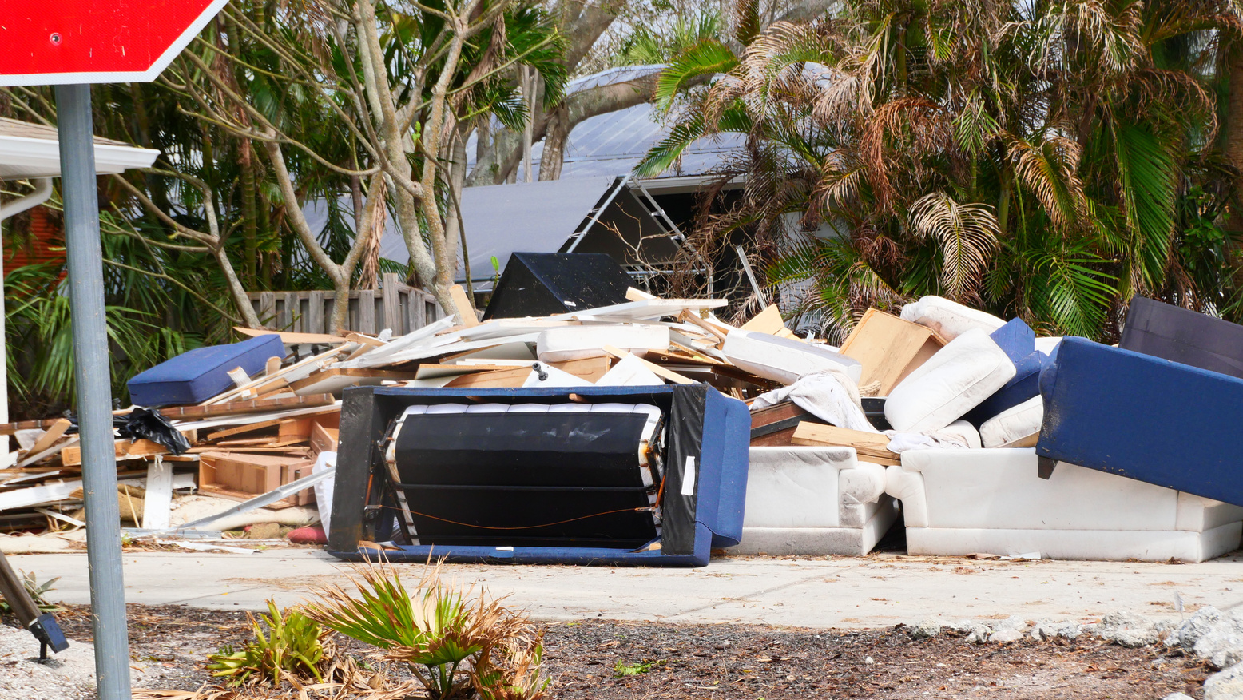

Slide 7
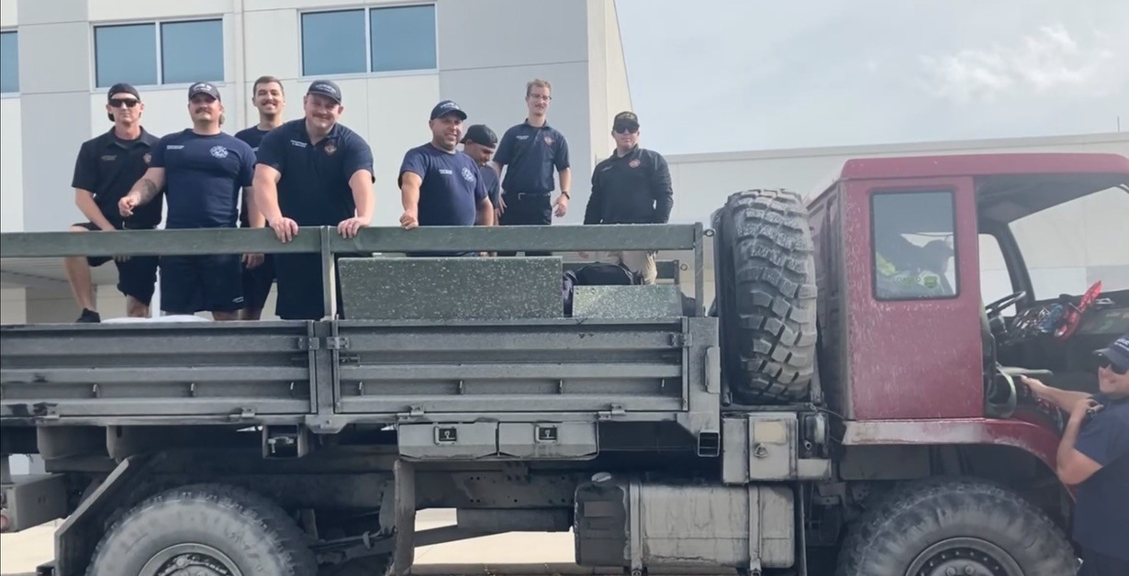
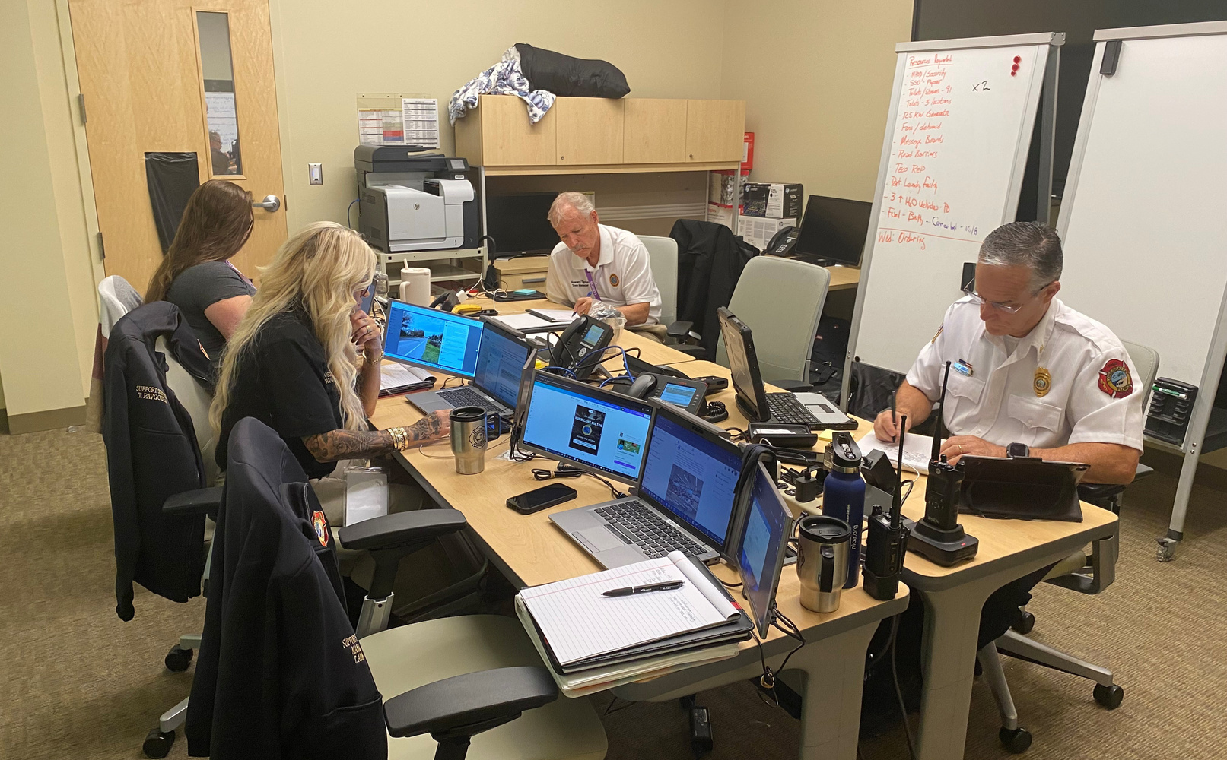
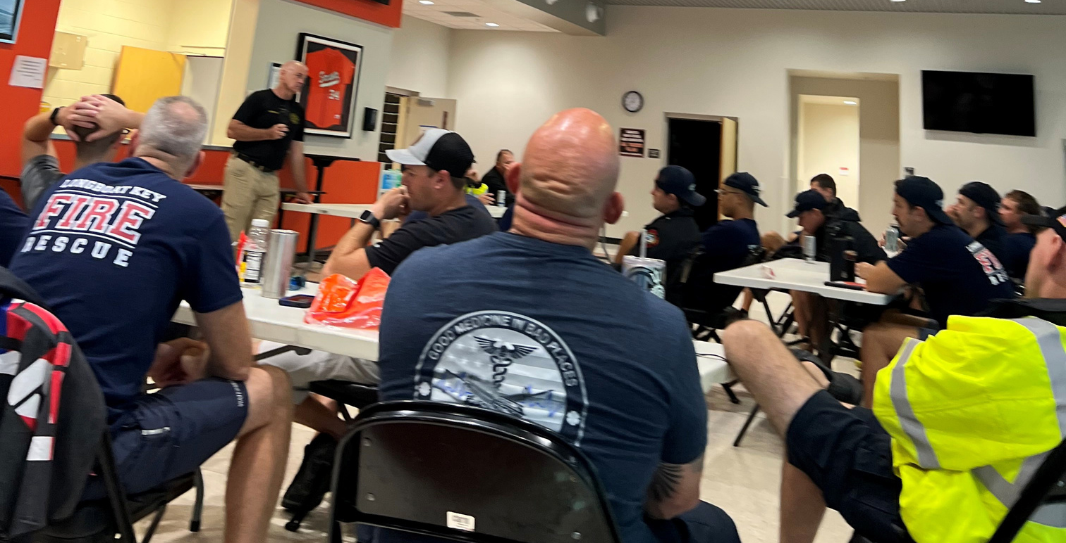
Operations

Slide 8
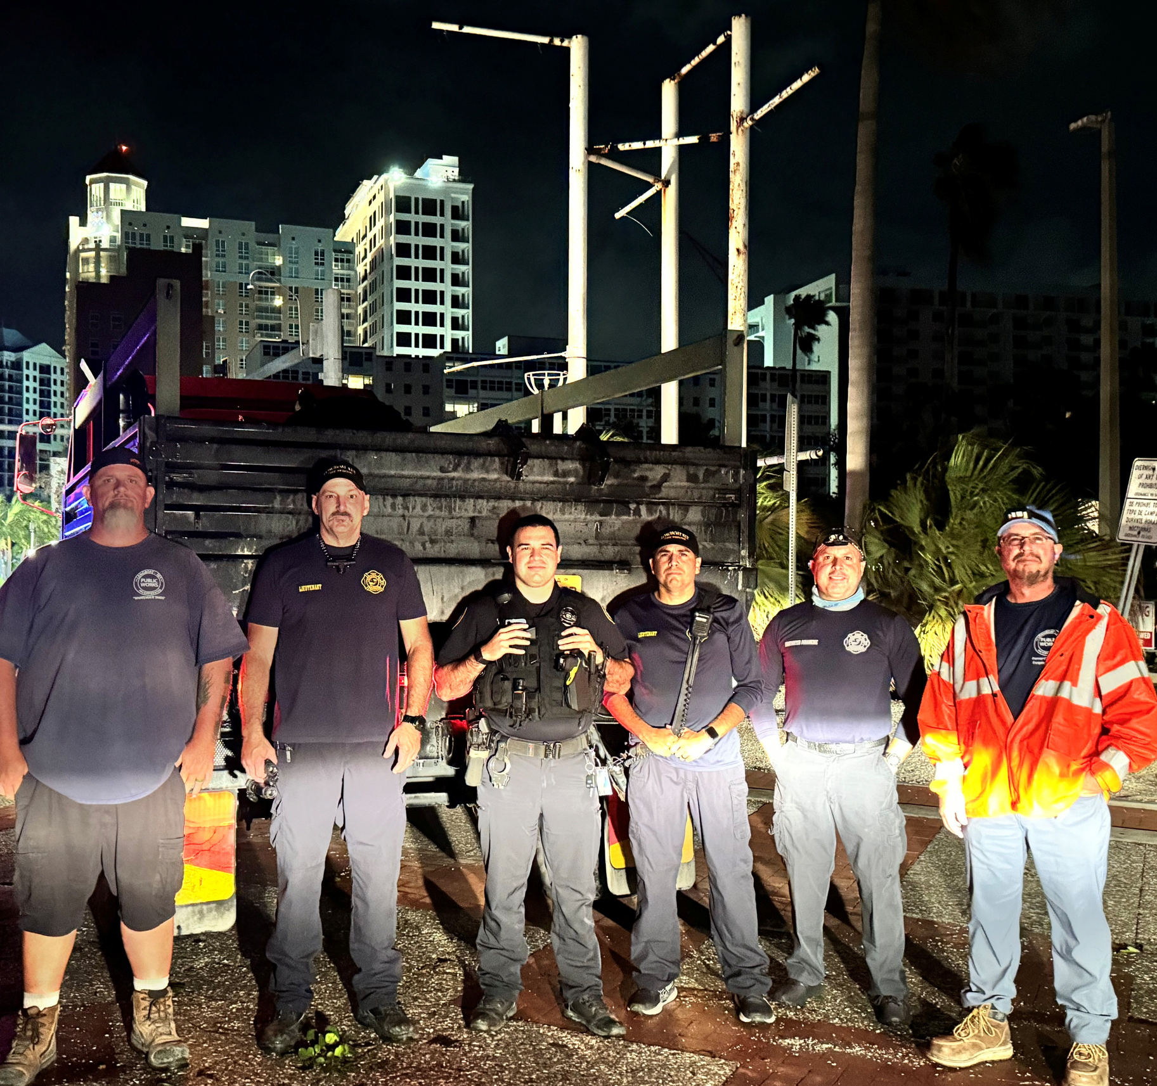
Lessons Learned
Teamwork
Review Insurance
County and City Relationships
Asking for Assistance Early
Reserves
Communications
Evacuation Orders

Slide 9
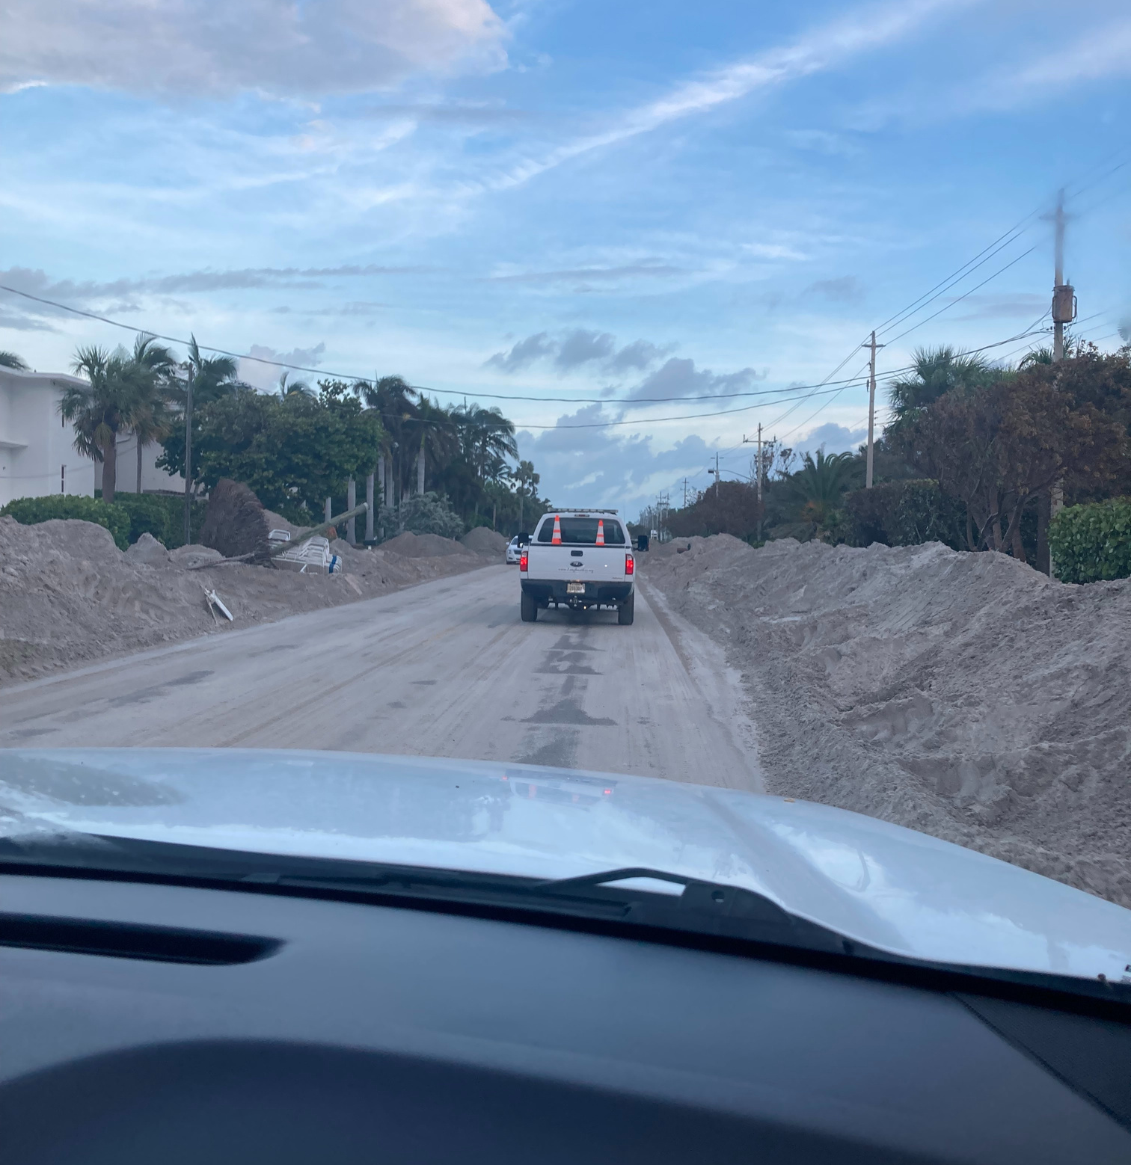
Re-entry and Curfew
Tier 1: Emergency Responders to ensure the island is safe to access
Tier 2: Individuals from the public and private sectors who support the restoration of critical infrastructure to facilitate the re-entry of the public
Tier 3: Town Residents and Business Owners

Slide 10
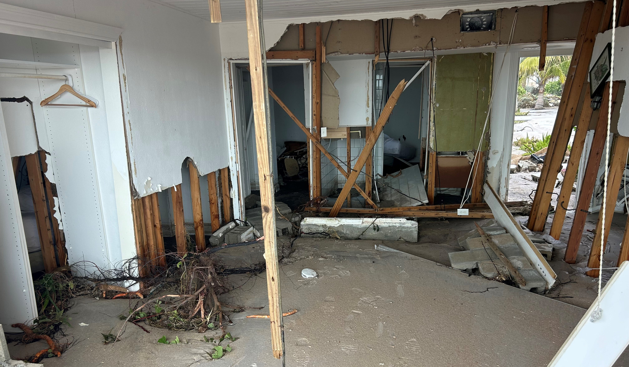
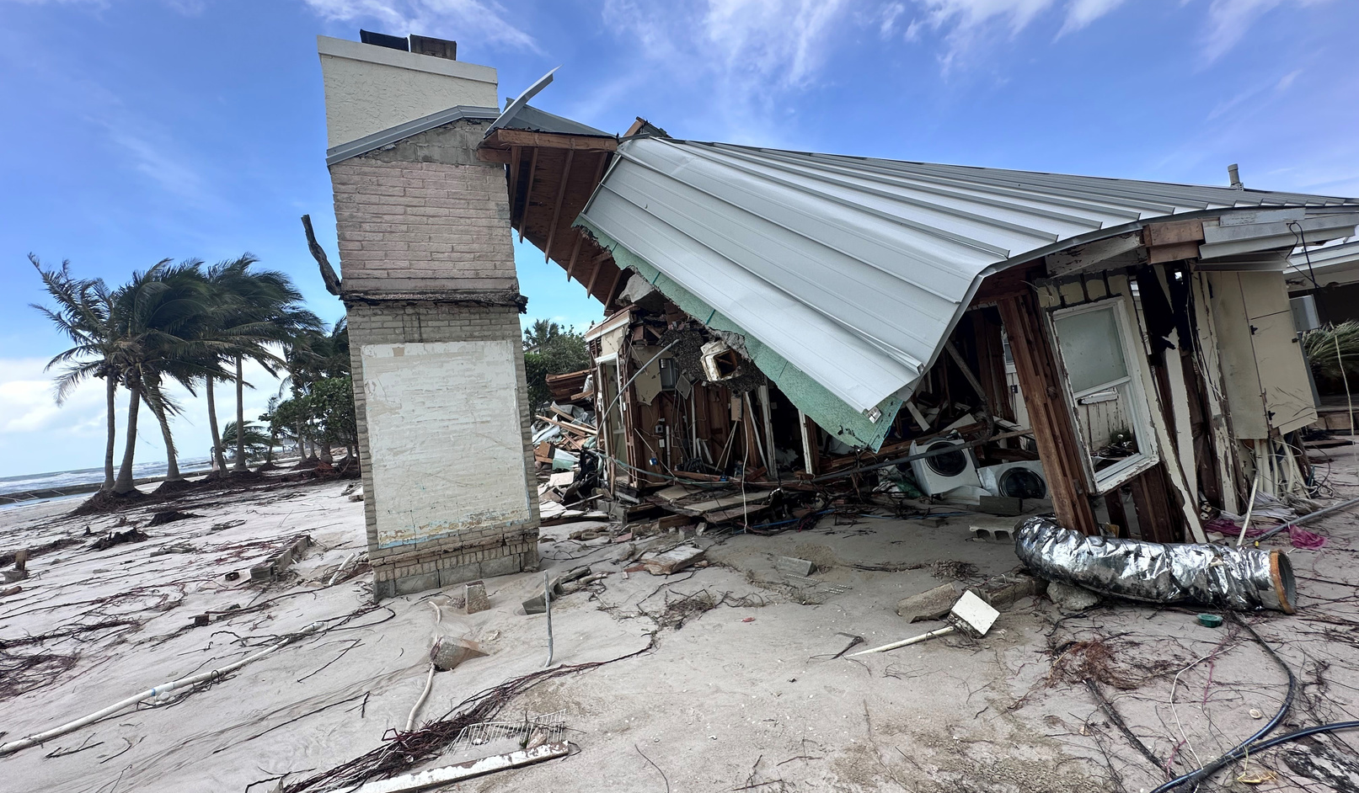
Permitting the Recovery

Slide 11
THANK YOU

